Slide 1
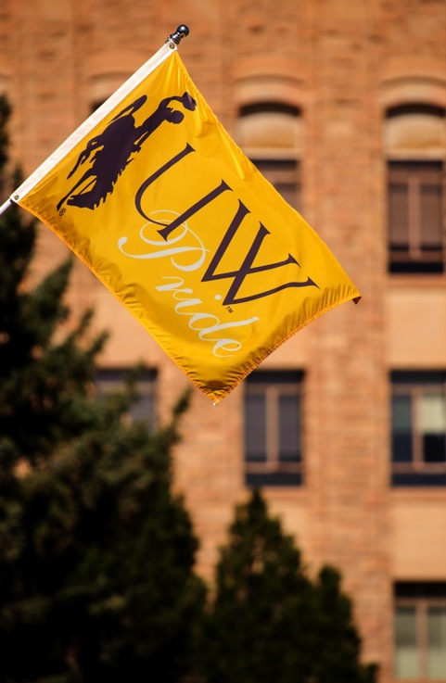

UWYO Honors:
From
Program
To
College
Susan Aronstein, Director of Honors
Anne Alexander, Academic Affairs

Slide 2

Today: The Honors Program

Slide 3
Recruits High-Achieving Students to UW
Average Freshman class 2014-2016: 275 students with an unweighted GPA of 3.7 or a composite ACT of 28.
Of the 313 students already accepted for 2017, 129 meet both requirements

Slide 4
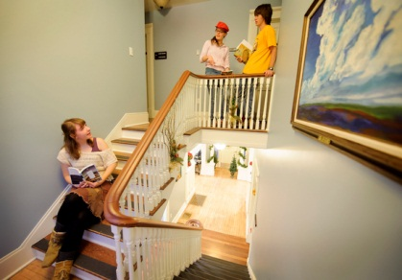

Provides 900 students across every college with an enhanced undergraduate experience

Slide 5
The Honors Minor
Honors Colloquiums I and II
            Fall Semester fulfills COM1 or H. Spring Semester fulfills COM2
Non-Western Perspectives
        Fulfills A&S G requirement and USP H
Modes of Understanding
        Fulfills H or PN requirement, Some classes also fulfill A&S D requirement
Issues and Choices
            Fulfills H or PN requirement. Some classes also fulfill A&S D requirement
Honors Project
          An independent research or creative project. Fulfills COM 3 requirement.

Slide 6


Innovative Courses

Slide 7

Research Opportunities

Slide 8

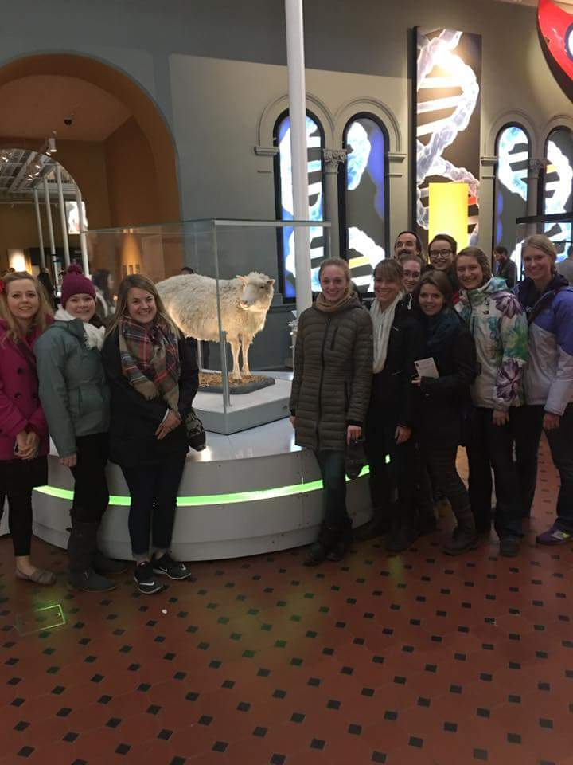
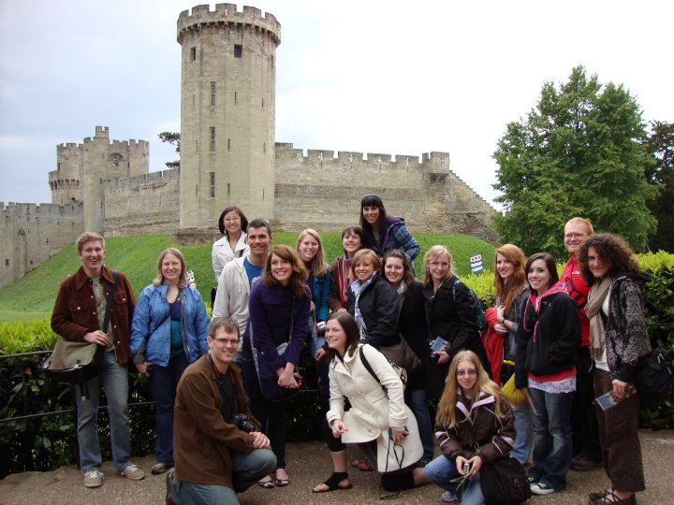
Unique Study Abroad Experiences

Slide 9
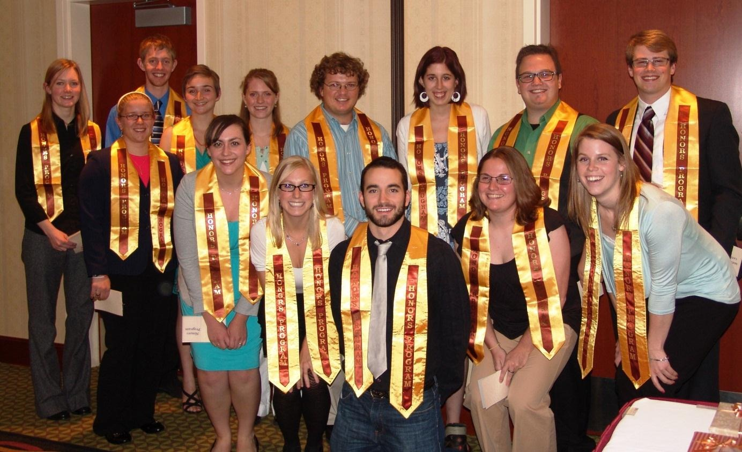
Helps Students Achieve at the Highest Levels
AY 2016 graduating class size: 121 students (record high)
  Average GPA of graduating class: 3.68, with 9 4.0 students
AY 2015 graduating class size: 110
  Average GPA of graduating class: 3.71, with 14 4.O students
Between 2005-2016: Over 50% of Tobin and Spitaleri finalists and of the Phi Beta Kappa nominees have been Honors Program graduates

Slide 10
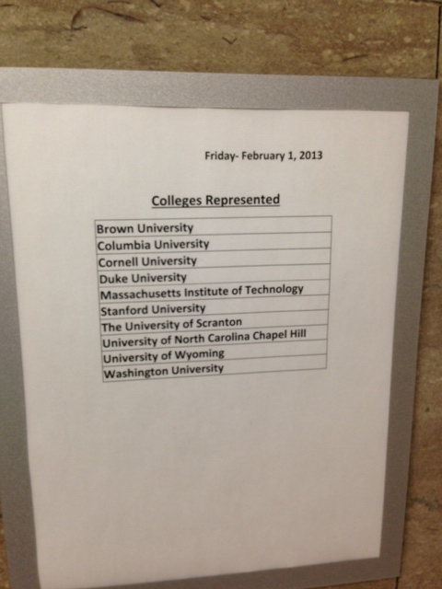
Positions Students for Success
Interviews for Columbia Medical School

Slide 11
Some Notable UW Honors Alums
Travis Feezell, President of Hastings College
Meredith Hindley, Senior Writer, National Endowment for the Humanities
Hamid Kahn, Deputy Director, the Rule of Law Collaborative, Professor of Law, University of South Carolina
Ann Lundberg, Professor and Chair of English, Northwestern College
Kirby Lawrence, Statistician, US Census Bureau
Jennifer Black, PhD Candidate in Anthropology, UC Berkeley
Robert Weatherford, Harvard Medical School
Vikram Singh, Graduate Research Assistant in Nuclear Engineering, University of Tennessee
Sean Higgins, PhD Candidate in Theater and Dance, Yale University

Slide 12
Moving Forward
Proposed Honors College:
Why?
How?
When?

Slide 13
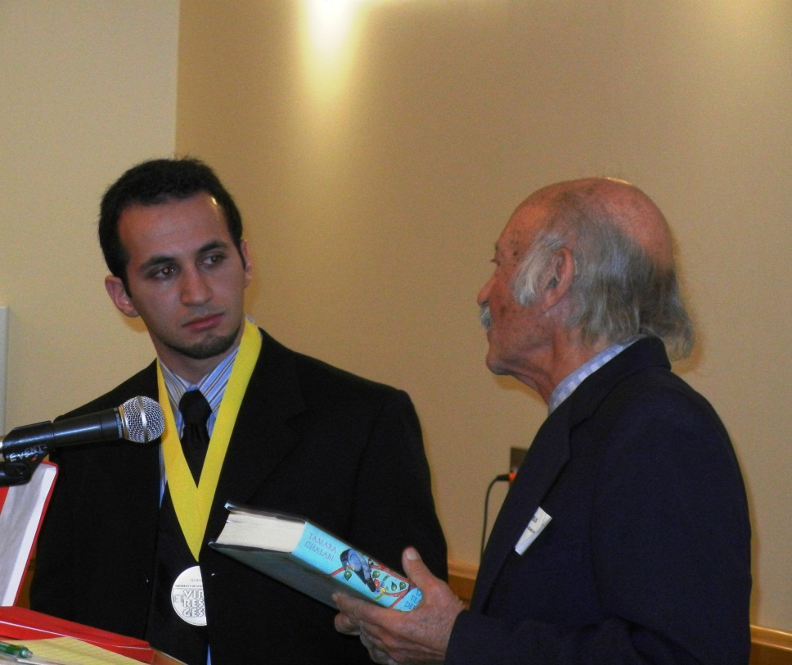
Why?
To compete more effectively for high-achieving students
Of the 18 schools, listed by the College Board as our major competitors for high achieving students, 11 have Honors Colleges
  As universities seek to attract high-achieving students, the move to an Honors College has become a national trend.

Slide 14
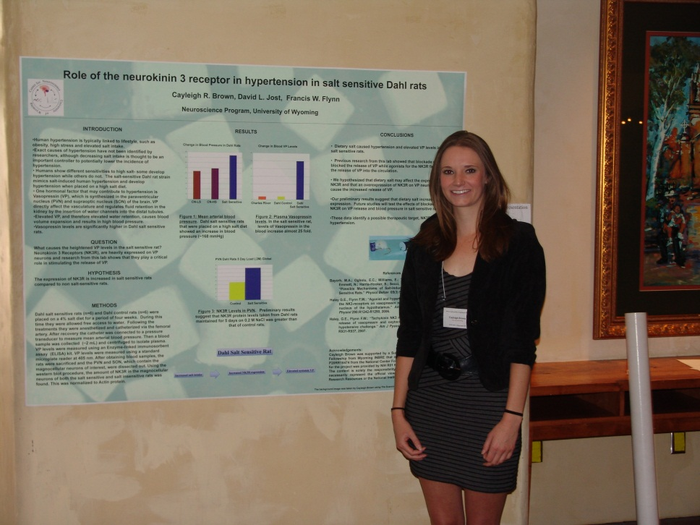
How?
Provide students with enriched educational opportunities in their chosen academic discipline
  Such a track would allow students to document their discipline-specific Honors education
  Of our competitor schools, Boise State and Texas A&M offer their students an opportunity for University Honors in discipline.
  The ability to complete Honors in field will prepare students for professional and graduate school success.

Slide 15
Possible tracks within field
In colleges
    Honors Agriculture; Honors Business; Honors Sciences; Honors Liberal Arts; Honors Health Sciences; Honors Engineering
3+2 programs
    Law, MBA, Nursing, MA programs across campus
Certificates
    Computer Science, Sustainability, Global Studies, Data Science
Departments
    English, Chemistry, COJO, Physiology, Marketing. The departments decide.

Slide 16
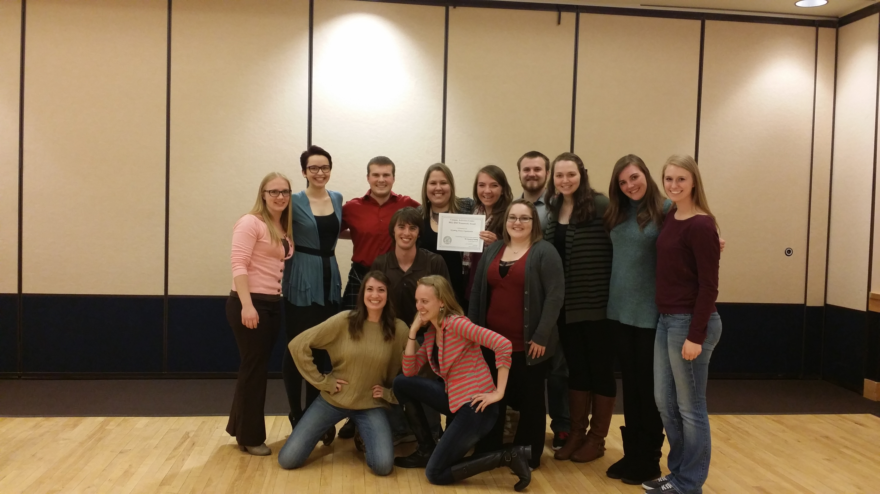
How?
Provide structured undergraduate research, internationalization, and civic engagement – an Experiential Learning Portfolio (Passport )
  As employers look for evidence of students’ experiences beyond the classroom, many university are implementing “passports” or ”engagement” credentials.
  Of our competitors, only Boise State has a defined program, although a few others, such as the University of Washington, require a service or experiential learning component.

Slide 17
Benefits
@Recruit: Faculty participation in lower division courses, either the colloquium or small Honors-specific sections of large introductory classes, provides a great opportunity to recruit majors, and Honors in field can provide those students with tempting options.
@Retain: Honors students can help upper-division courses meet enrollment requirements, thus smoothing the path to graduation for all students in your major.
@Faculty and majors: Benefit from smaller Honors and Majors sections of gateway classes.
@Colleges and departments: Provide your best majors with increased academic and co-curricular opportunities and develop your own Honors tracks.

Slide 18
Questions?

Slide 19
Appendix: Ancillary Information
Phase-in details
Main competitors
Baseline course provision and administration details

Slide 20
When?
Recommended Phase-In
Startup phase: AY 2017
Convert Honors Program Director position to Honors College Dean position. Fill position.
  (Current Honors Program Director is interim and going back to faculty at end of AY 2016-17)
Hire Office Associate

Slide 21
Recommended Phase-In
Startup phase: AY 2017
Actions/Projects
Working with departments and colleges, coordinate upper division courses and college tracks
Develop advisory committees
Begin fundraising and develop naming opportunities for Faculty Fellows and curriculum buildout with colleges

Slide 22
Recommended Phase-In
Startup phase: AY 2017
Budget
Startup Budget - Honors College | Salary + EPB's | Existing funding, Salary + EPB's | Net req'd
Honors College Dean | $ 220,976.00 | $181,250* | $ 220,976.00
Office Associate | $ 47,311.00 | $ - | $ 47,311.00
Total Startup Budget |  |  | $ 268,287.00
* Line and funding return to college/dept of interim director
Total startup + existing |  |  | $652,741.00

Slide 23
Recommended Phase-In
Incubation phase: AY 2018 and 19
Budget
Hire Associate Dean
Hire one new Honors faculty member
Hire three 50/50 College liaisons
Hire three faculty Fellows

Slide 24
Recommended Phase-In
Incubation phase: AY 2018 and 19
Actions/Projects
Begin developing and managing Experiential Learning portfolio
Continue developing tracks in colleges
Continued fundraising for Faculty Fellows and other programming

Slide 25
Recommended Phase-In
Incubation phase: AY 2018 and 19
Budget
Incubation Budget | Salary + EPBs | Running Total
Associate Dean | $ 151,477.00 | Total Incubation + Startup
1 new faculty hire | $ 98,850.00 | = $ 710,388.00
3 50/50 college liasion hires | $ 148,274.00 | Total Incubation, Startup, and existing funding:
3 Faculty Fellows | $ 43,500.00 | = $1,094,842.00
Total incubation Budget | $ 442,101.00

Slide 26
Recommended Phase-In
Sustainable phase: AY 2020 and 21
Budget
Hire one new Honors faculty member
Hire three 50/50 College liaisons
Hire three faculty Fellows, continue as funding available.

Slide 27
Recommended Phase-In
Sustainable phase: AY 2020 and 21
Actions/Projects
Manage and expand Experiential Learning portfolio
Develop 2+2 agreements with community colleges
Continue to develop college tracks and other curricular options
Continued fundraising for Faculty Fellows and programming options

Slide 28
Recommended Phase-In
Sustainable phase: AY 2020 and 21
Budget
Sustainability Budget | Salary + EPB's | Running Total
1 new faculty hire | $ 98,850.00 | Total incubation, startup, and sustainability
3 50/50 college liasion hires | $ 148,274.00 | $ 1,001,012.00
3 Faculty Fellows | $ 43,500.00 | Total with existing
Total sustainability budget | $ 290,624.00 | $ 1,385,466.00

Slide 29
High Achievers
Our competitors for these students – according to College Board:
  Montana State, University of Montana
  Washington State, University of Washington
  Colorado State, University of Colorado, Colorado School of Mines, UNC
  Utah State and University of Utah
  Boise State and University of Idaho
  Texas A&M and Texas Tech
  Arizona State and NAU
  Oklahoma State
  University of Maine
  UNM and NMSU

Slide 30
Provides UW with Student Credit Hours and USP seats
6501 Student Credit Hours Fall 2014-Spring 2016
  90-92% fill rate at the 1000—3000 level
  80% fill rate at the 4000 level
USP: Spring 2016-Spring 2017
  80 COM1 seats
  367 COM2 seats
  55 Com3 seats
  1102 additional USP seats
    including 167 Gs and 517 Ds
  .

Slide 31
Baseline Administration
1 Honors Program Director
+ 1 Program Coordinator
+ 1 Honors faculty member
+ Program ops budget and other funding to cover programming, course coverage, etc.
Total Current Budget: $384,454 + Director salary
Director is interim and will return to faculty at end of AY 2016-17. Regardless of whether this is a program or a college, the director (if program)/dean (if college) position will need refilled.

Slide 32
Baseline Administration
The Honors Program has grown exponentially at the behest of previous administrations.
However, the growth was an unfunded mandate. The Honors Program budget has been essentially stagnant for more than a decade.
The program is at its limit.
Whether or not we move forward to a different structure, there must be buy-in University-wide.
Otherwise, we will not have an Honors program. That is not an option as we compete with other universities for the best students.

