Slide 1

UW Institutional Marketing & Communications

Slide 2
Role of Institutional Marketing & Communications
Build and Protect the University of Wyoming Brand
Tell the University of Wyoming Story
Drive Results

Slide 3
Advertising History
Annual expenditures of $80,000-$90,000 from 2010-2014.
General brand awareness focus, not specifically student recruitment.
Most went to ad at Denver International Airport; insufficient return on investment.

Slide 4
Student Recruitment Advertising Campaign
President Nichols directed Institutional Marketing to craft campaign in summer 2016.
Plan approved by the president, and funding secured:
  $160,000 from two years’ savings by Institutional Marketing
  $50,000 from Admissions Office.
  $200,000 from President’s Office.
Intended primarily to boost fall 2017 inquiries and on-campus enrollment.

Slide 5
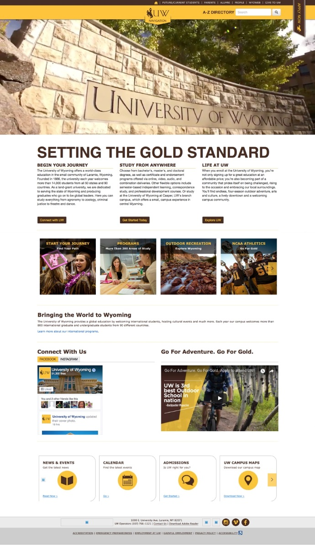
Preparation for Advertising Campaign
Redesign of UW website.
Use of Hubspot inbound marketing
software and landing pages.

Slide 6
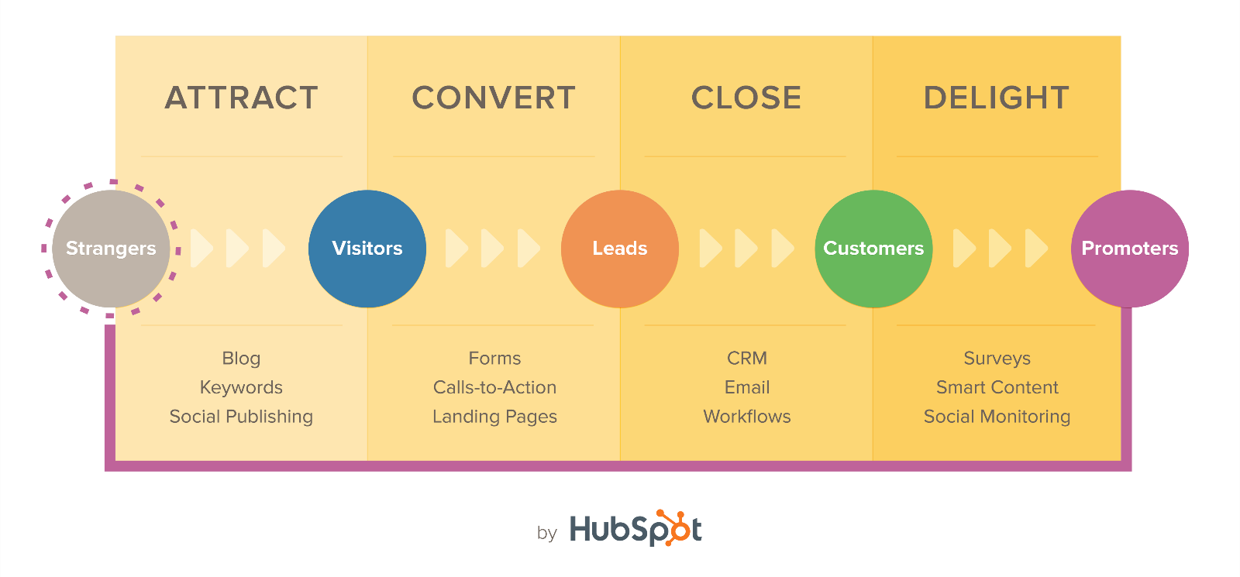
HubSpot
Inbound marketing software purchased in December 2015
Two case study “clients” – COB and CEAS
Used for:
  Creating and Measuring Marketing Campaigns that include:
    Landing Pages
    Social Media Publishing
    Blog
    Email Marketing
    Calls to Action
    Keyword/SEO Tools

Slide 7
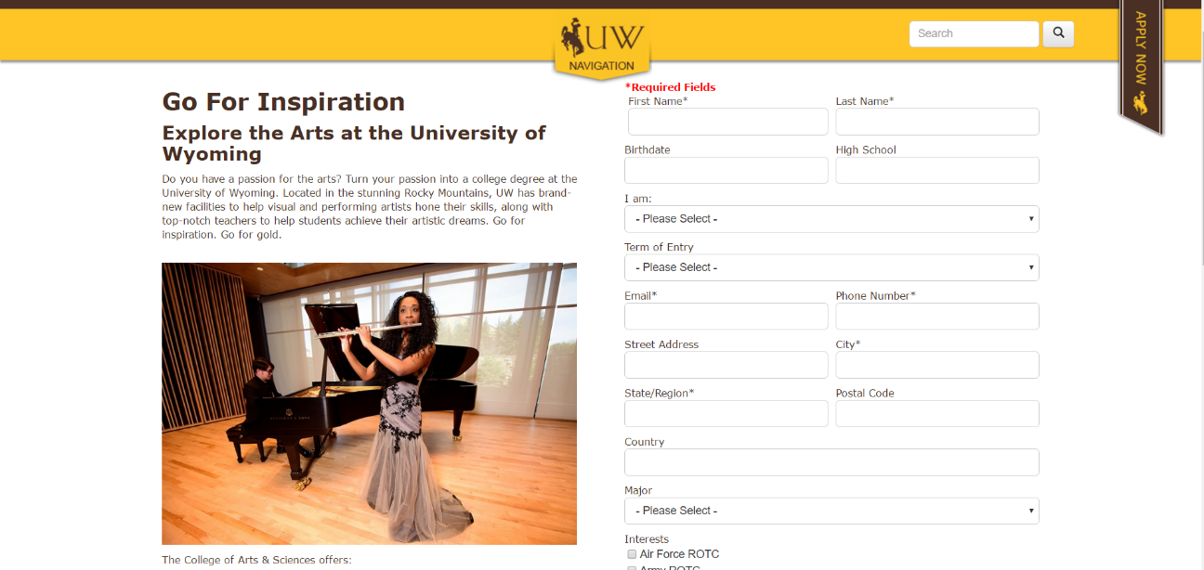
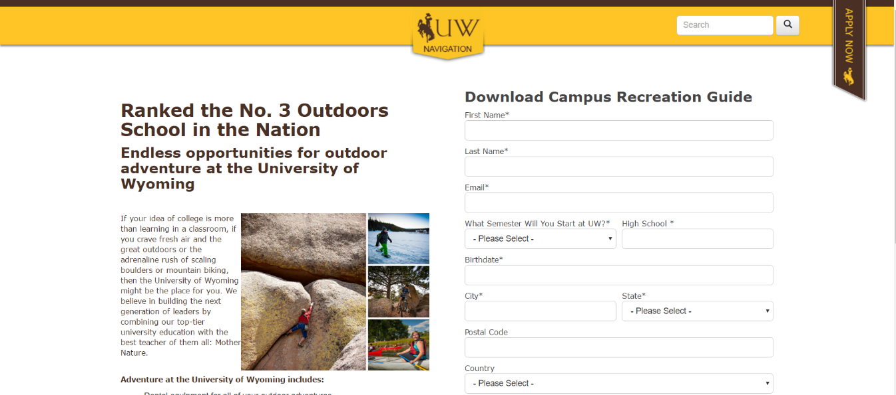
Landing Pages
Foundation of inbound marketing
Allows tracking of digital and traditional marketing channels
Captures prospective student information

Slide 8
Campaign Recap

Slide 9
Campaign Recap
Tasked with creating first ever enrollment marketing campaign
Moved to inbound marketing model in 2016
Benchmark Year – first year of measuring and tracking marketing activity
  Utilized HubSpot marketing software to track and measure

Slide 10
Campaign Timeline
Launched campaign 9/1/16
Media buying began in mid-October
Targeted 16 state geographies

Slide 11
Marketing Mix
Shifted media buying to skew digital to align with media consumption habits of younger demographic

Slide 12
Campaign Messaging

Slide 13

Campaign Messaging
A new take on the Go For Gold campaign
that was action-oriented and targeted
Identified aspirational keywords that
could be used across channels
Pattern of messaging across marketing
channels

Slide 14



Go For Adventure
Landing page:
info.uwyo.edu/adventure

Slide 15


Go For Inspiration
Landing page:
info.uwyo.edu/inspiration

Slide 16


Go For Innovation
Landing page: info.uwyo.edu/innovation

Slide 17


Go For Your Future | Go For Opportunity
Landing page: info.uwyo.edu/transfer

Slide 18
Campaign Results

Slide 19
Overall Campaign Results
4,330 prospective student leads entered the Admissions funnel from 9/1 to date
2,894 leads were for Fall 2017
Landing pages had 61,000 views
Landing page view to completed conversion = 7%
UWyo.edu website traffic increased 40% with almost 6 million visits
*As of 3/23

Slide 20
Overall Admissions Results

Slide 21
Institutional Marketing Campaign Results
16% yield (inquiry to confirmation)
*As of 5/3

Slide 22
Estimated Marketing ROI (MROI)
Confirmed Freshmen Estimated Lifetime Revenue: $6.3 million
Confirmed Transfer Estimated Lifetime Revenue: $2.6 million
Enrolled Graduate Estimated Lifetime Revenue: $170k
Total Estimated Campaign Generated Revenue = $8.6 million
Cost Per Acquisition = $892
Note: This is a rough estimate based on tuition and fees only. Additional revenue from ResLife and the University Store was not used in this estimation. This estimate uses current retention and persistence numbers (77% and 80%). This total does not include Outreach students as they do not confirm enrollment. The cost per acquisition number will decrease as more students from this campaign confirm.

Slide 23
Opportunities & Next Steps

Slide 24
Opportunities & Next Steps
Wyoming Tourism Potential Collaboration
BVK Findings
Advertising Proposal for 2017-18
Institutional Marketing Communications Restructuring

Slide 25
Advertising Proposal for 2017-18
President directed drafting of $375,000 proposal, down from $410,000.
Work with Office of Tourism and its ad agency to determine media mix and messaging.
Launch late summer, earlier than October start in 2016-17.
Solar eclipse opportunities.
Decision: New campaign language, or continue “Go For…”?
Following completion of UW strategic plan, develop new marketing/communications plan.

Slide 26
Potential Restructuring of Marketing and Communications
Marketing functions are filled by employees across campus
Institutional Marketing Communications will absorb four marketing/communications positions from Outreach School
UW College of Engineering and Applied Science funds a full-time marketing/communications person
Inventory of marketing and communications functions across campus is underway

Slide 27
Questions?

