Slide 1
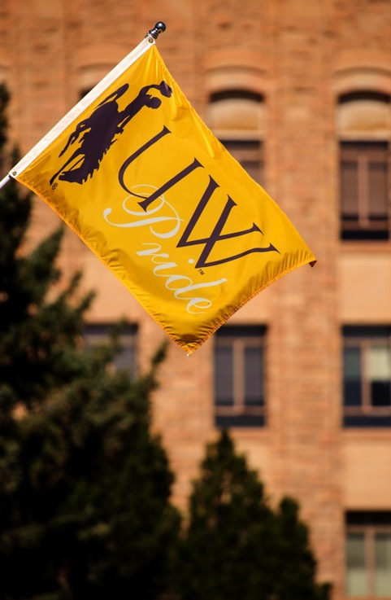

Academic Program Review
Kate Miller and Anne Alexander, Academic Affairs
Board of Trustees Meeting, May 2017

Slide 2
Background
Beginning in 2016, Academic Affairs initiated a process to review academic programs.
Trigger for a review was low demand as measured by number of graduates over the last 5 years.
  Undergraduate programs with less than 50 graduates total from 2010-2015;
  Masters programs with less than 25 total graduates from 2010-15;
  Dean’s request

Slide 3
Background
Criteria for making recommendations were expected to also include centrality to the university mission and quality of the program, including
  External demand for graduates
  Internal demand for courses
  Quality of inputs (e.g. faculty credentials and facilities)
  Quality of outputs (e.g. attainment of student learning outcomes, placement of graduates, grants, publications, scholarly and creative work of faculty.)

Slide 4
Multiphase Process
  Academic departments conducted their own review and made recommendations to the Dean, who in turn made a made a recommendation to Academic Affairs to retain the program, retained with further review, revised, or eliminate.
  After conducting its own review of unit recommendations, Academic Affairs released a list on October 16, 2016 of 15 programs that would be subject to continued review for potential elimination as outlined in UW Regulation 6-43.

Slide 5
Multiphase Process
  A 60-day period for public comment was initiated.
  Deans and department heads and were expected to use this time to provide further commentary on behalf of their college or department.
    Comments were to provide arguments, statements and facts in support of or in opposition to the proposal to eliminate an academic program, and could contain alternative proposals regarding the program, its elimination or modification.
  Prior to the end of the comment period, two programs were withdrawn from the process upon mutual agreement between the Dean of Engineering and Applied Science and the two department heads to put performance improvement plans in place.

Slide 6
Multiphase Process
  Academic Affairs compiled public comments as well as responses from deans and department heads received both via email and hard copy between October 16- December 16, 2016.
    This was provided to the Faculty Senate, including the Academic Planning Committee, the Graduate Council, and the Faculty Senate Executive Committee.
    In addition, all information was shared with ASUW and Staff Senate.
    Recommendations and reviews from these bodies were provided to Academic Affairs on or before March 24, 2017.

Slide 7
Multiphase Process
Provost’s recommendations to President were distributed to you in your Board Book. President concurs with recommendations.
Trustees will make the final decision on eliminations, performance improvements, and modifications to the recommendations, in accordance with UW Regulation 6-43.

Slide 8
Teach Out Plans
As required by UW Regulation 6-43 and HLC accreditation, teach-out plans for proposed eliminations have been constructed.
Link to Draft Teach Out Plans document

Slide 9
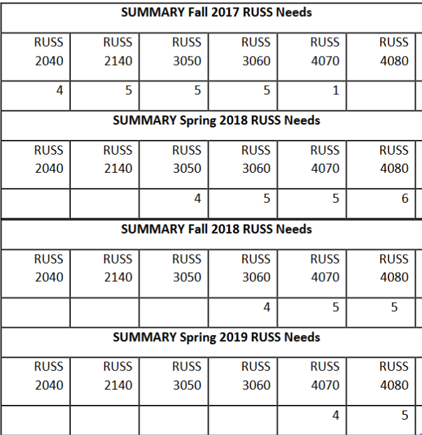
Teach Out Plan Example –
B.A. RUSSIAN
Starting Fall 2017: No new majors will be allowed to declare, and no new beginning courses will be offered.
Teaching capacity: Russian Fulbright Language Teaching Assistant awarded to UW for next year. Assistant Professor in French, Dr. Alexandrova, a native Russian, is willing to teach at least one course per year.
Sequence: Anticipate stacking two courses per semester for the next 4 semesters. Adjunct to take the place of the Fulbright TA in 2018-19. Students must take courses when they are offered, in the sequence they are offered. They may also complete majors or minors with study abroad in Saratov, Russia, or with other university-level transferrable credits.

Slide 10
Web information
Link to this phase’s recommendations
All notification of recommendations went out via email on May 4, 2017; hard copy followed via mail. Notifications per UW Regulation 6-43 sent to:
  Affected students
  Affected faculty
  Affected Department Heads and Deans
  All other deans, Faculty Senate, Staff Senate, and ASUW

Slide 11
Programs Retracted with Performance Improvement Plans
Adult and Post Secondary Education Graduate Programs | Program is revising curriculum to reflect national trends in higher education administration. Dean supports this new concentration.
Energy Systems Engineering | Program has initiated marketing and outreach plan to grow enrollments; responsible program coordinator has been tasked with growing program from 30 majors to 60 by 2018, and to 100 majors by 2021. Dean will review annually.
Environmental Engineering | Program has initiated change to administration as interdisciplinary program with two senior faculty tasked with oversight.

