Slide 1
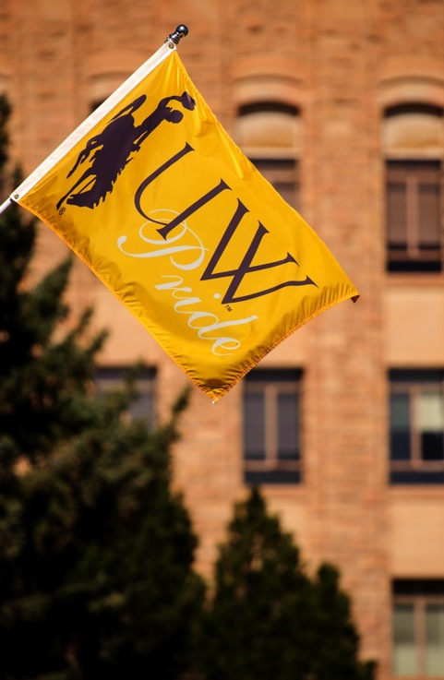

UWYO Honors:
Moving Forward
Kate Miller and Anne Alexander, Academic Affairs
Board of Trustees Meeting, May 2017

Slide 2
Recruitment
Of the 18 schools listed by the College Board as our major competitors for high achieving students 11 have Honors Colleges
  As universities seek to attract high-achieving students, the move to an Honors College has become a national trend.
  We need to be competitive to Wyoming residents and internationally for the highest achieving students. And, we need to be mindful of the fact we’ll find them in unexpected places.

Slide 3
Enriched Undergraduate
Experience
The Honors College would infuse and formalize High Impact Practices (HIP) throughout the Honors experience.
  HIP are teaching and learning practices “widely tested and... shown to be beneficial for college students from many backgrounds, especially historically underserved students, who often do not have equitable access to high-impact learning.”
    AAC&U

Slide 4
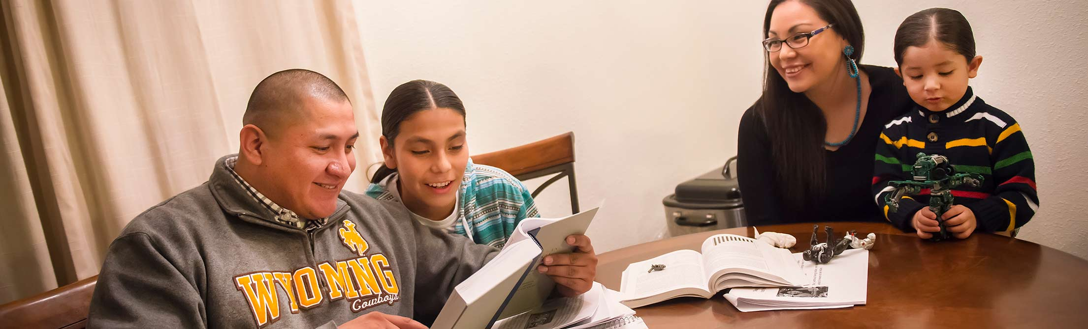
HIP Defined
First-Year Experiences
Common Intellectual Experiences
Learning Communities
Writing-Intensive Courses
Collaborative Assignments and Projects
Undergraduate Research
Diversity/Global Learning
Service Learning, Community-Based Learning
Internships
Capstone Courses and Projects

Slide 5
Positioning Students for
Professional Success
The HC Dean will be charged with structuring and providing a structured HIP– an Experiential Learning Portfolio (Passport)
  As employers look for evidence of students’ experiences beyond the classroom, many university are implementing “passports” or ”engagement” credentials showing they’ve been engaged in HIP.
  Of our competitors, only Boise State has a defined program, although a few others, such as the University of Washington, require a service or experiential learning component.

Slide 6
Positioning Students for
Academic Success
The HC Dean will invite colleges and departments to identify – if appropriate to departmental circumstances - an Honors track in discipline with upper division courses – which can be existing courses – to fill out the track. Honors in field will:
  Allow students to document their discipline-specific Honors education
  Provide support for students working on their capstone research projects.
  Prepare students for professional and graduate school success.

Slide 7
“Honors in Field”
Examples of Possibilities for Honors Dean to
Explore with Colleges and Departments
In colleges
    Honors Agriculture; Honors Business; Honors Sciences; Honors Liberal Arts; Honors Health Sciences; Honors Engineering.
3+2 or 3+3 programs
    Law, MBA, Nursing, MA programs across campus
Certificates
    Sustainability, Data Science
Departments
    English, Economics, Chemistry, COJO, Physiology, Marketing

Slide 8

EAS College - Future Engineering Honors Course Options Under Development
HONR section of multiple section ES courses
FY Seminar Honors Courses
Internship
New Engineering Courses

Slide 9
Honors Track to Law (conceptual only)
An Honors/Law track could offer highly motivated undergraduate students a way to earn both a bachelor's degree and a law degree in 6, rather than 7, years of study.
After completing 3 years as an undergraduate and gaining admission to the law school through a specified process, a participant could become a full-time, first-year law student at the College of Law. The student would need to have their required courses for their undergraduate curriculum done, but have free electives they need to complete.
Participants could follow the usual course of study for a 1L student
Upon successful completion of the first year of law study, the credits earned could be counted toward the JD degree and as elective credits sufficient to complete their undergraduate university's requirements for the bachelor’s degree.
Examples: George Mason, Gonzaga, Florida State, University of Arizona, University of Iowa, University of Kansas, Columbia, Rutgers

Slide 10
Timeline for College
Multiphase Staged Approach
Near Term: August 2017
  Hire Honors Dean and one supporting staff (added to current Program Coordinator in HP).
Startup Phase: Fall 2017-Spring 2018
  Honors Dean strategically evaluates all previous studies, current landscape, and develops their collaborative vision for curriculum and programming
Incubation Phase: Fall 2018 – Spring 2020
  Advising and instructional staffing, fundraising, and curriculum development
Established Phase: Fall 2020 and beyond
  Honors College is fully established; departments and colleges have developed curriculum with Honors Dean’s assistance; HIP portfolio fully deployed

Slide 11
Recommended Phase-In
Startup phase: By August 2017
Convert Honors Program Director position to Honors College Dean position.
  Current Honors Program Director is interim and going back to faculty at end of AY 2016-17)
Hire Office Associate to augment support staff (one FTE program coordinator, currently)
Note: Existing HP funding is ~$400,000

Slide 12
Startup phase: By August 2017
Search for Director/Dean has commenced, applications due May 26, 2017 (internal search).
  Chair of search advisory committee: Dr. Steve Barrett, Associate Dean, Engineering and Applied Science.
  Committee has broad campus representation, including students, faculty, and staff. They aim to bring candidates in during weeks of June 12 and June 19, 2017 for public presentations and campus interviews.
  Summary of strengths/weaknesses of candidates to Provost Miller by June 26, 2017.

Slide 13
Startup phase: Fall 2017 – Spring 2018
Actions/Projects for Honors Dean
Working with departments and colleges, coordinate and negotiate development of upper division courses and college track curriculum, as appropriate
Develop faculty advisory committees
Begin fundraising

Slide 14
Startup phase: Fall 2017- Spring 2018 – additional budget required (marginal budget requirements)
Startup Budget - Honors College | Salary + EPB's | Existing funding, Salary + EPB's | Net new req'd
Honors College Dean | $ 220,976.00 | $181,250* | $ 220,976.00
Office Associate | $ 47,311.00 | - | $ 47,311.00
Total Startup Budget |  |  | $ 268,287.00
* Line and funding return to college/dept of interim director
Total marginal startup + existing funding |  |  | $652,741.00

Slide 15
Startup phase: Fall 2017- Spring 2018 – additional budget required (marginal budget requirements)
This will be a required cost regardless if college/program
Startup Budget - Honors College | Salary + EPB's | Existing funding, Salary + EPB's | Net new req'd
Honors College Dean | $ 220,976.00 | $181,250* | $ 220,976.00
Office Associate | $ 47,311.00 | - | $ 47,311.00
Total Startup Budget |  |  | $ 268,287.00
* Line and funding return to college/dept of interim director
Total marginal startup + existing funding |  |  | $652,741.00

Slide 16
Recommended Phase-In
Incubation phase: Fall 2018 – Spring 2020
Actions/Projects for Honors Dean
Developing and begin managing Experiential Learning portfolio with formalized HIP
Continue working with faculty to develop college curriculum and tracks
Continued fundraising

Slide 17
Recommended Phase-In
Incubation phase: Fall 2018 - Spring 2020
Potential Incubation Budget | Salary + EPBs marginal budget | Running Total
Associate Dean | $ 151,477.00 | Total Marginal Incubation + Startup Marginal = $ 710,388.00
1 new faculty hire | $ 98,850.00
3 50/50 college liasion hires | $ 148,274.00 | Total Marginal Incubation, Marginal Startup, and existing funding = $1,094,842.00 :
3 Faculty Fellows | $ 43,500.00
Total marginal incubation budget | $ 442,101.00

Slide 18
Recommended Phase-In
Established phase: Fall 2020 and forward
Actions/Projects for Honors Dean
Manage and expand Experiential Learning portfolio with formalized HIP’s
Develop 2+2 agreements with community colleges
Continue to develop college tracks and other curricular options
Continued fundraising

Slide 19
Recommended Phase-In
Established phase: Fall 2020 and forward
Marginal budget requirements
Potential established phase budget | Salary + EPB's | Running Total
1 new faculty hire | $ 98,850.00 | Total incubation, startup, and sustainability= $ 1,001,012.00
3 50/50 college liasion hires | $ 148,274.00
3 Faculty Fellows | $ 43,500.00 | Total with existing = $ 1,385,466.00
Total marginal sustainability budget | $ 290,624.00

Slide 20
If you approve:
Change Honors Program → Honors College
Change Honors Director → Honors Dean
There are four UW Regulations pertaining to the Honors Program and/or colleges. We would bring them to you for revision at your July meeting.
  1-1
  6-701
  6-702
  6-703

Slide 21
Questions?

Slide 22
Ancillary Information

Slide 23
Current Honors Program is designed to recruit high-achieving students to UW
Incoming Freshmen must have either a 3.7 unweighted GPA or a 28 ACT
Average Freshman class 2014-2016: 275 students
Of the 215 students already accepted for 2017, 86 meet both requirements
Transfer or continuing students must have and maintain a 3.25 university GPA

Slide 24
Serves 900 students across every college

Slide 25
The Honors Minor
Honors Colloquiums I and II
            Fall Semester fulfills COM1 or H. Spring Semester fulfills COM2
Non-Western Perspectives
        Fulfills A&S G requirement and USP H
Modes of Understanding
        Fulfills H or PN requirement, Some classes also fulfill A&S D requirement
Issues and Choices
            Fulfills H or PN requirement. Some classes also fulfill A&S D requirement
Honors Project
          An independent research or creative project. Fulfills COM 3 requirement.

Slide 26
Offers innovative seminars, research and study abroad opportunities
Spring 2016- Spring 2017
72 on-campus seminars
23 online classes
5 faculty-led study abroad classes
143 Senior Research Projects Completed as of December 2016

Slide 27
Provides UW with Student Credit Hours and USP seats
6501 Student Credit Hours Fall 2014-Spring 2016
  90-92% fill rate at the 1000—3000 level
  80% fill rate at the 4000 level
USP: Spring 2016-Spring 2017
  80 COM1 seats
  367 COM2 seats
  55 Com3 seats
  1102 additional USP seats
    including 167 Gs and 517 Ds
  .

Slide 28

Engineering Honors
How:
Develop Honors in Field
Example of a Program Under Development
Engineering Honors

Slide 29
Engineering Honors Program Objectives
Recruiting competitiveness
Enhanced experience
Distinguish top performers
Complement existing UW Honors

Slide 30
Goals of the Engineering Honors Program
In the creation of an Engineering Honors program it is the goal of the College of Engineering & Applied Science to provide Honors students with an enhanced educational experience within the CEAS that complements the liberal arts curriculum currently offered by the Honors Program. This experience should foster creativity and critical thinking, and also provide distinction for HP EN students.

Slide 31
CEAS CURRENT STATUS DATA
AY 2015-2016—of the 349 graduates, number of students able to maintain GPA level all semesters of attendance
FR EN Full Time | > or = to 3.75
ARE | 13
CHE | 11
COSC | 13
CPEN | 6
CVLE | 9
EE | 7
ENUN | 32
ME | 20
PETE | 10
Total | 122
AY 2015-2016 Graduates
GPA | # of Students
3.75 | 19
3.5 | 23
3.25 | 39
AY 2016-2017—Number of first time freshman by department eligible to participate in the Honors program

Slide 32
CEAS CURRENT STATUS DATA
Current EN Honors Students
ARE | 10
CHE | 25
COSC | 32
CPEN | 6
CVLE | 10
EE | 13
ENUN | 2
ESE | 4
ME | 4
PETE | 7
Total | 152
AY 2016-2017—Current Honors Program enrollment by grade level
Current EN Honors Students
Freshman | 40
Sophomore | 37
Junior | 31
Senior | 43
Total | 152
AY 2016-2017—Current Honors Program enrollment by department
3

Slide 33
Eligible Students
GPA 3.70 or 26 ACT com—First time freshman
GPA 3.50—EN transfer students
3.50 GPA for AY 2017-2018 EN students currently enrolled in the UW Honors Program
3.50 GPA Maintenance required for Engineering Honors students continuing in the EN Honors program
  Leniency suggested in the 1st year
  One semester probation for GPA recovery

Slide 34
Program Incentives for Students
Up to $1000 to EN HP Students
  Use toward EN HP study abroad or technical conference experience
  Application required for $1000 award
  Benefit applied to actual costs only
  Can be applied to multiple events up to the $1000 award amount

Slide 35
Impact on Faculty Teaching Load
6 credit hours of HP UG research per year = 1 grad student per year
HP UG research efforts require an “Honors Thesis”
  Formally written
  Documented and reproducible
No fiscal compensation from college – but count towards load

Slide 36
Future Engineering Honors Course Options
HONR section of multiple section ES courses
FY Seminar Honors Courses
Internship
New Engineering Courses

Slide 37
Engineering Honors Course Options
 | UW Honors Program Requirements | CEAS Honors Program Requirements
General | HP Colloquium (3)[COM1 or H] HP Colloquium (3)[COM2] HP 215 (3) [H] HP 315 (3) [H] HP 415 (3) [H] | Required: HP EN Independent Study/Research (3) [HP, UL EL] or HP EN Methods/Seminar (3) [HP, COM3, UL EL] Select for 6 CREDIT HOURS: HP EN Independent Study/Research (3-6) [HP, UL EL] HP EN Methods/Seminar (3) [HP, COM3, UL EL] HP EN Study Abroad (3) (w/ advisor approval) HP EN Grad (3-6) [HP,UL EL] HP EN HONR sect (3) [HP]
18

Slide 38
Engineering Honors Specific Program Options
EN Honors Class Options
Methods/Seminar (3) [HP, UL Elective, COM3]
Independent Study/Research (3) [HP, UL Elective]
Interdisciplinary EN Honors Class Options
ARE 3030 (3) [H, HP 315 Mode of Understanding]
Identified EN Honors Section Courses
ARE 1600 (3) [HP for ARE]
Graduate Level Course (3) [HP, UL Elective]
Existing Course Honors Section (3) [HP, UL Elective]
EE 4620 (3) [HP UL Elective]
COSC 1020 (3) [Q, HP for COSC]
Independent study required or methods/seminar class open to all HP EN students
HP EN students able to choose from EN Honors class options to make up the additional 6 required credit hours
Honors section courses can be a separate section with designation for HP EN students or a cross listed course
19

