Slide 1
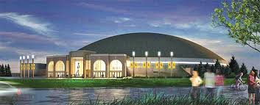
University of Wyoming Commencement Review Task Force:
Recommendations

Slide 2
UW Commencement Taskforce Recommendations
Charge to Task Force
Reduce Cost – Current configuration costs university $250,000.00 annually.
Limit to a single day.
Limit session length to 2 hours.

Slide 3
UW Commencement Taskforce Recommendations
Process for Developing Recommendations
Task Force meetings, beginning May 2017
Reviewed best practice resources, including the American Association of Collegiate Registrars and Admissions Officers Guide to Graduation Ceremonies
Reviewed peer institutions’ graduation practices
Drafted recommendations
Facilitated discussions with Faculty Senate, Council of Deans and ASUW, as well as with University community through two Town Halls
Incorporated feedback into a final set of recommendations

Slide 4
UW Commencement Taskforce Recommendations
May 2018 Commencement
NEW
All university
Single day
Single venue
PAST
College
Multiple days
Multiple venues

Slide 5
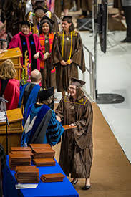
UW Commencement Taskforce Recommendations
May 2018 Commencement
Three 2 hour sessions – 8:30 AM, Noon, 3:30PM
Session 1: Undergraduate –Arts & Sciences, Education, & Haub School
Session 2: Graduate – All University*
Session 3: Undergraduate - All other colleges and schools
*The College of Law will continue to hold its own ceremony; law graduates will be welcome to attend this ceremony as well.

Slide 6
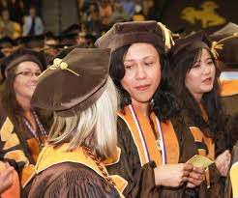
UW Commencement Taskforce Recommendations
May 2018 Commencement
OTHER RECOMMENDATIONS
Graduate Commencement Procedures
Hooding of Master’s graduates occurs off-stage.
Floor manager appointed to manage the queue or “chute.”
Readers announce name and field of study for master’s candidates using a pre-printed card.
Pre-select and train master’s hooding marshals for hooding masters’ candidates off-stage.

Slide 7
UW Commencement Taskforce Recommendations
May 2018 Commencement
OTHER RECOMMENDATIONS
Speakers
Keynote Address
1 speaker
10 minute limit
Honorary Doctorate Recipients
High Profile Speakers are paid for through fund raising.
No Pay for high profile local, state or UW alumni speakers.

Slide 8
UW Commencement Taskforce Recommendations
May 2018 Commencement
OTHER RECOMMENDATIONS
Speakers
Student Speaker
One student speaker
5-7 minute time limit
Open call for submissions to be selected by a student speaker selection committee.

Slide 9
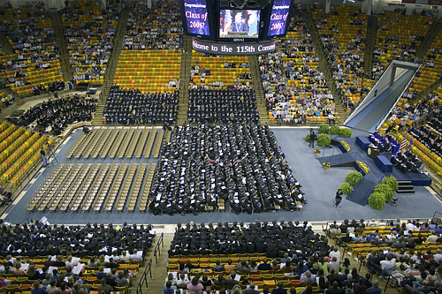
UW Commencement Taskforce Recommendations
May 2018 Commencement
DUAL RAMP – SINGLE RAMP EXIT SET UP

Slide 10
UW Commencement Taskforce Recommendations
May 2018 Commencement
OTHER RECOMMENDATIONS
Online Graduates
Invite online students to come to campus for commencement.
Video invitation and congratulations from UW President to be emailed to online graduates one month prior to commencement. Be sure to let those who cannot attend that they are valued members of the UW community, joining a worldwide alumni group and always welcome to visit campus.

Slide 11
UW Commencement Taskforce Recommendations
Discussion

