Slide 1
The Department of Ecosystem Science and Management
Overview of the Rangeland Ecology & Watershed Management Degree Program
Scott Miller, Department Head

Slide 2
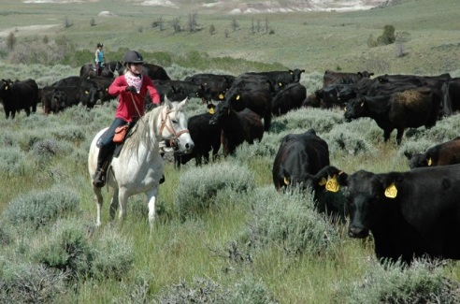
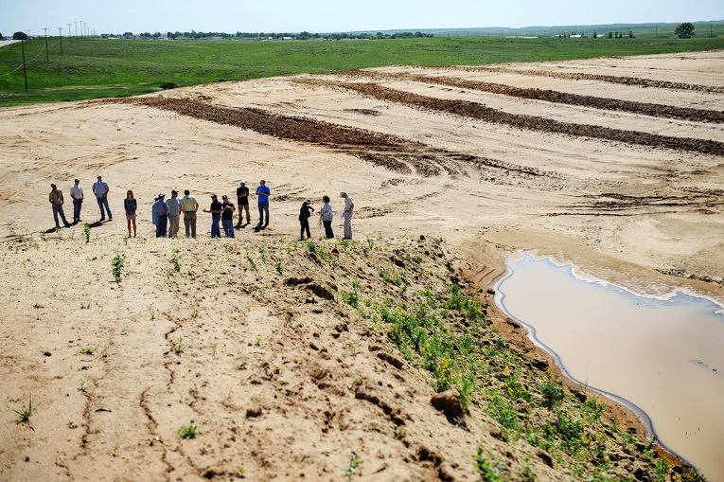
Our Undergraduate Programs
BS in Rangeland Ecology & Watershed Management
BS in Agroecology (partner with Plant Sciences)
Numerous minors
REWM
Forest Resources
Restoration Ecology
Soil Science
Insect Science

Slide 3
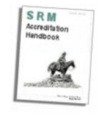
REWM: An Accredited Degree
We are one of only 11 accredited Range programs in the US
Contrary to rumor, we are not on probation
We are, however, in flux and are at risk

Slide 4
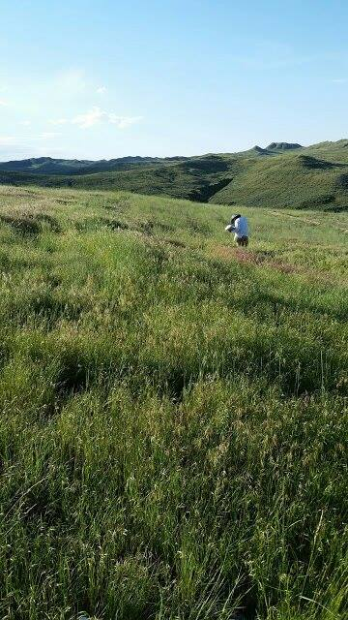
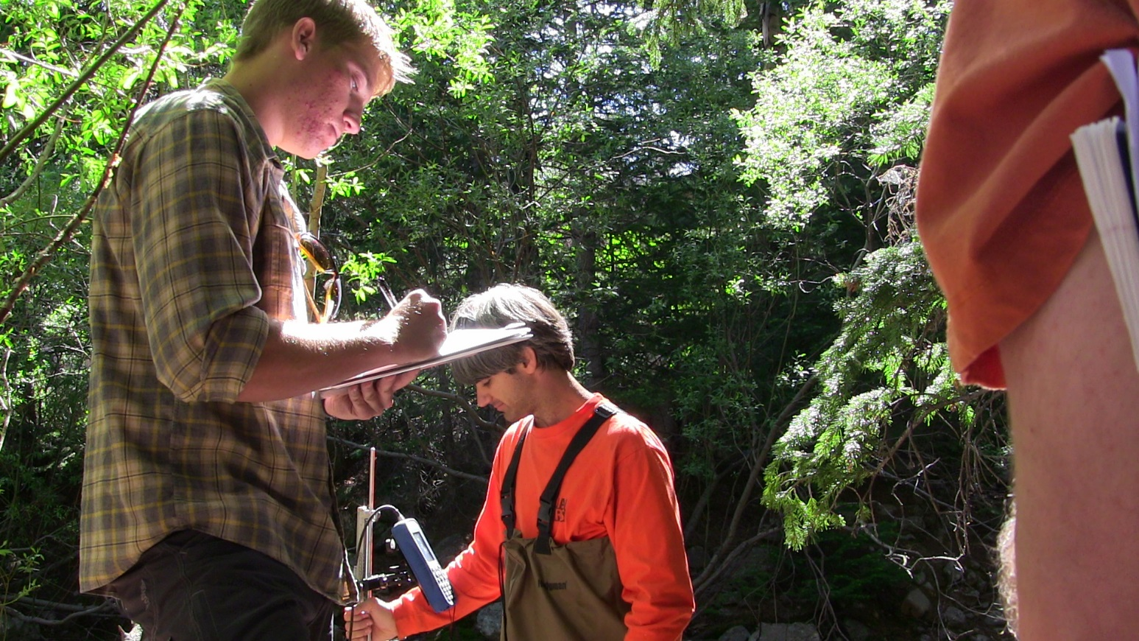
About the Department
We are made up of 16 faculty from 4 primary disciplinary areas
Rangeland Ecology
Water & Watersheds
Soil Science
Entomology
Our faculty have broad expertise in extensive landscapes
Range management
Wildlife ecology & conservation
Restoration of disturbed lands
Water resources & quality
Soil development
Native and invasive species
Integrated pest management
Notes:
Sara Burns in the field looking at restoration sites. Evan and Phil doing hydrology

Slide 5
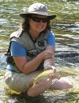
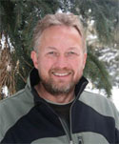
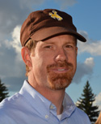
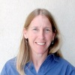
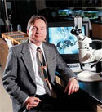
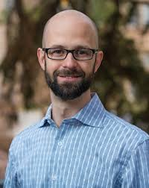
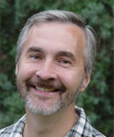
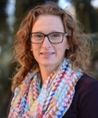
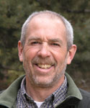
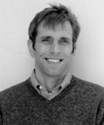
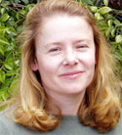
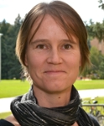
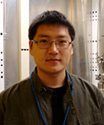
A Terrific Faculty – Teaching/Research/Extension
Melanie Murphy Jay Norton Derek Scasta Ginger Paige Scott Shaw
Fabian Nippgen Alex Latchininsky Karen Vaughan Pete Stahl Tim Collier
Kristina Hufford Thijs Kelleners Jeff Beck Linda van Diepen Mike Zhu

Slide 6
A Faculty in Flux
Departures
5 faculty took VSIP (3 Range)
3 faculty retired (2 Range)
2 faculty moved within UW (2 Range)
Arrivals
1 Range
2 Soil Sciences
1 Watershed

Slide 7
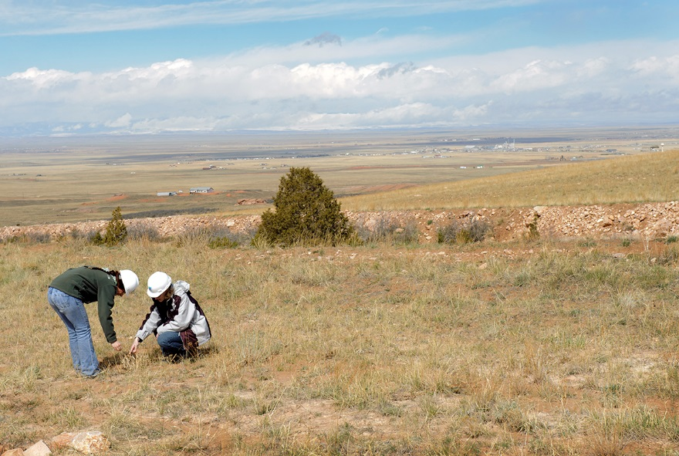
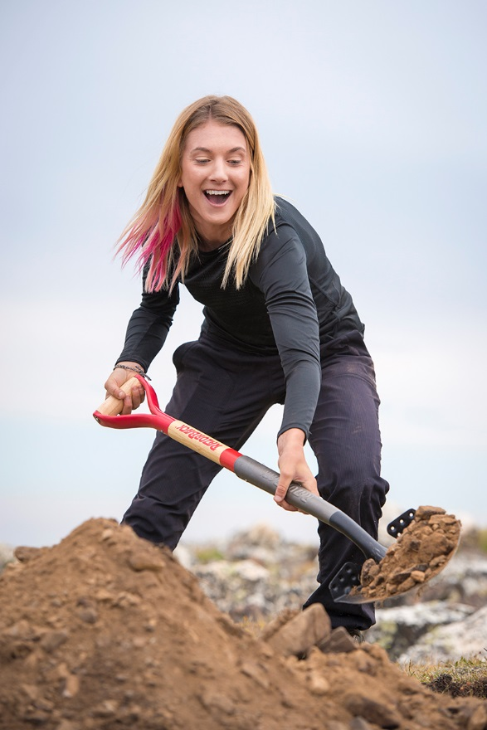
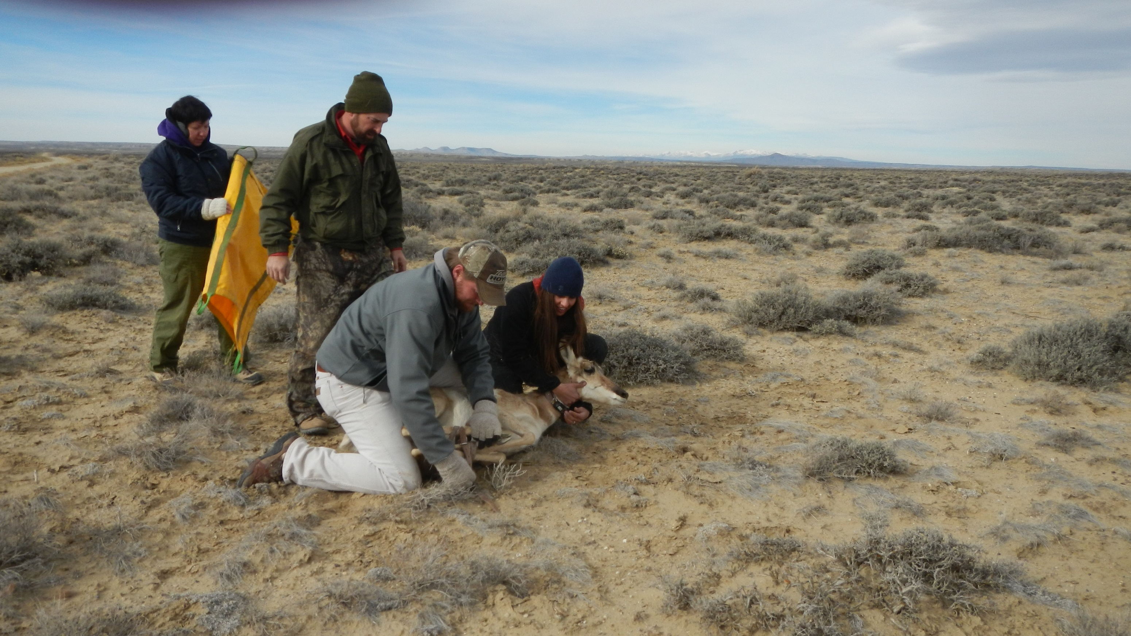
Why Do Students Study REWM?
Worldwide : Rangelands are 58% of the world
Rangelands make up 85% of Wyoming
Grass/shrub = 69%
Forests = 16%
Extensively managed lands are essential
Economic engine
Water towers
Notes:
Students doing applied research & extension activities in Wyoming

Slide 9
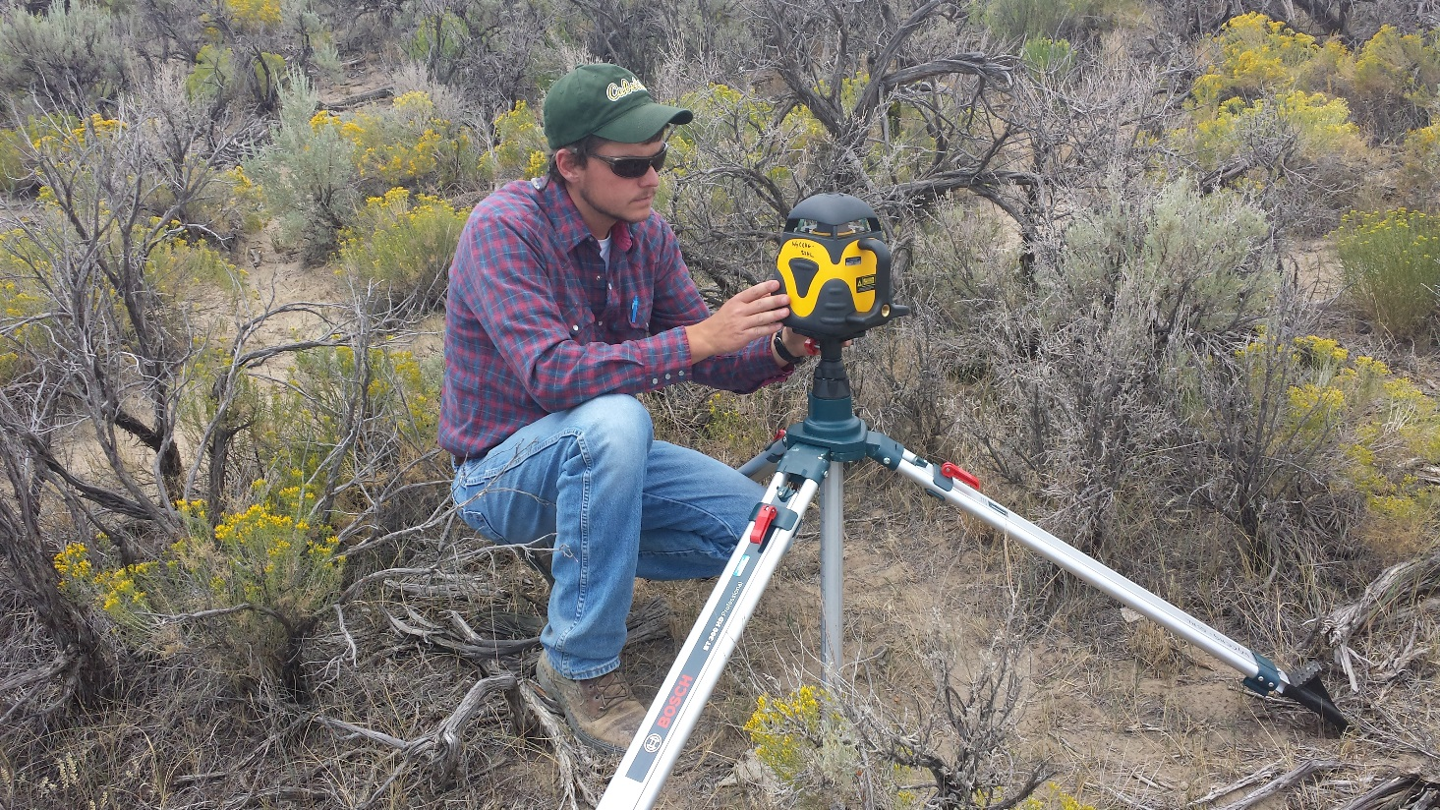
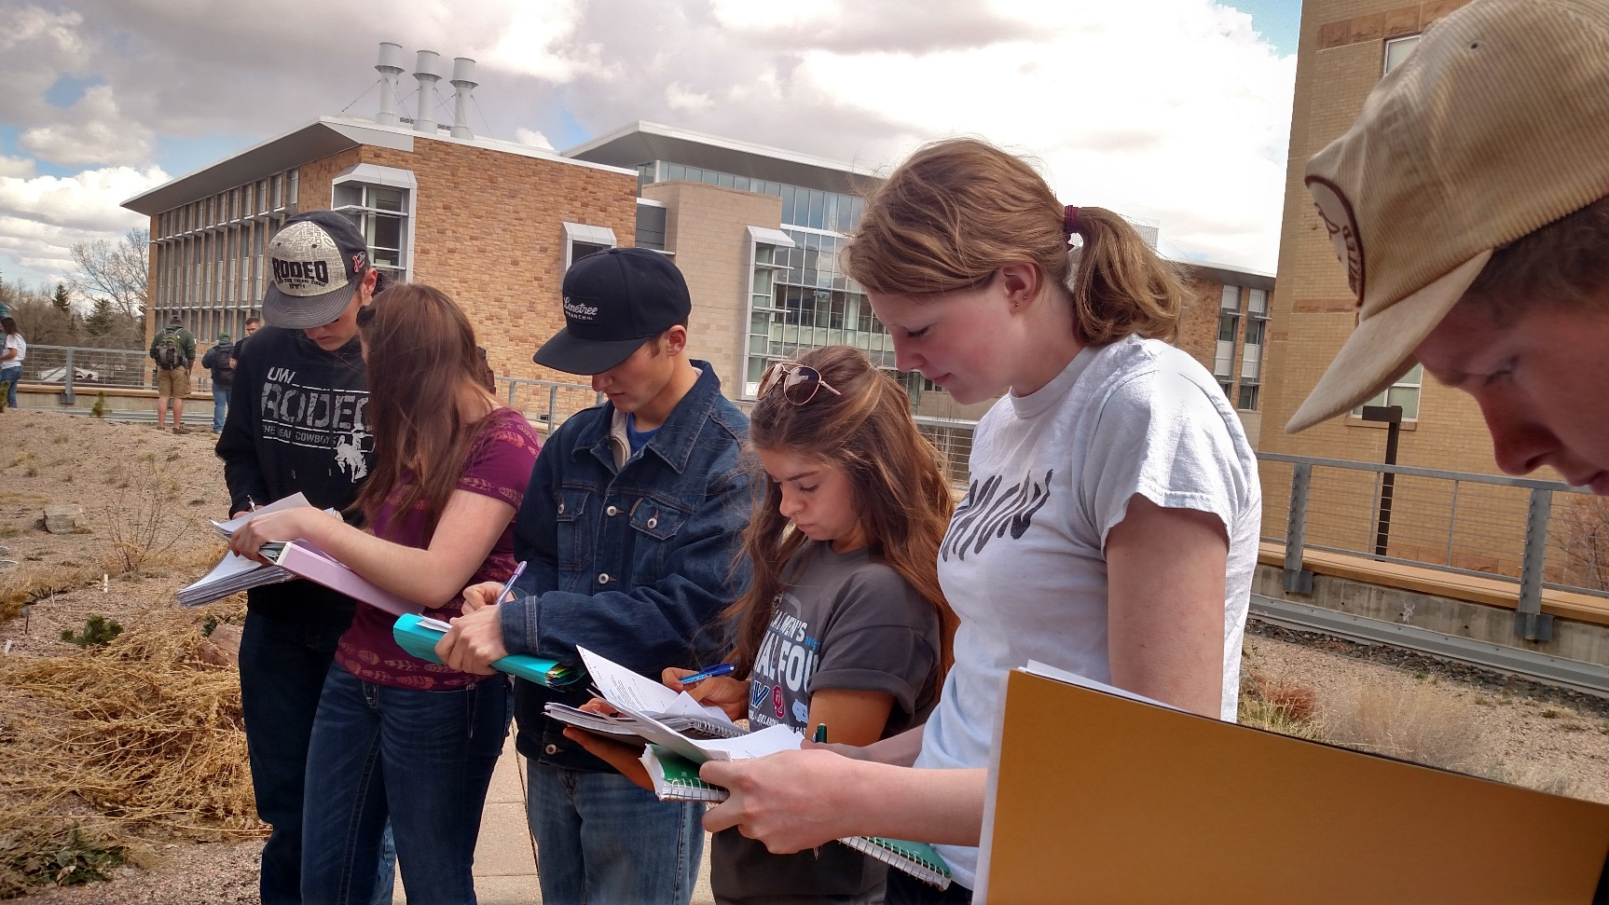
Undergraduate Student Snapshot
2014 was a significant year
High point in faculty numbers
Concerns over student success led to a change to REWM curriculum and grade policy
Majors
Graduated Students
Minors
Notes:
Field-based training as part of classroom experience

Slide 10
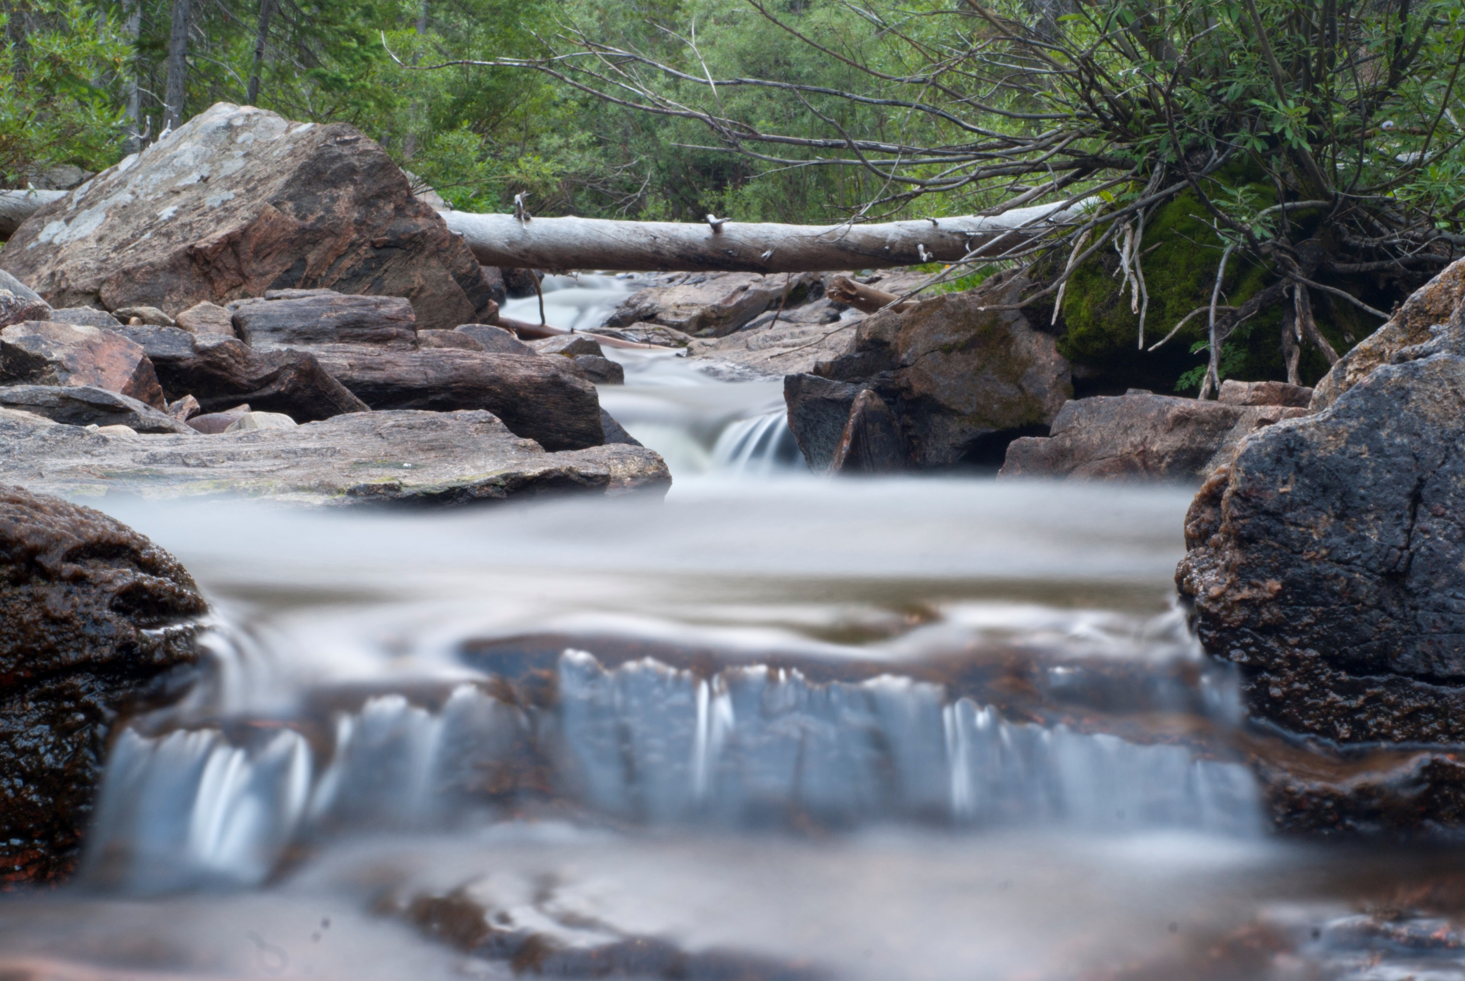
Research Snapshot
MS & PhD Students
We currently average 3.4 grad students per faculty member
Grant numbers do not reflect EPSCoR grant leadership
Co-Director of $20M Wyoming Center for Environmental Hydrology & Geophysics (Miller)
Co-Director of $20M Microbial Ecology (van Diepen)

Slide 11
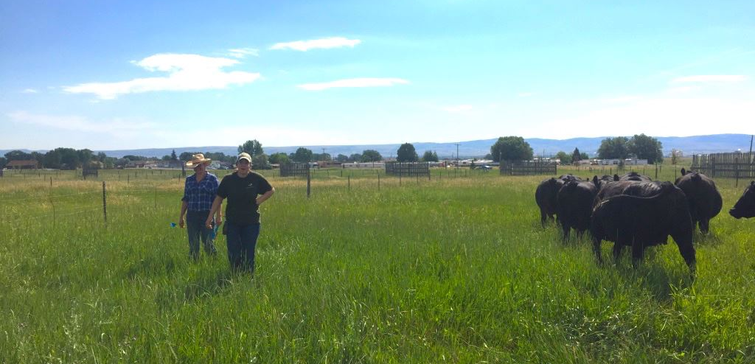
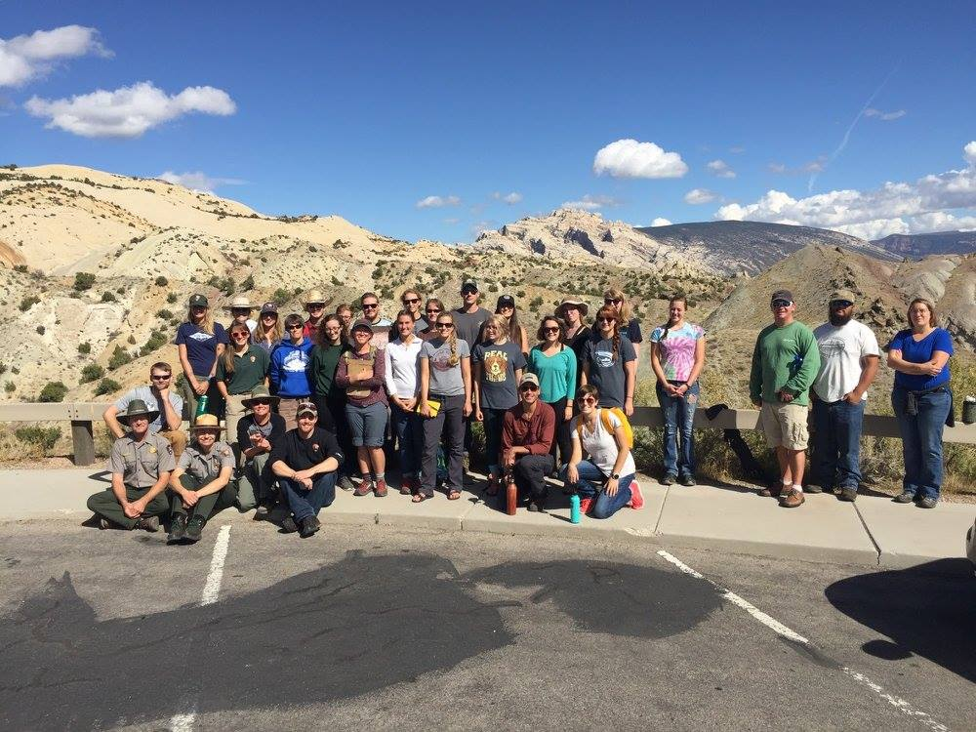
Department Initiatives
Two searches have been authorized in Range with emphasis in spatial sciences
Shrub / Grassland Ecologist
Domestic & Wild Animal Ecologist
Strategic Planning
Undergraduate program review
Aggressively modernize
Investigate building Forest Resources
Hiring Strategy
Improve curriculum, research, extension
Provide national leadership in REWM
Notes:
Emily Bean doing work on Laramie AES on soil health. Students on a field educational event with the US Park Service in Dinosaur National Monument

Slide 12
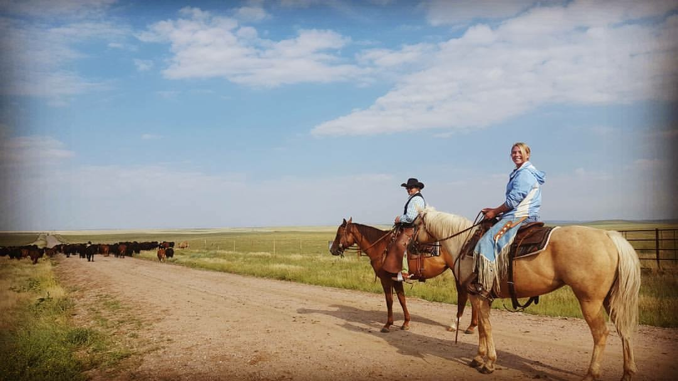
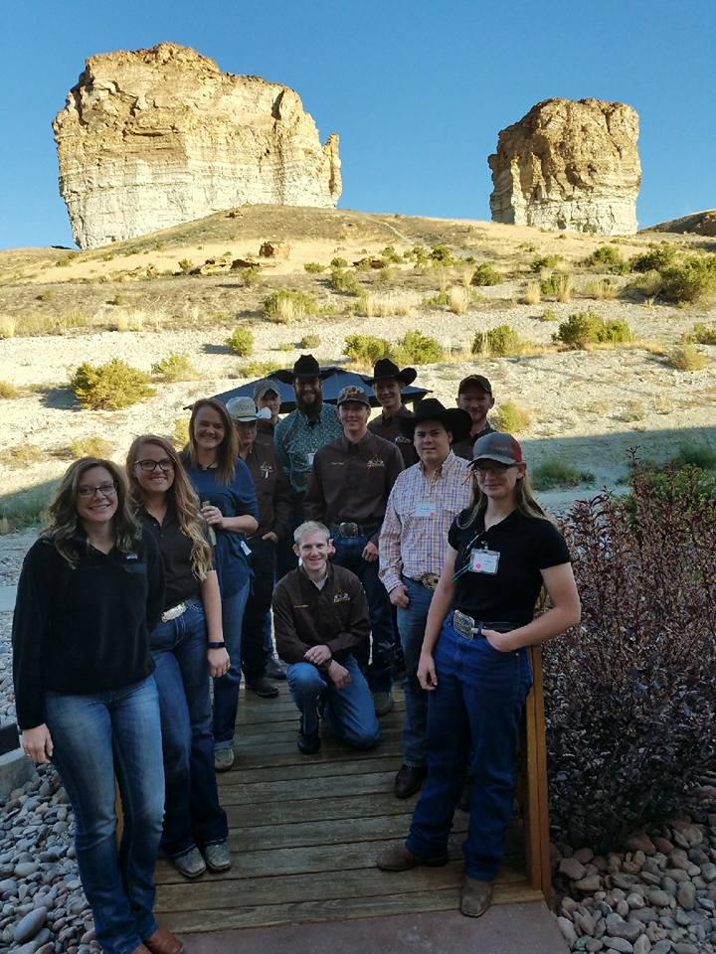
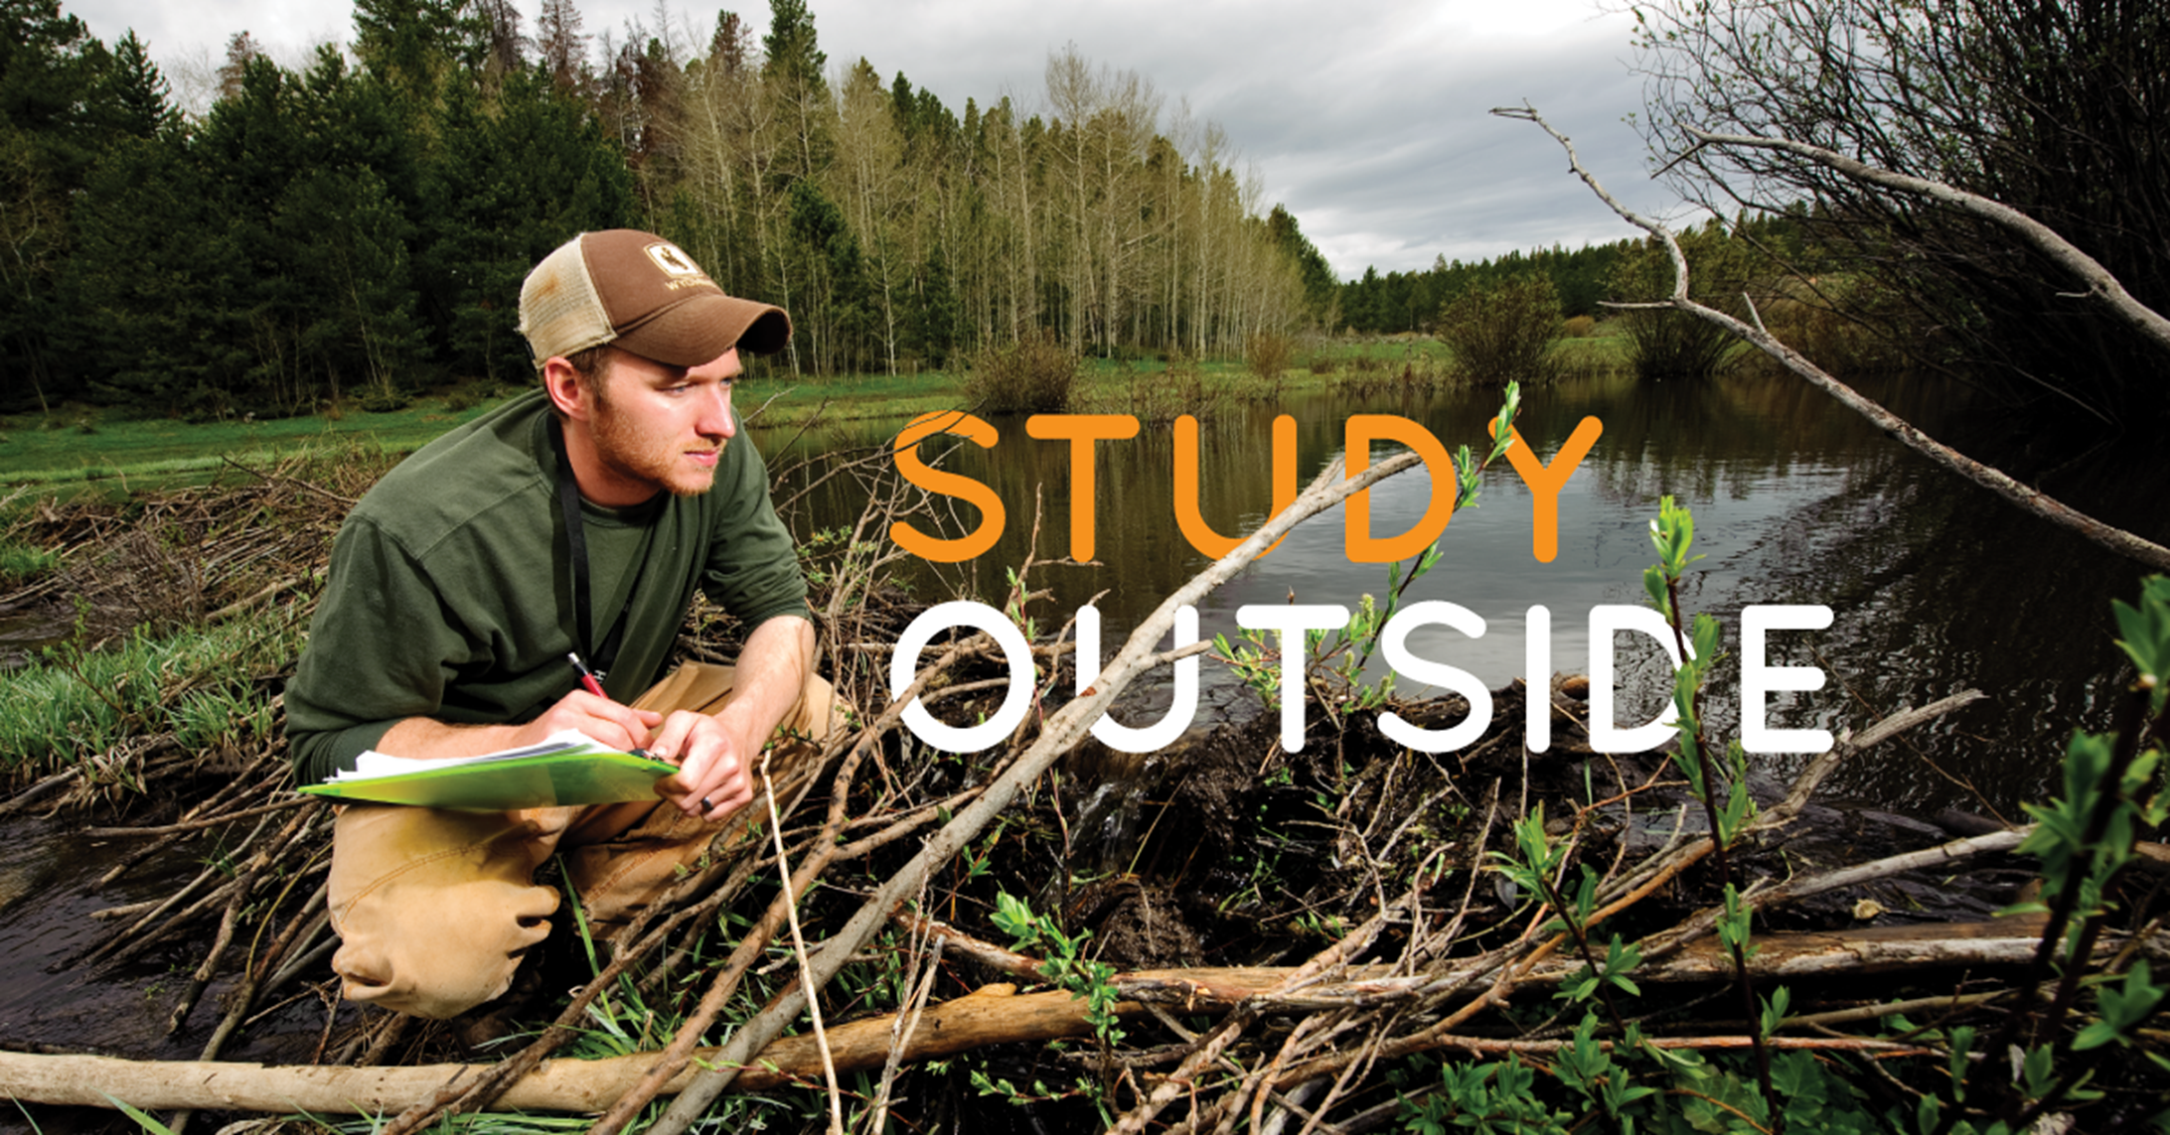
Goals for our Undergraduate Program
We aim to be a top accredited Range program in the US in terms of student numbers
Recruitment, retention, 2+2
Great education will draw students
Job readiness & desirable graduates
Undergraduate research, internships, travel & nontraditional opportunities
Be the destination for extensive land science & management
Notes:
Tami Plechaty is a USDA Pathways intern. Range Club students returning from SRM

Slide 13
Thank you for your attention!
Please contact us for any information
Head: Scott Miller; snmiller@uwyo.edu; 307-766-4274
On the web: uwyo.edu/esm
On Facebook: @UW.Ecosystem.Science.And.Management
On Instagram: @Uwyopedology

