Slide 1
UW’s Engagement Task Force
Board of Trustees
November 2017
Laurie Nichols, Jean Garrison

Slide 2
Carnegie Foundation Definition of Community Engagement
“The collaboration between institutions of higher education and their larger communities (local, regional/state, national, global) for the mutually beneficial exchange of knowledge and resources in a context of partnership and reciprocity.
The purpose of community engagement is the partnership of college and university knowledge and resources with those of the public and private sectors to enrich scholarship, research and creative activity; enhance curriculum, teaching and learning; prepare educated, engaged citizens; strengthen democratic values and civic responsibility; address critical societal issues; and contribute to the public good.”
– Carnegie Foundation for the Advancement of Teaching

Slide 3
Centrality of Engagement in Higher Education
“… [T]he understanding that not all knowledge and expertise resides in the academy, and that both expertise and great learning opportunities in teaching and scholarship also reside in non-academic settings. By recommitting to their societal contract, public and land-grant universities can fulfill their promise as institutions that produce knowledge that benefits society and prepares students for productive citizenship in a democratic society…. [It] posits a new framework for scholarship that moves away from emphasizing products to emphasizing impact.”
- Association of Public and Land Grant Universities

Slide 4
UW’s Land Grant Mission & Commitment to the State
Morrill Act Purpose: Enable all citizens of the US to participate in the nation’s economic and social progress; focus on practical public education for citizens
Engagement & Land Grant Mission of the 21st Century
  Embrace commitment to service to our community
  Commitment to reciprocity, collaboration, and partnership
2016-17 - Strategic Planning Listening Sessions showed a deep commitment to this at UW & need to better coordinate these efforts
Engagement Task Force is the vehicle to articulate this mission

Slide 5
UW’s Engagement Task Force
Develop a plan for strengthening UW’s mission as a land-grant university and to collaborate with constituents and partners to improve and enhance the health and well-being of the state’s communities and environments.
Work with the UW community to think futuristically about engagement to create an environment of engaged education, student opportunities, scholarship, service, and faculty and staff development to build collaboration between UW and our constituents and to address the complex economic and social challenges facing UW and Wyoming.
Task Force Charge:
Use this year to create a plan for an Office of Engagement and Outreach
Work toward UW designation as a Carnegie Foundation “community engaged university”

Slide 6
UW’s Engagement Task Force
Where are we now and what do we need to do?
  Discuss make up and structure of the task force
  Provide an update on where we are & next steps
  Compare UW to its peers & discuss Carnegie model
  Provide a snapshot of UW engagement examples
  Grab the opportunity we have now

Slide 7
Make Up of UW Engagement Task Force
Jean Garrison (chair) – director of the Center for Global Studies
Anne Alexander, associate vice provost in the Office of Academic Affairs
Chad Baldwin, associate vice president for marketing and communications
Jordan Blazovich, student senator representing the College of Health Sciences
Chris Boswell, vice president for governmental and community affairs
Mary Burman, dean of the Fay W. Whitney School of Nursing
Jo Chytka, director of UW Advising, Career and Exploratory Studies
Tony Denzer, head of the Department of Civil and Architectural Engineering
Shelley Dodd, director of the Office of Admissions
Jeff Edgens, associate dean and director of UW-Casper
Brent Ewers, botany professor and director of Wyoming EPSCoR
Paul Flesher, professor or religious studies and director of Saturday University
Keener Fry, director of the UW Alumni Association
Bret Hess, professor of animal science, associate dean for research and director of the Wyoming Agricultural Experiment Station
Richard Raridon, coordinator of community engagement and service, Center for Service, Leadership, and Community Engagement
Kate Welsh, associate professor in the School of Teacher Education and director of the Social Justice Research Center

Slide 8
Where is the Task Force to Date?
Meetings with constituent groups
5 Task Force Meetings – hosted guests from across campus to gain perspective on UW’s current engagement and outreach
Chair reach out to groups on and off campus
Committee Structure
Set up Structure with Steering Committee & 5 Committees Completing Reports
  Strategic Planning for Engagement and Awards
  Assessing Engagement Impacts
  Strategic Communication, Funding and Constituent Relations
  Curriculum and Professional Development
  Community Partnerships
Focused Meetings
Co-hosted Workshop on Documenting Engagement with Service, Leadership + Community Engagement Office (SLCE) and Ellbogen Center for Teaching and Learning (ECTL)
Task force group attended workshop on Carnegie process in Denver
1st campus listening session held in November
Using Carnegie Model for our Work

Slide 9
Institutional Motivation for Carnegie Designation
Institutional self-assessment and self-study: A way to bring the disparate parts of the campus together in a way that advances a unified agenda. At the same time it allows for the identification of promising practices that can be shared across the institution.
Legitimacy: Seeking a new level of legitimacy and public recognition and visibility for your work.
Accountability: A way to demonstrate that the institution is fulfilling its mission to serve the public good.
Catalyst for Change: A tool for fostering institutional alignment for community-based teaching, learning and scholarship.
Institutional Identity: The classification is a way to clarify institutional identity and mission that distinguishes the institution from peers.

Slide 10
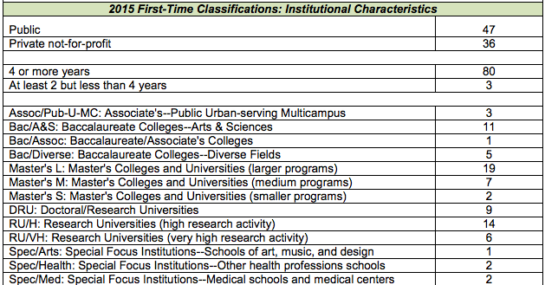
2015 Carnegie First-Time Classification

Slide 11
Carnegie Community Engagement Classification UW Close Peers and Stretch Peers
UW’s Close Peers - Carnegie Designation
Montana State University - 2010
New Mexico State University - 2015
Oklahoma State University - 2006, 2015
University of Idaho - 2010
University of Maine - 2008, 2015
The University of Montana - 2008
Not Carnegie Designated
South Dakota State University
University of Nevada-Reno
University of Rhode Island
Utah State University
UW’s Stretch Peers - Carnegie Designation
Clemson University - 2008, 2015
Colorado State University - 2008, 2015
Kansas State University - 2010
Texas Tech University - 2006, 2015
University of Utah - 2010
Washington State University - 2008, 2015
West Virginia University - 2010
Not Carnegie Designated
University of Nebraska-Lincoln
University of New Mexico
Others of Interest
Oregon State University - 2010
Ohio State University - 2008, 2015
University of Northern Colorado - 2015

Slide 12
New Mexico State University
2015 designated as a community engaged campus
Highlights of NMSU process:
  Community Engagement Plan called for under NMSU strategic plan Vision 2020; designed to align institutional engagement efforts; craft a methodology to effectively record and report the impacts of community engagement; leverage partnerships and resources; and most importantly to communicate and reward community engagement activity
Created a Community Engagement Council to implement the strategic plan - co-chaired by VP for Economic Development and Director of Cooperative Extension
No central administration for engagement

Slide 13
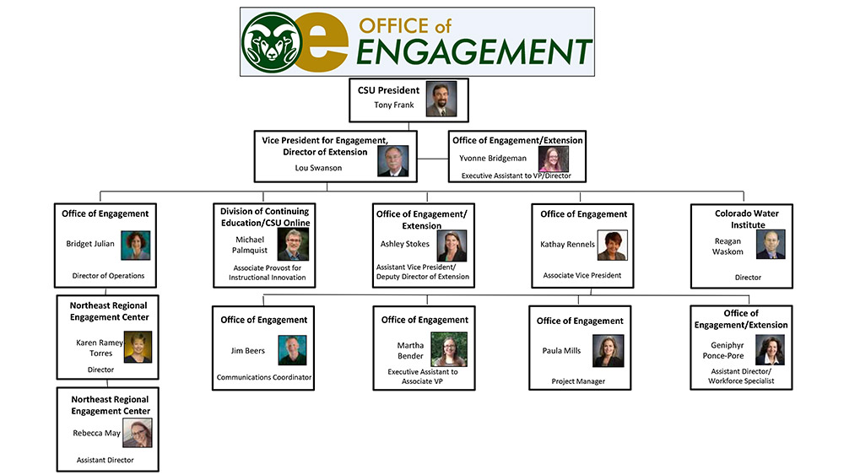
Colorado State University
Office of Engagement led by Vice President for Engagement
Provost’s Council for Engagement – convened by Provost and Vice President for Engagement with faculty representation from each college.

Slide 14
Oregon State University
Division of Outreach and Engagement led by Vice Provost
The 2016 strategic plan for the Division of University Outreach and Engagement outlines how the Division responds to Oregon's complex problems as well as Oregon's natural landscape and industry, state priorities, and the mandate of Oregon State University
Our vision is that the life of each person we engage will be demonstrably improved and enriched by access to and co-creation of innovation, knowledge and expertise.

Slide 15
Carnegie Classification Application as a Best Practice Model for Engagement
Foundational Indicators
  Institutional Commitment
  Institutional Identity and Culture
Curricular Engagement
Outreach and Partnerships

Slide 16
Foundational Indicators
Institutional identity & culture | Institutional Commitment
Mission/vision Recognition Assessment/data Marketing materials Leadership priority | Infrastructure Budget/fundraising Tracking/documentation Assessment/data Strategic plan Professional development Community voice Recruitment/promotion Student leadership

Slide 17
Foundational Indicators
Does the institution indicate that community engagement is a priority in its mission statement (or vision)? (Yes)
  Relevant Mission in Breaking Through: Cultivate a community of learning energized by collaborative work among students, faculty, staff and external partners.
  Values: Engagement and Communication: Engagement with local, state, tribal, national and global constituencies inspires our daily work. We are committed to active outreach and clear communication with our extensive communities.
Is community engagement defined and planned for in the strategic plans of the institution? (Yes)
  Breaking Through Goal 3: Impacting Communities: Improve and enhance the health and well-being of our communities and environments though outreach programs and in collaboration with our constituents and partners.

Slide 18
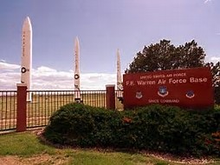
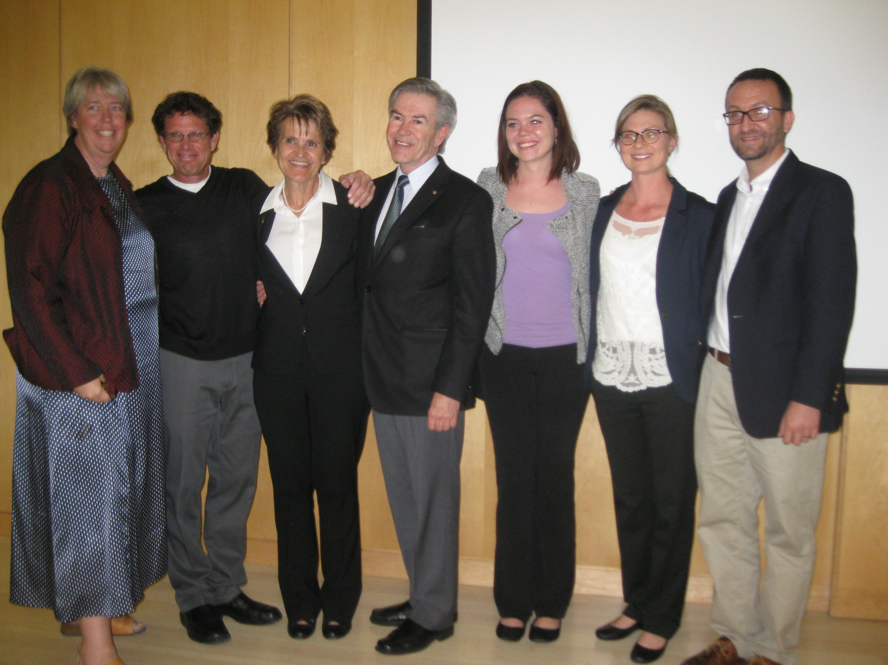
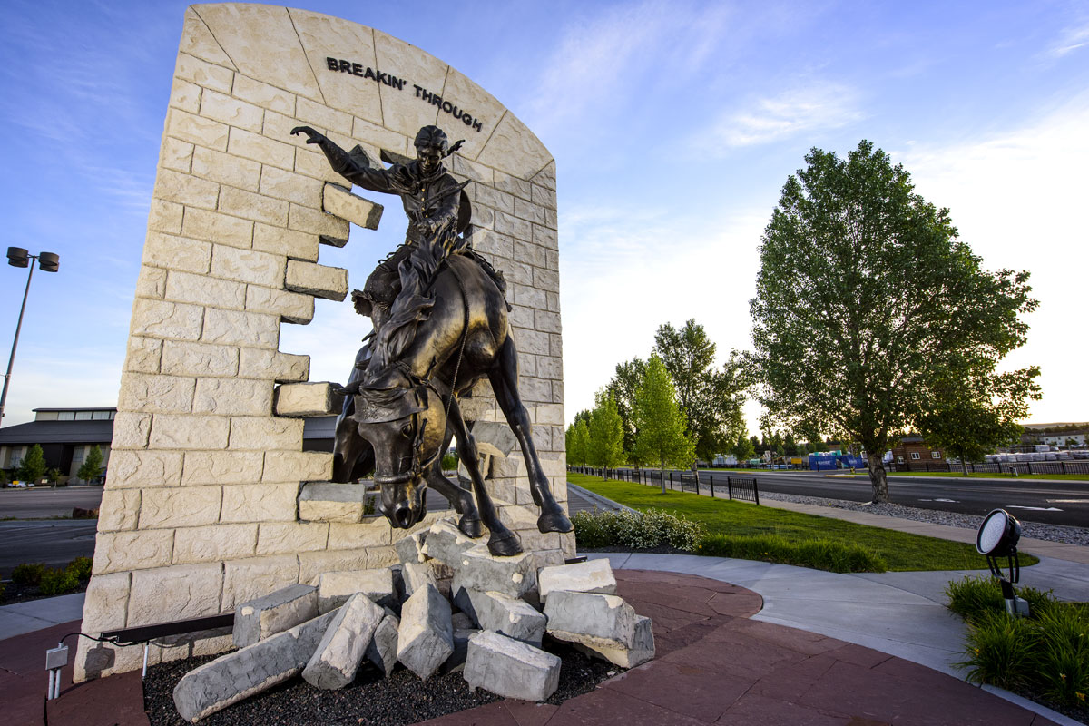
UW and Foundational Indicators: Strategic Planning Process and UW’s Engagement Commitment
- Fall 2016 statewide listening sessions with President Laurie Nichols that informed Breaking Through
- Ongoing engagement from the top around the state
- Formation of the Engagement Task Force

Slide 19
Curricular Engagement
Curricular Engagement describes teaching, learning, and scholarship which engage faculty, students, and community in mutually beneficial and respectful collaboration.
Their interactions address community identified needs, deepen students’ civic and academic learning, enhance the wellbeing of the community, and enrich the scholarship of the institution.

Slide 20

Curricular Engagement
Office of Service, Leadership + Community Engagement (SLCE)
  Community Engagement Mini-Grants to assist with a class project (8 mini-grants in AY 17; courses served 278 students and ~300 more potential students in World Languages Day and Choir Program
  Project Assistance - Identifying a community partner; Project/syllabus design - Reflection activities and assignments
Service Learning Course Example
  COJO 3190 Cross Cultural Communication
    Dr. Tracey Owens Patten
  Student project focused on Post-Traumatic Stress Syndrome. The class examined PTSS issues as related to military veterans, abuse survivors, survivors of terrorism, survivors of natural disasters, etc. The class heard personal testimonies of those that have been affected both directly and indirectly by PTSS. Hosted a “Chili Cookout for a Cause” with local Laramie restaurants and businesses to raise funds to be donated to the Albany County Safe Project.

Slide 21


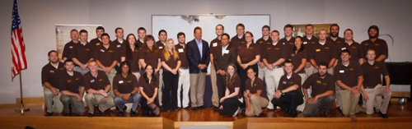
Experiential Learning - MBA Strategic Project Initiative & Jackson Leadership Summit
The MBA program partners with industry in mutually-beneficial strategic initiative projects. These projects provide General and Energy MBA students with opportunities to apply their skills in a business environment and to assist corporations in addressing strategic initiatives. Students address sponsor-defined challenges under the guidance of MBA faculty and present their findings to organizational leaders.

Slide 22
Outreach & Partnerships
Outreach and Partnership describe two different but related approaches to community engagement.
Outreach focuses on the application and provision of institutional resources for community use benefiting both campus and community.
Engagement focuses on collaborative interactions with community and related scholarship for the mutually beneficial exchange, exploration, discovery, and application of knowledge, information, and resources (e.g.. research, economic development, capacity building, etc.) and related scholarship.
Outreach and Partnerships around Wyoming
  View of UW around the state
  Examples at UW

Slide 23
Survey on Statewide Engagement
Fall 2016 Survey by WySAC of 722 Wyoming residents; margin of error of plus or minus 3.6 percentage points.
36% of respondents gave UW an “A,” and 42 % offered a “B” rating, with the average of all responses equating to 3.24 on a 4.0 scale. That “grade-point average” is the third highest since polling on UW’s performance began in 1984. It is down from the all-time high of 3.31 in 2012.
On the issue of “being responsive to the needs of the state and its citizens,” 66% responded excellent or good (14 percent rated UW’s performance as excellent and 52 percent as good).
On whether UW has “a strong level of engagement with your community,” 61% responded excellent or good (19 percent said excellent, 42 percent good, 20 percent fair and 9 percent poor).

Slide 24
UW Outreach & Partnerships
Examples of Outreach and Partnership in every college
Just to highlight a few …

Slide 25
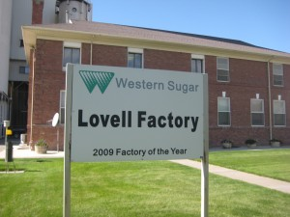
College of Engineering and Applied Science and Partners - Western Sugar Greenhouse
Project Team
UW-Business-Community Partner Project to build and operate the greenhouse to be managed by the Big Horn Food Hub to provide fresh produce for local schools
College of Engineering Building Energy Research Group (BERG) expertise in architecture, solar heating, project management, building energy modeling, design and control operation of heating and cooling systems in buildings
College of Agriculture expertise in horticulture, greenhouse operations, soils, extension; local foods consultant
Public Sector partners: Wyoming Business Council, agribusiness (Wyoming Department of Agriculture), business incubation (Wyoming Entrepreneur Market Research Center)
Private Sector partners: project support/expertise (Lovell Sugar Plant Manager and CEO of Western Sugar)

Slide 26
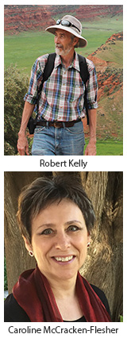
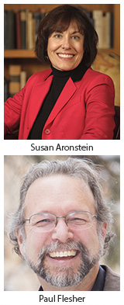
SaturdayU
Community Outreach
SaturdayU in Sheridan: Professor Susan Aronstein, English, and Professor Paul Flesher, Philosophy and Religious Studies.
SaturdayU, in Pinedale: Professor Robert Kelly, Anthropology, and Professor Caroline McCracken-Flesher, English.

Slide 27
UW Clinics in 2016-17
College of Health Sciences, Speech-Language Pathology
  Patient visits around Wyoming (15 counties served) to UW Speech and Hearing Clinics – Audiology: 972 patient visits; Speech: 1803 patient visits
  Student practicum hours: 25,440 overall (14,400 in Wyoming)
College of Law – 6 legal clinics offered
  Ex: Civil Legal Services Clinic – Provided legal assistance to Wyoming citizens for over 20 years. Student interns represent low-income and marginalized individuals who cannot otherwise afford legal representation on general civil legal matters.

Slide 28
College of Arts and Sciences
Community Engagement
Founded in 2012, The Wyoming Migration Initiative, advances understanding, appreciation, and conservation of Wyoming’s migratory ungulates.

Slide 29
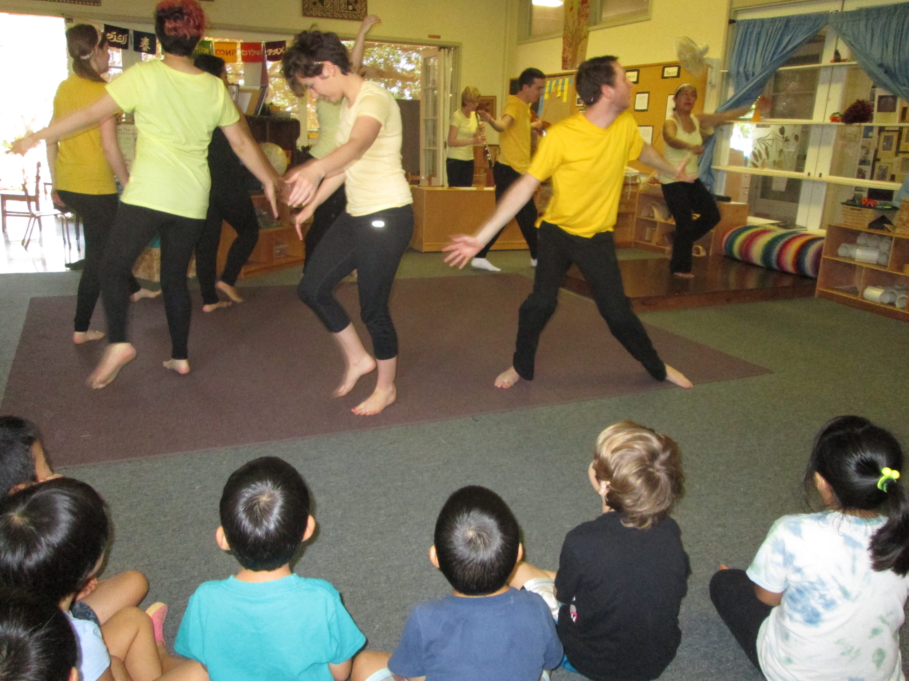
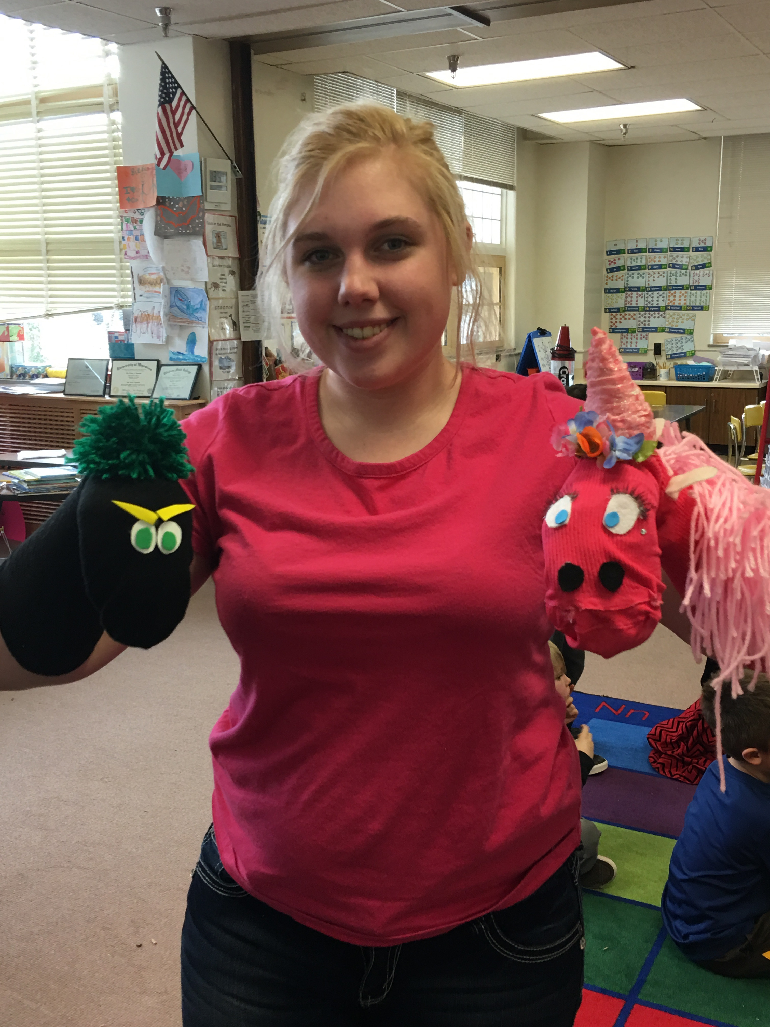
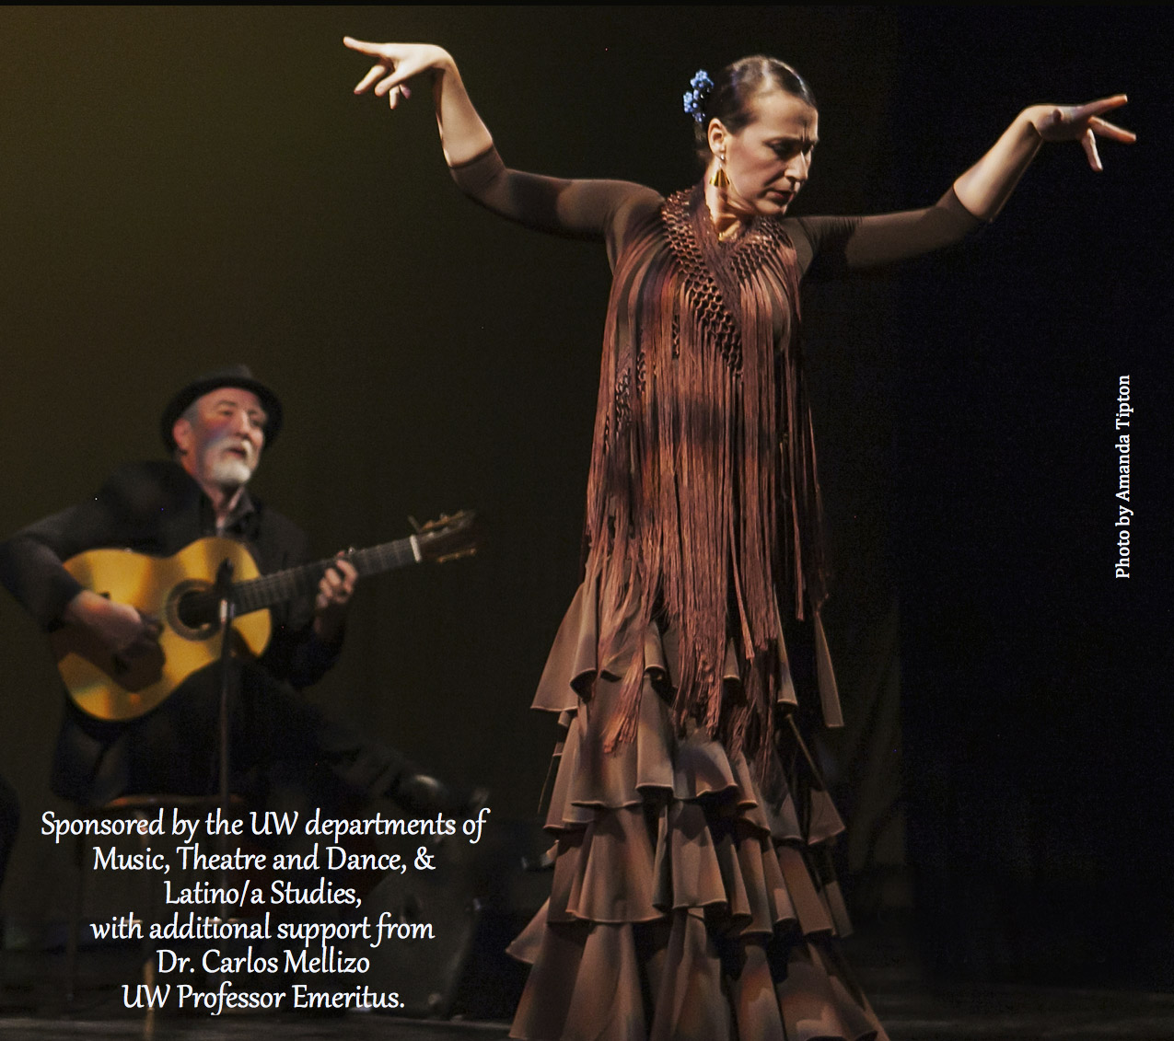
College of Arts and Sciences
Community Engagement
The Theatre for Young Audiences and Theatre Education Program (Theatre and Dance), toured regional schools with three productions. Above Left: The Effects of Chemicals on Bees (cross-disciplinary dance drama); Above middle: Makayla Buszek and her puppets; Above Right: Flamenco Denver

Slide 30
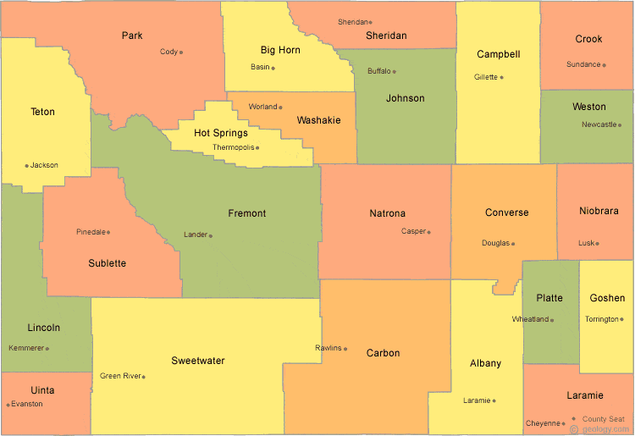
College of Agriculture and Natural Resources Engagement
UW Extension - "Extending Knowledge, Changing Lives". Programs in 4-H and youth development, agriculture, horticulture, nutrition, food safety, natural resources, ecosystems, and community development education
Wyoming Agricultural Experiment Stations statewide since 1891
  Production Ag Research Priorities and Ag Corporations
  Formal meetings and field days; advisory boards; service on committees
  Professional meetings at all scales
    Economic Development
    Chambers of Commerce
  Living and engaging
  in the communities
Notes:
Involves students, staff, and faculty

Slide 31

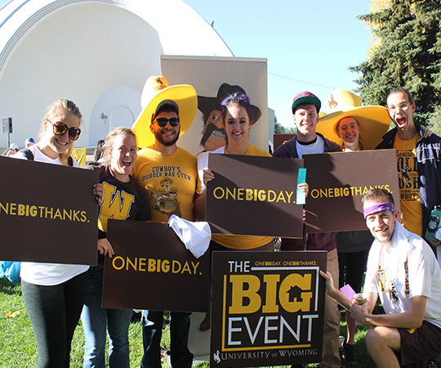
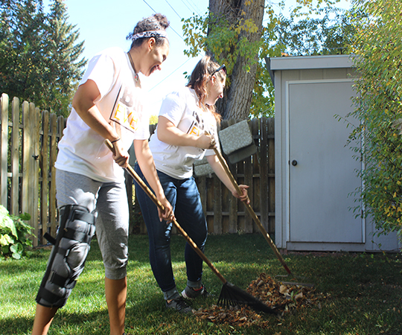
Service, Leadership + Community Engagement (SLCE)
The Big Event is an opportunity for UW students to say thank you to residents of the greater Laramie community for the support they provide to college students. 700 student volunteers serving nearly 150 locations in October 2017.

Slide 32

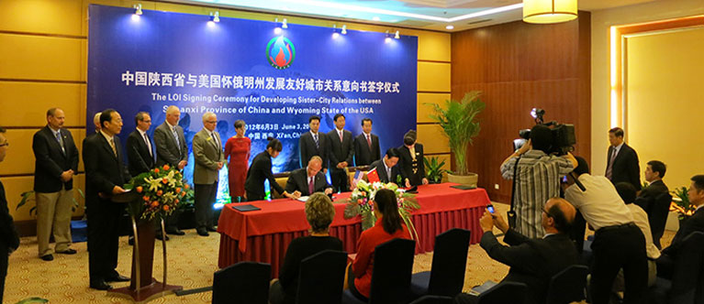

School of Energy Resources and Haub School of Environment and Natural Resources
School of Energy Resources - Transfer of technology and knowledge to Wyoming's energy stakeholders; collaborate with UW colleges, Wyoming community colleges, industry and state constituents lead to the staging of a variety programming
Haub School and Ruckleshaus Institute – Sponsorship of a variety of forums, cooperation with agencies, neutral third-party facilitation and mediation services to help communities resolve natural resource challenges

Slide 33
Center for Global Studies Lecture Series by the Numbers

Slide 34
Engagement Opportunity at UW Now
Coordinate and streamline engagement efforts to achieve enhanced consistency, follow-through, communication, marketing, and impact
Provide a portal of access to UW for the citizens of Wyoming (and beyond)
Strengthen UW’s culture of engagement with enhanced recognition and reward
Whenever possible, integrate engagement with other institutional initiatives and offices (e.g. admissions, distance education, community college/regional centers, Extension, entrepreneurship, etc.)
Become a Carnegie designated engagement university and use this designation in university marketing efforts

Slide 35
What’s coming next for the task force?
December 2017 - Preliminary committee reports
December - website launch page
December-February - Inventory exercise, Dean/Dept. Head survey
January-February - Focus groups in 13 Wyoming communities
Late March-Early April - Report to the President and Provost and Campus Community for comment
May 2018 - Revised report submitted to President and Provost

Slide 36
Questions and Discussion?

