Slide 1
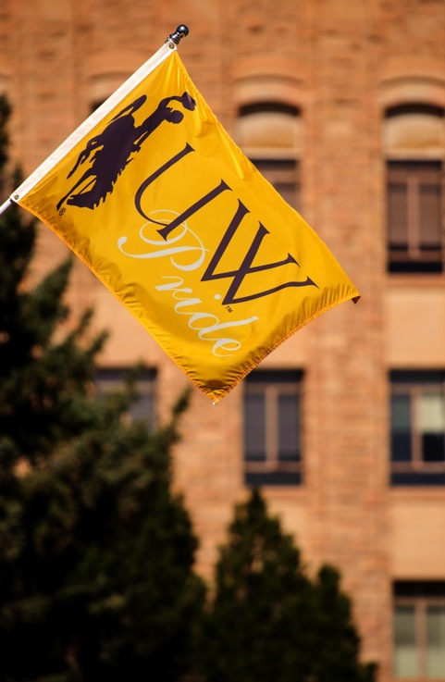

Legislative Response on Recruitment/ Retention
Board of Trustees
November 2017
Kate Miller & Mary Aguayo

Slide 2
Legislative Request
2017 SF0001 The University of Wyoming, the community college commission and each community college shall collaborate and develop a unified plan to provide a coordinated approach to the recruitment and retention of and incentives for students graduating from Wyoming secondary schools and from schools in states contiguous to Wyoming. The university, on behalf of the university, community colleges and commission, shall report their progress on the plan to the joint education interim committee and the joint appropriations committee not later than September 30, 2017, and incorporate a final plan for the legislature not later than December 1, 2017, within their respective 2019-2020 biennial budget requests.

Slide 3
The Response
All 8 public college presidents and the Wyoming Community College Commission have jointly authored and endorsed Wyoming Colleges’ Recruitment and Retention Plan
The Plan represents the specific, collaborative strategies and tactics necessary to meet the statewide post-secondary education attainment goal and support ENDOW

Slide 4
Key Themes
creating a college-going culture,
removing barriers to college participation,
building a pipeline for Wyoming’s colleges,
developing paths to re-entry into college for Wyoming high school graduates entering higher education from the workforce, and
building pathways to completion

Slide 5
College-going Culture
Statewide co-produced communication plan for students in grades 9-12
Partner with the WDE to share student names with WY colleges
Develop postsecondary plans for 9th graders
Set a goal to increase the rate of immediate entry into college from high school

Slide 6
Remove Barriers to College
Common college application
Explore a shared student information system and data systems
Jointly promote FAFSA completion
Identify a goal and secure resources for state-funded need-based financial aid

Slide 7
Create a Pipeline to WY’s Colleges
Expand regional pricing strategies for nonresidents
Create a marketing campaign for non-resident students to attend college in WY
Focus on transfer, including more 2+2 paths
Evaluate capacity for a resident and nonresident student mix in the right programs
Analyze student housing capacity

Slide 8
Develop Paths to Re-entry into College
Provide transitional student services
Ensure career and technical programs are aligned with WY’s economic needs
Provide certificate programs for the workforce
Expand the Bachelor of Applied Science degree

Slide 9
Build Pathways to Completion
Utilize data to set aggressive student success goals
Increase retention and graduates through Complete College Wyoming
Partner with ENDOW to establish practices to retain graduates in WY

Slide 10
Next Steps
Board of Trustees approval requested
Submit the Plan to the legislature by December 1, 2017
Begin the 3-year action steps as outlined in the Timeline
Report regularly on the progress made to the Board of Trustees

Slide 11
Questions?

