Slide 1
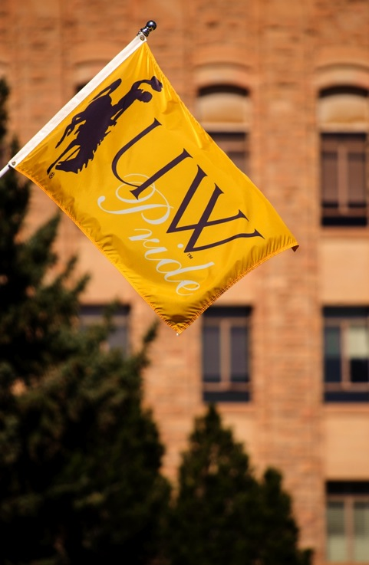
President Laurie Nichols September 14, 2017
2016-17 Annual Accomplishments
The Year in Review

Slide 2
Biennium Budget Reduction
Effective reduction of nearly $48.6M (12.5%) to Block Grant funding in 2017-2018 Biennium Budget
Made reductions and took proactive and strategic steps to transform, reorganize and reduce operations to protect and maintain funding for core missions of research, teaching and service

Slide 3
Biennium Budget Reduction (cont’d)
All divisions reduced operating budgets; reviewed by the Financial Crisis Advisory Committee
Standardized faculty workloads
Offered two retirement/separation plans; eliminated vacancies to cut 370 positions
Academic program review led to elimination of 5 programs with low enrollment

Slide 4
Biennium Budget Reduction (cont’d)
Eliminated duplication of services, especially with the reorganization of the Outreach School; consolidated fleet and IT services
Reduced fringe benefits and implemented a standard fringe rate
Implemented strategic sourcing for three major procurement categories

Slide 5
WyoCloud Implementation
WyoCloud went live July 17
First upgrade, including enhanced financial management reporting, will be released to campus September 26
Developed first-ever all-funds budget for FY18 in alignment with launch of the WyoCloud; system will be utilized to develop FY19 operating budget

Slide 6
Opening the High Bay Research Facility
Completed in January 2017, Grand Opening held on August 17, 2017
$68 million, 90,000 square foot facility housing research laboratories and offices largely dedicated to transformative research on unconventional reservoir oil and gas recovery

Slide 7
Recent Groundbreakings
Engineering Education & Research Building
Groundbreaking in fall 2016 with an anticipated completion date of spring 2019
110,000 square feet of shop space and research laboratories, including a drilling simulation laboratory, dedicated to Engineering research

Slide 8
Recent Groundbreakings
Mick and Susie McMurry High Altitude Performance Center
Groundbreaking in fall 2017 with an anticipated completion date of June 2018
Includes renovations and additions to the existing Rochelle Athletic Center, to provide cutting edge conditioning facilities, dining facilities to promote athletes’ nutrition, and academic support spaces

Slide 9
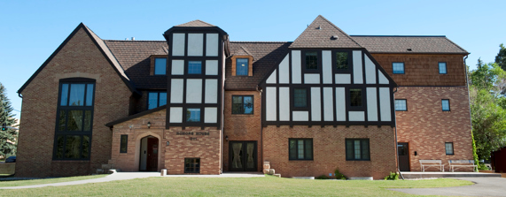
Honors College Designation and Move
Trustees approved the creation of a degree-granting Honors College, an expansion of the existing Honors Program, in July 2017
Honors College now housed in Guthrie House, formerly home to the UW Foundation

Slide 10
Native American Education, Research, and Cultural Center
Grand Opening of the new center will take place September 29 with remarks from elected officials, tribal leaders, and other dignitaries
Center will provide classes, facilitate research, and includes space for hosting cultural events, meetings, collaborative work, and study

Slide 11
Strategic Plan Development
Kicked off in fall 2016 with appointment of a Strategic Planning Leadership Council
Listening sessions across campus and the state—in 10 communities—between November 2016 and January 2017
Final plan, “Breaking Through,” approved by Board of Trustees in July 2017
Will guide UW’s success through 2022

Slide 12
Comprehensive Residential Housing Plan
Development of a comprehensive 10-year plan for the construction of new residence halls; modernization and renovation of existing facilities, recommendations for apartments and Greek Life housing

Slide 13
Strategic Enrollment Management Plan
Five-year enrollment plan developed by a task force under leadership of Provost Miller and Vice President Blackburn
Provides a roadmap for growth in transfer and first-year students, as well as addressing student success, retention, and completion
Enrollment initiatives targeting special student populations, including American Indian and Honors students

Slide 14
Enrollment, Recruitment, and Retention
Appointed UW’s first VP for Enrollment Management, Kyle Moore, in August 2017
New marketing campaigns targeting online students were launched and have started to yield results
Signing Day events across the state
UW welcomed its largest freshman class this fall and saw an increase in transfers

Slide 15
Statewide Travel
Nearly 100 trips to communities across Wyoming to get to know the people of Wyoming and promote the University
Visits included listening sessions, alumni events, high school visits, recruitment and Signing Day events, legislative visits, media interviews, development, and speaking engagements to conferences, service organizations, banquets, etc.

Slide 16
New Leadership Hires
Provost and Vice President for Academic Affairs: Dr. Kate Miller
Vice President for Research and Economic Development: Dr. Ed Synakowski
Vice President for Student Affairs: Dr. Sean Blackburn
Chief Diversity Officer: Dr. Emily Monago
General Counsel: Tara Evans
Chief of Staff: Dr. Dan Maxey

Slide 17
President Laurie Nichols September 14, 2017
2016-17 Annual Accomplishments
The Year in Review

