Slide 1
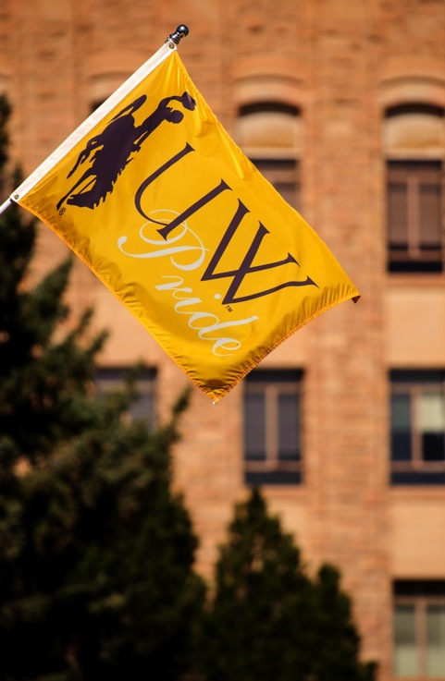

Legislative Response on Recruitment/ Retention and
Lumina Update
Board of Trustees
September 2017
Laurie Nichols, Kate Miller, & Mary Aguayo

Slide 2
Legislative Request
2017 SF0001 The University of Wyoming, the community college commission and each community college shall collaborate and develop a unified plan to provide a coordinated approach to the recruitment and retention of and incentives for students graduating from Wyoming secondary schools and from schools in states contiguous to Wyoming. The university, on behalf of the university, community colleges and commission, shall report their progress on the plan to the joint education interim committee and the joint appropriations committee not later than September 30, 2017, and incorporate a final plan for the legislature not later than December 1, 2017, within their respective 2019-2020 biennial budget requests.

Slide 3
Response Development Process
Meeting 1
  June 20, 2017
  All Wyoming Presidents, their chief enrollment officers, and the Wyoming Community College Commission met in Casper
  Topic: Possibilities for partnership in recruitment and retention of Wyoming and neighbor-state students

Slide 4
Response Development Process
Meeting 2
  July 20, 2017
  All Wyoming Presidents or delegates, select board members, the Wyoming Community College Commission, and the Wyoming Department of Education met with Lumina in Rock Springs
  Topic: Consider a statewide postsecondary educational attainment goal

Slide 5
Response Development Process
Meeting 3
  October 11, 2017
  All Wyoming Presidents and the Wyoming Community College Commission will again meet in Casper
  Topic: Review and finalize the Plan, determine opportunities for further development, and articulate the timeline for deliverables

Slide 6
Response Development Process
Plan provided to UW’s Trustees
  November 2017
  The Board will have the opportunity to review the plan, as developed in partnership across the state, prior to its submission to the legislature in December 2017

Slide 7
Key Themes
creating a college-going culture,
removing barriers to college participation,
building a pipeline for Wyoming’s colleges,
developing paths to re-entry into college for Wyoming high school graduates entering higher education from the workforce, and
building pathways to completion

Slide 8
Statewide Educational Attainment
Lumina is an independent, private foundation focused on higher educational attainment and completion
By 2025, 60% of the nation’s workforce will need a post-high school credential, but Wyoming has just 46%

Slide 9
Importance of a Skilled Workforce
An educated workforce is a major draw for companies who can provide economic diversification
Setting and achieving a statewide postsecondary educational attainment goal is critical to meet the state’s future workforce needs

Slide 10
Next Steps
Lumina will provide support funds to consider the goal, which can be met in 3 ways:
  Joint Resolution (ex: Wisconsin)
  Law (ex: Minnesota)
  Governor’s executive order (ex: South Dakota)

Slide 11
Questions?

