Slide 1
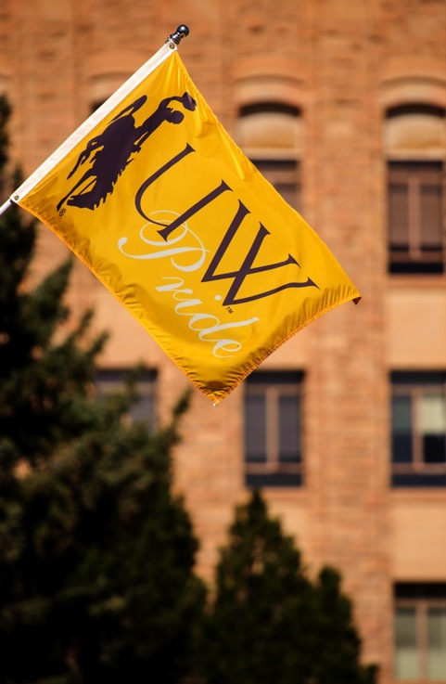

HLC Accreditation
Board of Trustees
September 2017
Kate Miller, Anne Alexander
Academic Affairs

Slide 2
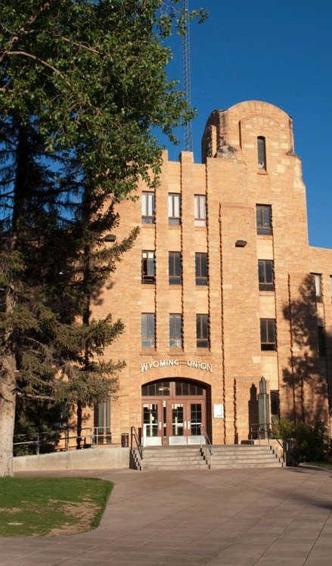
Higher Learning Commission (HLC)
What/why
Accreditation cycle
  QI and comprehensive evaluation
Role of the Board in Accreditation

Slide 3
Reminder: HLC What & Why
In order to receive federal support, public post-secondary institutions are required to have accreditation from their regional accreditor:
  Since 1915, UW has been accredited by the Higher Learning Commission (HLC, formerly the North Central Association)
  HLC is our “US Department of Education gateway.” They watch over and vouch for quality, rigor, robustness of our curriculum, student support, governance, finances.
  Without accreditation, all federal funding is at risk.

Slide 4
Reminder: HLC What & Why
In January, we spoke with you about our HLC Quality Initiative Project, which is one part of the accreditation process.
This time we’re starting to prep you for the 10-year, on-site accreditation review, which is about 2 years away, and review the specifics of your governance role.
  Any areas of weakness you might identify can still be corrected or improved at this time.

Slide 5
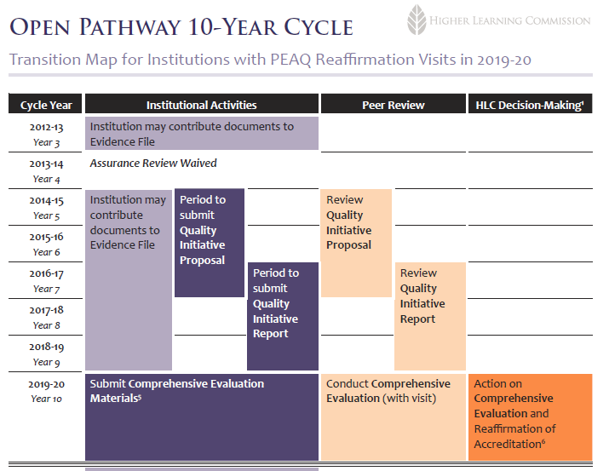
Where are we now?
UW QI proposal accepted 2015 = First Year Seminar implementation
UW QI Report submitted Jan. 2017. During your meeting in January, we shared the report with you. HLC notified us in March that our report and project were accepted based on the “genuine effort of the institution, the seriousness of the undertaking, the significance of scope and impact of the work, the genuineness of the commitment to the initiative, and adequate resource provision.”
UW begins preparing for evaluation visit

Slide 6
A Board Guide to Accreditation
HLC website
  Our profile

Slide 7
HLC Guiding Value
#7. Governance for the well-being of the institution.
“The well-being of an institution requires that its governing board place that well-being above the interests of its own members and the interests of any other entity. Because HLC accredits the educational institution itself, and not the state system, religious organization, corporation, medical center or other entity that may own it, it holds the governing board of an institution accountable for the key aspects of the institution’s operations. The governing board must have the independent authority for such accountability and must also hold itself independent of undue influence from individuals, be they donors, elected officials, supporters of athletics, shareholders, or others with personal or political interests.
Governance of a quality institution of higher education will include a significant role for faculty, in particular with regard to currency and sufficiency of the curriculum, expectations for student performance, qualifications of the instructional staff, and adequacy of resources for instructional support.”

Slide 8
Role of the Board
Assumed Practices → translation: a set of practices shared by institutions of higher education in the United States. They are (1) generally matters to be determined as facts, rather than matters requiring professional judgment and (2) unlikely to vary by institutional mission or context.
  Assumed Practices A1, A8, and A9 specifically discuss the governing board of the institution

Slide 9
Role of the Board – Assumed Practice A: Integrity
A1: The institution has a conflict of interest policy that ensures that the governing board and the senior administrative personnel act in the best interest of the institution

Slide 10
Role of the Board – Assumed Practice A: Integrity
A8: The governing board and its executive committee, if it has one, include some “public” members. Public members have no significant administrative position or any ownership interest in any of the following: the institution itself; a company that does substantial business with the institution; a company or organization with which the institution has a substantial partnership; a parent, ultimate parent, affiliate, or subsidiary corporation; an investment group or firm substantially involved with one of the above organizations. All publicly-elected members or members appointed by publicly-elected individuals or bodies (governors, elected legislative bodies) are public members.

Slide 11
Role of the Board – Assumed Practice A: Integrity
A9: The governing board has the authority to approve the annual budget and to engage and dismiss the chief executive officer.

Slide 12
Role of the Board in the Criteria for Accreditation
Criteria: the standards of quality by which the HLC determines whether we earn and keep our accreditation

Slide 13
Role of the Board – Specifics in HLC Criteria
1.A. The institution’s mission is broadly understood within the institution and guides its operations.
1. The mission statement is developed through a process suited to the nature and culture of the institution and is adopted by the governing board.

Slide 14
Role of the Board - Specifics in HLC Criteria
2.A The institution operates with integrity in its financial, academic, personnel, and auxiliary functions; it establishes and follows policies and processes for fair and ethical behavior on the part of its governing board, administration, faculty, and staff.

Slide 15
Role of the Board - Specifics in HLC Criteria
2.C The governing board of the institution is sufficiently autonomous to make decisions in the best interest of the institution and to assure its integrity.
The governing board’s deliberations reflect priorities to preserve and enhance the institution.
The governing board reviews and considers the reasonable and relevant interests of the institution’s internal and external constituencies during its decision-making deliberations.
The governing board preserves its independence from undue influence on the part of donors, elected officials, ownership interests, or other external parties when such influence would not be in the best interest of the institution.
The governing board delegates day-to-day management of the institution to the administration and expects the faculty to oversee academic matters.

Slide 16
Role of the Board - Specifics in HLC Criteria
5.B. The institution’s governance and administrative structures promote effective leadership and support collaborative processes that enable the institution to fulfill its mission.
The governing board is knowledgeable about the institution; it provides oversight of the institution’s financial and academic policies and practices and meets its legal and fiduciary responsibilities.
The institution has and employs policies and procedures to engage its internal constituencies—including its governing board, administration, faculty, staff, and students—in the institution’s governance.
Administration, faculty, staff, and students are involved in setting academic requirements, policy, and processes through effective structures for contribution and collaborative effort.

Slide 17
AGB/CHEA Joint Advisory Statement
Association of Governing Boards (AGB) and the Council for Higher Education Accreditation (CHEA) suggested practices for governing boards:
  Establish an accreditation education program
  Be informed – receive, review, and engage on self-study, team report, formal action and decision letters
  Be informed about accreditation standards that apply to board governance
  Participate in accreditation process
  Assure faculty participation

Slide 18
Upshot: A Board Guide to Accreditation
Understand the importance of accreditation and the basics of our criteria and assumed practices.
Participate in the self-study as we begin it next year.
Review final self-study report next year.
Meet with visiting team when they come in 2019.
Review draft and final team report.
Attend an accrediting commission meeting with CEO and ALO – Chicago, every April.
Receive and review action letters.
Require ongoing follow-up reports from staff.
Should you decide to reactivate the academic and student affairs committee, HLC accreditation could be placed with this committee.

Slide 19
Questions?

