Slide 1
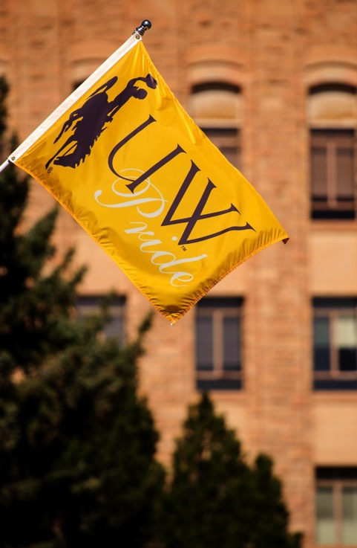

Educational Attainment Planning Grants
Board of Trustees
July 2018
President Laurie Nichols and
Director of Transfer Relations Mary Aguayo

Slide 2
Our Attainment Goal
In November of 2017, the University of Wyoming Board of Trustees and the Wyoming Community College Commission formally adopted a statewide attainment goal.
The attainment goal was formally endorsed and increased by ENDOW in their December 2017 report.
Governor Matt Mead issued an executive order on January 26, 2018 stating Wyoming will achieve these levels of post-secondary educational attainment:
  67% by 2025
  82% by 2040

Slide 3
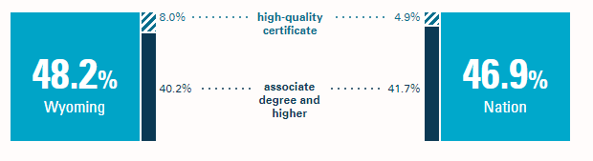
Wyoming’s 2018 Attainment
Source: Lumina Foundation, “A Stronger Nation”

Slide 4
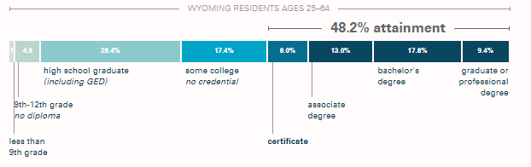
Wyoming’s 2018 Levels
Source: Lumina Foundation, “A Stronger Nation”

Slide 5
The Plan
UW, the Wyoming Community College Commission, the Wyoming Department of Education, and the community colleges have been charged by Governor Mead to develop a plan to achieve the attainment goal and report on our progress annually.

Slide 6
The Grants
Lumina Technical Assistance Funding- State convening, July 2017
Lumina Peer Learning Opportunity- State delegation, November 2017
WICHE Task Force on Closing Postsecondary Attainment Gaps- March 2018
Lumina Peer Learning Opportunity- State delegation, May 2018
Lumina State Policy Retreat- State delegation, October 2018
Lumina Technical Assistance Funding- Attainment Gaps, In Progress
SHEEO Adult Promise- Cohort selection, In Progress

Slide 7
WICHE Task Force
UW, the Wyoming Community College Commission, and all seven colleges jointly submitted an application and was selected for Wyoming to be selected as one of just three states to serve on the WICHE Task Force to Close Postsecondary Attainment Gaps.
Participation provides 20 months of consulting support and $30,000 per year in implementation funds.
Priorities
Develop a statewide plan to achieve our attainment goals
Determine clear steps to create a statewide college-going culture
Innovate new ways to engage adults in higher education

Slide 8
SHEEO Adult Promise
UW, the Wyoming Community College Commission, and all seven colleges jointly submitted a letter of intent to apply to become an “Adult Promise” state.
Wyoming’s annual report to SHEEO highlights our collaborative attainment work.
If selected, Wyoming would receive $400,000 to:
Develop and promote state-funded need-based financial aid for adult students, as endorsed by ENDOW
Target outreach to re-enroll the 87,000 Wyoming adult students with some college and no degree
Build support services and programs to serve the needs of adult students

Slide 9
Keys to Success
Wyoming’s biggest strengths in improving educational attainment:
  Cross-sector support from K-12, higher education, employers, ENDOW, and the governor’s office
  Economic necessity of the work
  Engaged and action-oriented stakeholders
  Proactive approach to data sharing between all eight colleges and K-12

Slide 10
Questions?

