Slide 1
The UW Family Medicine Residency Program and The Educational Health Center of Wyoming

Slide 2
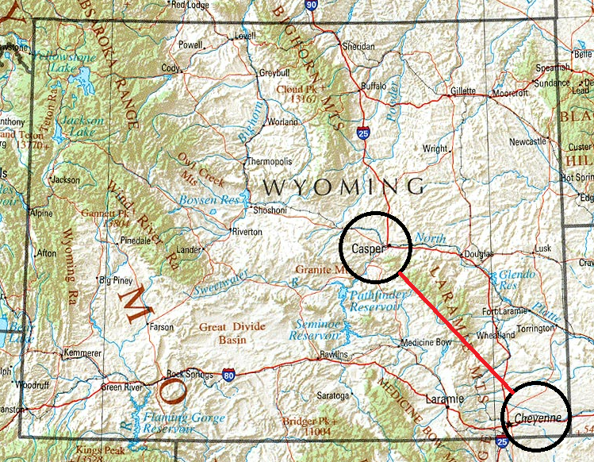
UW Family Medicine Residency Program (FMRP)
Casper – Cheyenne
Purposes
Train Resident Physicians in Family Medicine
Provide training for students in other health fields
Provide safety net health care to citizens of Wyoming

Slide 3
UW FMRP Clinics: Benefit to the State
42 Family Medicine Resident Physicians providing health care across the lifespan--obstetrics to geriatrics (24 in Casper, 18 in Cheyenne)
~103 Family Medicine Physicians practicing in Wyoming are graduates of the FMRP
Opportunities
Family Medicine Resident Rural Training Track
Geriatrics Fellowship (with VA Hospital in Sheridan)

Slide 4
UW FMRP Clinics: Benefit to the State
July 2017 thru May 2018
FMRP-Casper
27,114 patient visits
FMRP-Cheyenne
17,954 patient visits

Slide 5
UW FMRP Clinics
2012
FMRP was increasingly reliant on general funds
State continued to face fiscal challenges
Governor Mead directed UW to study options that might reduce this increased reliance on general fund

Slide 6
UW FMRP Clinics
2012
UW created a stakeholder group to study possibilities for generating revenue beyond the General Fund
The stakeholder group recommended:
Seek Health Resources & Services Administration (HRSA) designation of Federally Qualified Health Center Look ALike (FQHC-LA)
Governor supported this recommendation

Slide 7
UW FMRP Clinics
Benefits of FQHC
Increased opportunities for HRSA grant funding
340b Pharmacy pricing
Enhanced reimbursements from Medicaid and Medicare
National Health Services Corps loan repayment program for providers

Slide 8
UW FMRP Clinics
2014
HRSA designated the FMRP as a FQHC-Look Alike
Governing body for the FQHC-LA
The Educational Health Center of Wyoming (EHCW)
The UW and the EHCW became HRSA co-applicants

Slide 9
UW FMRP Clinics and EHCW
2016
UW-EHCW applied to HRSA for funding that would establish a third clinic in Laramie
Funding was awarded to the Laramie Clinic as a “New Access Point”
Resulted in the designation of a “full” FQHC

Slide 10
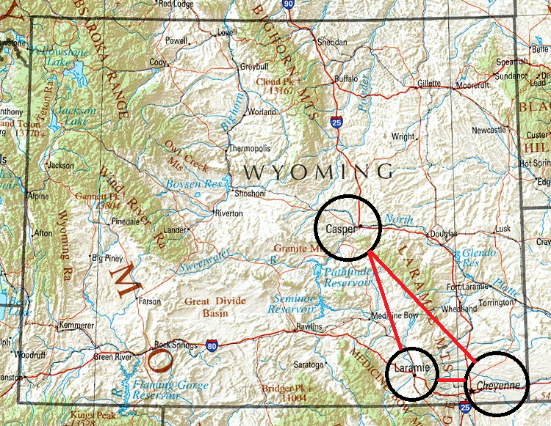
Educational Health Center of Wyoming (EHCW)
UW Family Medicine Residency Clinics
Casper
Cheyenne
Albany Community Health Center
Laramie

Slide 11
The EHCW
Casper and Cheyenne Clinics
Integral part of the UW FMRP
Funded by General Fund and Clinic Revenue
Albany Community Health Center (ACHC)
Newest addition – Funded by HRSA and Clinic revenue
No UW or General Funds support the ACHC

Slide 12
The EHCW, UW, and the State of Wyoming
Casper and Cheyenne Residency Clinics
Funding structure: Viewed as a “State Agency”
Clinic revenue considered to be State revenue
This structure has created challenges for the Clinics

Slide 13
The EHCW, UW, and the State of Wyoming
Challenges
Current governance structure is complex and may not fully comply with the expectations of HRSA for a FQHC
The current budget process for the UW FMRP limits the FMRP’s ability to run modern-day clinics
Current budget process does not allow the enhanced revenue received via FQHC designation to flow back to clinic operations (which is expected by HRSA)
The EHCW has little authority over the FQHC

Slide 14
July 2017
Educational Health Center of Wyoming
University of Wyoming

Slide 15
Addressing the HRSA issue
Fall 2017
UW hired consultant to assess current organizational structure and provide recommendations to ensure HRSA compliance
Consultant identified areas of concern -- developed possible work plan to address HRSA-related issues

Slide 16
General Fund / Clinic Revenue Levels

Slide 17
Addressing the HRSA issue
December 2017
Began discussing issues with Joint Appropriations Committee…asked for guidance
March 2018
HRSA site visit: Concerns raised regarding current administrative and fiscal structure

Slide 18
The EHCW, UW, and the State of Wyoming
Select Committee formed with the following charge:
“The select committee shall study and make recommendations on the operations, organizational structure, services and funding of the University of Wyoming family medicine residency programs. The select committee shall submit a report summarizing its studies and recommendations to the joint appropriations committee on or before November 12, 2018. The joint appropriations committee shall consider the recommendations and develop any legislation it deems appropriate for consideration by the legislature.”

Slide 19
Desired Outcome of Select Committee Meetings
Guidance as to how the FMRP Clinics can operate as a Federally Qualified Health Center and still meet state expectations
Clinic revenues must flow back to clinical operations to enhance and expand services
Recommendations that would separate FMRP functions to allow a clear separation of authority

Slide 20
University of Wyoming
Educational Health Center of Wyoming
UW -- Education
Resident Education
Clinical Research & Scholarly Activity
State Budget Requests
EHCW Board
Clinic Mission, Vision, and Values
Monitor Quality of Care
Monitor staffing levels and make recommendations
HRSA
Monitor Clinic Revenue & Use

Slide 21
Possible Model for EHCW: ‘Block Grant’ Clinic Revenues
UW continues to have oversight of personnel
Clinics can use patient revenues to operate and enhance services

Slide 22
Possible Model for EHCW: 501c3 Status
Bluegrass Community Health Center (BCHC)
Co-applicant with Eastern Kentucky University
BCHC is a 501c3
BCHC is completely self-funded
Clinic revenue – Salaries for Professional Staff
Grants/Contracts – Salaries for Support Staff

Slide 23
Possible Model for EHCW: Bluegrass Community Health Center
BCHC provides student education (EKU)
APRN and Psychiatric APRN students
BSN Students
Athletic Training
Medical Management
Public Health
Family Medicine Residents from U Kentucky

Slide 24
Possible Model for EHCW: Bluegrass Community Health Center
All employees of BCHC are EKU employees
BCHC pays EPBs into EKU
BCHC pays its malpractice insurance into EKU

Slide 25
Possible Model for EHCW: Bluegrass Community Health Center
Indirect Costs go to EKU -- Services provided:
Human Resources
General Counsel
Sponsored Programs
Procurement
Contracts Proposal Requests
OSHA Training

Slide 26
UW provides support for:
HR, General Counsel, Procurement, Sponsored Programs
UW -- Education
Resident Education
Clinical Research & Scholarly Activity
State Budget Requests
EHCW Board
Clinic Mission, Vision, and Values
Monitor Quality of Care
Monitor staffing levels and make recommendations
HRSA
Monitor Clinic Revenue & Use
EHCW pays the UW:
EPBs and cost of
Malpractice insurance

