Slide 1
Tuition Recommendations for the 2019-2020 Academic Year
David Jewell and Kyle Moore
Financial Affairs and Enrollment Management
Presentation to the Board of Trustees - July 2018

Slide 2
2019-20 Academic Year Tuition Rates According to BOT Policy
The table below outlines the current 2018-19 Academic Year (AY) tuition rates and what the rates would be for the 2019-20 AY according to the existing Trustees tuition policy of a 4% increase.
 | Current Tuition | BOT Tuition Policy of 4% Increase
 | 2018-19 AY (FY2019) | 2019-20 AY (FY2020)
 | (Per Credit Hour) | (Per Credit Hour)
Undergraduate Resident Tuition | $134 | $139
Undergraduate Non-Resident Tuition | $537 | $558
Graduate Resident Tuition | $261 | $271
Graduate Non-Resident Tuition | $780 | $811

Slide 3
Historical On-Line Tuition Rates
Through the 2012-13 Academic Year (AY), the on-line tuition rate charged to both graduate and undergraduate non-resident students was equal to the corresponding resident rate. Beginning with the 2013-14 AY, a 4-year phase-in plan was implemented to increase the on-line non-resident rates to be equal to the Laramie campus non-resident rates by the 2016-17 AY.

Slide 4
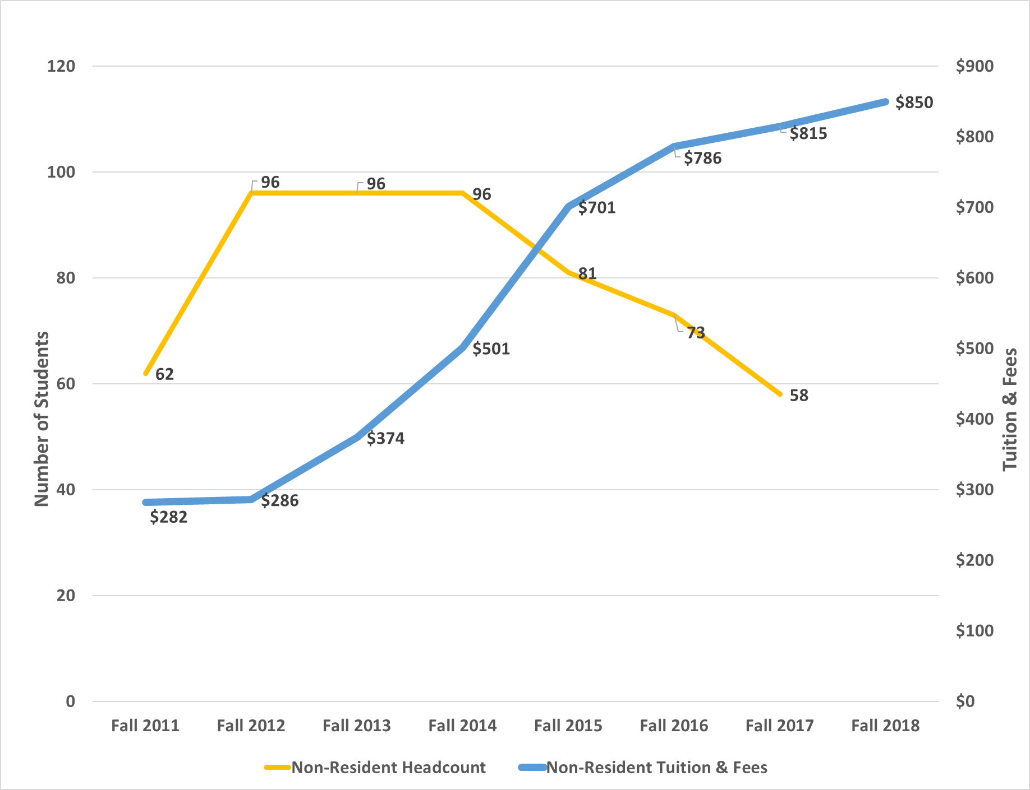
On-line Non-Resident Graduate Tuition vs. Enrollment Headcount
Since the phase-in increase of on-line non-resident graduate tuition began in the Fall of 2013, there has been nearly a 40% decline in enrollment headcount through the Fall of 2017.

Slide 5
Market Comparrison

Slide 6
Recommendation: 2019-20 On-line Non-Resident Graduate Tuition
The Administration recommends that the Board of Trustees consider setting the per credit hour tuition for on-line, non-resident graduate tuition for the 2019-20 academic year at a rate so that UW’s tuition and fees per credit hour is in line with the median tuition and fees per credit hour of the market peers.
About HEPI
The Higher Education Price Index (HEPI) is an inflation index designed specifically for use by institutions of higher education. Compiled from data reported by government agencies and industry sources, HEPI measures the average relative level in the price of a fixed market basket of goods and services purchased by colleges and universities each year through current fund educational and general expenditures, excluding research. A more accurate indicator of cost changes for colleges and universities than the Consumer Price Index (CPI), HEPI is used primarily to project future budget increases required to preserve purchasing power.

Slide 7
Strategic Direction - Education
Step 1
  Increased enrollment
    Demand increase
    Out of state market development
  Revenue Generation
    Transparency of price in the marketplace
    Removal of Higher Education “sales” tactics
Step 2
  Profile Improvement
    Increased opportunity for academic talent
  Retention
    Enrollment through increased persistence
  Academic efficiency

Slide 8
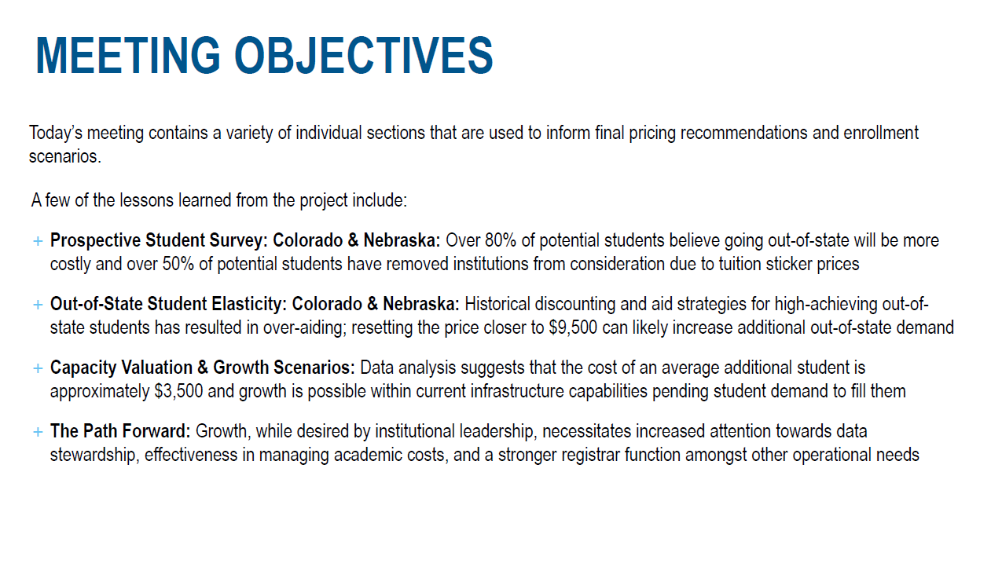
Strategic Direction – Huron Recap

Slide 9
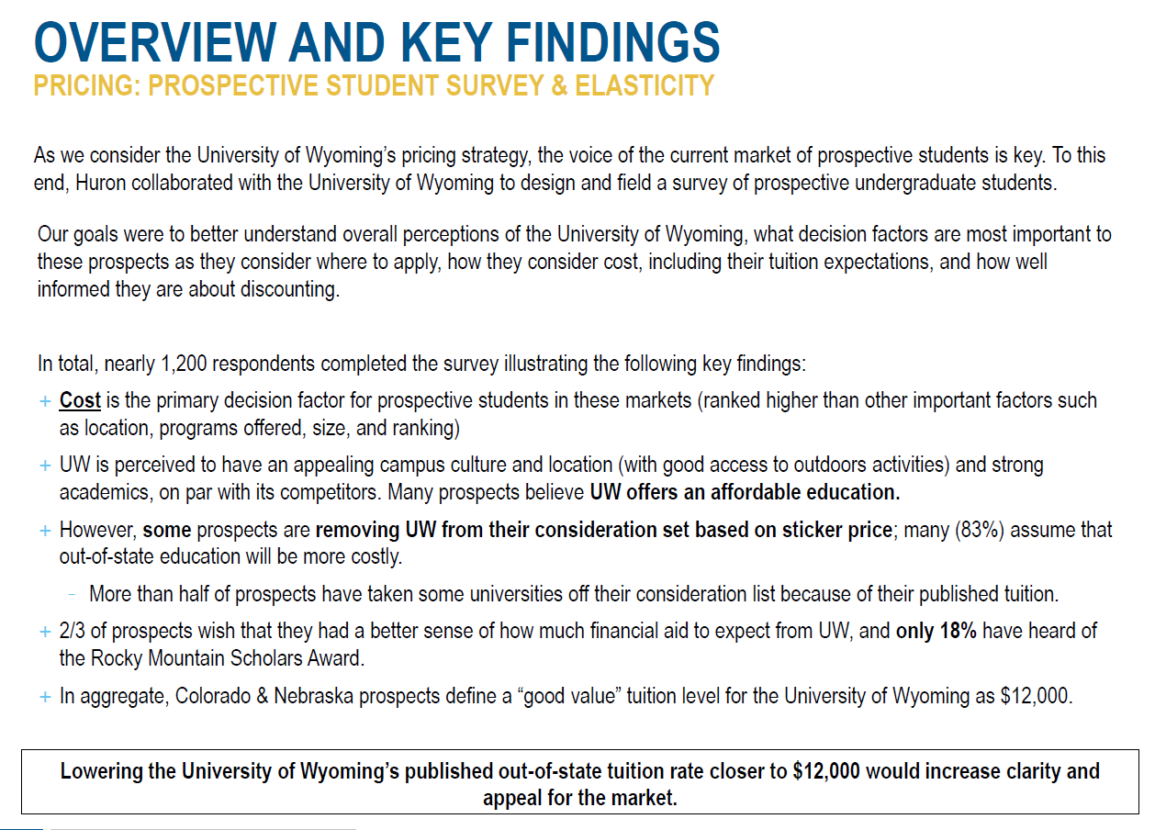
Strategic Direction – Huron Recap

Slide 10
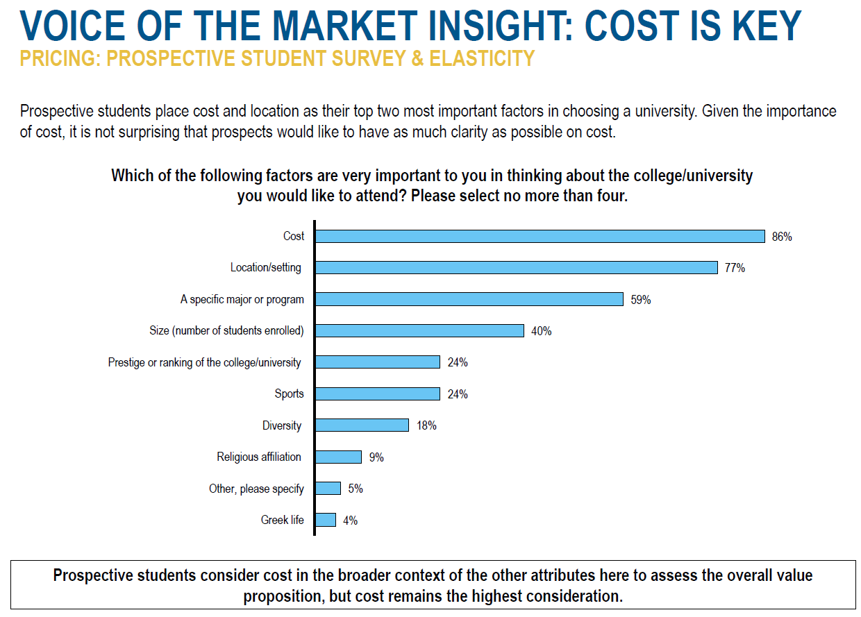
Strategic Direction – Huron Recap

Slide 11
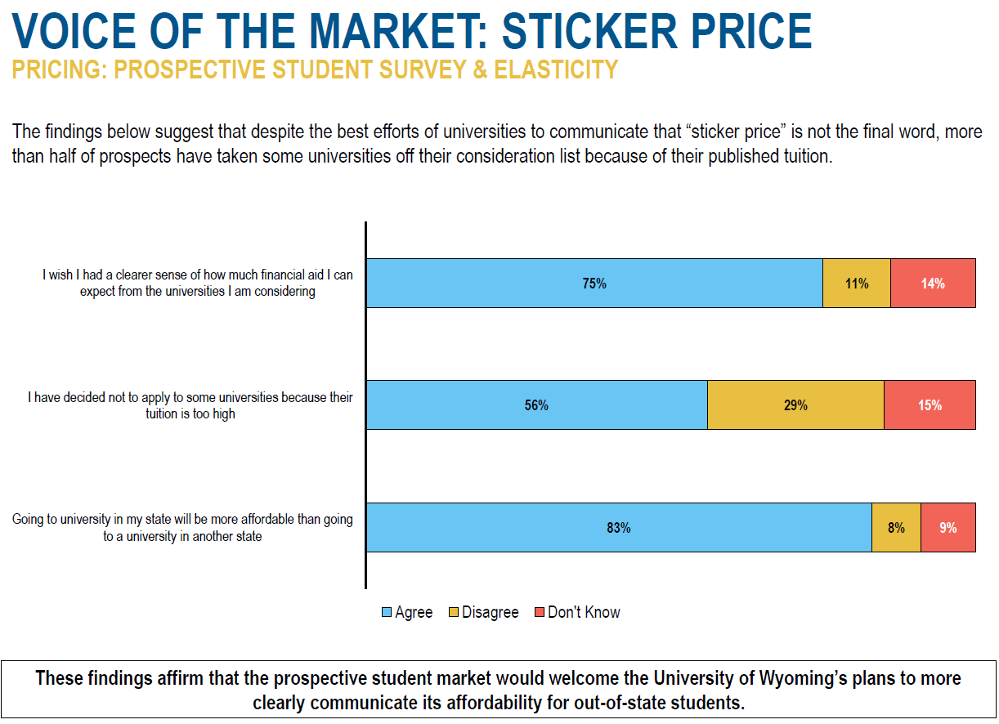
Strategic Direction – Huron Recap

Slide 12
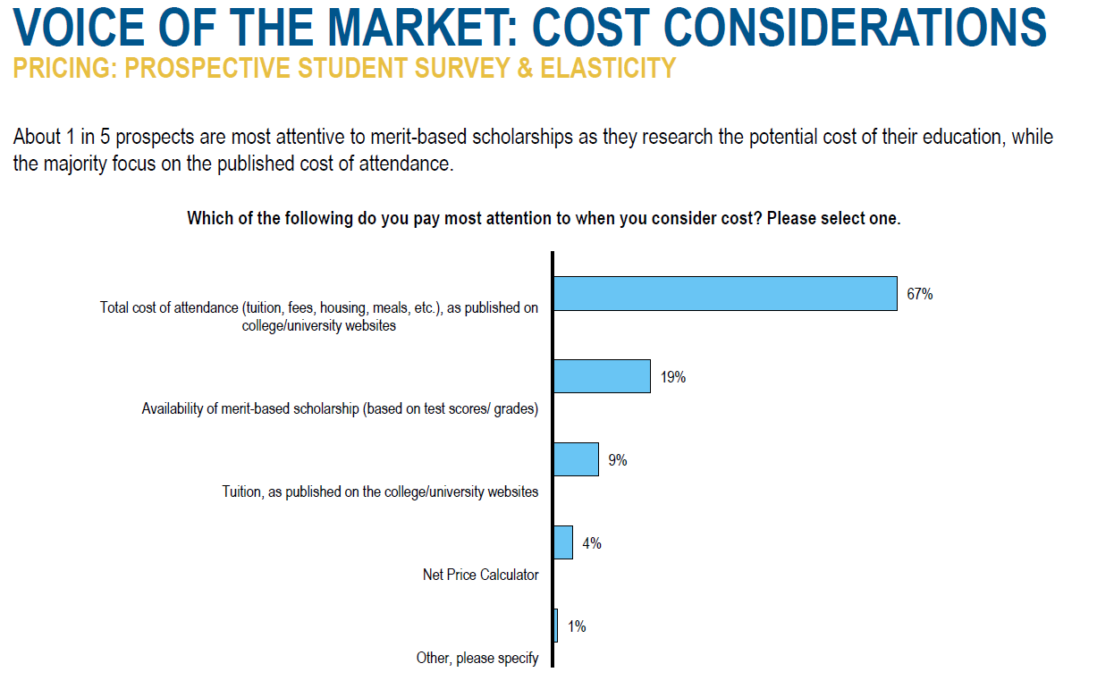
Strategic Direction – Huron Recap

Slide 13
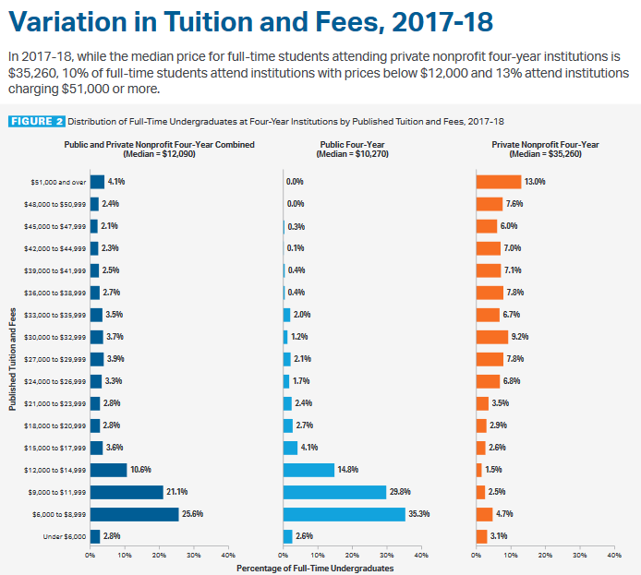
Market opportunity
Current UW market share – 10% drop from next market
Right pricing increases market share opportunity
Notes:
Sticker price is the driving force behind recruitment opportunities

Slide 14
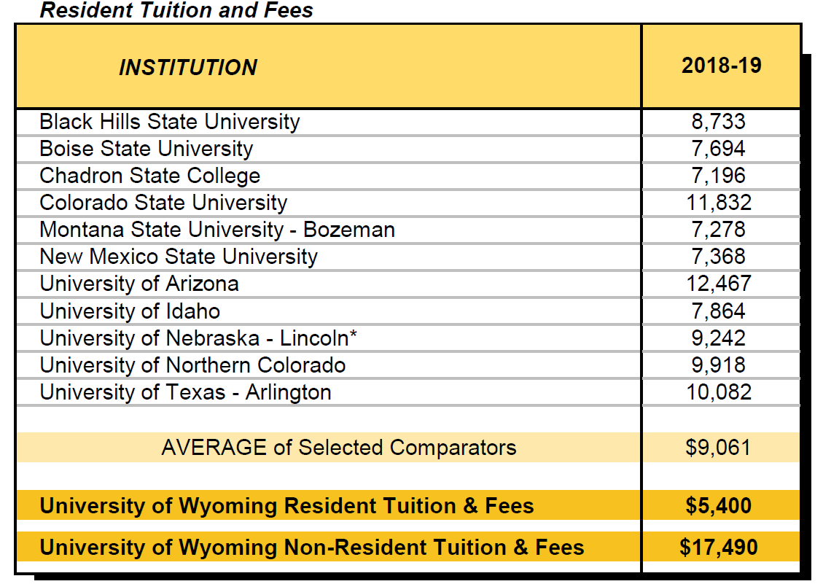
Summary - comparison to competitors

Slide 15
Additional background – current and suggested tuition
 | Current Tuition | Administration Recommendation | BOT Tuition Policy of 4% Increase
 | 2018-19 AY (FY2018) | If implemented for 2018-19 AY (FY2019) | 2019-20 AY (FY2019)
 | (Per Credit Hour) | (Per Credit Hour) | (Per Credit Hour)
Undergraduate Non-Resident Tuition | $534 | $400 | $417
ONLINE Graduate Non-Resident Tuition | $780 | $TBD | $TBD
Notes:
Update with New Slide - Alex

Slide 16
Administration’s draft recommendations
Non-resident focused tuition evaluation
  Re-set non-resident undergraduate tuition rate
    Establish cost conscious and nationally competitive rate
    $400/ch for non-resident undergraduate
  Re-set non-resident ONLINE graduate tuition rate
    Establish cost conscious and nationally competitive rate
    *$#00/ch for ONLINE non-resident graduate rate
* Online Graduate pricing recommendation has not been finalized – further analysis is needed. NO Recommendation o of ONLINE graduate pricing is being made
Notes:
What is our online graduate proposal?

Slide 17
Financial Impact
Refer to Non-Resident Undergraduate Tuition Pricing for 2019-2020 Academic Year (FY2020) spreadsheet for financial impact analysis
The Administration’s recommendation for non-resident undergraduate tuition re-set recommendation for the current (2018-2019) academic year would have been: $400/credit hr.
Annual Tuition (@ 30 Credit Hours) | $16,080 | $12,500 | $12,000 | $11,500 | $9,500
Cost Per Credit Hour | $536 | $417 | $400 | $370 | $316
Moving to a non-resident tuition of $400/credit hour ($12,000/year for 30 credit hours) for Fall 2018 would result in an estimated two year plan for implementation solvency. UW recommends use of university reserves over a two year period to honor existing institutional commitments. Continued dedication of $3.5M-$4.0M from the reserve to maintain existing discount/waiver for existing full-time, non-resident undergraduate students who are currently paying an Average NTR less than $12,500.

Slide 18
Administration’s proposed timeline
July 2018 | Presentation to BOT of tuition reduction recommendation
August 2018 | Public comments
September 2018 | Set tuition rates for 2019/2020. Adopt timeline for establishing tuition and recommend establishing timeframe and guidelines for new annual tuition increase
Notes:
Update to new timeline

Slide 19
Questions?

Slide 20
Appendix

Slide 21
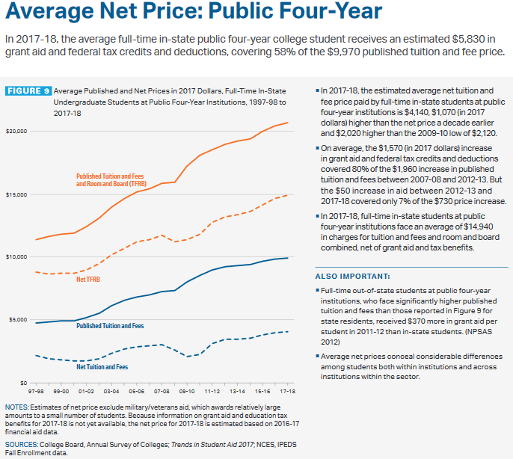
Market opportunity
Notes:
Pricing cloudiness
clear and transparent pricing
increasing out scholarshiping opportunities through the Foundation

