Slide 1

Recruitment Direction
July 12, 2018

Slide 2
Enrollment Projections
First year students | 5685 applications ▲ 27.27%* 1705 enrolled ▲ 6.5%*
Transfer Students | 1779 applications ▲ 13.02%* 674 enrolled ▲ 21.22%*
Returning Students | 284 applications ▲ 37.2%* 127 enrolled ▲ 18.69%*
Graduate Students | 2,522 applications ▲ 12.84%* 387 enrolled ▲ 8.71%*
New First time Freshmen | 1750 ▲ ~3%^
New Transfers | 1140 ▲ ~5%^
Federal Total | 12,#00 ▲ ~2.5%^
*As compared to Fall 2017 enrollment at this time last year. ^As compared to Census day Fall 2017

Slide 3
Pressing Recruitment objectives
Marketing:
Increasing demand
Market developments
  California – 127% yoy increase in enrolled students
  Nebraska – 61% yoy increase in enrolled students
Communications overhaul
  Inbound Marketing and redirect campaign
On campus lead development
Cross campus integration of lead collection
Centralize name collection
  EM support to program level recruitment efforts

Slide 4
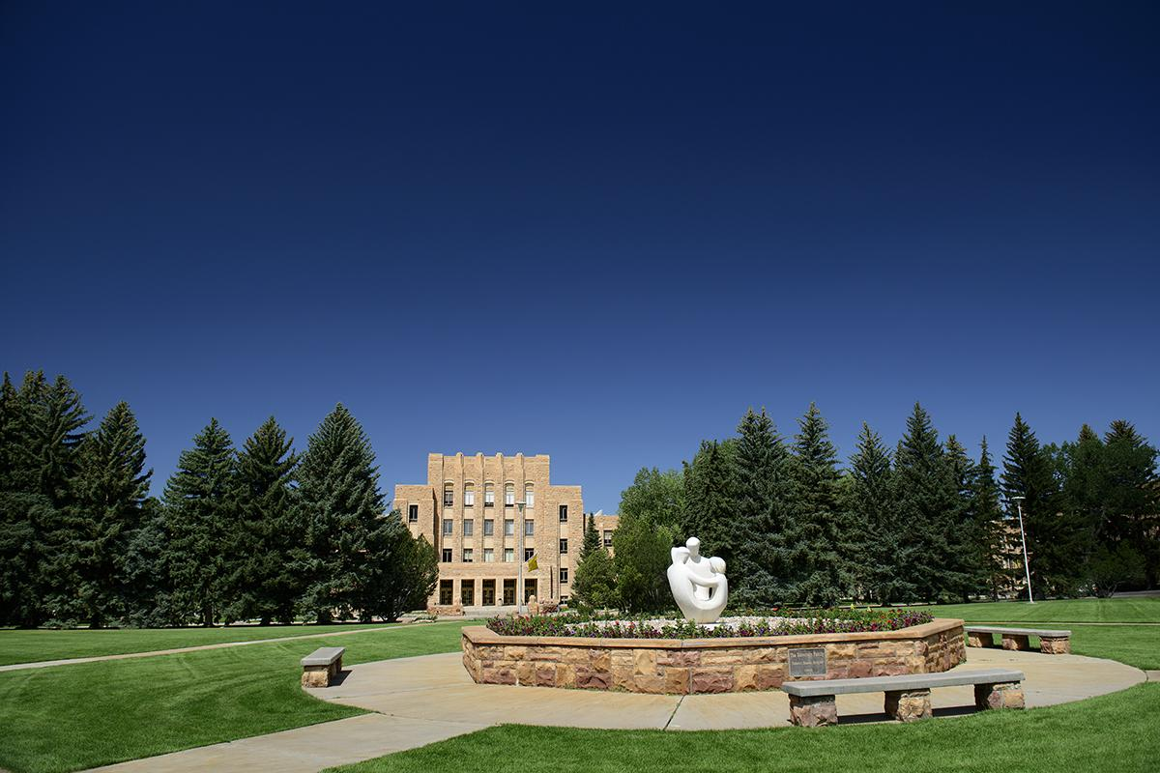
Pressing Recruitment objectives
Systems and Policy
Replace antiquated systems
  Develop queues and pathways for follow up and completion of requests
  Standardize student experiences across the academic plateau
Policy Review
  Remove institutional barriers to student enrollment – ie COE
  Centralize and empower Policy within the Office of the Registrar
Office of the Registrar complete overhaul
Update and revise PDQs
Mandate automation and systemize process
  Transcript evaluations
  Online Course Catalog

Slide 5
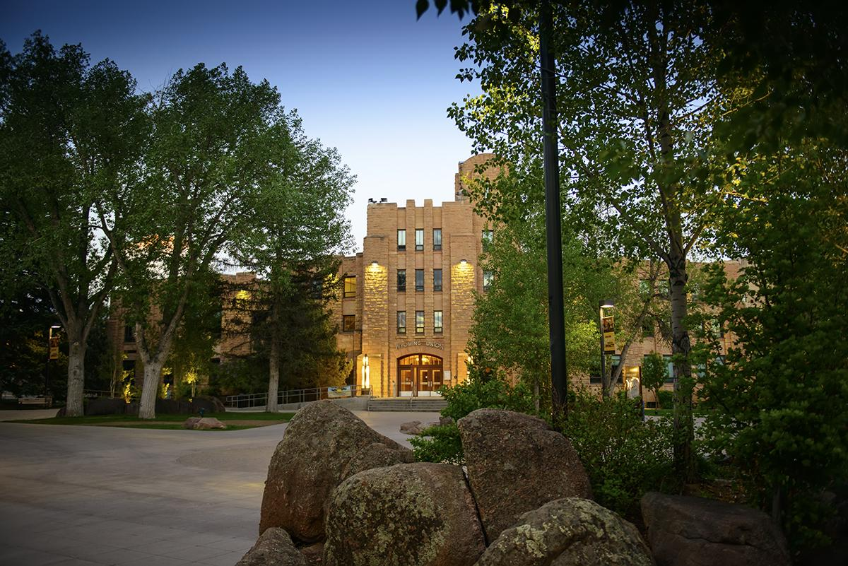
Pressing Recruitment objectives
On Campus event revisions
Optimize planning and stakeholder involvement
  Time of year, focus and implement takeaway
  Stackable experiences
Invest and focus on daily Campus Visit experience
Increase enrollment yield of daily campus visits
  Currently at 44% (56 / 100 seniors who visit decide to not attend)
Increase number of daily campus visits
  Average # of campus tours is 1200
  National data + tours #s should equal freshmen applications
Utilize campus visit as funnel progression tool
  Apply the theory of X+1

Slide 6
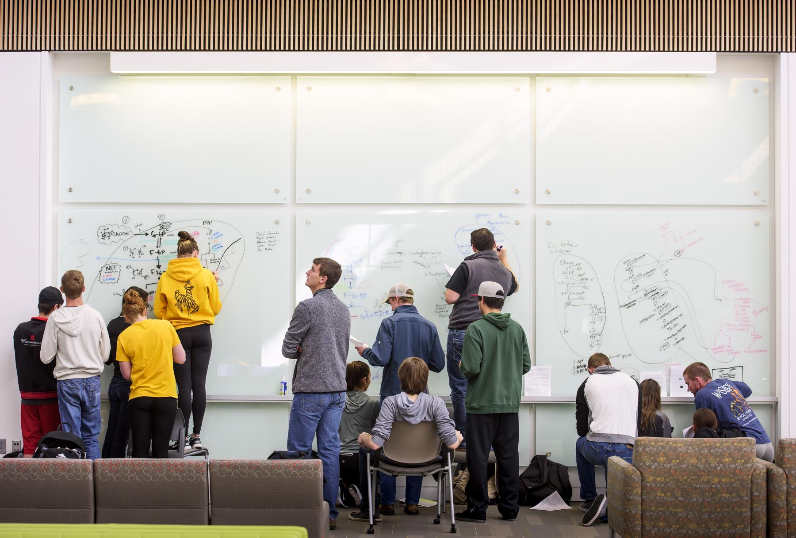
Pressing Recruitment Objectives
Invest and focus on daily Campus Visit experience – Continued
Build relationships
  Know who is visiting before they arrive
  Find ways to develop and build upon relationships
Foster belonging
  Pronoun use
  Continued campus visit engagement
Provide Authenticity of the Student Experience
  Where do students spend their time

Slide 7

Incorporating “Alexa” questions
Energize Daily Campus Visit
Where will I sleep?
Who will I study with?
Where will I eat?
How will I get involved and meet new people?
Where will I study?
How do I choose a field of study?

Slide 8
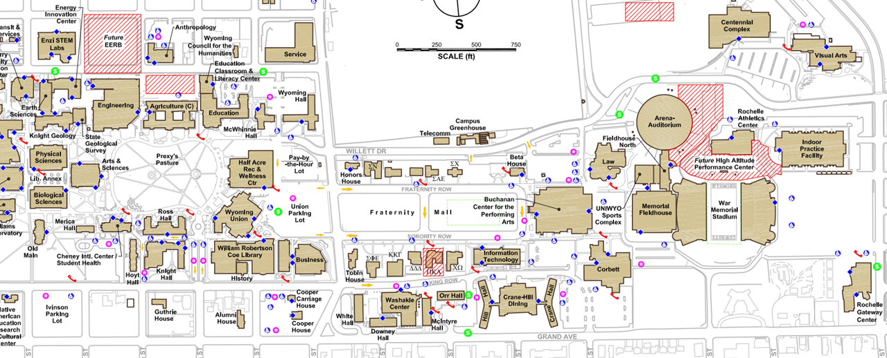
Current Tour Route

Slide 9




Current Tour Route
2 hours
>5 miles
NO time for academic buildings

Slide 10
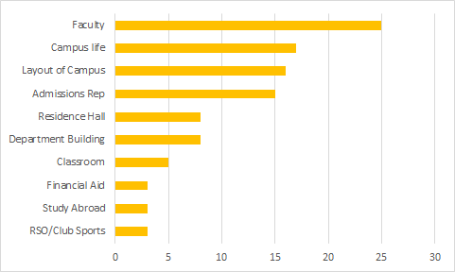
What was the most beneficial part of your campus tour?
Notes:
Survey was compiled from 103 responses.
Make point that no students indicated athletics was a part of their tour wants/expectation

Slide 11


Revising the Campus Tour Experience
Focus on the center of campus and student activities to:
Build better relationships, foster belonging, and incorporate an authentic UW experience
Reframe the Marian H. Rochelle Gateway Center experience to better showcase its value and purpose creating a “signature moment”
Expose visitors to realistic, daily, student, and academic experiences

Slide 12
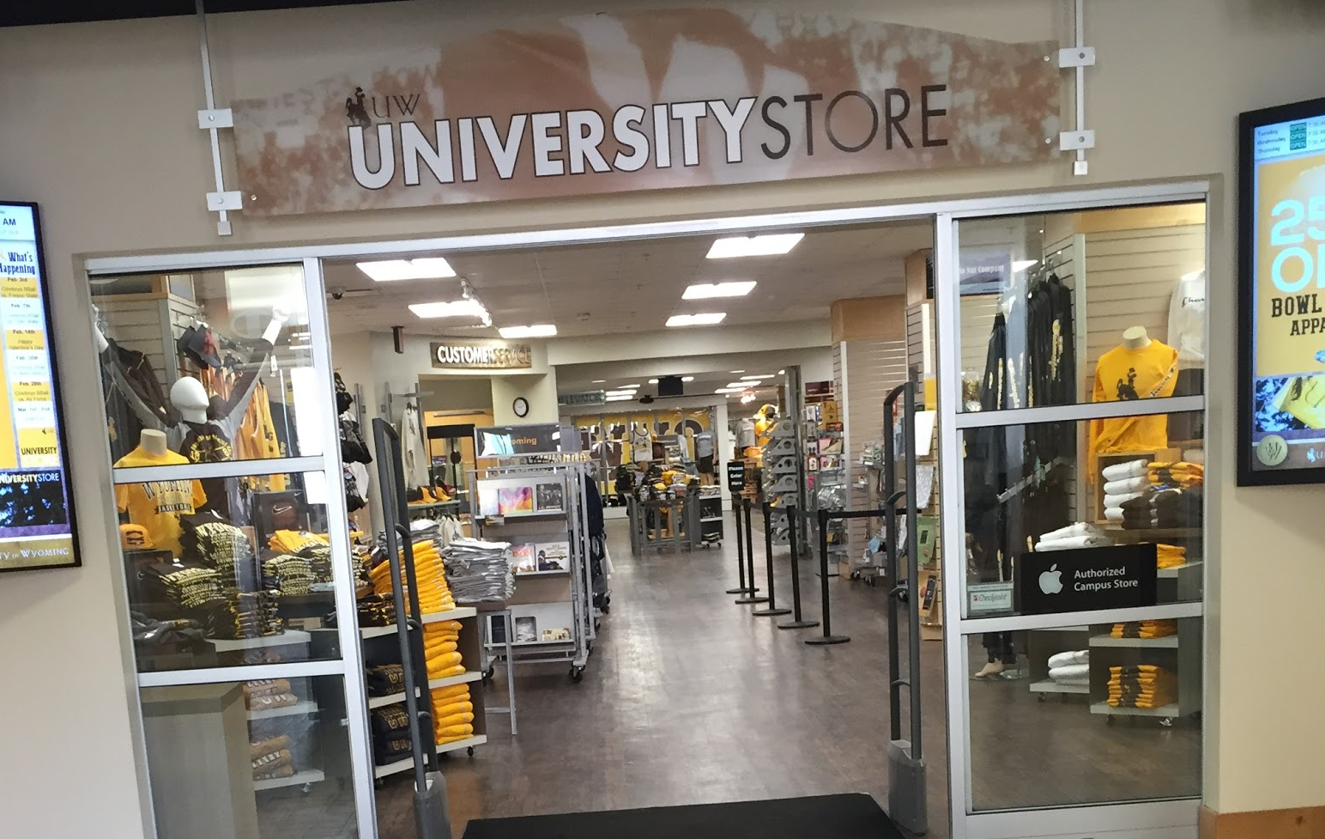
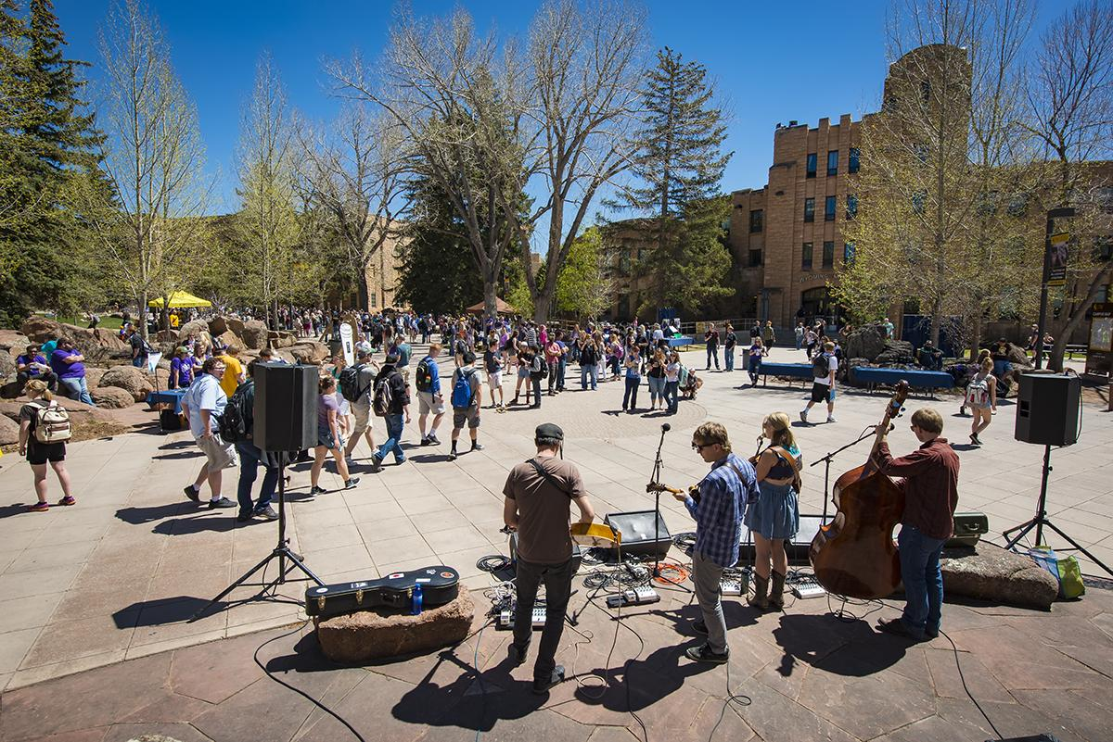
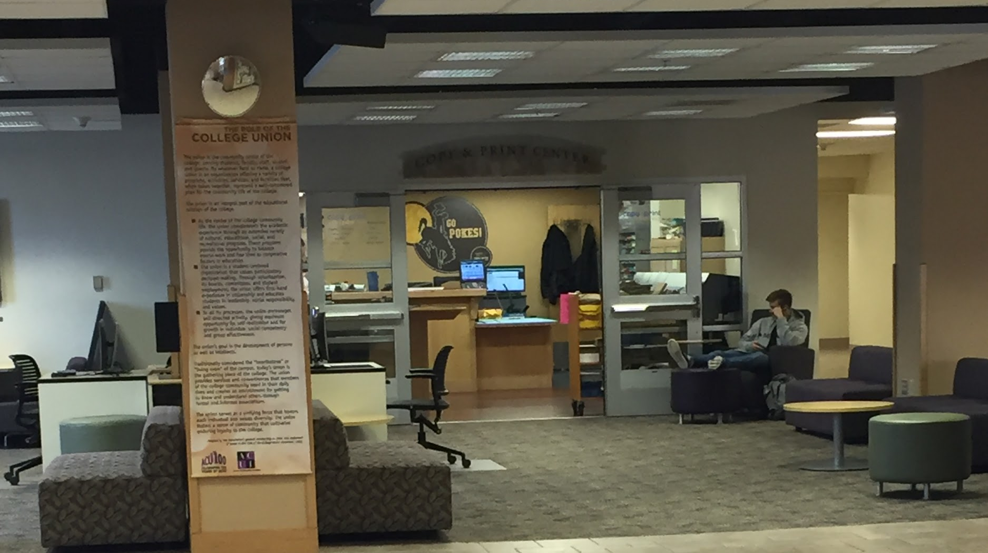
Relocation: Benefits of the Student Union
Waiting area will be engaging for current students and prospective students
Prospective students will be able to engage with current students
01
03
Students, Staff and Faculty engaging with one another
RSO’s are tabling
02
Students will be able to spend more time on main campus
Students will be able to see more academic opportunities
Notes:
Need to cut down on wording

Slide 13
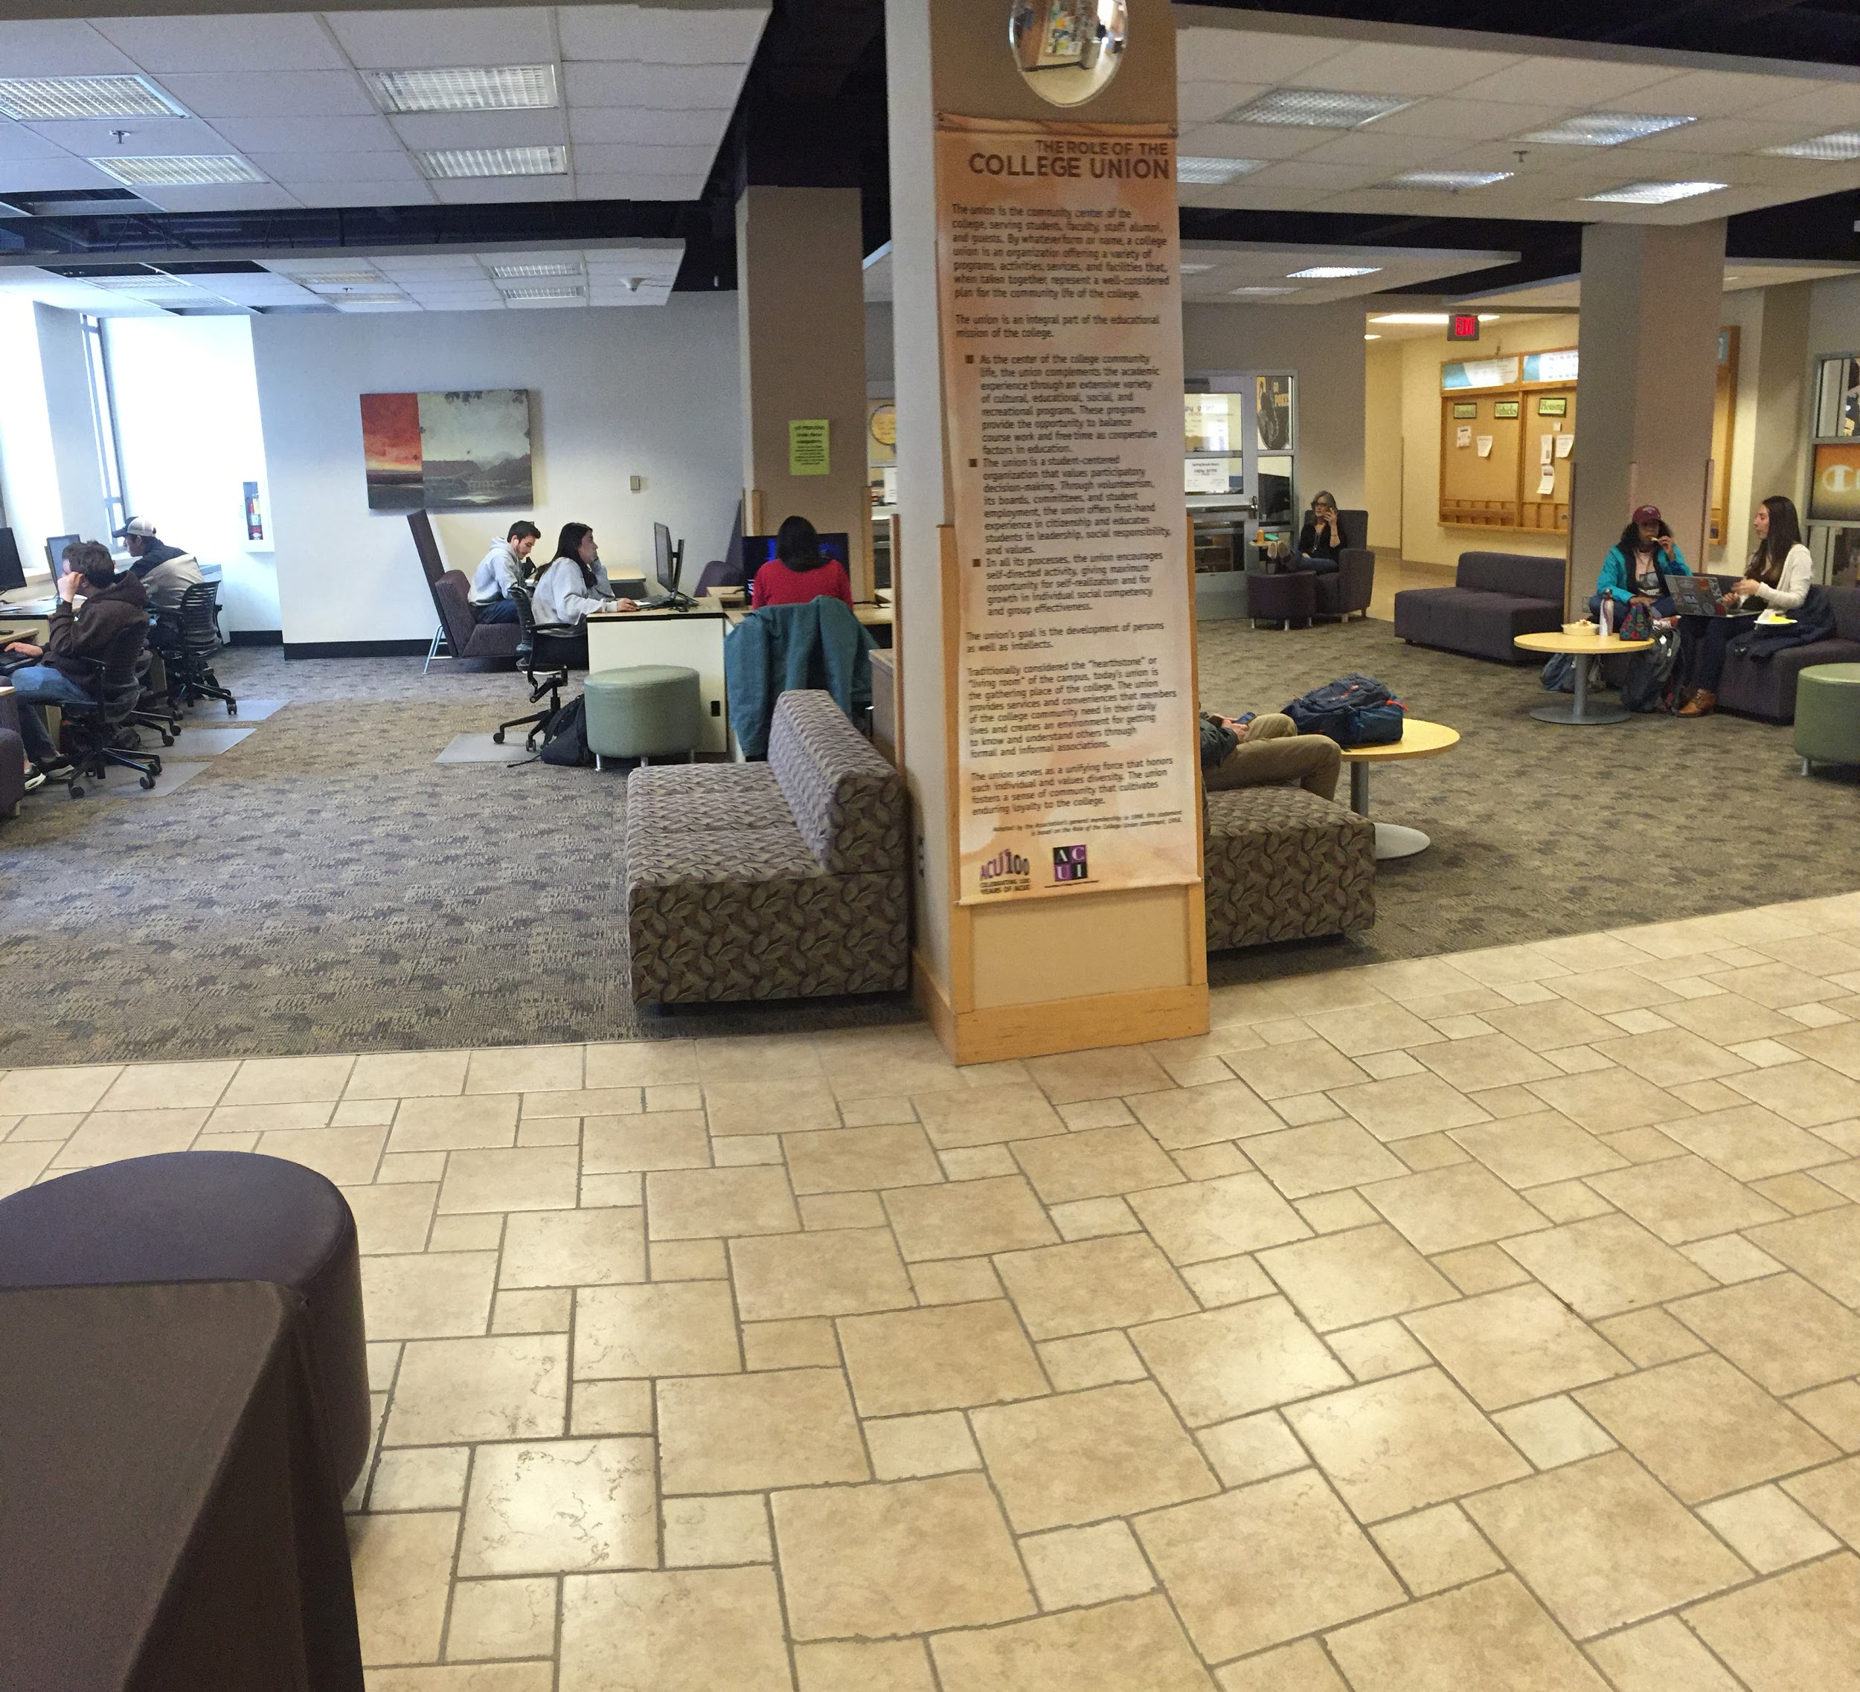
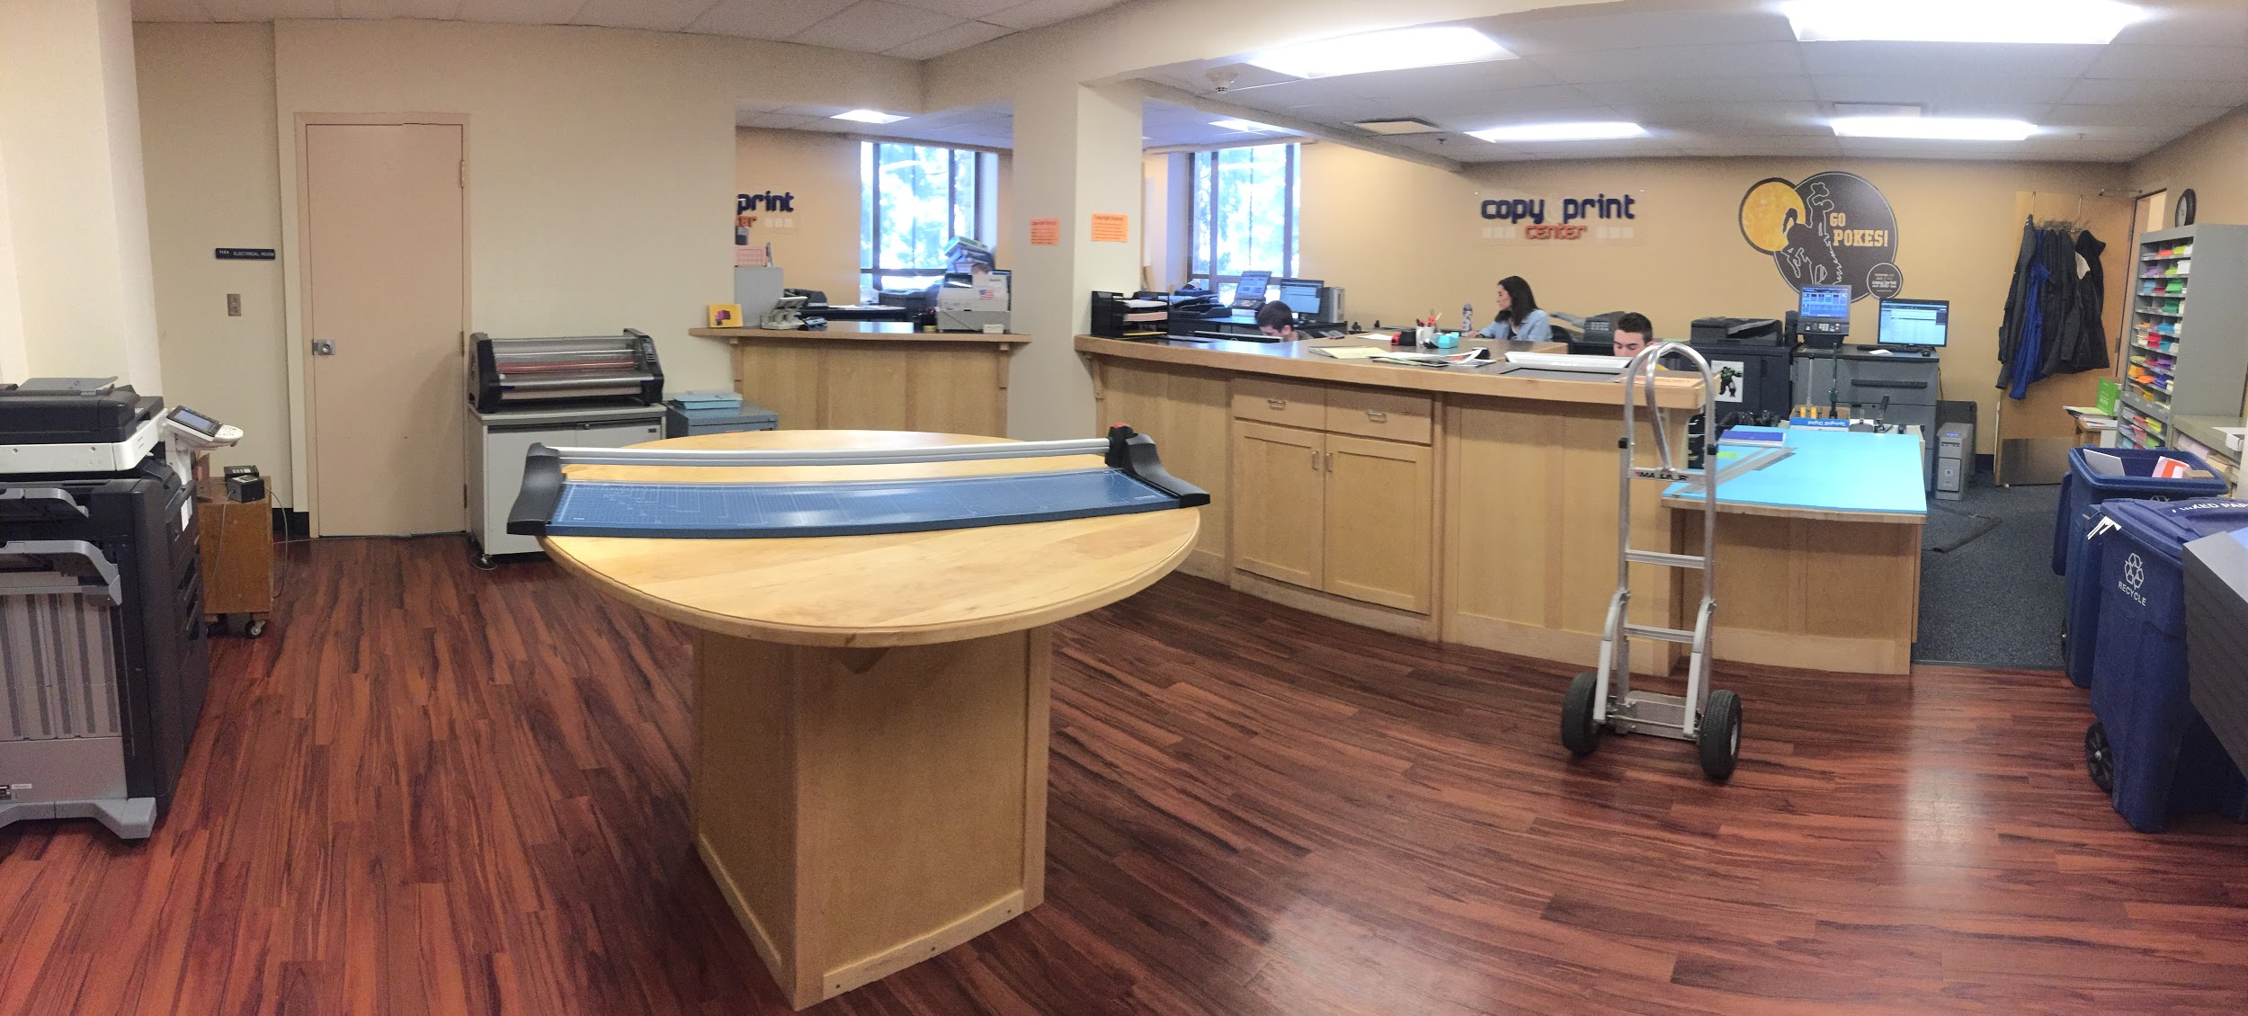
Location, Space and Immersion into UW Student Life

Slide 14
Upgraded Tour Route
Bus Route
Athletic Tour
New Tour Route

Slide 15
Upgraded Tour Route
1 hour
1.2 miles
Plenty of time for academic and activity inclusions

Slide 16



Fundamental Need
A true UW experience
Shorten the physical demand when touring @7220
Center visits around students
Develop Marian H. Rochelle Gateway Center Signature Moment

Slide 17
Yield Strategy
Launch of Cowboy Joe
  2,943 Students Texted
  9.5% opt-out
Week One engagement
  10% unique student engagement
  22,360 messages
  97% correctly handled by CJ
  Knowledge base 1,088 answers
Dynamic messaging- student time

Slide 18
Recruitment Direction
July 12, 2018

