Slide 2
CAMPAIGN PURPOSE
Help meet UW’s enrollment goals by engaging and converting future UW students.
Achieve pieces of Goal 4 in “Breaking Through: 2017-2022” – “develop a comprehensive branding, public relations and marketing campaign” and “effectively communicate UW’s opportunities to prospective students, regional partners and national and global markets.”
Engage and rally the UW community to help tell UW’s story.

Slide 3
MATERIALS IN HAND FROM
VICTORS & SPOILS
Campaign guide, including design guidelines.
Media purchase plan (Supply).
Anthem video and shorter versions.
Radio spots.
Digital and print ads.
Research results on campaign effectiveness.

Slide 4
CAMPAIGN EFFECTIVENESS
Tested by a professional marketing research firm among a national sample of 15-18-year-olds who are likely to apply to a four-year university.
Included a statistically significant number of African-Americans, Hispanics and Native Americans.

Slide 5
CAMPAIGN EFFECTIVENESS
Before the respondents viewed the campaign video, 25 percent said they definitely or probably would consider UW, and 25 percent indicated they definitely or probably will apply. Among ethnic respondents, the numbers were 36 and 33 percent, respectively.
After viewing the video, 48 percent of the national sample said they definitely or probably would consider UW, and 41 percent they definitely or probably will apply. For ethnic respondents, the numbers were 53 percent and 48 percent, respectively.
Research firm’s description of those numbers:
“Very significant. There’s lots of reasons to believe the campaign idea is quite compelling and motivating.”

Slide 6
PERCEPTIONS OF ‘COWBOY’
Some 68 percent
of national respondents and
56 percent of ethnic respondents said viewing the video changed their perception of what it means to be a cowboy. Among the comments from those respondents:
“Everybody can be a cowboy.”
“Cowboys aren’t just males. A cowboy is anyone who is strong, smart, persistent.”
“I no longer just think of the Marlboro Man and see this differently. A cowboy now is someone who takes chances, tries to improve things and is outgoing.”
“A cowboy is someone blazing a new trail and seeking new experiences.”
“The video helped me to understand that the school is much more modern than I imagined.”
“A cowboy is not just some guy in a cowboy hat.”

Slide 7
AN INCLUSIVE CAMPAIGN
Before the survey respondents viewed the campaign video, 36 percent of the overall sample (41 percent of ethnic students) agreed that UW is “a university rich in diversity.
After viewing the video, those numbers rose to 58 percent for both sets of students.
Research firm representative’s description of that change in perception: “really amazing.”

Slide 8
TRANSITIONING FROM
VICTORS & SPOILS
Contract ready with Supply to continue media buys.
Contract being prepared with Danielle Fuller for overall campaign guidance.
Pending engagement with consultant on unpaid social media.

Slide 9
INTERNAL PREPARATION
Work underway with Admissions to create branded recruitment materials (examples).
Brand Camp for UW marketers, communicators and recruiters July 17.
Meetings with Foundation, Alumni Association, Student Affairs and Athletics reps to coordinate efforts.
Creation of brand portal for units to use in ordering recruitment materials.
Redesign underway for key UW web pages.
Creation of landing pages tied to advertising campaign.

Slide 10
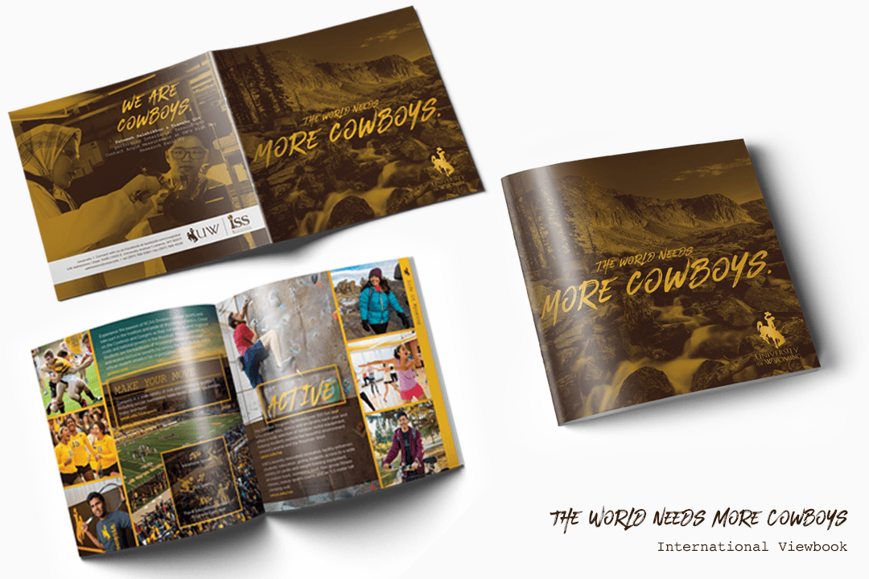

Slide 11
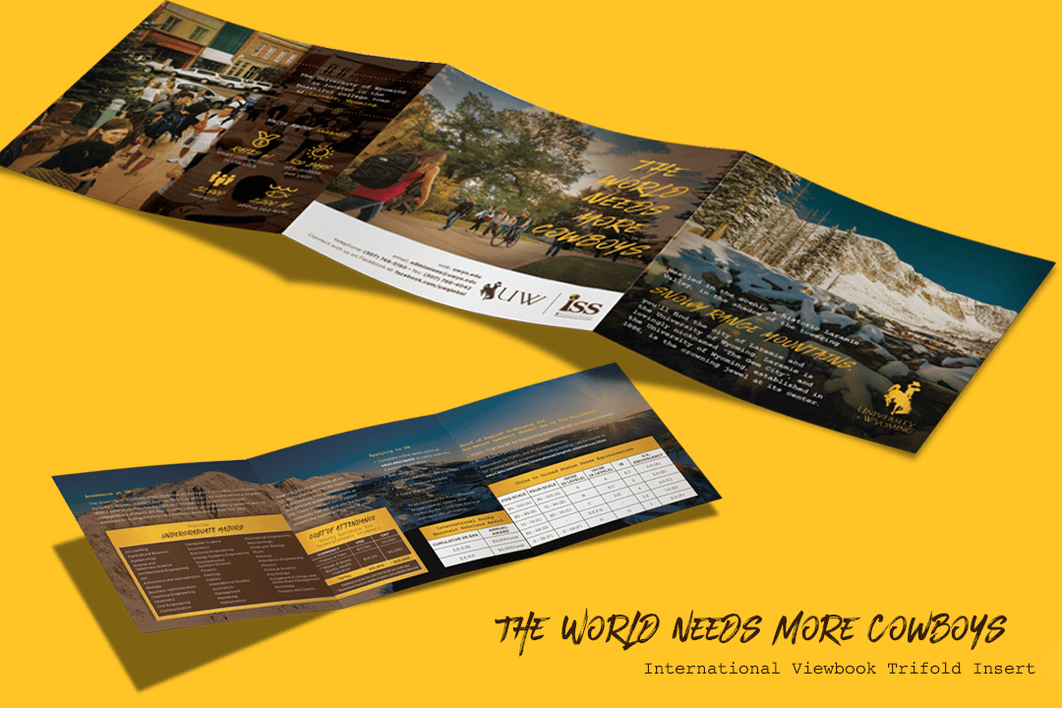

Slide 12
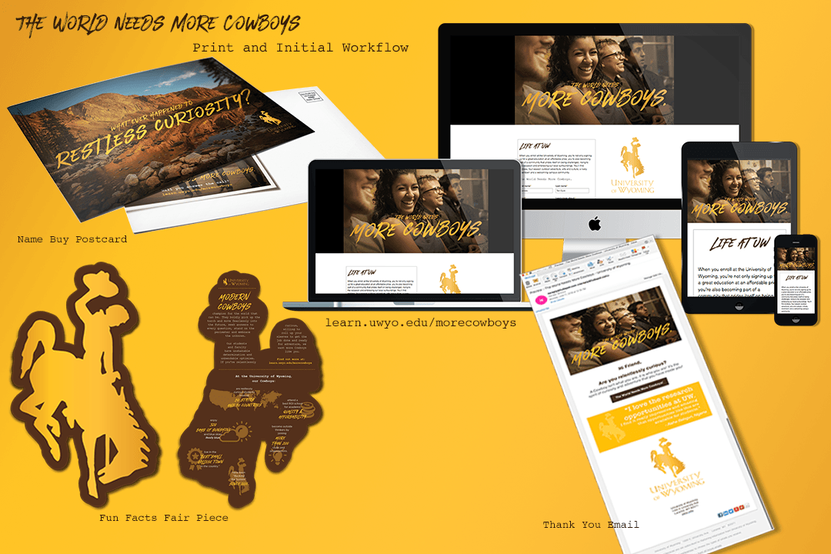

Slide 13

BRAND CAMP AGENDA ITEMS
Campaign theme and concept.
Campaign guide directions on visuals and wording.
Brand portal.
Social media strategy.
Opportunities to participate – websites, content creation, wraps, events, etc.

Slide 14
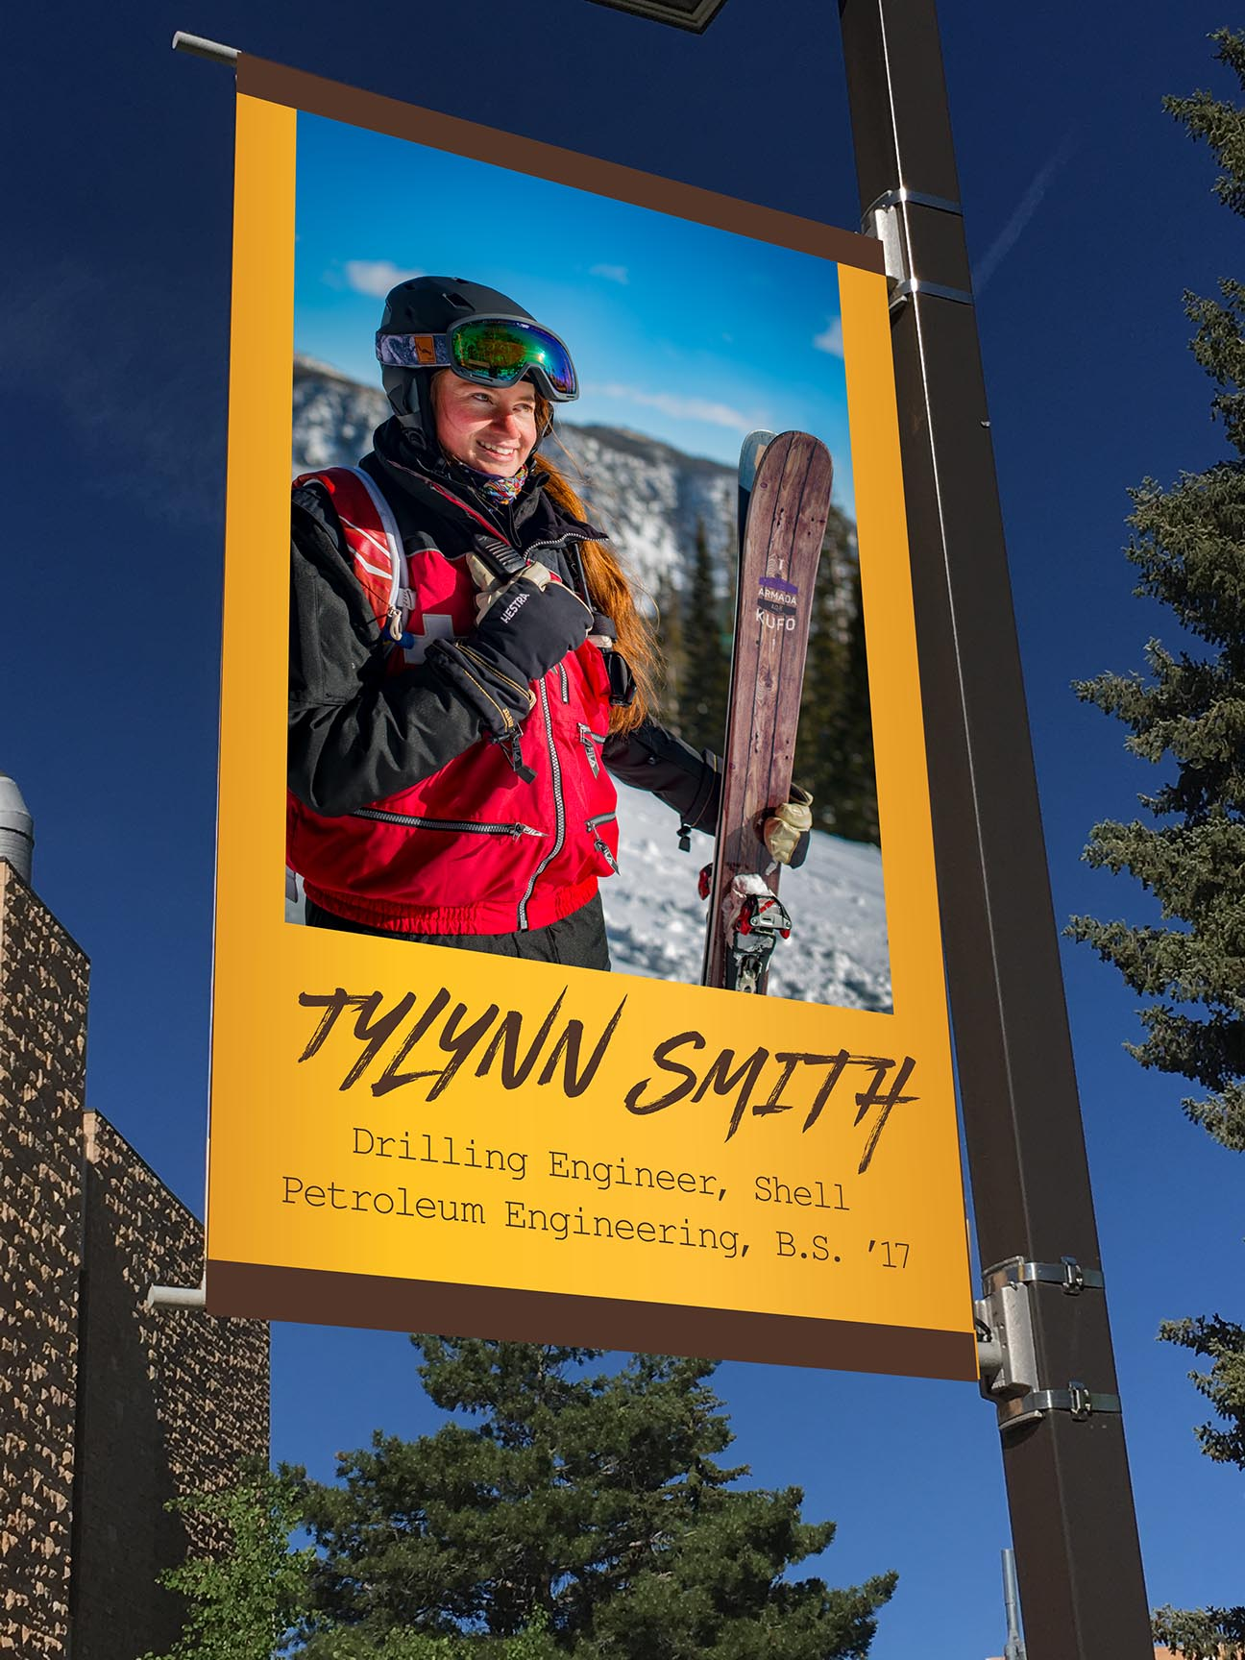
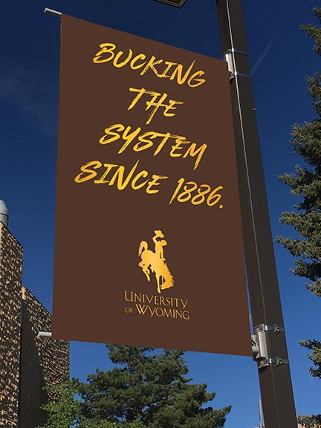
WHAT’S HAPPENING BEFORE SEPT. 14
Admissions materials designed with TWNMC look and feel.
Some digital advertising presence in late August.
Campus banners go up in August.
Campaign video airs on
TV during Sept. 1
and Sept. 8 football
games.

Slide 15
PAID MEDIA
Paid search – Google, Bing.
YouTube video.
Facebook, Instagram, Snapchat.
Pandora Radio, Spotify.
Everything above prospecting in Washington, California, Colorado, Utah, Arizona, Texas and Wyoming; retargeting is national.
Television ads in Colorado, Wyoming, Nebraska.
National FFA magazine, FFA conference.
Billboards at Cheyenne, Laramie, Casper, Gillette, Sheridan, Riverton, Cody, Evanston.
Townsquare Media, SVI media.
UNPAID MEDIA
Social media – strategy to be developed with consultant.
News coverage of campaign launch.

Slide 16
SEPT. 14 LAUNCH
Press conference.
Kickoff event – Downtown Mash Up.
Website changes are live.
UWyo magazine with TWNMC theme.

Slide 17
DOWNTOWN MASH UP INVOLVEMENT
UW is title sponsor for $3,000 – from campaign budget.
UW buses to transport students to and from downtown.
Unveiling of anthem video.
Live bands.
Participatory programming – social media scavenger hunt,
art project, customized swag, etc. Budget being developed.

Slide 18
PRESENCE ON CAMPUS
Banners.
Bus wrap(s).
Building wraps.
Merchandise in
University Store.
Student involvement ideas to be explored
Interactive Snapchat filters.
Instagram GIF stickers.
Photo booth in Union breezeway.
Promotion of Mash Up and campaign at Cowboy Connect events.
Use of Cinebody app.

Slide 19
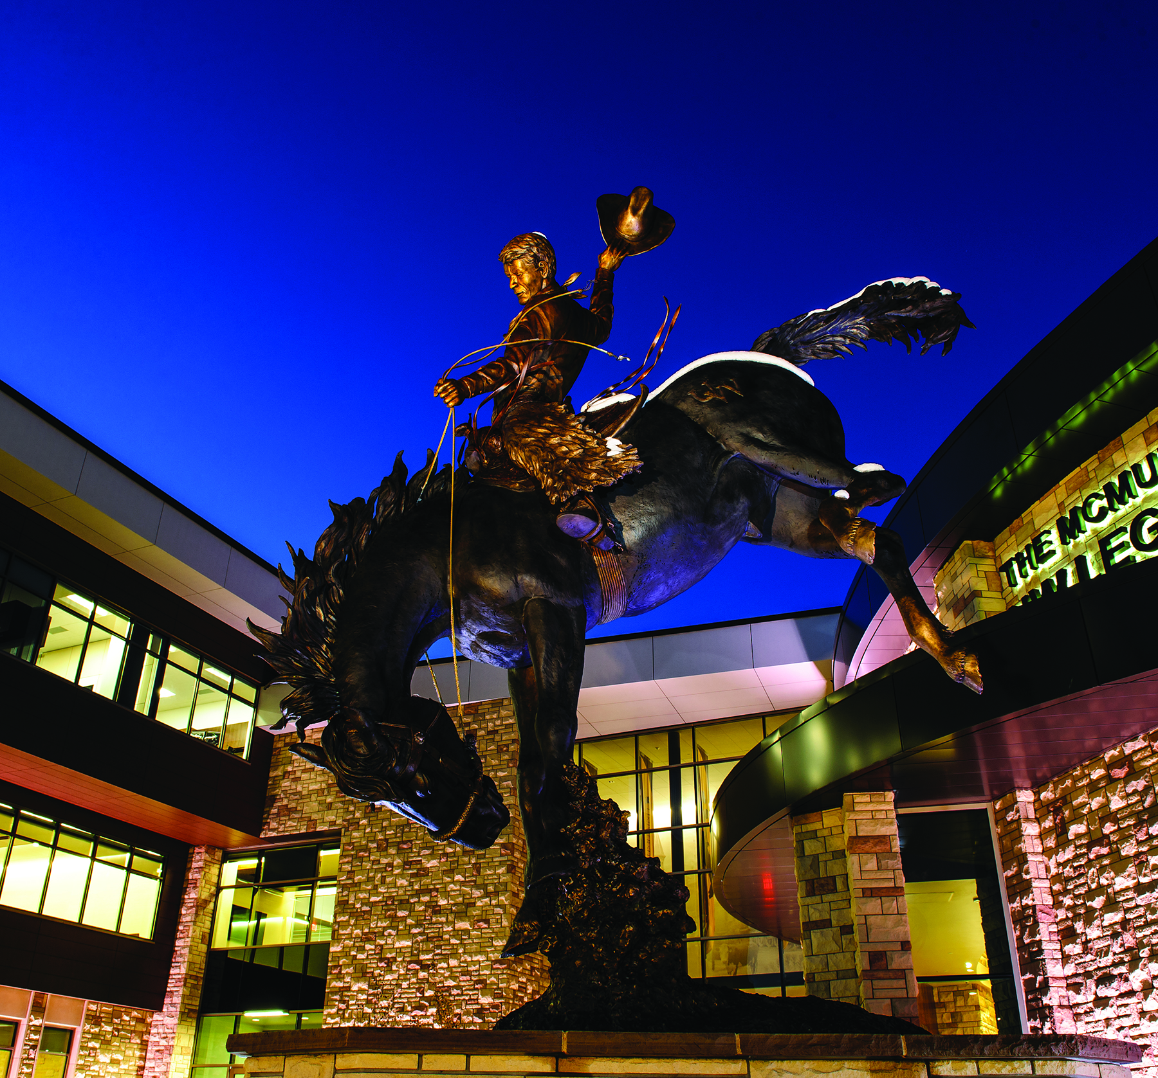
UW FOUNDATION PARTICIPATION
Incorporate branding and messaging into social media, stewardship reports, and major gift proposals.
Incorporate into Marian H. Rochelle Gateway Center exhibits.
Weave messaging into narratives for publications.
Match website design changes
for UW Foundation website.
Banners on light poles near the
Marian H. Rochelle Gateway Center
(if funding is available).

Slide 20
FOLLOWING SEPTEMBER KICKOFF
Additional videos released over the year.
Homecoming theme is TWNMC.
Printing of “Look Book.”
Discussion of what to do
with second year of campaign.

Slide 21
