Slide 1
UPDATE ON COURSE SCHEDULING AND CLASSROOM USE
Academic Affairs
Presentation to the Board of Trustees - March 2018

Slide 2
Registrar and scheduling optimization
Challenge | Huron’s recommendation
Seat utilization | Increase seat utilization from 60 to 75-80%
Classroom utilization | Implement policy to conform more course offerings to the “block schedule”
System adoption | Fully implement Banner and Degree Works
Advising support | Identify policy, process, system and staffing bottlenecks
Student analytics and reporting | Designate a lead for the development and deployment of tools and data

Slide 3
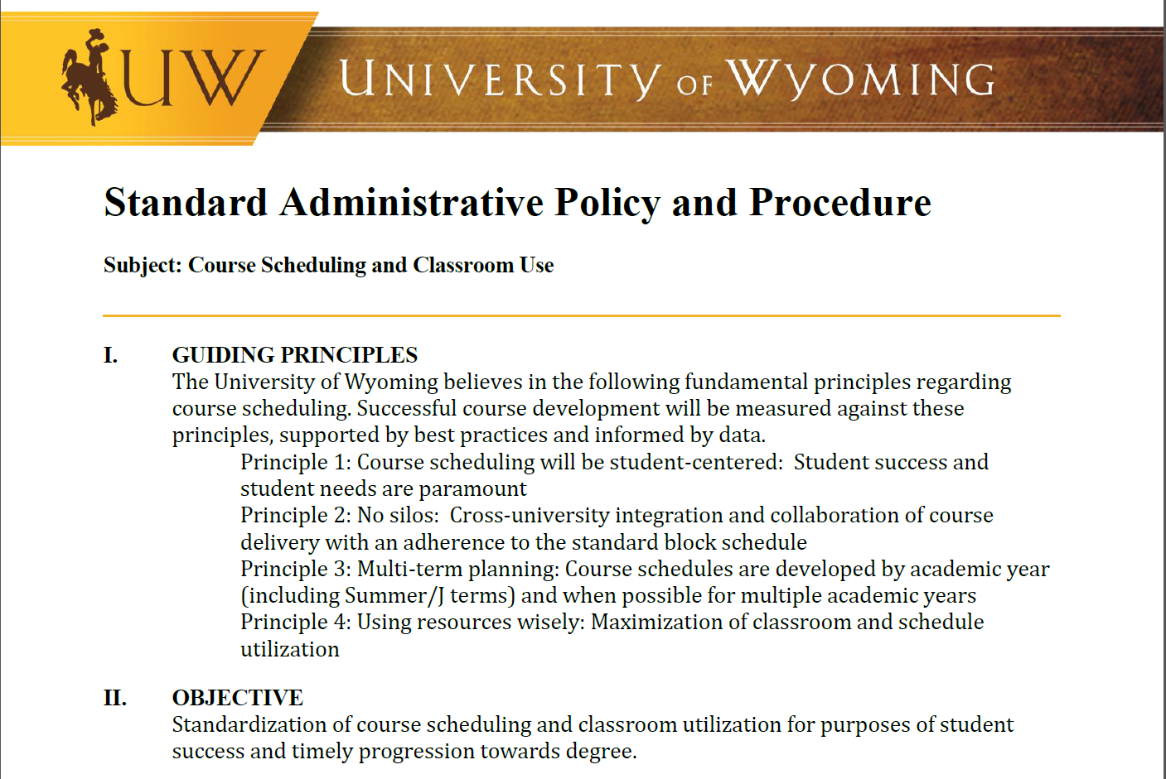
SAPP
Standard Administrative Policy and Procedure
Emphasizes student-centered and cross-university scheduling policies
Addresses course scheduling and classroom use issues identified by Huron
Notes:
Standard Administrative Policy and Procedure (SAPP) for ‘Course Scheduling and Classroom Use’ developed by Provost
· Provost sent SAPP to all deans late January
· Analysis and cleanup to begin for Fall 2018 schedule, with more thorough work expected in future semesters
Gives clear direction form the Provost this is the direction and expectation for course scheduling

Slide 4
Seat utilization
Notes:
SAPP also gave direction from Provost to depts to diversify class offerings (which should lead to better seat utilization, correct?)
o 15-50-15-20% goal of class offerings
§ At least 15% prior to 10 am
§ No more than 50% between 10 am and 2 pm
§ At least 15% after 2 pm
§ At least 20% online
o If doesn't make pedagogical sense, then 25-50-25%, without online
By better utilizing the full clock each day, classroom use is spread out, allowing for better sonsumption

Slide 5
Classroom utilization
Non-standard start and end times
Issue
Huron identified 600+ unique start times
Response
430 for undergraduate classes in Fall 2017
Course Management Strike Force
Notes:
Work for Fall 2018 focused on undergraduate classes – less than 6% of all credit-bearing classes
Reduction of number of meeting times which partially-overlap standard meeting blocks, allowing students to better utilize their day
Some classes previously scheduled Mon & Wed 11 am – 12:15 pm rescheduled to Tues & Thurs 11 am – 12:15 pm, which will allow the students to schedule a Mon/Wed/Fri 12 – 12:50 pm class, for example
Allowance for departments to explain why non-standard blocks need to be offered
Kinesiology & student-athletes
Offer classes that end 10 min earlier than the standard time, to allow student-athletes time to get to practice starting at 3 pm; the 10-min adjustment on start time would not actually affect many people, since the start time would be 1 pm and few classes meet over the lunch hour like that.
Studio or seminar classes – to allow additional consolidated time for setup/cleanup and field trips, etc.
Adjuncts or professionals from community teaching & working around their work schedules

Slide 6
System adoption
Incomplete implementation of tools
Needs
Inventory of opportunities
Roadmap for deployment
Champion for their implementation
Response
UW has and continues to improve Banner functionality
Registrar and IT are close to reporting data from DegreeWorks
Student Data Working Group is tackling Canvas
Notes:
Banner
UW has been able to heavily modify Banner functionality to serve students and faculty.
Undeniably there are Banner products which UW could implement, but each would need to be purchased by UW, with ongoing costs, and implementation time.
DegreeWorks
With work between the Office of the Registrar and UW IT, we are getting closer to being able to report data out of DegreeWorks (Electronic Degree Check). Run a degree Audit to be able to predict and forecast what our academic needs are. (14 sections of Chem in the Fall) – also identifies PELL recipients who have enough hours to graduate
Sole product the Registrar uses to evaluate whether any student has completed their degree requirements for the last 4 years.
We have not yet implemented degree plans, in which a student could plug in guesses as to which classes they expect to take in the upcoming 2-3 years, to see if they will graduate.
Don’t recall hearing of any school in Colorado or New Mexico utilizing this functionality either, but I cannot say with absolute certainty that none use it.
Canvas
WyoCourses
Export Grades from Canvas to import into Banner

Slide 7
Advising support
Issues
Coordination among units
Policy, process, system and staffing bottlenecks
Response
Ongoing work by Advising Redesign and Student Success action groups;
Pending formation of a UW Advising Council (March 2018);
Two new positions in the Transfer Success Center (February 2018);
Many other strategic enrollment management projects
Notes:
Additional examples:
Massive coordination and collaboration among units through Huron-suggested advising redesign teams
20.5 professional advising hires
Departments are nominating faculty advisors and mentors
Pulling together a diverse team to develop a plan for advising assessment

Slide 8
Student analytics and reporting
Data-driven decision-making
Needs
Improved analytics
Champion for development/deployment
Ease the manual data burden
Response
Student Data Working Group (ongoing)
Creation of a Data Governance team (Spring 2018)
Cross-unit participation in the Association for Institutional Research’s webinar, “Institutional Culture of Evidence” (February 2018)
Notes:
SDG is working primarily to get better data out of Canvas
Data Governance group will work on data policy and structure

Slide 9
Registrar and scheduling optimization
Challenge | Huron’s recommendation | Actions since January
Seat utilization | Increase seat utilization from 60 to 75-80% | Proposed redistribution of offerings throughout the day
Classroom utilization | Implement policy to conform more course offerings to the “block schedule” | Provost put forth the SAPP regarding scheduling
System adoption | Fully implement Banner and Degree Works | Ongoing improvements
Advising support | Identify policy, process, system and staffing bottlenecks | Multiple ongoing initiatives, working groups, and new hires
Student analytics and reporting | Designate a lead for the development and deployment of tools and data | Pending formation of a Data Governance group

Slide 10
Advising support
Issues
Availability and consistency.
Response
Ongoing work by Advising Redesign and Student Success action groups; formation of a UW Advising Council (March 2018);
College Advising Hubs/Centers (approximately 20 new hires), College Advising Plans, Required Training
Two new positions in the Transfer Success Center (February 2018);
Many other strategic enrollment management projects
Notes:
Additional examples:
Massive coordination and collaboration among units through advising redesign teams (these pre-date Huron, actually)
20.5 professional advising hires – Academic Advising Professionals located in
AG = two job changes, 1 new hire
A&S = one job change, 5 new hires
COB = 1 new hire
Ed = one job change, 3 new hires
EAS = two job changes, 5 new hires
HS = 3 new hires
Haub = no changes
SER = 1 new hire
Honors = 1 new hire
Training requirements – minimum 2/4 levels of training (5 hours) plus professional community building, observation among peers; to advise first-year and first semester transfer student, must achieve 4/4 levels of training, approx. 15 hours total.
Estimated income from $6/SCH = $1.55 million. Estimated/budgeted costs = $1.5 million
Departments are nominating faculty advisors and mentors. Advisors will be required to go through training and may have job expectations adjusted accordingly.
Pulling together a diverse team to develop a plan for assessment of advising

Slide 11
Advising support
Issues
Availability and consistency.
Response
College Advising Hubs/Centers and College Advising Plans
Notes:
Each plan grounded in structures and practices designed to meet UW student needs, ensure available and consistent advising:
Embrace and promote a culture of student readiness and success that overcomes barriers;
First-year student and first-semester transfer student advising that is consistent, available, and student centered;
Training and certification for all advisors to ensure consistency and accuracy;
Clear governance and accountability for advising system;
Use advising technology and communications that promote student success;
Promoting engaged academic and career planning;
Establishment of exploratory studies tracks;
Assessment and continuous improvement of advising system.

Slide 12
Student analytics and reporting
Data-driven decision-making
Needs
Improved analytics
Champion for development/deployment
Ease the manual data burden
Response
Student Data Working Group (ongoing)
Advising Redesign Action Group taskforce on evaluation of student success diagnostic and advising tool
Creation of a Data Governance team (Spring 2018)
Cross-unit participation in the Association for Institutional Research’s webinar, “Institutional Culture of Evidence” (February 2018)
Notes:
SDG is working primarily to get better data out of Canvas
Data Governance group will work on data policy and structure

Slide 13
Former Website Navigation
Notes:
Currently, there is no link in the body of the the uwyo.edu homepage linking directly to cost of attendance estimates. However, there is a direct link to the admission’s scholarship cost of attendance page within the UW Navigation slider accessible from all pages within the uwyo.edu content management system (CMS).
(UWYO navigation, image 6, clicks through to image 5)
Alternatively, to find the cost of attendance, a prospective student may search for the information via the uwyo.edu website, or consider where they may possibly find the estimates within the uwyo.edu website.
Should a prospective student choose the admissions area of the uwyo.edu website, they will need to scroll to the bottom of the admissions homepage to discover the link in the “Check These Out!” section of the webpage.
After clicking through, the prospective student arrives on the admission’s scholarship page, when they again must scroll to the bottom of the page to find the cost estimates page.
After clicking through, the prospective student arrives on the admission’s scholarship cost of attendance page, when they must choose the estimate type.
After clicking through, the prospective student arrives at the cost estimate.
In this example, the prospective student must click 5 times to find the cost estimate information.

Slide 14
5-6 Click Search Process

Slide 15
5-6 Click Search Process

Slide 16
Current Search Return Confusion
Notes:
Currently, there is no link in the body of the the uwyo.edu homepage linking directly to cost of attendance estimates. However, there is a direct link to the admission’s scholarship cost of attendance page within the UW Navigation slider accessible from all pages within the uwyo.edu content management system (CMS).
(UWYO navigation, image 6, clicks through to image 5)
Alternatively, to find the cost of attendance, a prospective student may search for the information via the uwyo.edu website, or consider where they may possibly find the estimates within the uwyo.edu website.
(cost of attendance search results, image 2)
Should a prospective student choose the Financial Aid area of the uwyo.edu website, they find the cost of attendance link in the first row to the far right. (image 3)
After clicking through, the prospective student arrives on the scholarships and financial aid website’s Estimaged Cost of Attendance page. (image 4)
After clicking on the tuition type, the prospective student will see the tuition details. (image 5)
In this example, the prospective student must click 4 times to find the cost estimate information.

Slide 17
New Home Page Navigation

Slide 18
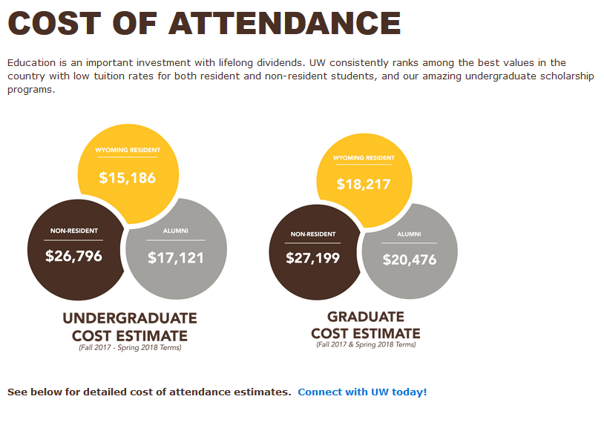
Revised - 2 Click Navigation
Notes:
The proposed plan is to replace the uwyo.edu homepage 1st row content area to icons, and reducing written content.
The Invest in your future icon, as well as the ‘Cost of Attendance’ link within the UW Navigation slider, will point to: uwyo.edu/sfa/cost-of-attendance
The current costs estimates may be accessed by clicking on student, or graduate level program type.
In augmenting this process, there are only 2 clicks to get to the Cost of Attendance estimates.
Pamela

Slide 19
Questions?
Academic Affairs
Presentation to the Board of Trustees - March 2018

