Slide 1
Enrollment Update
BOT March 2018

Slide 2
Spring 2018 Day 15 Enrollment
The Spring 2018 enrollment numbers reflect figures from February 9th, 2018. The Spring 2017 enrollment comparisons reflect numbers from February 10th, 2017.
Spring 2017
Spring 2018
Spr ‘18 Day 15:
+11 overall
+0.1% overall
+0.9% for Laramie campus
As of Spring ‘18 Day 15:
- 17 overall
- 5% overall
Spring ‘18
Day 15:
+ 0% In State
- 17% Out of State
As of Spring ‘18 Day 15:
+ 2,143 SCH overall
+1.5% overall
As of Spring ‘18 Day 15:
- 7 overall
- 12% overall
Spring ‘18 Day 15:
+ 3% In State
- 33% Out of State
Spring ’18 Day 15:
- 25 overall
-1% overall
FR
Soph
JR
SR
2nd Bach

Slide 3
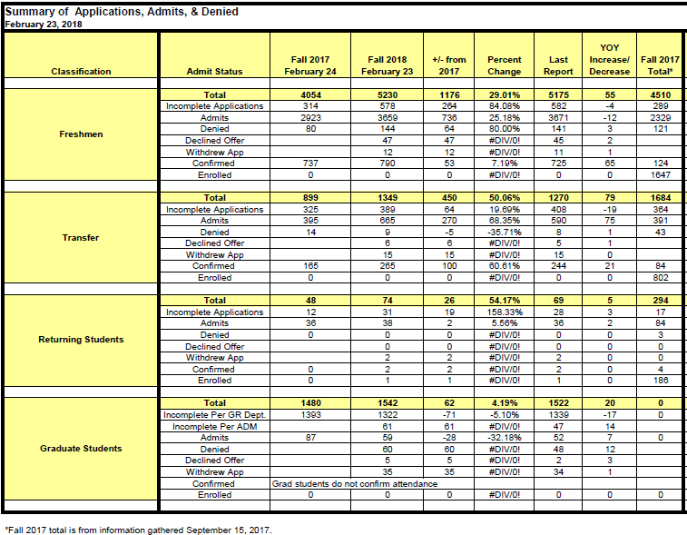
Fall 2018 Enrollment Projections

Slide 4
Fall 2018 Enrollment Projections

Slide 5
Fall 2018 Enrollment Projections
Freshmen projections

Slide 6
Fall 2018 Enrollment Projections
Freshmen projections

Slide 7
Fall 2018 Enrollment Projections
Freshmen projections

Slide 8
Fall 2018 Enrollment Projections

Slide 9
Fall 2018 Enrollment Projections
Transfer projections

Slide 10
Fall 2018 Enrollment Projections
Transfer projections

Slide 11
Overall Enrollment
All markets are trending +
New students
First time = 17XX
Transfers = 11XX
Returning students (continuing)
Graduate Students
Bottom Line – it’s a GREAT year to be a cowboy!

