Slide 1
Zero Waste Initiative
Board of Trustees March 2018 Meeting
Japheth Frauendienst- ASUW Haub School Senator
Zayne Hebbler - Haub School Zero Waste Intern
Notes:
Zayne & Japheth

Slide 2
Zero Waste Background
“Zero Waste is a goal that is ethical, economical, efficient and visionary, to guide people in changing their lifestyles and practices to emulate sustainable natural cycles, where all discarded materials are designed to become resources for others to use.” - Zero Waste International Alliance
90% or greater diversion from the landfill
Recycling, compost, reuse, and waste reduction
Notes:
Zayne

Slide 3
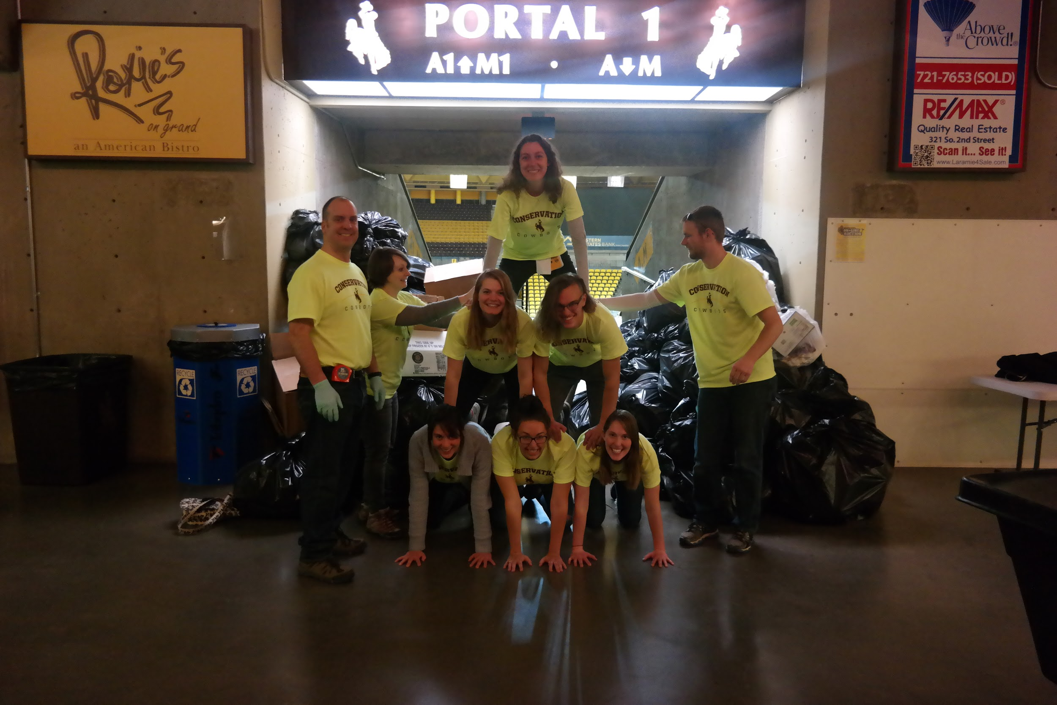
History of Zero Waste at UW
Shepard Symposium on Social Justice 2016; 2017; 2018
Spring 2017 Haub School Board Meeting
Conservation Cowboys waste-less basketball game and football games
Sustainability Coalition and Campus Sustainability Committee support
Notes:
Japheth

Slide 4
Haub School AY 17-18 Pilot
Including everyday operations and events in the Kendall House
Reusable utensils and dishware
Dishwasher installation
Weekly waste tracking
Internal post consumer composting
Event | Attendance | Weight of Compost | Weight of Recycling | Weight of Landfill Materials | Diversion Rate
Pancake Breakfast | 70 | 4lbs | 2oz | 8oz | 89%
Telluride Mountainfilm | 1300 | 0oz | 30.2lbs | 4.8lbs | 87%
Joe Riis Migration Talk | 600 | 5oz | 12lbs | 8oz | 96%
Grad Celebration | 45 | 5oz | 13.2oz | 6.2oz | 75%
New Wyoming Narratives | 65 | 6oz | 3oz | 15.5oz | 38%
Notes:
Work with catering to reduce single use items, reusable china and napkins, and appropriate meal numbers
Sum up the information in the table (e.g.--how are we doing with regard to waste diversion? where can we make improvements?
Zayne
fall 2017 board meeting had an estimated diversion rate of 90%

Slide 5
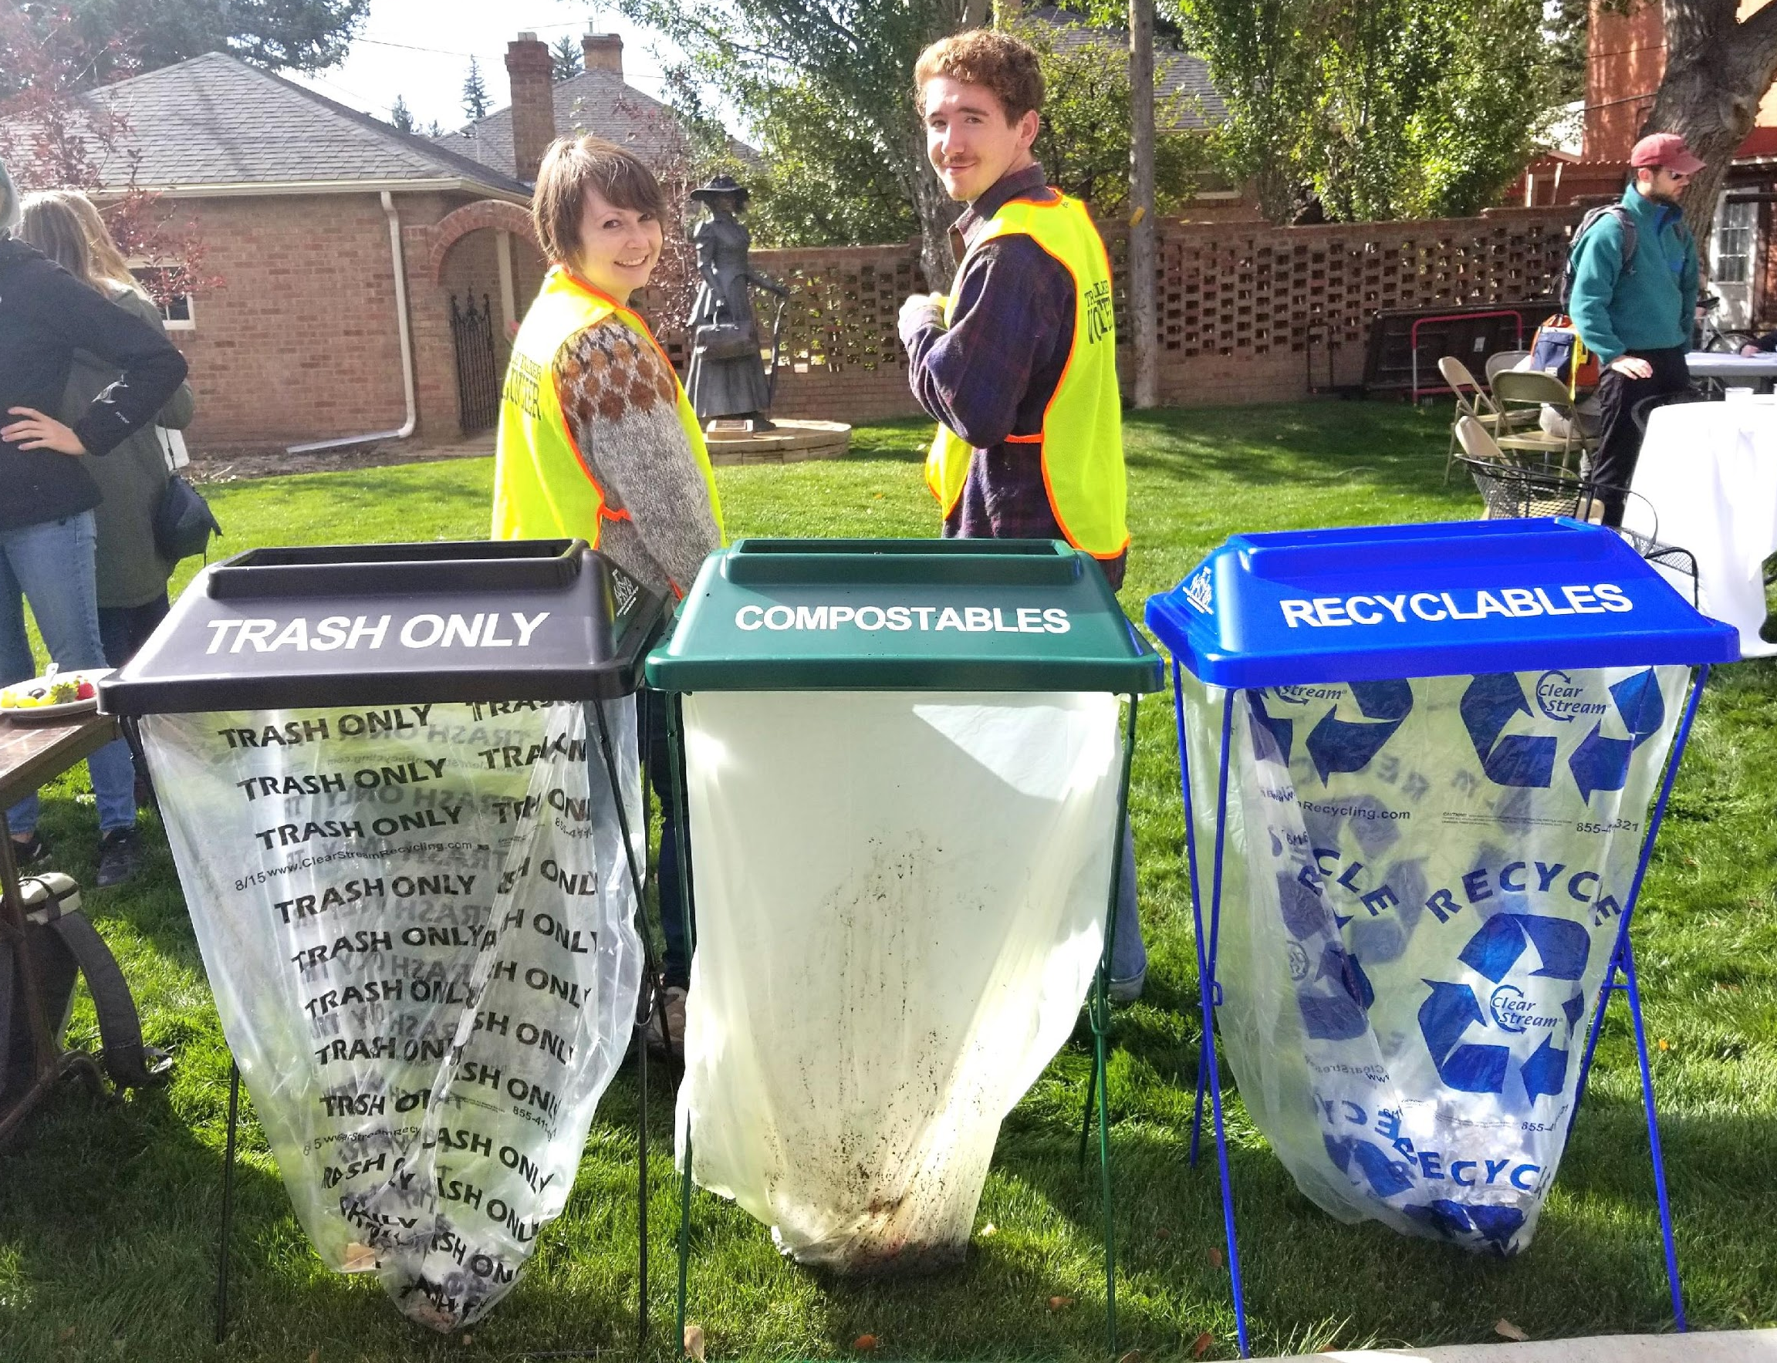
Waste Audit
ASUW-supported
A waste audit will assess the amount and composition of our waste.
Landfill
Recycling
Potentially compostable food and other waste
Why a waste audit?
Notes:
Expand on what potentially compostable stuff is: prep waste from kitchens, landscaping waste, post-consumer food waste and to-go products
Week of april 16th
Japheth
Why? We need to know more about what our waste looks like so we can pinpoint where we can make strategic and cost-effective reductions in waste, including institutional composting feasibility analysis with Sustainability Coalition and College of Business to examine various large-scale composting strategies, cost/benefit analysis, etc.--all will make us more competitive with peer institutions.

Slide 6
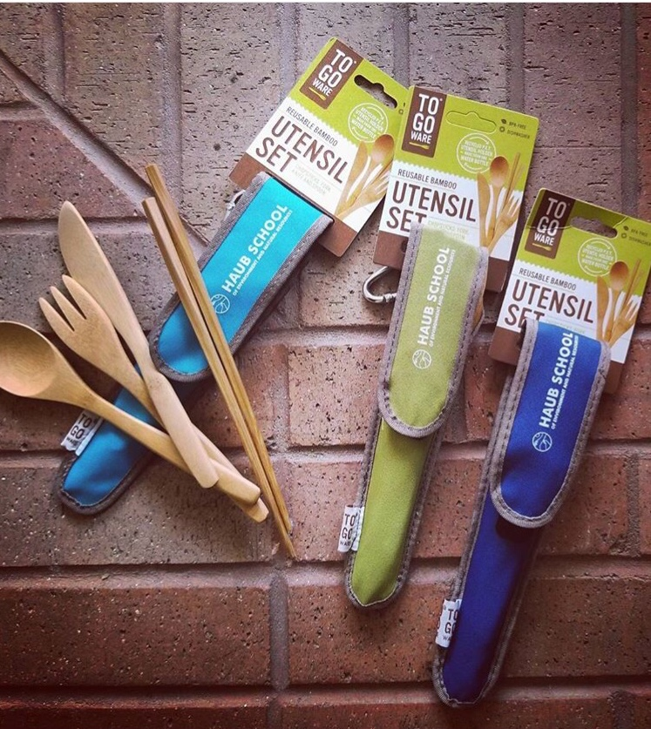
What to Expect
Opt out of printed meeting materials
Receptacles for recycling paper, aluminum cans, and plastic bottles
Reduced packaging and single use dishware
Catering will safely share leftover food with local food relief organizations and compost prep waste with ACRES
Notes:
Zayne

Slide 7
UW Interest in Zero Waste
Monteith Shop - WY Fish & Wildlife Research Unit
MLK Days of Dialogue
Sustainability Club
Law School
College of Engineering
Shepard Symposium
ENR Club
Sustainability Coalition
Fashion Club
International Students Association
Seeking support for zero waste efforts across campus
Notes:
Student Volunteers- At zero waste events trash talkers are available to help people properly sort their waste.
Seeking support for zero waste efforts across campus

Slide 8
Long Term Goals
Reach and sustain a 90% or greater diversion rate for all waste generated in the Haub School.
Create a culture of zero waste for incoming and current Haub School students, staff, and faculty.
Continue to support zero waste at BOT meetings.
Share best practices with other units and organizations across campus.
Provide leadership and facilitate institutional composting solutions at the University of Wyoming.
Notes:
Zayne

Slide 9
Thank You
UW Board of Trustees
Trustee Michelle Sullivan
Shannon Polk, UW Office of the President
Derek Jones, UW Catering & Events
Mary Ivanoff, UW Foundation
Notes:
Thank all of the Trustees for their time.
Specifically thank Trustee Sullivan again for making the arrangements

