Slide 1
Zero Waste Initiative
Board of Trustees March 2018 Meeting
Japheth Frauendienst- ASUW Haub School Senator
Zayne Hebbler - Haub School Zero Waste Intern
Notes:
Zayne & Japheth

Slide 2
UW BOT Meeting Waste Report
Landfill waste material (18lbs) = 100% food waste
Institutional composting could solve this challenge
Zero waste goal = 90% diversion rate
Event | Attendance | Weight of Compost | Weight of Paper Materials | Weight of Recycling | Weight of Landfill Materials | Diversion Rate
Spring 2018 BOT Meeting | ~30 | 10.1oz | 14oz | 15oz | 18lbs | 12%
Notes:
Zayne

Slide 3
Future of Zero Waste at UW
Campus-wide waste audit and compost feasibility results
Institutional composting
Meat
Dairy
Compostable to-go-ware
Post-consumer waste
Reduce landfill and waste costs
Notes:
Japheth

Slide 4
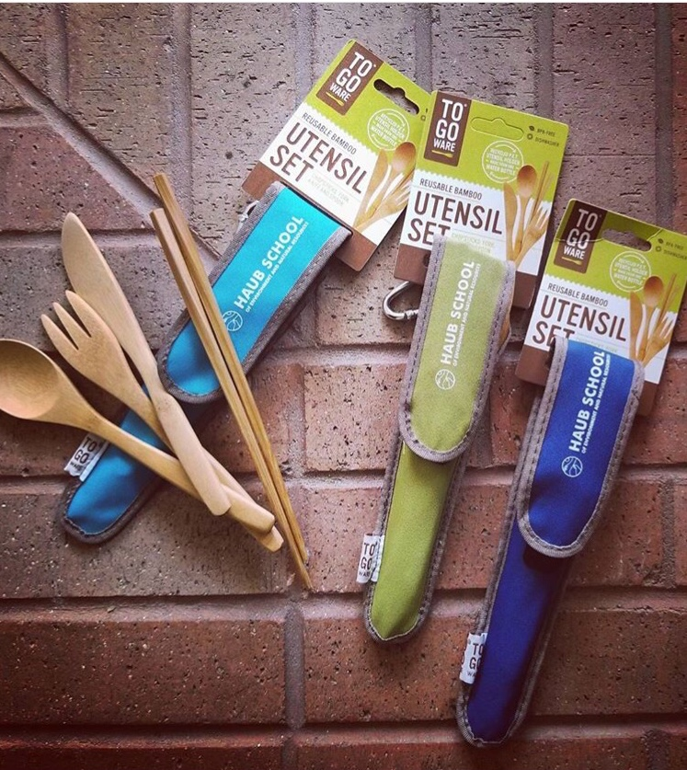
Looking Forward
Future UW BOT meetings
Reduce single-use items and disposables
Opt out of paper materials
More accurately estimate meal portions
Continued support from Haub School
Zero Waste Tool Kit
Notes:
Zayne
-packets

Slide 5
Thank You
UW Board of Trustees
Trustee Michelle Sullivan
Shannon Polk, UW Office of the President
Derek Jones, UW Catering & Events
Mary Ivanoff, UW Foundation
Notes:
Thank all of the Trustees for their time.
Specifically thank Trustee Sullivan again for making the arrangements

Slide 6
Questions?

