Slide 1
UW Trustee Conference Calls
A Guide for Best Practices

Slide 2
Zoom for conferencing: Phone Only
Connecting by Phone:
Dial our number 1-887-369-0926
Put in our Meeting ID: 381140209 (Public) – Hit # once after meeting ID and again # to bypass participant code info.
Muting and unmuting is done by hitting *6.
You will hear a voice that will inform you of the muting toggle.

Slide 3
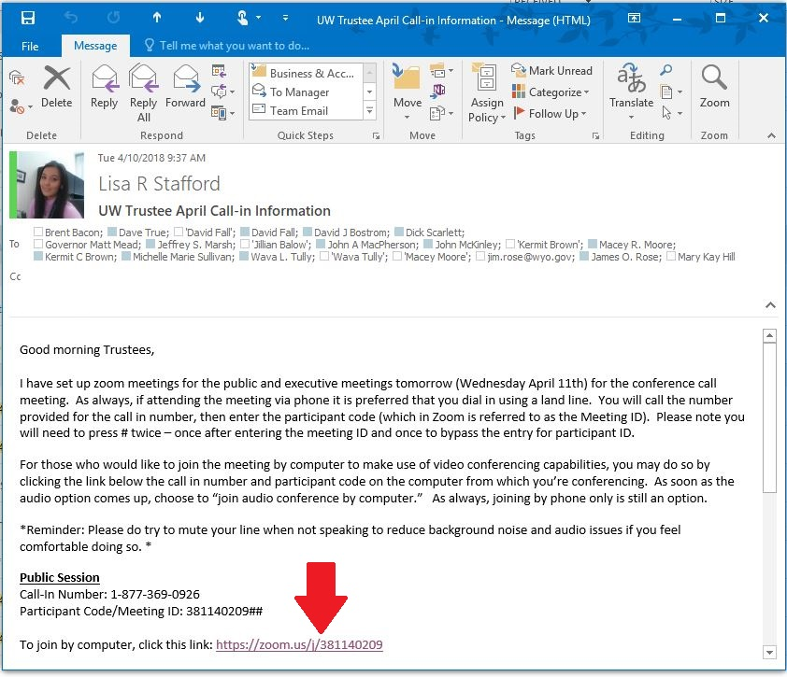
Zoom for conferencing: Computer
To initially connect:
Click the link in the e-mail

Slide 4
Open up zoom in browser:

Slide 5
Opens up the zoom app:

Slide 6
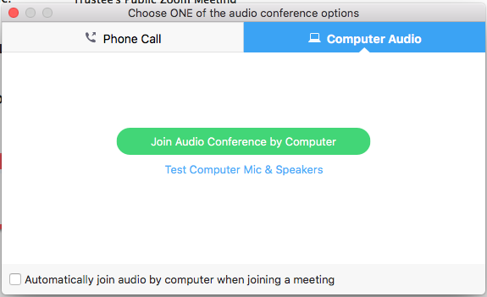
Choose Audio: If you have a microphone, join by computer

Slide 7
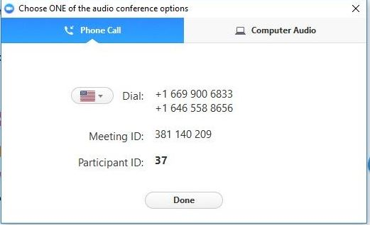
If you have no computer audio:
Call in – but instead of the number provided, use the trustee toll free call in number:
1-877-369-0926

Slide 8
Toggling your mute and video
Why do we want to toggle mute?

Slide 9
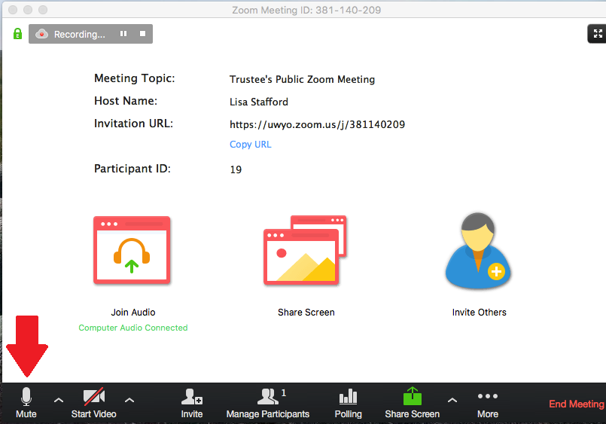
Toggling your mute and video

Slide 10
Toggling Video:

Slide 11
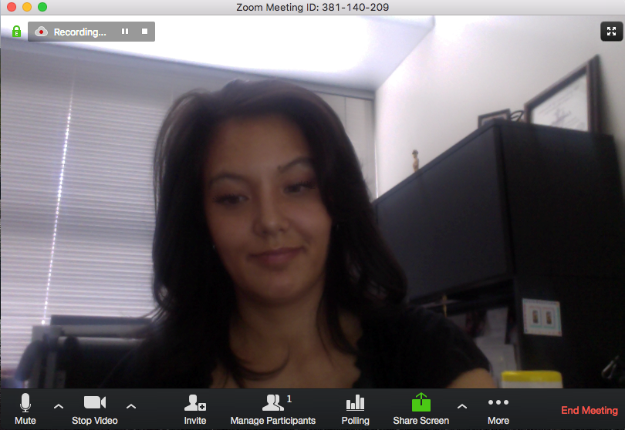
Toggling Video:

Slide 12
Zoom on your cellphone:
Download the application from the apple app store or android google play store.
Once installed, open zoom.

Slide 13
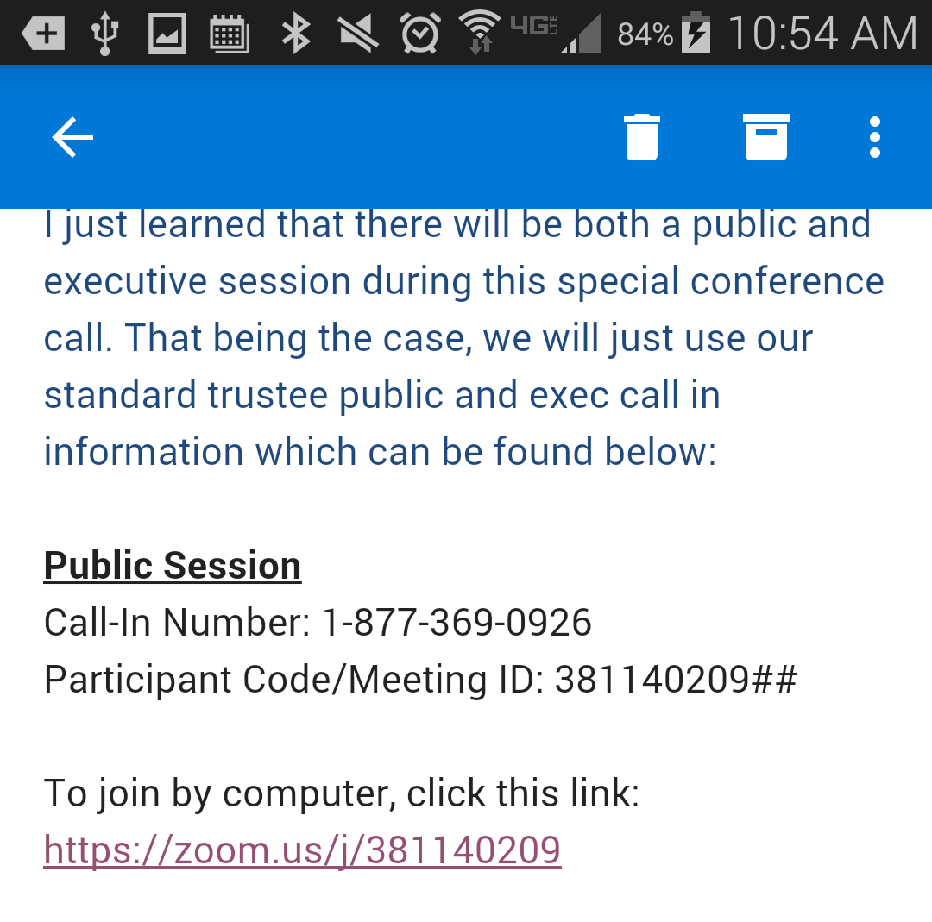
Open up the invite e-mail on your phone
Only use this option when you have full bars of wireless.

Slide 14
Open up the invite e-mail on your phone
Only use this option when you have full bars of wireless or full bars of data.

Slide 15
Open up the invite e-mail on your phone
Only use this option when you have full bars of data or full bars of wireless.
Make sure you have an unlimited data plan:
Click the link to the meeting in the invite.

Slide 16
Open the link using Zoom:

Slide 17
Enter your name as you’d like it to appear in zoom:

Slide 18
Use your phones Audio (Call via device audio)

Slide 19
You’re in!

Slide 20
Questions?
If you’d like me to set it up on your smart phone for you I would as always be happy to do so!

