Slide 1
Information Technology’s
Information Security
(A Primer)
Notes:
Information security is the protection of information and systems from unauthorized access, disclosure, modification, destruction or disruption.
Warning – This is not going to be very sexy.
IT’s role is in safeguarding institutional, student and personal data.

Slide 2
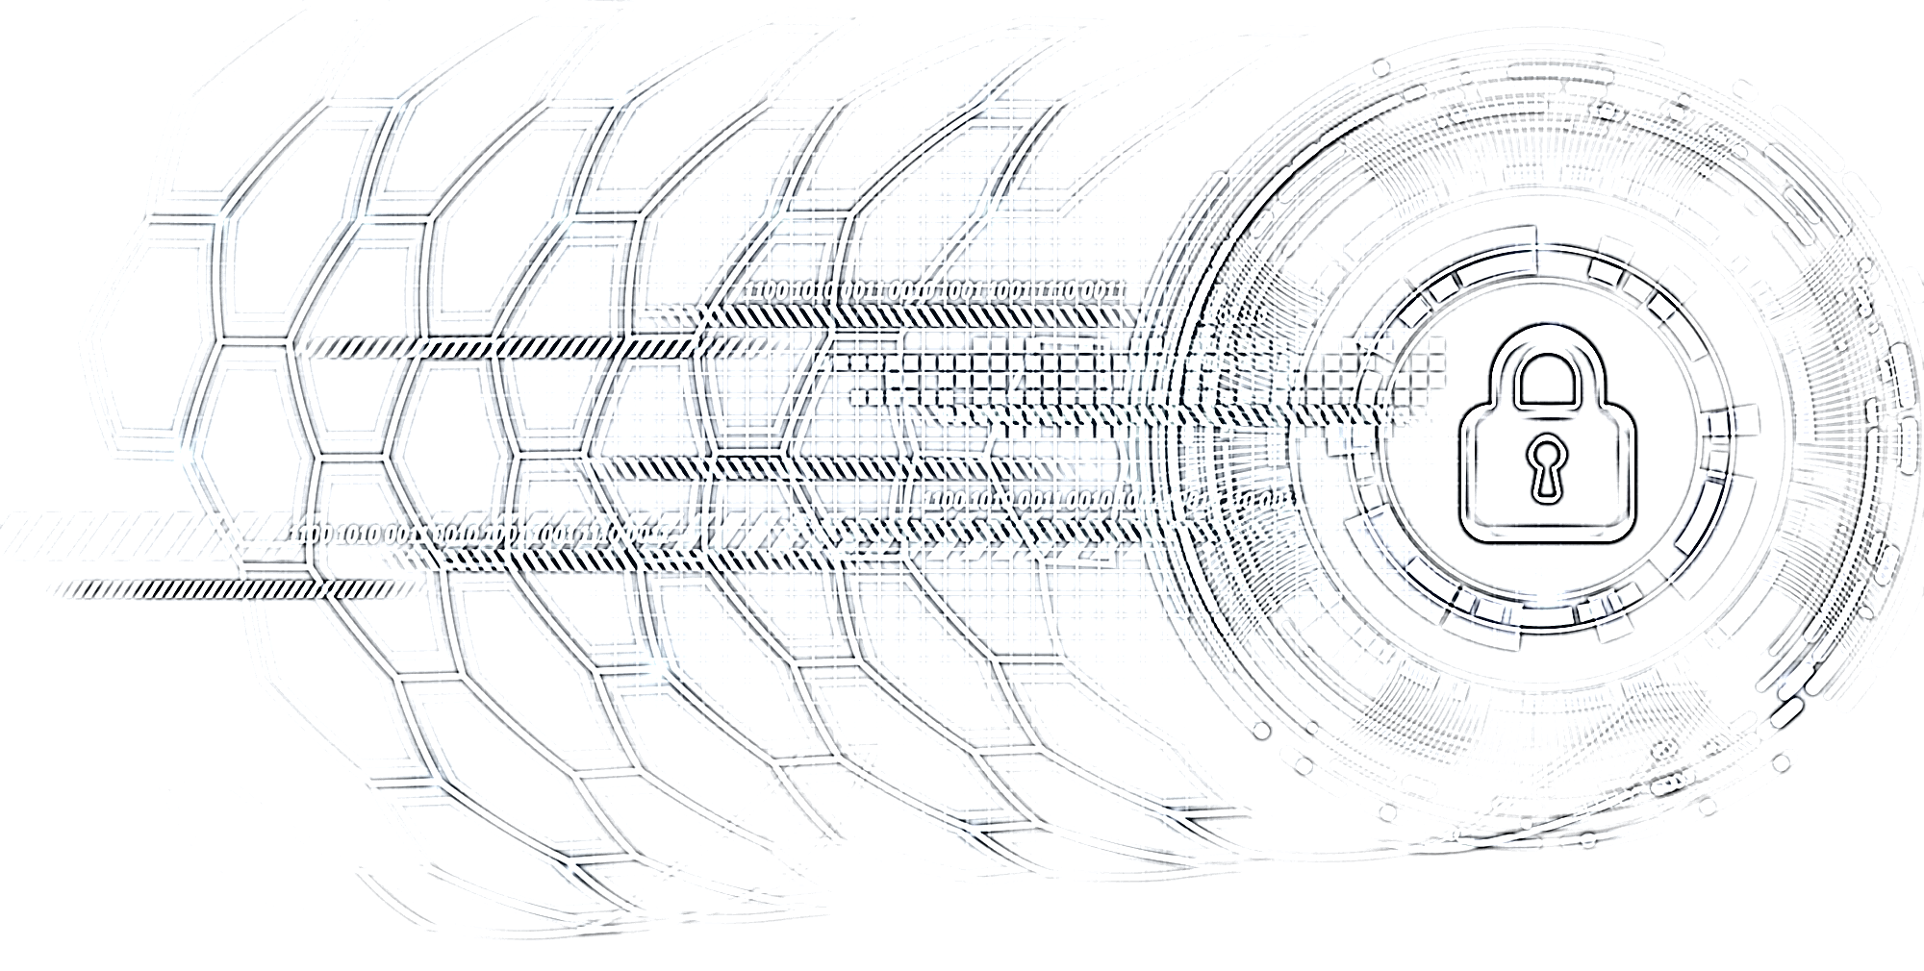
Information Technology’s
Information Security
(A Primer)

Slide 3
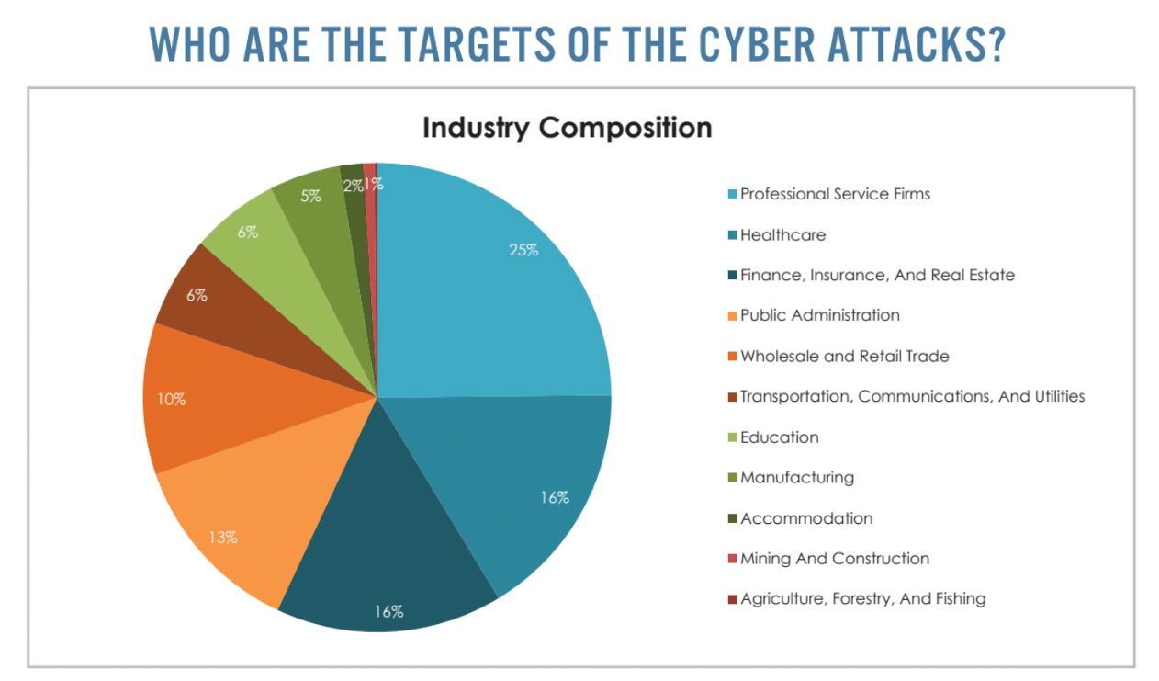

Slide 4

Cybersecurity = Information Security
People
Processes
Technology
Used to Protect Systems and Data

Slide 5
Security Processes
Identifying
Protecting
Detecting
Responding
Recovering
Notes:
Identifying – Knowing your infrastructure architectures, environment. How everything interrelates. Understanding what you need to protect.

Slide 6
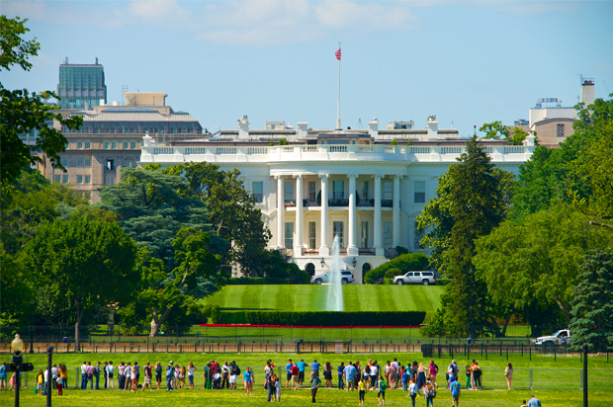
Notes:
Strong Perimeter, Credientals to get in out. Alarms, Cameras. Good, competent staff to guard – the Secret Service.

Slide 7
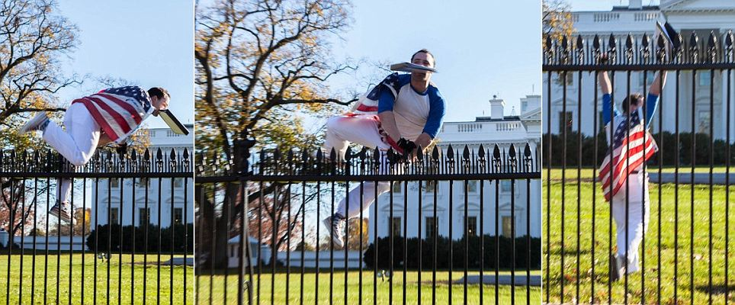
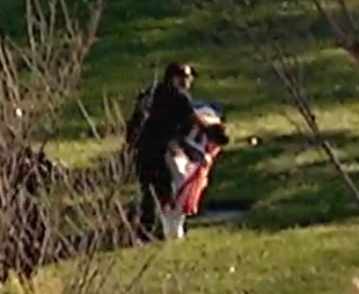

Slide 8
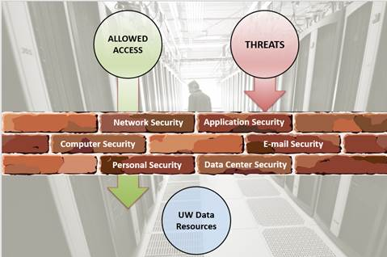

Slide 9

Academic Openness vs Security
A Balancing Act
Flourishing academic environments are based on the free flow of information among students, faculty, staff, community members and the world.
At the same time, that openness also conflicts with the goal of cybersecurity in locking things down.
Notes:
https://www.higheredjobs.com/articles/articleDisplay.cfm?ID=1133
https://www.theatlantic.com/technology/archive/2015/10/can-campus-networks-ever-be-secure/409813/

Slide 10
Academic Openness vs Security
“The whole notion of a university is that it thrives on collaboration and exchange of scholarship and ideas, both with people inside the university and outside the university… Building an infrastructure for IT that is based around those assumptions is pretty different from the kind of things that can be done in a corporation where you can dictate to your customer base what they can and can’t do, and where you really want to keep the outside out and the inside under control—we can’t do either of those things.”
– Jim Waldo, CTO, Harvard University.

Slide 11
Academic Openness vs Security
We are always under attack.
We watch the “behavior” of our network closely.
In a university setting we accept some risk. The goal is to drive that risk to a minimum while still allowing access, information flow and usability.
We do this with various network architectures, tools, security hierarchies and monitoring.
Notes:
We have multiple devices, desktops, servers, phones and tablets that touch our network daily (students, faculty, staff and visitors to campus).

Slide 12
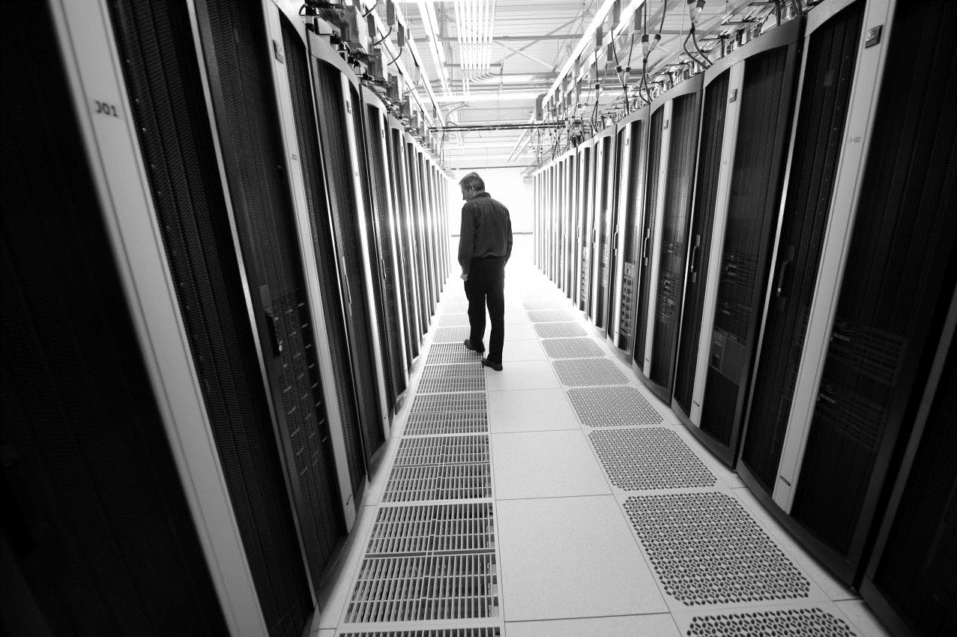

ALLOWED ACCESS
THREATS
Network Security
Application Security
Computer Security
E-mail Security
User Security
Data Center Security
UW Data Resources
Notes:
Option 2

Slide 13
Computing Statistics
Servers
607 supported by IT
Databases
100 run by IT
Workstations
6,157 on campus
Notes:
We support over 125 software applications.

Slide 14
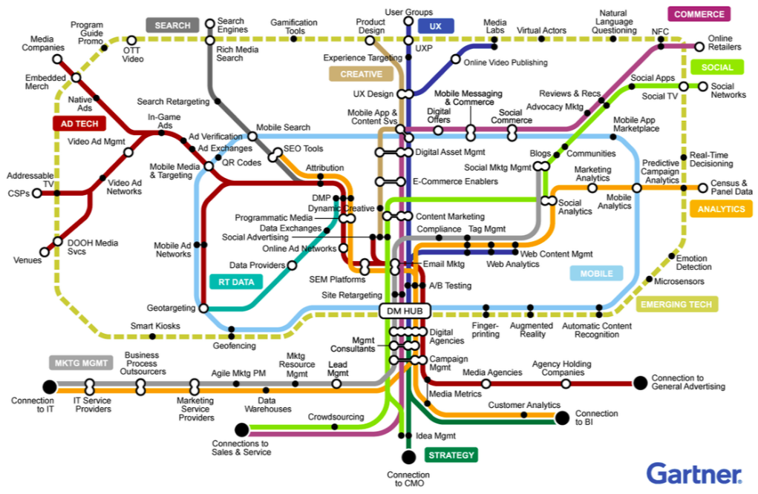
Technologies
Source: Gartner
Notes:
Stops of technology and buildings. We have to make everything run on time.

Slide 15

IoT – 125,000
Notes:
Smart TVs, Firestick, Sling, Alexa, Gaming Consoles, Your Fitbit, building security. Everything is connecting to the network and becoming smart. How many have Google Home, Alexa, a Next Thermostat. Lighting ran by and app on your phone?

Slide 16
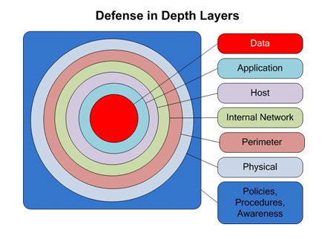
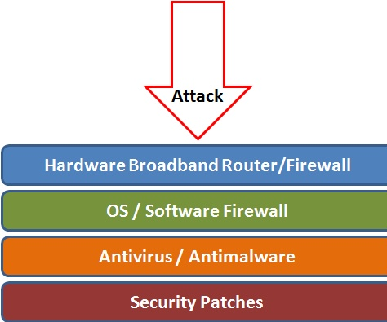
Multiple Layers of Defense
User Account Controls

Slide 17
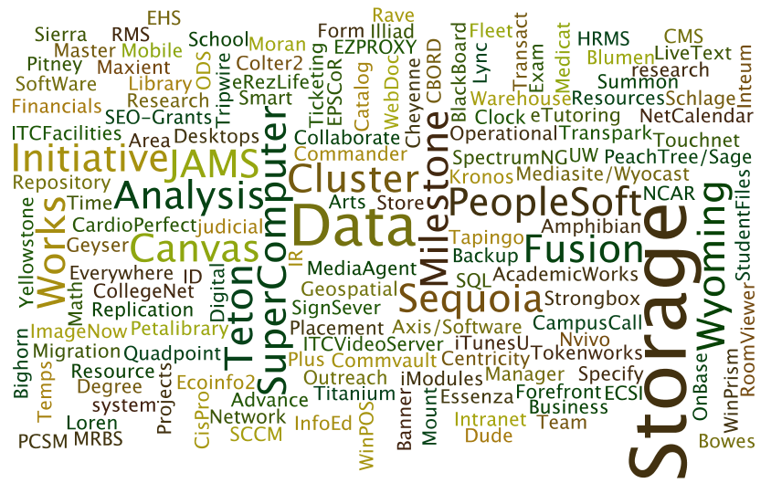
Protected Data
FERPA (Student, Academic)
HIPPA (Medical)
PII (HR, Student, Donor)
Financial
Research, IP
PCI (Credit Card)
Notes:
The data we protect is very sensitive and personal. Falling under federal regulations such as FERPA and HIPPA. As well as being critical to our institutions, such as financial data.
This data is being entered and stored in a wide variety of program and tools.
Personally Identifiable Information (PII);PII data refers to name, SSN, D. Licenses, bank accounts
Identity Theft-computer intruders intent on stealing your personal information to commit fraud or theft

Slide 18

FERPA (Student, Academic)
HIPPA (Medical)
PII (HR, Student, Donor)
Financial
Research, IP
PCI (Credit Card)

Slide 19
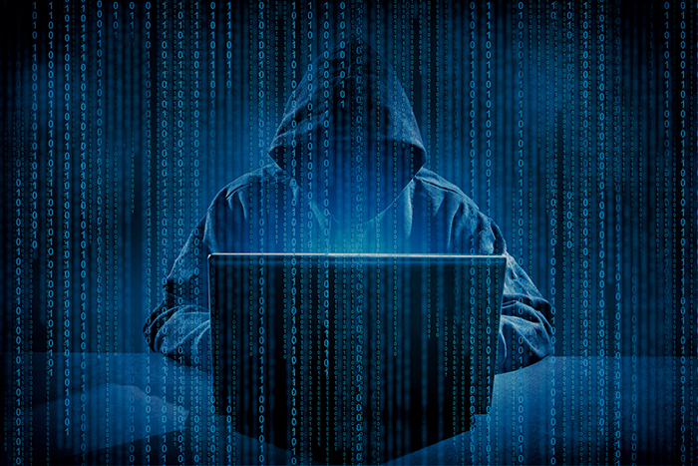
Some Threats
Hacking
Denial of Service
  (DDoS Attack)
Phishing, Spear Phishing and Pharming
Social Engineering
Human Error
Malware
  Viruses
  Worms
  Trojan Horses
  Rootkits
  Botnets / Zombies
  Ransomware

Slide 20
UW’s Cyber Insurance Coverage
$5 Million Coverage for:
  Business Interruption Loss & Extra Expense (after 12 hour waiting period)
  Digital Data Recovery
  Network Extortion
  Third Party Liability:
    Technology Errors and Omissions Liability
    Cyber, Privacy and Network Security Liability
    Electronic, Social and Printed Media Liability

Slide 21
UW’s Cyber Insurance Coverage
$2.5 Million Coverage for:
  Regulatory Proceedings
  Cyber Incident Response ($2.5m if we use a response provider approved by the insurance carrier; $100,000 for any other response provider)
$750,000 Sublimited Coverage for Payment Card Loss
$100,000 Self-Insured Retention (similar to a deductible) per claim
$5 Million Aggregate

Slide 22
Tools, Equipment, Structure
Notes:
Software tools.

Slide 23
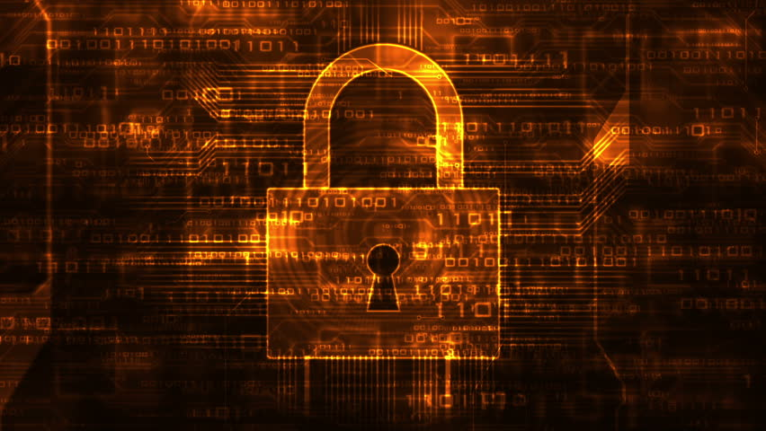
Network Security

Slide 24
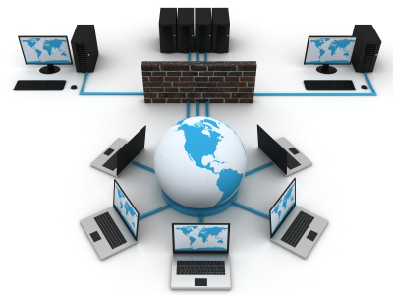
Campus Firewall
Notes:
A firewall is a device that inspects traffic between networks with different security needs and either permits or denies the traffic based on security policies.
Security zones define networks with different security requirements. For example Networks for student and networks with PCI data.
For example Trusted campus users will have access to more restricted data than users on the Internet.

Slide 25
ALLOWED ACCESS
THREATS
Network Security
Application Security
Computer Security
E-mail Security
User Security
Data Center Security
UW Data Resources
Notes:
Option 2

Slide 26
Campus Firewall
Permits 90,000,000 connections/day
  25TB of data downloaded from the internet/day
Denies 50,000,000 connections/day
  DDoS Attacks
  Network Scans
  Attempted Intrusions
Notes:
Co-Location (CoLo) networks are networks physically housed in the IT data center, but contain servers not administered by central IT.
DMZ is a network that is directly accessible from the internet. Because these machines can be directly accessed they pose the most risk for an IT organization

Slide 27

65 Network Security Zones
Notes:
These unique pathways aren’t shared and therefore are subject to being hacked.

Slide 28
65 Network Security Zones
  IT
  ResNet
  Guest WiFi
  HIPAA Data
  FERPA Data
  PCI Data
  Financial Data
  Research Data

Slide 29

NIDS (Network Intrusion Detection System)
To Detect Malicious Behavior on the Network
BRO – Open Source IDS
  Network Security Monitoring & Traffic Analysis
  Designed for high performance networks.
  Cluster architecture allows IDS to scale
  Processes 100TB of network traffic per day.
Suricata – Open Source IDS
  Traditional signature based IDS
Notes:
NIDS are tools to help detect malicious behavior on a network. They can detect compromised hosts or activity that can lead to a compromise such as network scanning or downloading a malicious file.
BRO (https://www.bro.org/)
While focusing on network security monitoring, Bro provides a comprehensive platform for more general network traffic analysis as well. Well grounded in more than 15 years of research, Bro has successfully bridged the traditional gap between academia and operations since its inception. Today, it is relied upon operationally in particular by many scientific environments for securing their cyberinfrastructure. Bro's user community includes major universities, research labs, supercomputing centers, and open-science communities.
Suricata (https://suricata-ids.org/)
Suricata is a free and open source, mature, fast and robust network threat detection engine.
The Suricata engine is capable of real time intrusion detection (IDS), inline intrusion prevention (IPS), network security monitoring (NSM) and offline pcap processing.

Slide 30
SCCV (Security Center Continuous View)
Vulnerability Scanner
Scans Devices for Known Vulnerabilities
Verify Compliance
  Regulatory Compliance
  IT Security Policies
Notes:
SecurityCenter Continuous View (SCCV) is a commercial product created by Tenable secutiry (https://www.tenable.com)
SCCV is used for the following:
Vulnerability Assessment – Used to determine if servers are vulnerable to known exploits
Vulnerability Analytics – Used to determine how to prioritize remediation efforts
Compliance – Used to verify servers meet IT security policies

Slide 31
Network Protection
Operates at a low level on network equipment.
Dynamic Host Control Protocol DHCP Snooping
  Prevents Rogue DHCP servers
  Prevents Hijacking and Misusing Network Configuration
ARP Inspection
  Prevents machines on the same network snooping on traffic.
Notes:
DHCP snooping that ARP inspection protect computers from having their network traffic routed through a malicious computer located on the same network segment.

Slide 32
Incident Response Tools
  ELK Log Management and Analysis – 3 Applications
    Stores and indexes 250,000,000 log entries/day
    Elasticsearch – Clustered database designed to scale.
    Stores ~ 1,800,000,000 records
    Logstash – Parse structured log data into consistent format for
    indexing
    Kibana – Visualize data
  ThreatDB – Written by IT
    Monitors logins to all public facing resources
    Builds profile of user activity
    Detects anomalous user logins and alerts in real-time
Notes:
ELK Open source log management and data analysis application
Consists of 3 separate applications
Elasticsearch – Clustered database designed to scale. Stores ~ 1,800,000,000 records
Logstash – Parse structured log data into consistent format for indexing
Kibana – Visualize data
ThreatDB Custom application written and maintained by UW IT.

Slide 33
Denial of Service (DDoS)
Attacks aimed at disrupting campus connectivity
  Online Gamers are a top target
    Booter or stresser service used to knock players offline
  Public facing infrastructure
    DDoS on WyoCloud go-live
Firewall Tuning to prevent DDoS
  Limit amount of resources a single IP can consume
RTBH (Remote Triggered BlackHole)
  Advertise DDoS targets to upstream provider
  Traffic dropped before it is delivered to our network
Notes:
DDoS Distributed Denial of Service attack. In a DDoS multiple machines attempt to exhaust resources in order to prevent legitimate users from having access. These attacks can either exhaust firewall resources or send enough network traffic to exhaust network connections.
Booter or Stresser services are services where users can buy a DDoS attack. These types of services are commonly used to attack gamers.
Remote Triggered BlackHole (RTBH) is a tool we can use to recover from a DDoS while we are being attacked.

Slide 34
Centralized IT &
Data Repositories
Master Databases: We make a conscious effort to highly limit where sensitive and important data is stored.
We put defensives around the data and who can access it.
If an employee’s job doesn’t require access to the data they can’t access it.
Notes:
The Cloud, as example, Oracle, makes this more difficult. But we limit what data vendors have access to and make them demonstrate they are protected.

Slide 35
Server and Database
Standardization
Network Segregation & Isolation
Communication Segregation
User Access Segregation And Restriction
Operating System (OS) Security
Application Security
Database Security
Server Monitoring
Server Backups
Additional Threat Protections Installed
  AIDE
  Tripwire
  Logwatch
  ELM
  Fail2ban
  Antivirus
Notes:
Network segregation & Isolation based on server usage and informal risk assessment.
i.e. web servers (web sites) accessible from off campus are typically placed on a VLAN with specific outbound access restrictions.
Communication segregation using network ACLS (as mentioned above) and using host based firewalls.
i.e. host based firewalls configured to restrict all access to the server except the access needed to administer the machine or for it to fulfill its purpose.
User access segregation by limiting accounts that can login to the server both remotely and directly via the console.
Configure local and service accounts by limiting all unneeded access locally and use AD accounts were possible to further restrict logon access.
Configure OS specific security. i.e. including SSH, RDP, SSSD, group policy settings, AD server groups, etc.
Configure application specific security. i.e IIS, File Server, FTP, database engine, encryption levels, etc.
Additional Threat Protections, Install and configure OS specific hardening application. i.e. AIDE, Tripwire, logwatch, ELM, fail2ban, antivirus. These are additional tools installed depending upon the OS to help identify intrusions, anomalies, etc…
Setup server monitoring for services, drive sizes, patching & updates, resource utilization, certificates, access and intrusion anomalies, and events logs.
Configure server backups meeting the server requirements.
i.e. database backups are setup locally, and server backups can be VM based or file system based, etc.

Slide 36
Account Security
Centrally Managed Application Access.
  27 Applications – Security managed by the IT Application Security Office – By Role
  Automated process to remove access in the event of:
    Change in department
    Change in employment status
  Annual audit to determine if access is still required

Slide 37
UWIT Employees
IT employees only have access to systems and applications that are in their direct areas of responsibility.
IT employees sign a Confidentiality Agreement that recognizes the responsibilities and obligations placed upon them in order to fulfill the Division’s mission to provide high performance computing and networking, technical support for systems and applications, computer support and training, and telecommunications services. UWIT Confidentiality Agreement
Notes:
Every IT employee understands: Failure to comply with the terms of this agreement will have consequences and may result in disciplinary action up to immediate termination and criminal prosecution, depending upon the infraction's severity, evidence of my intentions, and the sensitivity and scope of the information compromised.

Slide 38
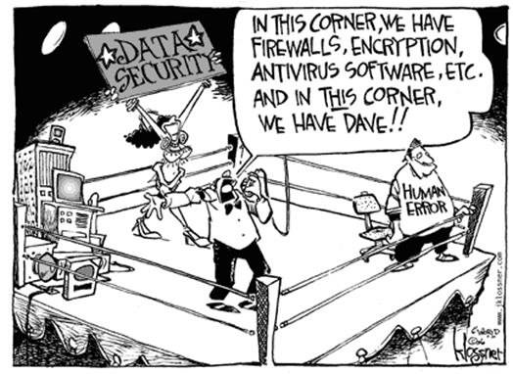
Two Factor (2F) Authentication
Notes:
Why we use 2F authentication. Attackers will always go after the softest target. At this point in time our users are the softest target.
For each successful Phishing campaign that we detect we average 15 users who are compromised.

Slide 39
What is two-factor authentication?
Two-factor authentication is a log-in method that adds a second layer of log-in security, keeping your account secure even if your password (first-layer) is compromised.
At UW, the two layers are comprised of:
  Something that you know (your password)
  Something that you have (such as a mobile phone or token)
Something you KNOW
Something you HAVE
ACCESS!
Notes:
If you are off the campus network we require 2 Factor authentication to access the campus network.
W2 Phishing
Attackers used phishing to gain access to individual employee W2
Implemented 2 factor for self service
After two factor was turned on, there was only one more attempt to hack into W2s

Slide 40
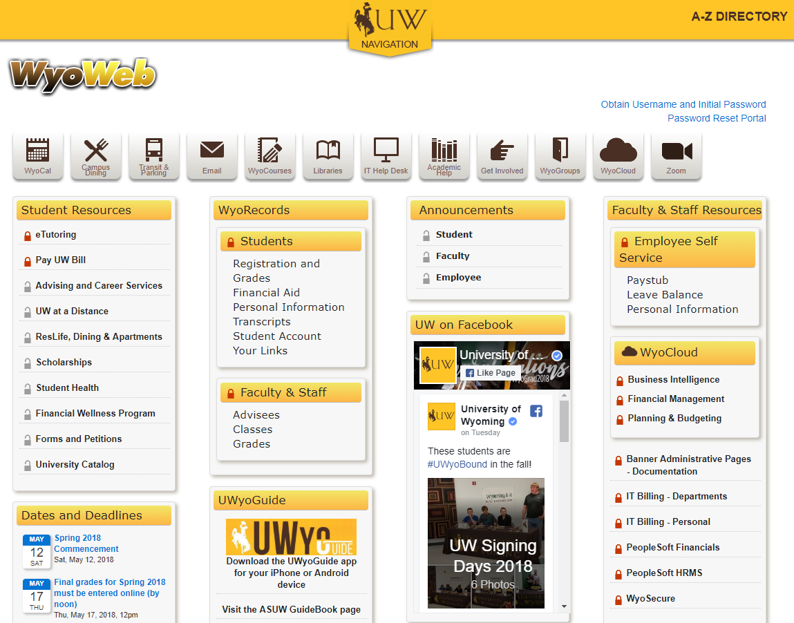

Slide 41
Desktop Standardization
IT Image Center:
  University computers that need their hard drive wiped, rebuilt, and any newly purchased system for desktop use.
  Installs a standard desktop image (Windows 7 or Windows 10, with Office 365 current version, multiple browsers (Chrome, Firefox). The image is the same for all machines.
Microsoft SCCM for deployment, which allows us to remove administrative privileges from machines
UWIT Software Center which has 40 software packages available for installation at the click of a button that do not require administrative privileges to install.
All computers on the UW Domain receive updates and patches as needed from UWIT.
Notes:
(outside of Phishing, most threats that attack a desktop are installation of software from malicious sites. Not allowing the ability to install software minimizes these threats.)

Slide 42
Desktop Standardization
Our customers can still install software that is needed for University required work, but cannot install software downloaded from third party, or potentially malicious webpages without contacting UWIT.
By having a standardized image for desktops and laptops, and minimizing the use of administrative privileges our systems that are on our network are more secure and easier to support. If a machine is infected, it can quickly be rebuilt and restored to working production.
All machines on the UW Domain receive updates and patches as needed from UWIT.
Notes:
There are exceptions in place for customers who require administrative privileges to perform their jobs, but as more software is packaged to the software center this should decrease.

Slide 43
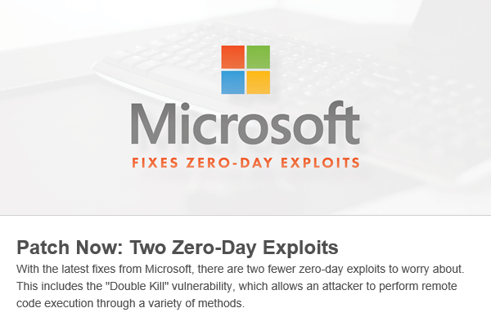
Patching (“Updates”)

Slide 44
Patching
Servers, Databases, Workstations
Monthly Patching during Systems Time.
Development Systems 1st then Production
Security and Bug-Fix Releases.
Emergency Patching – Zero Day
Notes:
One of the most proactive and productive things we do to enhance security.
Patching provides updated security and stability to our servers, workstations and databases
A patch is a piece of software designed to update a computer program or its supporting data, to fix or improve it. This includes fixing security vulnerabilities and other bugs, with such patches usually called bugfixes or bug fixes, and improving the usability or performance.
Dev and Prod Groups – we apply to Development first to ensure we are not introducing any unforeseen issues with the patch, then we apply to production
Remediation enforced weekly means if there was an issue applying the patch one weekend, it will automatically work to apply the patch again the following systems time to ensure patches are applied to each system
Enforced via group policy – is what allows us to “push” the patches out rather than someone having to manually apply them every month.

Slide 45
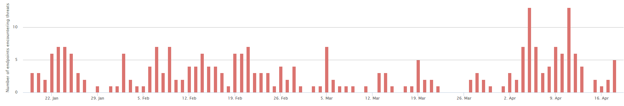
Antivirus
Antivirus is software to detect, prevent, and remove malicious software.
IT supports a mix of Webroot SecureAnywhere and Windows Defender software.
Our Antivirus software protected University computers from over 1,300 malicious programs during the past year.
Notes:
Malicious software can lead to lost productivity, compromised accounts, and stolen information.
The chart shows threats detected over the past 3 months
Most malware remediation is able to be performed through the antivirus software with no impact to the user.

Slide 46
Condo HPC
HPC Resources
Condo – Mount Moran / Teton ~ 500 Servers (Red Hat Enterprise Linux)
Loren HPC – 75 Servers (CentOS Linux)
EORI – 12 Servers (Red Hat Enterprise Linux)
Access
Authentication: Two-Factor Authentication (2FA) to Campus RADIUS servers (implemented early 2016)
Authorization
  Red Hat Identity Management
  Host-based access controls
  Services access controls
Patching & Updates
Nightly updates check on public facing equipment.
Orchestrated systems upgrades bi-annually
https://cdn.pbrd.co/images/34OOR5HAW.jpg
Network Based Security
Campus & Server Firewalls → Desired connections only
Restricted Network Services → Don’t respond to undesired services
Automated blocks on multiple failed logins
http://firewall.firm.in/wp-content/uploads/2016/12/firewall.png

Slide 47
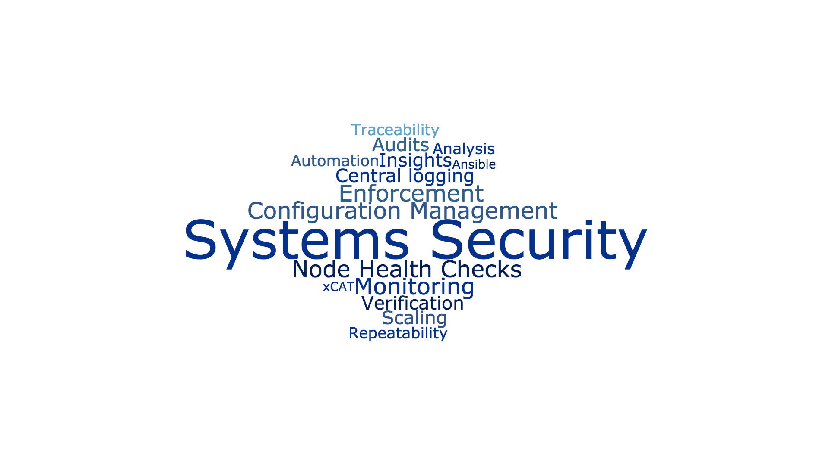
Condo HPC
User Security
No shared accounts
Warnings for attempted privilege escalation
Compute Security
Fencing of resources
Computation time limits
Concurrent allocation restrictions
Filesystem Security
Quotas
  Capacity
  File Count
UNIX permissions and Access Control Lists

Slide 48
PetaLibrary
ScienceDMZ / Internet
Design:
Open & collaborative space
Data access controlled by end users
Scalable File Storage for *RESEARCH*
GridFTP
Access Methods:
Globus GridFTP on ScienceDMZ & Internet
Standard authenticated network share (SMB) access on campus
Standard network filesystem (NFS) access on controlled servers
PetaLibrary
Data Store
Campus Desktops & Laptops
SMB
NFS
IT Servers
PetaLibrary Supported Systems
42 Supporting servers (Red Hat Enterprise Linux or CentOS Linux)

Slide 49
ScienceDMZ
Design
High performance *data* network
transfers large research data
(> 1TB / day)
Internet2 connected
No firewall appliances
100 GbE ingress/egress site connection
Few, but large flows.
Security
Restrictive host-based firewalls
Restrictive network service configuration
Repeatable and auditable configuration
Centralized system logging
Globus GridFTP service
All systems are auditable to port scanning and configuration inspection by research support and security teams
GridFTP Security
Based on end points
Automatic data transfer integrity verification - checksums
In flight encryption available
WyoLogin & 2FA
ScienceDMZ Servers
6 Data Transfer Nodes (Red Hat Enterprise Linux)
2 PerfSonar Nodes (Red Hat Enterprise Linux)
2 Globus GridFTP Network Test Nodes (Red Hat Enterprise Linux)

Slide 50
Email Security - Layers
Multiple Layers of Protection
  Reputation Filter (Sender Trustworthiness)
  Sophos Mail Gateway
  Office 365
600,000 emails received each day.
  230,000 dropped by IP Reputation Filter
  100,000 quarantined by Sophos
  30,000 quarantined by Office 365
Notes:
Sophos and Office 365 both scan for spam, phishing and Malware/Virus. Defense in depth.
There are several scripts that detect signs of compromise based on e-mail behavior. Forwarding to the same address, sending e-mail to beacon addresses.

Slide 51
Phishing Response
Coordinated response between multiple teams to mitigate damage from phishing messages
  All team tasks happen in parallel
  Mitigation tasks are often completed within minutes of a notification
Network Security – Determine the scope of the Phish
  Block access to the phishing website
  Determine Number of users impacted
Client Support – Manage Customer interactions
  Notify campus of the threat
  Work with customers who responded
Enterprise Sys – Clean up
  Remove messages from inboxes
  Place rules to detect and prevent spread
Admin Sys – Prevent
  Place rules on gateway to block messages
  Submit samples to Sophos to flag

Slide 52
Security Training
Identifying & Avoiding Phishing training module is available online
Computer Security Seminar is available to departments and groups by request.
Notes:
Computer Security Seminar has been offered in the classroom (low attendance) and provided to: Agriculture Extension, Outreach, SBDC

Slide 53
Data Center - Security
UW Administrative and Operational Systems
Research Computing and Data
UW Department and College Equipment
Part of the Core Network Hub
State Agencies
Notes:
Physical Security. The importance of backups and DR.

Slide 54
Future Initiatives
Financial Audit – BKD – IT Segment
Configuration Management
  Detect and remediate devices that differ from standards.
Geographically based and “known” device access.
Phishing Response
  Leverage BRO to detect phishing e-mail quicker and respond in real-time.
Increase Security Awareness - Security Training
  Required Security Training for All Employees
Artificial Intelligence and Machine Learning Systems – Great Promise

Slide 55


