Slide 1
Ed Synakowski Vice President Research and Economic Development November 2018
Capturing the Full Potential of UW Biodiversity Research and Outreach
Presented to the
Board of Trustees

Slide 2
Presented here:
Overview of biodiversity research; UW elements; potential; contributions of the Berry’s
The Biodiversity Institute (BI) activities and challenges
Recommendations:
Transition of high priority BI activities
Establishing a new Berry Biodiversity Center
In the Berry Biodiversity Conservation Center Building
New home for high priority BI activities
A new umbrella for strengthening campus-wide biodiversity research, education, and outreach and asserting national leadership at a time of global need

Slide 3
Biodiversity science is a grand, transdisciplinary challenge
From UW faculty:
Biodiversity refers to:
‘… the variety of life on Earth, it includes all organisms, species, and populations; the genetic variation among these; and their complex assemblages of communities and ecosystems… It also refers to the interrelatedness of genes, species, and ecosystems and their interactions with the environment.’ (UN Environment Program)
Studying biodiversity spans spatial, temporal and hierarchical scales
Its study inherently involves interdisciplinary work, linking research at the cellular, organismal, community, and ecosystem levels…
“We seek to understand the processes and factors contributing to biodiversity across varying spatial, temporal, and hierarchical scales. These studies range from focus on genes to focus on whole communities, and range from interactions at a single-organism level to considering continent-wide and global patterns in biodiversity.”

Slide 4
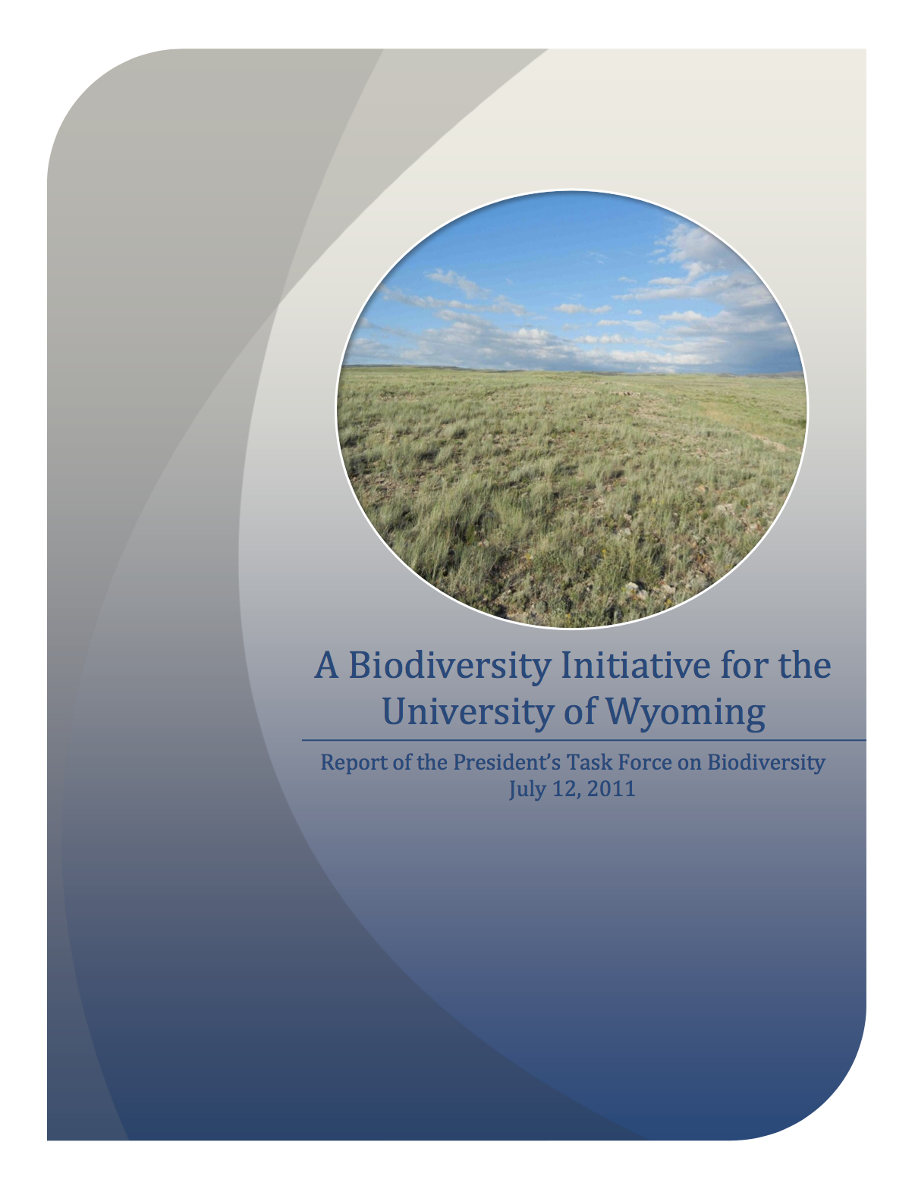
The Frost Report (2011) recognized UW’s potential in biodiversity research and Wyoming as a unique resource
Peter Raven, Missouri Botanical Garden: UW can take advantage of its unique setting, biology, and culture, and create a model that can be adopted elsewhere. Dr. Raven sees an opportunity for UW to create a university-wide interdisciplinary initiative, and to develop a unique curriculum in biodiversity studies that produces graduates prepared to deal with the world as it is… [H]e suggested that UW can lead in developing a vision of nature and society in the interior West for the coming decades
Georgina Mace, Imperial College, London: UW has a huge opportunity to bring the physical, biological, and social sciences together, and to train students at all levels to communicate across disciplinary boundaries… UW could be unique by developing a deep, specific focus on biodiversity science and conservation. She knows of no university, anywhere in the world, that is doing this at an institutional level
The BI was inspired, in part, by this report

Slide 5
Research in biodiversity at UW is broad and deep
Spans many colleges and departments with both core and supporting activities. Examples of present and potential players include:
College of Arts & Sciences – Anthropology, Botany, Chemistry, Geology & Geophysics, Zoology & Physiology
College of Agriculture and Natural Resources – Agricultural & Applied Economics, Animal Science, Ecosystem Science and Management, Plant Sciences, Molecular Biology, Veterinary Sciences
College of Business – including the emergent Center for Business and Economic Analysis (IIE)
College of Engineering and Applied Science – Atmospheric Science, Civil and Architectural Engineering
Haub School of Environment and Natural Resources
School of Energy Resources
Resources include:
Computation and data science, including NCAR-Wyoming supercomputing center
Core facilities
Natural history collections
Berry Biodiversity Conservation Center, its labs and activities
Science Initiative building and programs
Field research facilities

Slide 6
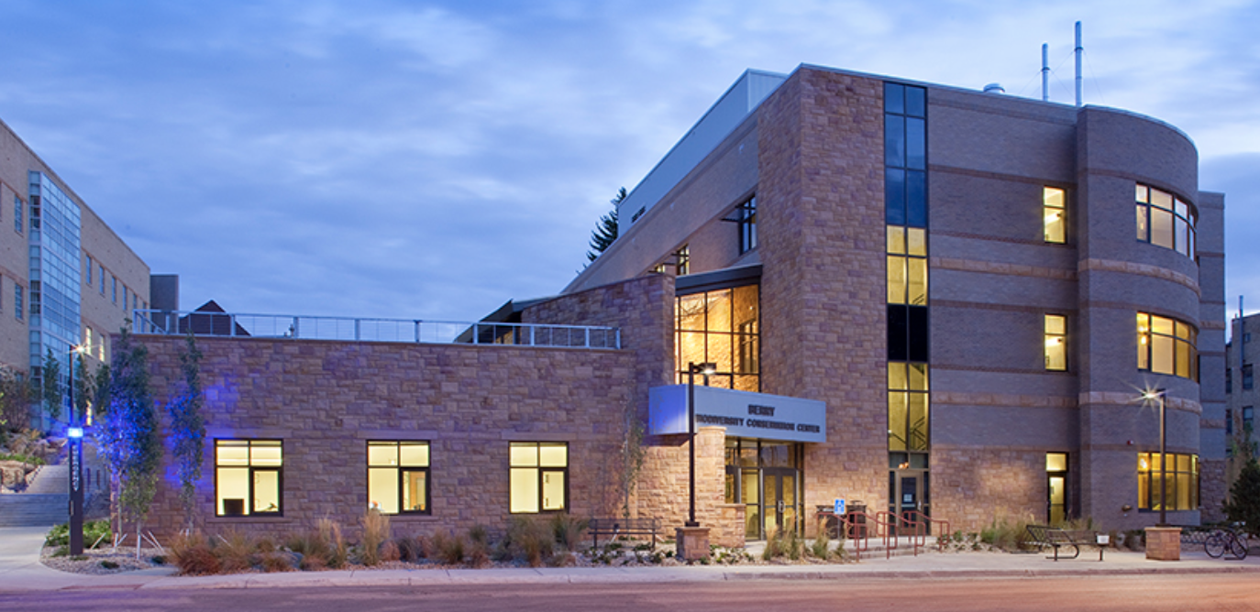
We have been carried forward by extraordinary generosity
The generosity of Bob and Carol Berry in providing resources through the Wolf Creek Foundation has been singularly important in elevating the profile and impact of biodiversity research, education, and outreach at UW
Their contributions led to the construction of the Bob and Carol Berry Biodiversity Conservation Center, an endowed chair in biodiversity science, and the operations of the BI. They are among the most generous in the history of UW
The Bob and Carol Berry Biodiversity Conservation Center is host to the BI, WYNDD, Museum of Vertebrates, students and administration in the Program in Ecology, research laboratories, and attractive space for convening. In part, it serves as a public stage for biodiversity activities and exchanges

Slide 7
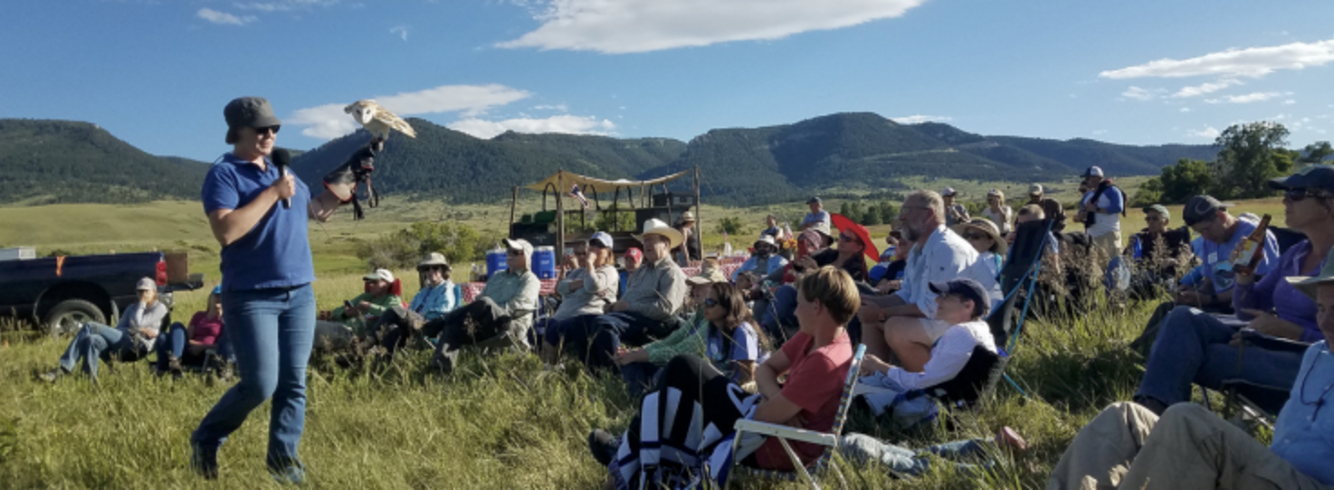
The Biodiversity Institute has served UW and Wyoming’s citizens with distinction
The BI has also been enabled by the exceptional generosity and vision of the Berry’s.
Public comments have attested to the impact of the devotion and service of the BI staff and associated faculty.
Five staff, 4.5 FTE, plus an interim director
From the BI Strategic Plan:
“UW already supports strong enterprises of life sciences research and education, and thus BI activities in those arenas strive to engage, enhance, and promote (rather than duplicate or compete with) existing faculty, departments, and initiatives.
“In contrast, UW is in the process of developing an effective outreach/ engagement enterprise, and thus BI activities in that arena are designed to be more independent, innovative, and exemplary. The BI is already recognized as a regional leader in biodiversity outreach.”

Slide 8
The proximate cause of the BI challenge: a fiscal reality and vulnerability
Funds will expire at the end of this calendar year. We are vulnerable because we’ve not succeeded in diversifying the support of the BI
It’s exclusive reliance on soft money has presented this vulnerability for years
Sustaining any of the BI functions requires identifying resources within an approved and prioritized UW budget, when the budgetary constraints on UW are very tight

Slide 9
The opportunity: organize and build on UW resources and investments in biodiversity towards national leadership
Biodiversity represents a major research strength at UW, spanning departments and colleges, and supported by many facilities
The opportunities outlined in the Frost Report were never captured
For clarity, sustainability, and growth: establish a Berry Biodiversity Center (BCC; name tentative), housed at the Berry Biodiversity Conservation Center Building
BCC to serve and advance all of biodiversity research at UW
role forward BI activities into a BCC
build on a foundation of diversified support for research and outreach – federal & state grants, private industry projects, and donor contributions

Slide 10
Recommendation I: Maintain the highest impact aspects of the Biodiversity Institute programs and practices, learning from and strengthening them
Recommendation II: Develop a plan to create a new Berry Biodiversity Center (BBC). With a foundation of world-leading research, the BBC will inform conservation efforts and enable rapid responses to biodiversity matters of statewide and national economic and societal import. It will be home to the BI’s leading activities. BBC planning will be faculty led. BBC’s home will be the Berry Biodiversity Conservation Center Building
An opportunity to rebrand and strengthen biodiversity research and outreach: The Berry Biodiversity Center (BBC; tentatively named) will have a vastly expanded research mission compared to the BI that spans the campus and promotes further partnership with other institutions. Its research activities will serve as the foundation for outreach and teaching.
The Berry Biodiversity Conservation Center building will serve as the administrative home of the BI and its activities, including serving as a public focal point
This is well aligned with the original vision for the use of the building and the BI

Slide 11
Recommended priorities for a BI transition of activities were informed by several sources
Priorities were informed by UW’s strategic plan, “Breaking Through,” discussions with stakeholders and potential stakeholders, and communications from citizens and students
In early August, a Transition Group of stakeholders and potential stakeholders was formed. Foci: BI functions, impact of loss of funds, and causes leading to present situation
Individual discussions were also held by the VPRED with:
BI staff, director of PiE, dean of the College of Education, Associate Dean of Arts and Sciences, department heads, director of Office of Engagement and Outreach, leadership of Academic Affairs (AA), General Counsel especially regarding process and Regulation 2-13, and the UW president
Conversations with those inside and outside of the BI helped develop a picture of STEM education and outreach activities on campus that put the BI activities in context and informed the recommendations here
The priorities as identified by the BI participants and stakeholders were assessed in the context of the strategic plans of UW and ORED

Slide 12
Recommendation I: Maintain the highest impact aspects of the Biodiversity Institute programs and practices, learning from and strengthening them
Four priorities comprise Recommendation 1:
Lever the BI’s practices and programs to benefit STEM education and outreach across UW
Maintain administrative support for the Program in Ecology
Continue support of the Vertebrate Museum and its curation and lever with the Science Initiative
Develop a capacity to create “Broader Impacts” plans for research proposals for all disciplines that demand it
It is recommended that these activities continue to be housed in the Berry Conservation Center Building, under the umbrella of a new Berry Biodiversity Center (BCC)
Level of effort will be reduced in some areas, owing to available budget. But there are opportunities for mitigating this

Slide 13
Priority: Lever the BI’s practices and programs to benefit STEM education and outreach across UW
Background – There should be a parallel, vigorous effort, already begun by the Office of Engagement and Outreach (OEO), to survey existing UW outreach and engagement work in STEM fields
Level of effort: 1.0 FTE, an Education and Outreach Coordinator. Citizen Science and K-12 activities. Effort will be augmented to enable leverage from a broader range of biodiversity research ged than is done presently with the BI.
Long range vision: Impacts experienced across the state that lever a wide range of biodiversity research at UW
Resources: UW budget reallocation
Administrative home: new Berry Biodiversity Center, reporting to ORED and housed in the Berry Biodiversity Conservation Center building

Slide 14
Priority: Maintain administrative support for the Program in Ecology
Background – Administrative support for PiE comes through BI resources. This is UW’s most impactful cross-disciplinary PhD program in terms of numbers of PhDs granted annually; its continuation is essential and is strongly aligned with the interests of biodiversity research
At its inception in 2005, PiE was comprised of five faculty members from three different departments. It has grown substantially, and now includes 51 students, 52 alumni, 42 faculty, and 15 affiliates.
Level of effort – Total of 1.0 FTE, with 0.75 FTE for PiE administration and other duties as assigned in the Office of Graduate Education, and 0.25 FTE for Citizen Science and Outreach. Benefit from consultation with BBC leadership and ORED
Resources - UW budget reallocation
Administrative home - PiE administration will be administered through the Office of Graduate Education

Slide 15
Priority: Continue support of the Museum of Vertebrates and its curation; lever with the Science Initiative
Background - This is rapidly becoming a vibrant research tool as it rises in profile nationally
A research-oriented vertebrate museum can be a strong component of a nationally leading effort in biodiversity systems science in concert with modern-day DNA analysis techniques, the Stable Isotope Facility in the Berry Center, the Rocky Mountain Herbarium, and leveraging the Science Initiative
Level of effort: – 35 - 40k annually for consumables and maintenance
Resources: FY 2019, use existing BI funds
FY 2020: UW budget reallocation
Faculty line is in the Department of Zoology and Physiology
Administrative home - Recommended that museum support be administered through the Zoology and Physiology Department, with advising on status given to Berry Biodiversity Center director

Slide 16
Priority: Developing a capacity to create “Broader Impacts” plans for research proposals applicable to all disciplines that demand it
Background – A strong theme revealed to ORED last year in a series of listening sessions with faculty is the institutional need to develop a UW-supported approach to assisting faculty in developing plans for research that has an impact that is broader than the primary research itself. This is a long-term goal for UW and ORED. BI broader impacts expertise will be levered to enable a broader impacts capacity to benefit all proposals that require such plans.
Level of Effort – 0.50 FTE near-term, 1.0 FTE recommended as a self-supporting business model is developed.
Resources – ORED reserves

Slide 17
Editorial from last week: November 6, 2018
The point to make here: biodiversity research has emerged as an international Grand Challenge, with vast implications.
This editorial is about just one slice of biodiversity research, but the message is clear:
Wyoming must assert its relevance and place at this research and economic development table
…

Slide 18
Recommendation II: Develop a plan to create a new Berry Biodiversity Center (tentatively named BBC). With a foundation of world-leading research, the BBC will inform conservation efforts and enable rapid responses to biodiversity matters of statewide and national economic and societal import. It will build upon and administer the BI’s leading activities upon a research foundation, and its planning will be faculty led. BBC’s administration will be centered at the Berry Conservation Center Building
Priority – Support 30% of a faculty member’s time through FY 2020 to lead the development of a plan for a Berry Biodiversity Center
These resources will be found through indirect cost recovery (ICR), which are intended for use for research administration and program investment
This director will lead a Faculty Task Force to develop this plan, research priorities, and outreach approach. Foundation participation with the Task Force will be required
With a good plan: Additional revenue from ICRs to help stand up the BBC
Ultimate aim: Develop a nationally leading, coherent biodiversity enterprise that touches all corners of campus and has a self-sustaining business model
The Berry Biodiversity Conservation Center Building will serve as the administrative center and leadership home of BBC

Slide 19
A faculty-led Task Force will develop the plan
The BBC leader will convene a Task Force of UW faculty as well as Foundation representation. The Task Force will develop a plan with an impactful, exciting vision for research leading to a strengthened capacity in biodiversity science that will be at the foundation of education and outreach.
A model: Task Force that helped stand up the Office of Engagement and Outreach
A successful plan will
Identify scientific grand challenges in biodiversity and outline a means of addressing the grand challenges
Develop a sustainable business model based on grant capture and contracts
Assess the potential of donor base development for research and outreach
Outline strategies for targeted faculty hires: combining income through grant capture and donor support with UW resources to pursue them

Slide 20
Many core elements for stepping towards the vision of the Frost Report are in place
Computation and data science
NCAR-Wyoming Supercomputing Center
Advanced Research Computing Center
Data Science Initiative
Wyoming Natural Diversity Database
Wyoming Geographic Information Science Center
Natural history collections
Rocky Mountain Herbarium
Museum of Vertebrates
Insect Museum
Geological Museum
Analytical core facilities
Stable Isotope Facility
Center for Advanced Scientific Imaging
Jenkins Microscopy Facility
DNA facility
Biogeochemistry Core Lab/EcoLab
Berry Biodiversity Conservation Center
Administrative offices
Research labs
Core facilities
Public spaces
Outreach and education facilities
Science Initiative building and programs
Life sciences research labs
Research greenhouses
Animal care facility
Active learning classrooms
Wyoming Research Scholars Program
Field research facilities
UW-NPS Research Station (AMK Ranch)
Glacier Lakes Ecosystem Experiments Site

Slide 21
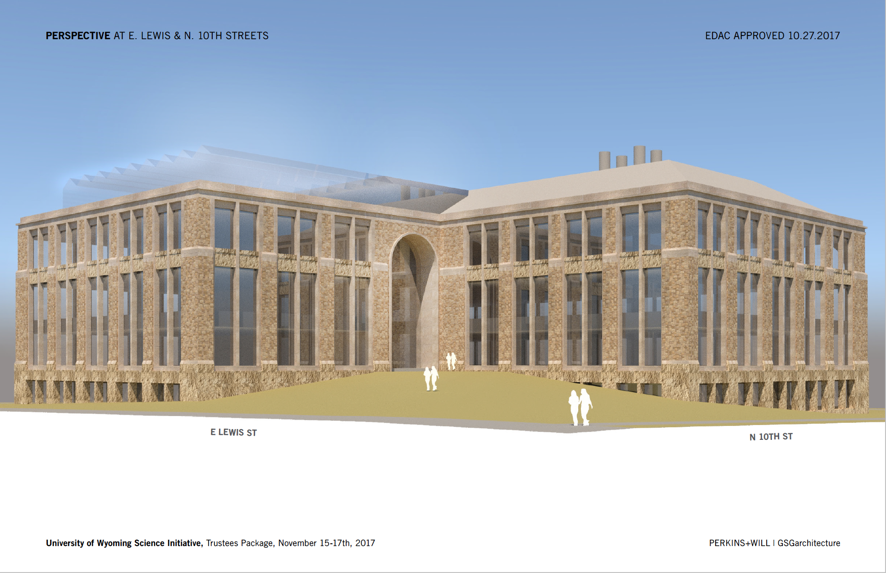
Major investment in biodiversity science: UW Science Initiative (Phase I)
Interdisciplinary Sciences Facility
Building construction - $100M
Features:
Flexible laboratories for leading life science research groups Center for Advanced Scientific Instrumentation
State-of-the-art greenhouses for plant research
200-seat active learning classroom
Student “collaboratory” fostering science innovation
Three pillars of the Science Initiative facility - cell biology, organismal biology, and earth systems biology – are central to an integrated understanding of biodiversity
Notes:
The University of Wyoming Science Initiative began in response to a legislative mandate to elevate UW science programs to top quartile in the nation. There are three main outcomes of this effort:

Slide 22
A new Berry Biodiversity Center: at the cutting edge in research, building on best practices
Faculty informed and led - Developing the plan for the BBC will require a faculty Task Force to identify Grand Challenges and identify a plan to address them.
Participation by all of the Colleges and Schools – A mature BBC shall engage across the disciplines, and with the Science, Tier 1 Engineering, and Trustees Education initiatives
Stability through diverse funding – Develop a business model that does not rely on UW funds provided by the state. Derive most of its resources from successful grant capture from state and federal agencies, privately funded projects, and donors
Accountability – For the privilege of leadership, ensure director accountability for securing resources. With a mature plan, set Foundation goals and expectations as well
Foundation engagement – Transparent sharing of ideas between the director and the Foundation to develop effective fund raising strategies for both research and outreach
External advice - A mature BBC will engage with an external advisory committee
Outreach best practices – Build on best practices in STEM education and outreach in the BI, the Science Initiative, the NSF EPSCoR and NIH INBRE programs, the Trustees Education Initiative, Tier 1 Engineering, and other such activities at UW

Slide 23
A new Berry Biodiversity Center (continued)
Rapid response capacity
Enable rapid coordinated responses to time-sensitive challenges in biodiversity science that have economic and societal impact. Capacity will be inspired and informed by WYNDD practices
Economic and societal impacts
Participation will be required of non-STEM entities including the emergent Center for Business and Economic Analysis (CBEA) of the Institute for Innovation and Entrepreneurship, the social sciences, humanities, arts, and HPAIRI
Built on partnerships
As UW leads, a successful BBC will act on the recognition of requiring successful partnerships with Wyoming’s community colleges, other universities, and national labs in order to succeed

Slide 24
Example of potential grant capture
NSF’s Science and Technology Centers
Grant income ~$30M over five years
Requires successful competition with nation’s leading research universities
Ten STC’s presently operate in the US
From a AAAS review board regarding these STC’s:
“The NSF Science & Technology Centers Integrative Partnerships program supports universities, national laboratories, industrial organizations, and others that join together to create new multidisciplinary research centers. From nanobiotechnology to microbial oceanography, the AAAS report concludes, the centers successfully pursue innovative basic science while promoting its applications to larger societal issues.”
“The centers ‘foster collaboration between faculty with an orientation toward basic science and those interested in more applied and clinical research, and as such enable a true integration of science and technology’”

Slide 25
The potential for taking significant step forward in biodiversity research and outreach is high
Wyoming provides an extraordinary platform for biodiversity research and outreach that engages the best faculty and citizens alike
Many of the resources for a coordinated response to the grand challenges of biodiversity science and associated outreach are in place
Proposed is launching a Berry Biodiversity Center (name TBD), with its home being the Berry Conservation Center Building
The BBC will be a research and outreach enterprise with a broad reach, with a goal of enabling UW to assert regional and national leadership
The BBC will host many of the activities presently under the BI umbrella, but will do so on a research foundation that engages across UW

