Slide 1
UW’s Engagement Task Force Board of Trustees Meeting November 2018

Slide 2
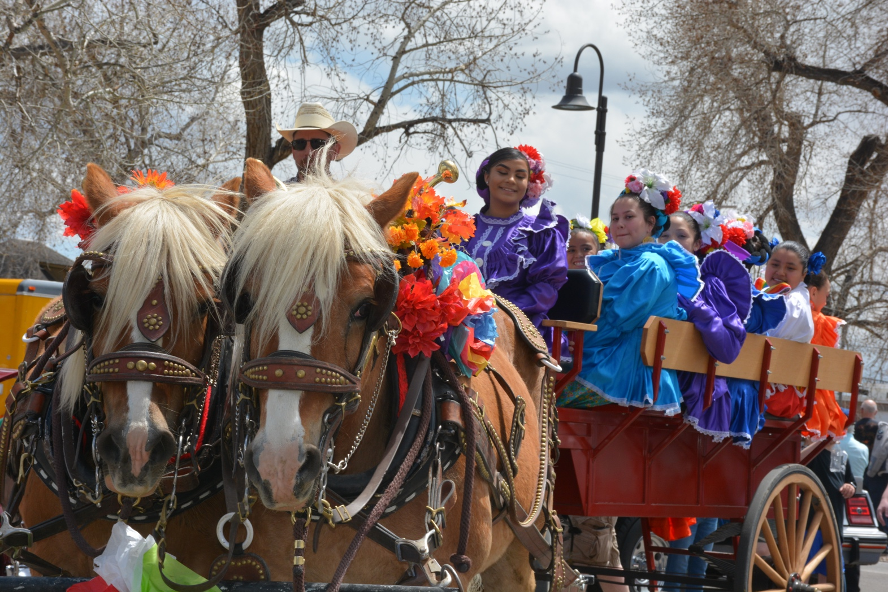
Envisioning Community Engagement and Outreach at UW Engagement Task Force Report available: www.uwyo.edu/engagement

Slide 3
UW Strategic Plan & Task Force Charge
Create a plan for an Office of Engagement and Outreach to serve as a portal of access to UW for citizens of Wyoming and beyond
Work toward UW designation as a Carnegie Foundation “community engaged university”

Slide 4
Definition of Community Engagement – Carnegie Foundation
“The collaboration between institutions of higher education and their larger communities (local, regional/state, national, global) for the mutually beneficial exchange of knowledge and resources in a context of partnership and reciprocity.
The purpose of community engagement is the partnership of college and university knowledge and resources with those of the public and private sectors to enrich scholarship, research and creative activity; enhance curriculum, teaching and learning; prepare educated, engaged citizens; strengthen democratic values and civic responsibility; address critical societal issues; and contribute to the public good.”
– Carnegie Foundation for the Advancement of Teaching

Slide 5
Centrality of Engagement in Higher Education
“… [T]he understanding that not all knowledge and expertise resides in the academy, and that both expertise and great learning opportunities in teaching and scholarship also reside in non-academic settings. By recommitting to their societal contract, public and land-grant universities can fulfill their promise as institutions that produce knowledge that benefits society and prepares students for productive citizenship in a democratic society…. [It] posits a new framework for scholarship that moves away from emphasizing products to emphasizing impact.”
- Association of Public and Land Grant Universities

Slide 6
Guiding Principles
Recognize that UW’s diverse resources extend across the state
Centralize awareness of UW outreach and engagement efforts and where appropriate provide leadership, support, and training
Communicate the significance of engagement and outreach activities and their contribution to the land-grant mission
Build off existing exemplars to evaluate how to achieve institution-wide progress on engagement goals

Slide 7
Task Force Process
Named a 16-member task force that included wider participation of resource experts which met across 2017-18
Formed five committees and followed Carnegie Foundation guidelines
Met with constituent groups and key stakeholders & held campus listening sessions
Inventoried President’s Strategic Planning Listening Sessions & UW Listening Sessions completed for Breaking Through: 2017-2022
Hosted focus groups in 12 communities
Afton/Star Valley, Casper, Cheyenne, Ethete Northern Arapaho Tribe, Fort Washakie Eastern Shoshone Tribe, Gillette, Laramie, Powell/Cody, Riverton/Lander, Rock Springs/Green River, Sheridan, and Torrington
Completed benchmarking and institutional comparisons – Compared UW to 25 higher education institutions
Launched Faculty and Staff Inventory Survey

Slide 8
Task Force Process
Named a 16-member task force that included wider participation of resource experts which met across 2017-18
Formed five committees and followed Carnegie Foundation guidelines
Met with constituent groups and key stakeholders & held campus listening sessions
Inventoried President’s Strategic Planning Listening Sessions & UW Listening Sessions completed for Breaking Through: 2017-2022
Hosted focus groups in 12 communities
Afton/Star Valley, Casper, Cheyenne, Ethete Northern Arapaho Tribe, Fort Washakie Eastern Shoshone Tribe, Gillette, Laramie, Powell/Cody, Riverton/Lander, Rock Springs/Green River, Sheridan, and Torrington
Completed benchmarking and institutional comparisons – Compared UW to 25 higher education institutions
Launched Faculty and Staff Inventory Survey

Slide 9
Faculty/Staff Inventory Survey Highlights
Voluntary survey completed by 83 UW units show 1,296,287 individuals across all counties were served by UW engagement/outreach efforts in 2016-17
The 666,795 contact hours for these efforts represent the equivalent of 321 full-time employees (FTEs).
UW spent $12,083,611 on engagement and outreach across 2016-17
Mapping UW Community Engagement

Slide 10
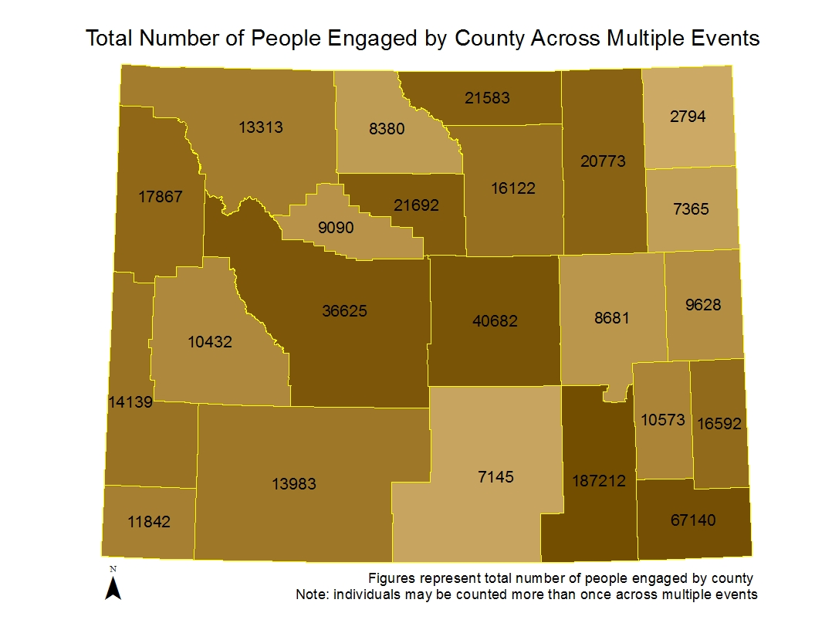

Slide 11
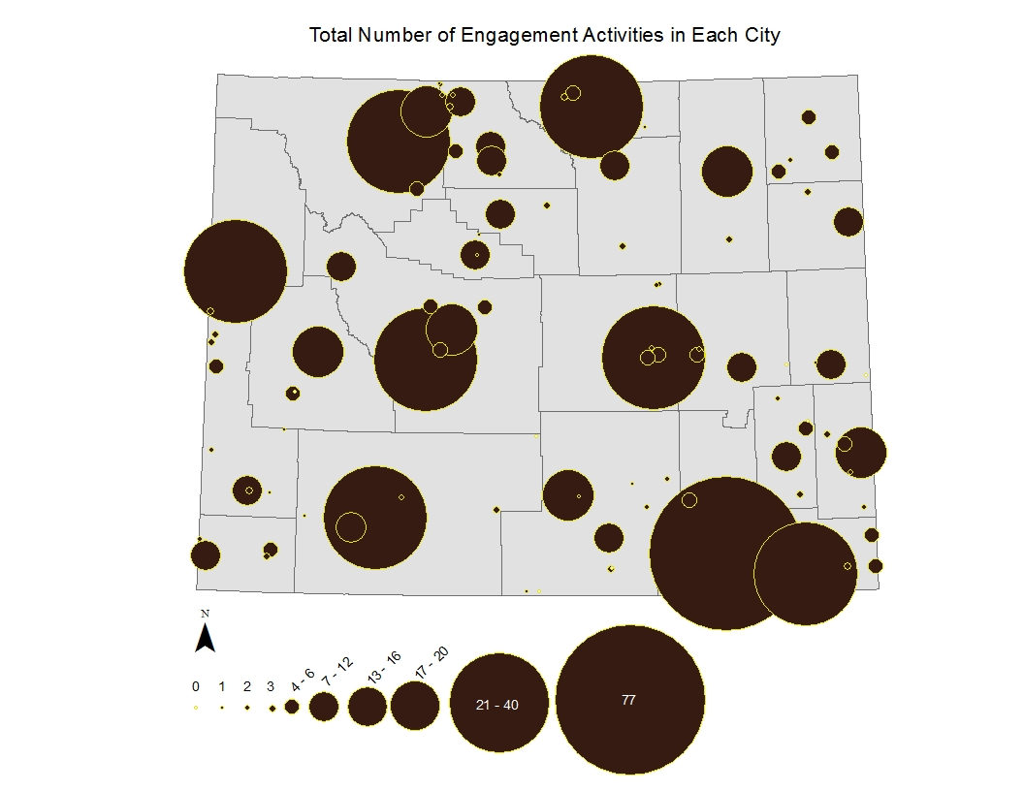

Slide 12
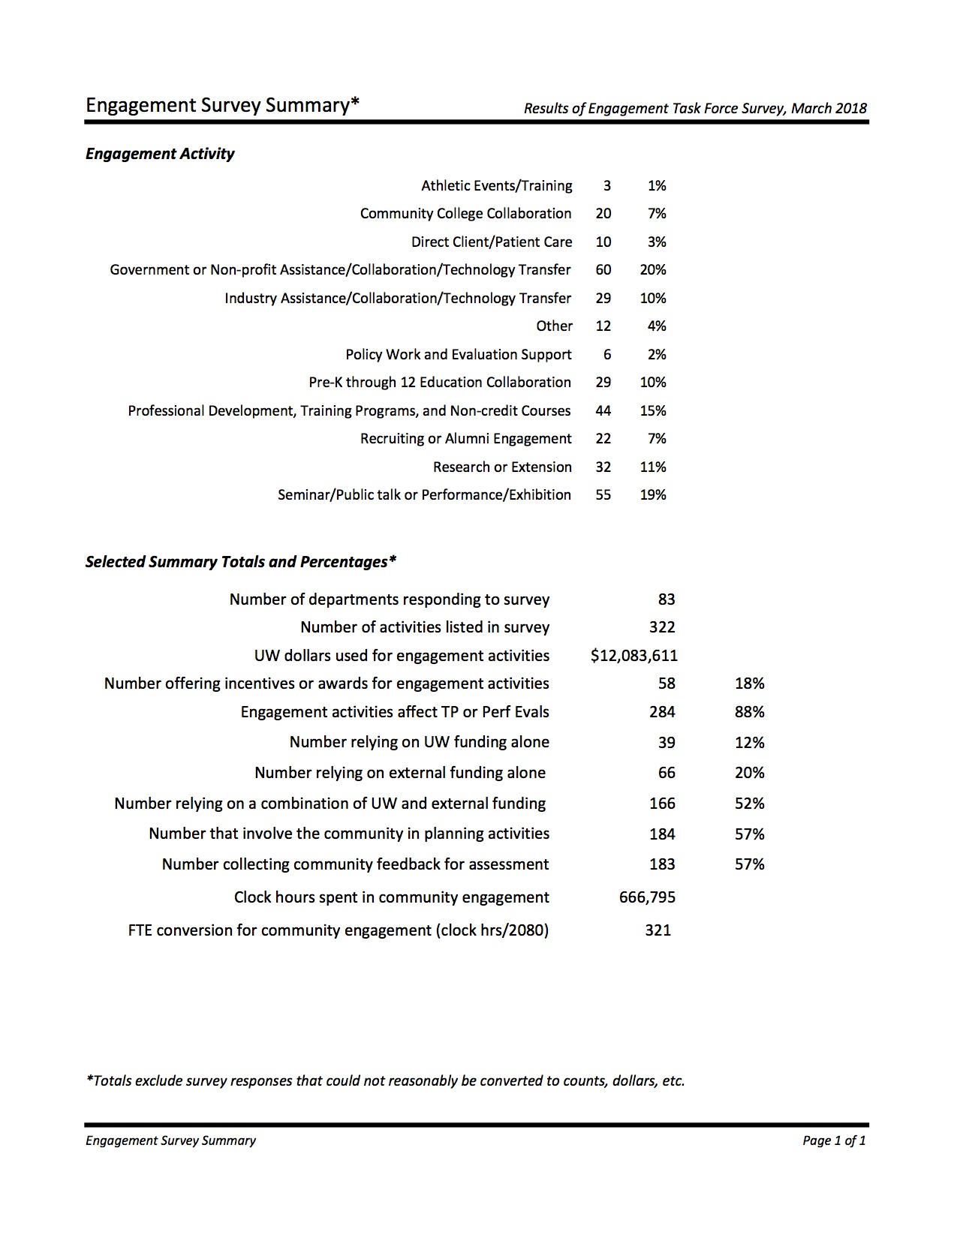
Engagement Activity

Slide 13
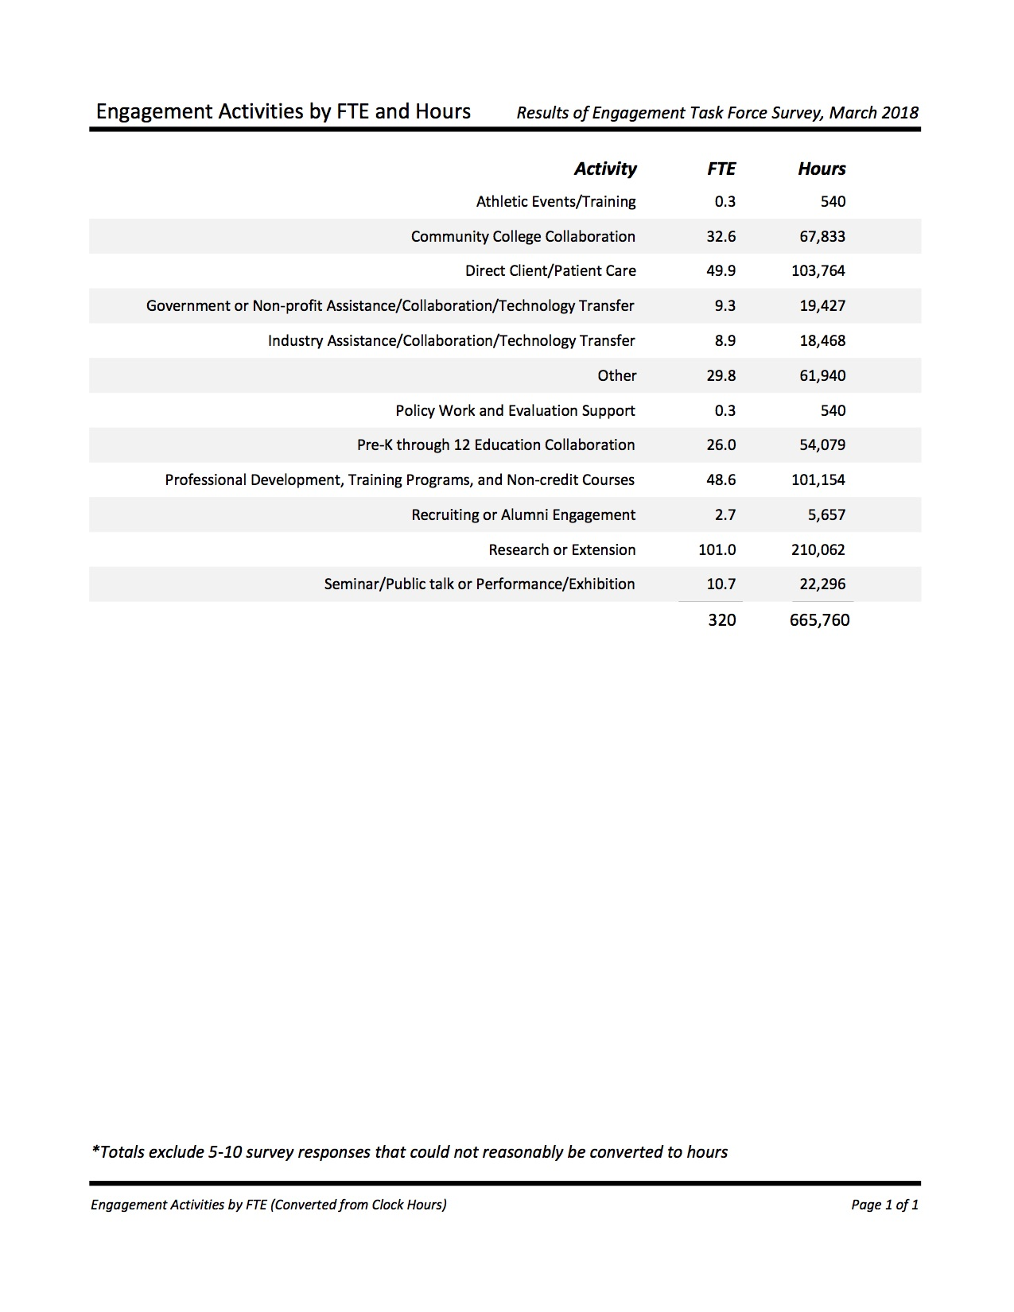

Slide 14
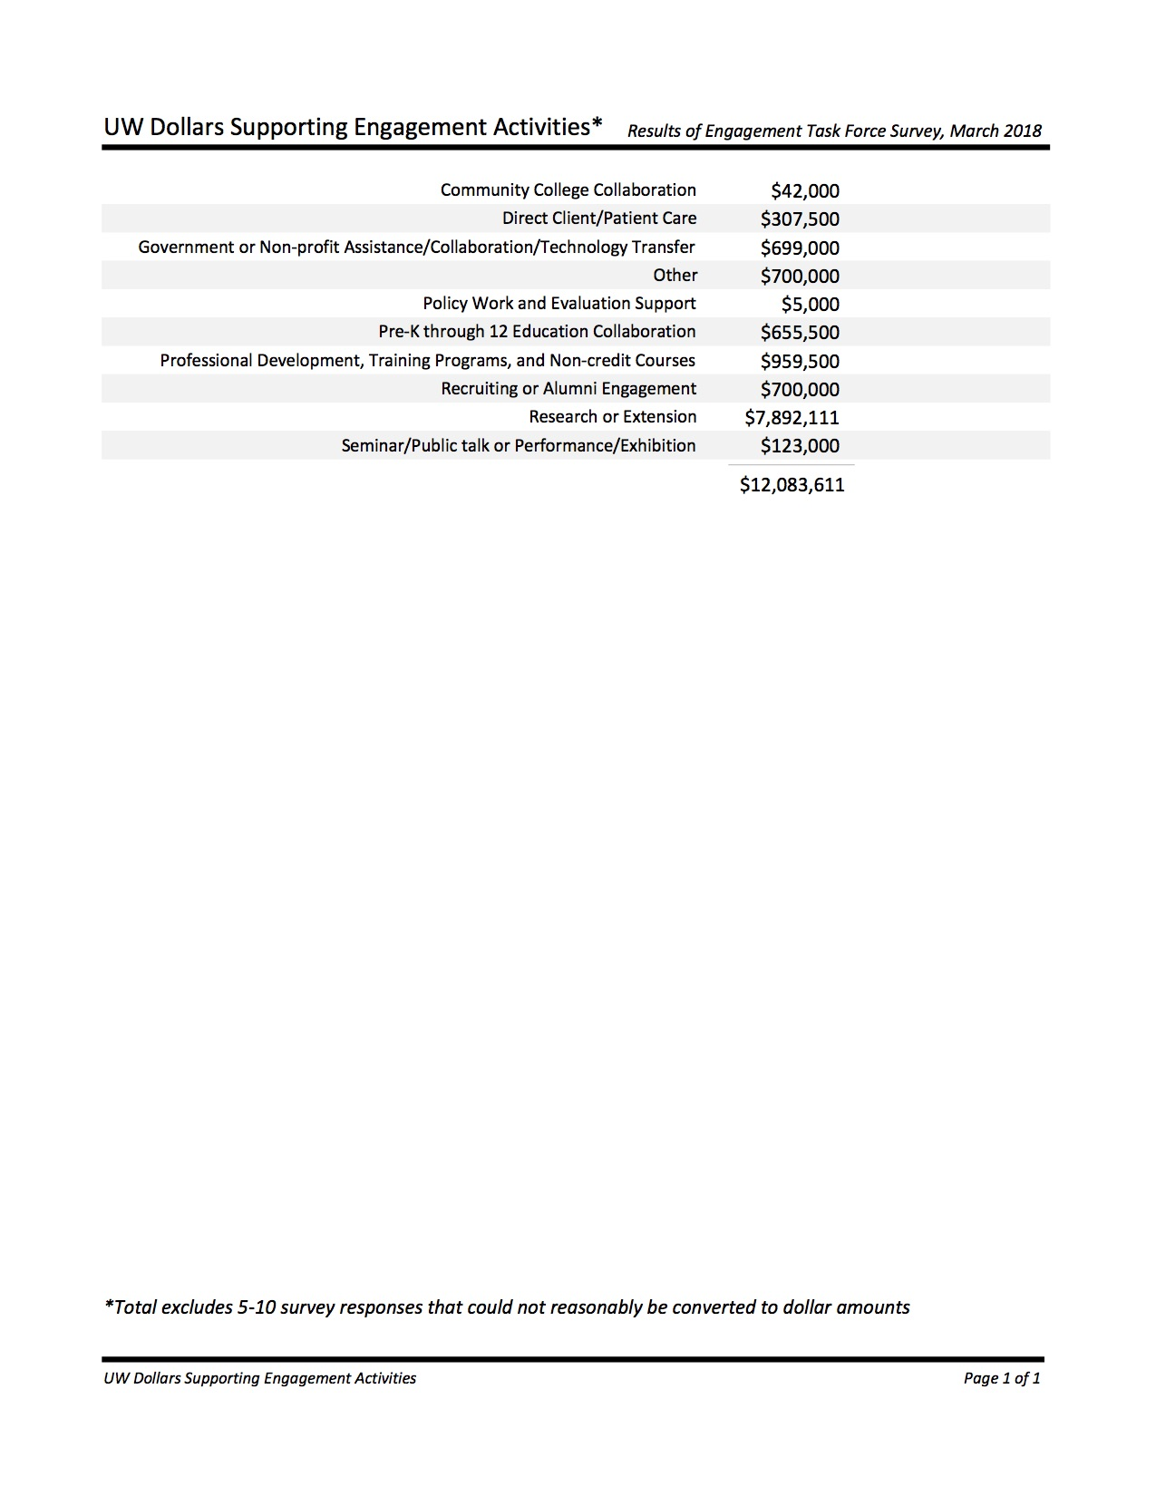

Slide 15
8 Task Force Recommendations
Create an Office of Engagement and Outreach that serves as a portal of access to UW for the citizens of Wyoming (and beyond) and coordinates and streamlines engagement/outreach efforts to achieve enhanced consistency, follow-through, and impact.
Strengthen UW’s culture of support for community engagement and outreach practices, integrate this work with institutional initiatives, and reward this activity within the UW community.

Slide 16
Task Force Recommendations Cont.
Develop practices and structures to expand mutually beneficial relationships with community partners across the state.
Develop robust connections between engagement and student learning and student success measures.
Embrace diverse perspectives and experiences as we work with a broad range of communities and stakeholders.

Slide 17
Task Force Recommendations Cont.
Seek recognition for UW’s engagement and outreach strengths through national benchmarks, such as the Carnegie Foundation’s Classification for Community Engagement, which model best practices in community engagement.
Assess community engagement and outreach activities and use results to drive future decisions.
Communicate regularly and effectively about engagement and outreach.

Slide 18
Celebrating Excellence in Engagement
Marvin Millgate Community Engagement Awards - 2018
Faculty Award: Susan Dewey (Gender and Women’s Studies) – Pathways from Prisons Project
Staff Award: Alec Muthig - Information Technology Client Support Services – Pathways from Prisons Project
Student Award: Dilnoza Khasilova - Ph.D. Program in Literacy, College of Education – World Language and Culture Program
Community Partner Award: Wyoming Conservation Exchange – a partnership among UW Extension faculty members and the Environmental Defense Fund, Sublette County Conservation District, the Wyoming Chapter of the Nature Conservancy and the Wyoming Stock Growers Association

Slide 19
Engagement Priorities for 2019
Open Engagement & Outreach Office in January 2019
Develop & Launch Event Calendar Web App to track UW statewide engagement
Complete OEO Strategic Plan
Form President’s Engagement Council
Complete STEM Inventory; Americorps Assessment Project
Support High Impact Outreach and Engagement Events
Host Discussions on Statewide Engagement Processes, e.g., Hub model

Slide 20
Thank You

