Slide 1
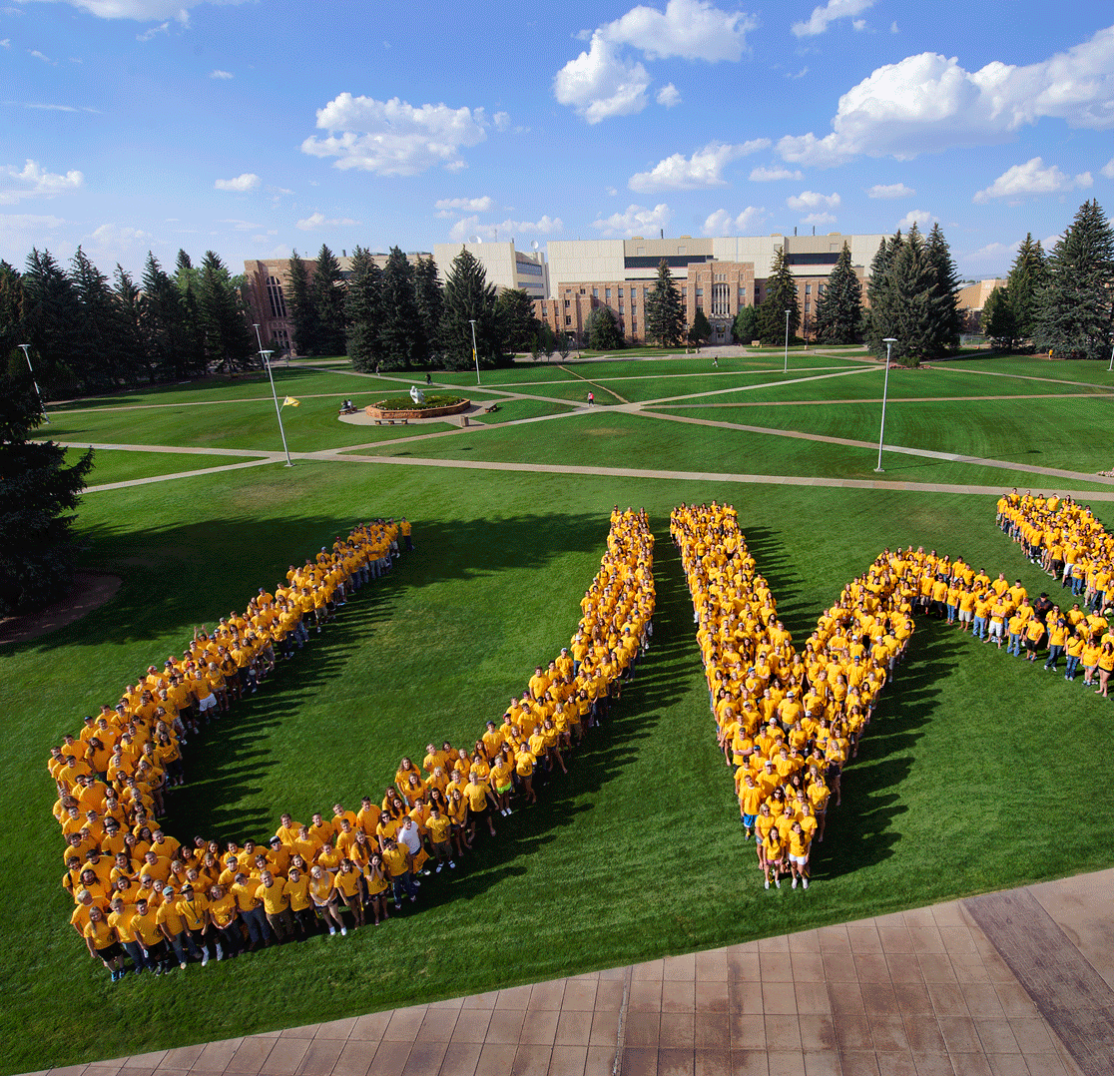

AASHE STARS
Advancing Sustainability at UW

Slide 2

Our Team
Campus Sustainability Committee
Co-chairs
Rachael Budowle, Lecturer, Haub School of Environment and Natural Resources
Nicole Korfanta, Director, Ruckelshaus Institute of Environment and Natural Resources
Student intern team
  Sam Richins, Environmental System Science / ENR (Sustainability / Outdoor Leadership minors)
  Slade Sheaffer*, Civil and Architectural Engineering / ENR (Sustainability minor)
  Dhayanandh Murugan Udupam, Civil and Architectural Engineering
Notes:
President Nichols and Provost Miller have asked the Campus Sustainability Committee to provide some oversight and guidance in meeting UW’s sustainability goals.
Rachael Budowle and Nicole Korfanta co-chair the committee, which includes students, staff, and faculty from across campus.
President Nichols also provided funding to hire two student interns to lead the effort this year.
Slade Scheaffer (lead STARS student coordinator)
Sam Richins
Daya Udupam
We have additional funding from a grant from the Rocky Mountain Power Foundation for the third intern.

Slide 3
Campus Sustainability committee
Academics
Christi Boggs, Instructional Design
Rachael Budowle, Haub School of ENR
Tony Denzer, Civil & Architectural Engineering
Patrick Johnson, Chemical Engineering
Engagement
Amy Bey, Residence Life and Dining Services
Emily Reed, Student
Melissa Nelson, Residence Life and Dining Services
Kimberle Zafft, Residence Life and Dining Services
Operations
Jennifer Coast, Facilities Engineering
Lee Kempert, Materials Services
Karan Manhas, Facilities Engineering
Frosty Selmer, Utilities Management
Michael Ziemann, Utilities Management
Planning and Administration
Nicole Korfanta, Ruckelshaus Institute
Casey Mittelstaedt, Auxiliary Services
Tod Scott, Custodial Services
Rachel Watson, Molecular Biology

Slide 4
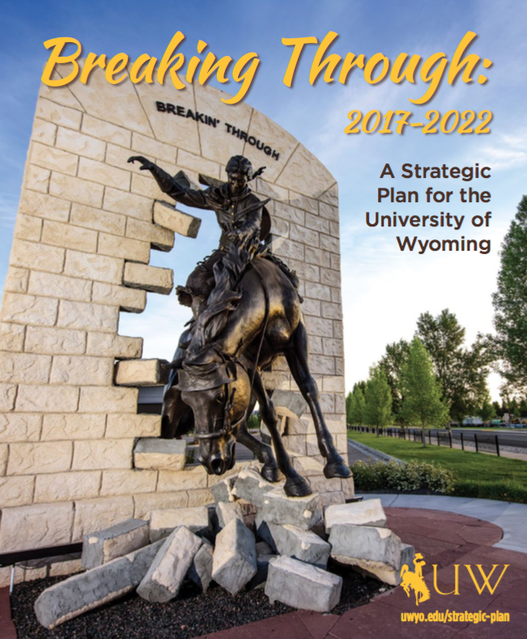

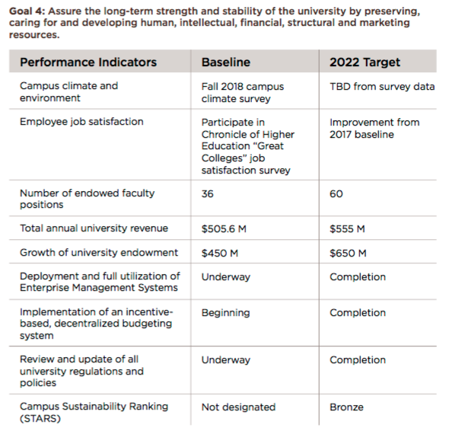
Notes:
Goal 4 of UW’s strategic plan, Breaking Through, is to foster a high-performing university. One performance indicator for that goal is a campus sustainability ranking of Bronze within STARS.
STARS allows us to document the sustainability work we’re already engaging in and to identify the gaps / places where we want to do more.

Slide 5
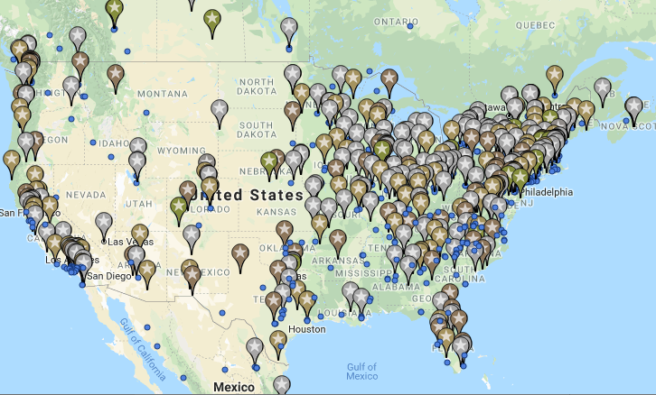

Association for the Advancement of Sustainability in higher education (AASHE)
Sustainability Tracking, Assessment, & Rating System (STARS)
STARS Universities
Notes:
About STARS
STARS—the Sustainability Tracking, Assessment, and Rating Systems— is the most commonly used sustainability tracking tool used by university and college campuses. About half of UW’s close and stretch peers participate in STARS, and many of our regional competitors such as CSU, are part of STARS.
Levels
Administered by the Association for the Advancement of Sustainability in Higher Education, campuses are rated as bronze, silver, gold, or platinum. Campuses may also start out as reporter institutions to use the tool and submit data without be scored. A little over 80% of campuses are gold or silver certified.
WY is aiming for STARS-Bronze, at least initially, which other campuses report as being quite achievable.

Slide 6
What does stars evaluate?
STARS credit category | Subcategories | Possible points
Academics | Curriculum | 40
 | Research | 18
Engagement | Campus Engagement | 21
 | Public Engagement | 20
Operations | Air and Climate | 11
 | Buildings | 8
 | Energy | 10
 | Food and Dining | 8
 | Grounds | 3-4
 | Purchasing | 6
 | Transportation | 7
 | Waste | 10
 | Water | 6-8
Planning and Administration | Coordination and Planning | 8
 | Diversity and Affordability | 10
 | Investment and Finance | 7
 | Wellbeing and Work | 7
Innovation and Leadership | Exemplary Performance | 0.5 each
 | Innovation | 1

Slide 7
Example | Academics, curriculum
STARS credit category | Subcategories
Academics | Curriculum
 | Research
Engagement | Campus Engagement
 | Public Engagement
Operations | Air and Climate
 | Buildings
 | Energy
 | Food and Dining
 | Grounds
 | Purchasing
 | Transportation
 | Waste
 | Water
Planning and Administration | Coordination and Planning
 | Diversity and Affordability
 | Investment and Finance
 | Wellbeing and Work
AC 1 Academic Courses
AC 2 Learning Outcomes
AC 3 Undergraduate Program
AC 4 Graduate Program
AC 5 Immersive Experience
AC 6 Sustainability Literacy Assessment
AC 7 Incentives for Developing Courses
AC 8 Campus as a Living Laboratory
Total number of undergraduate courses offered by the institution
Number of undergraduate sustainability courses offered
Number of undergraduate courses offered that include sustainability
Total number of graduate courses offered by the institution
Number of graduate sustainability courses offered
…..

Slide 8
Example | planning & Admin, Wellbeing
STARS credit category | Subcategories
Academics | Curriculum
 | Research
Engagement | Campus Engagement
 | Public Engagement
Operations | Air and Climate
 | Buildings
 | Energy
 | Food and Dining
 | Grounds
 | Purchasing
 | Transportation
 | Waste
 | Water
Planning and Administration | Coordination and Planning
 | Diversity and Affordability
 | Investment and Finance
 | Wellbeing and Work
Has the institution conducted a survey or other evaluation that allows for anonymous feedback to measure employee satisfaction and engagement during the previous three years?
Percentage of employees (staff and faculty) assessed, directly or by representative sample (0-100)
A brief description of the institution’s methodology for evaluating employee satisfaction and engagement
A brief description of the mechanism(s) by which the institution addresses issues raised by the evaluation
PA 11 Employee Compensation
PA 12 Assessing Employee Satisfaction
PA 13 Wellness Program
PA 14: Workplace Health and Safety

Slide 9
timeline
Register for STARS
Reporter Institution
Fill sustainability gaps
AY 2018
AY 2020
AY 2022
AY 2019
AY 2021
Campus Sustainability Committee
Report
Seek minimum
STARS-Bronze
Fill sustainability gaps
Submit report May 2019

Slide 10
CAMPUS engagement
  Timely data collection and reporting
  Sustainability planning
  Identifying credits to pursue:
    Credits to pursue right now
    Near-reach credits to pursue with a little more effort/resources
    Far-reach credits worth pursuing with a big lift

Slide 11
Thank you

Slide 12
Peer institutions

Slide 13
timeline
Register for STARS
Reporter Institution
Fill sustainability gaps
AY 2018
AY 2020
AY 2022
AY 2019
AY 2021
Campus Sustainability Committee
Report
Seek minimum
STARS-Bronze
Fill sustainability gaps
Notes:
The Campus Sustainability Committee spent last year hatching a plan to get this done.
This year we plan to submit a preliminary report to see where UW shakes out, to iron out our data collection processes, and do some planning around which credits we want to pursue.
Next year we will submit our data for a score.
We have up to two years to keep working toward sustainability goals.
We can choose whether to submit a STARS report annually or every three years, which is the minimum to maintain a STARS rating.
The CSC is committee to provide oversight and guidance to complete STARS but even more importantly, want to continue to move the ball forward on real sustainability progress at UW.

