Slide 1
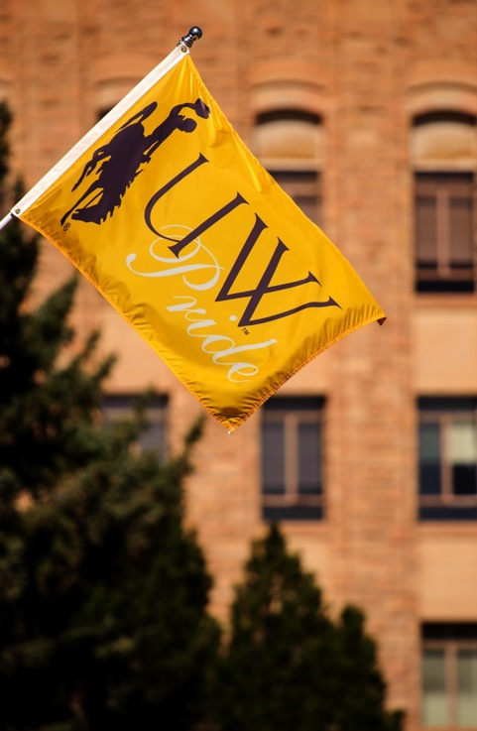

Report to the Board of Trustees
November 2018
Student Satisfaction Survey
1994-2018 Results and Key Takeaways
Anne M. Alexander
Associate Vice Provost for Undergraduate Education
Sean Blackburn
Vice President for Student Affairs

Slide 2
Student Satisfaction Survey
1994-2018 Results
Why?
Accreditation
Assessment, Improvement, Change
Tell Our Story
DIVISION OF STUDENT AFFAIRS
DIVISION OF STUDENT AFFAIRS
DIVISION OF STUDENT AFFAIRS
DIVISION OF STUDENT AFFAIRS
DIVISION OF STUDENT AFFAIRS

Slide 3
Surveys used
ACT Student Opinion Survey:
Used since 1994
Contains 65 Questions
Questions like: "Have you used....?"/"How satisfied are you with....“
Climate related and security/safety related questions not asked on other survey and are highly useful for panel analysis.
Noel Levitz Student Satisfaction Inventory:
Used since 1998
Contains 73 Questions
Importance and Satisfaction
Comparisons to national four-year publics
DIVISION OF STUDENT AFFAIRS
DIVISION OF STUDENT AFFAIRS
DIVISION OF STUDENT AFFAIRS
DIVISION OF STUDENT AFFAIRS
DIVISION OF STUDENT AFFAIRS

Slide 4
Administration:
All administration online, WYSAC
7200 students surveyed, chosen at random from pool of 11,791 valid UW student records with valid email addresses.
Email notification pre-Spring Break to selected students
Survey live notification post-Spring Break, 3 reminders
Random assignment of which survey administered
RNL survey = 3100 surveys deployed, 932 completions (30.1%)
ACT survey =4100 surveys deployed, 1505 completions (36.8%)
Analysis done by Dr. Oliver Walter
DIVISION OF STUDENT AFFAIRS
DIVISION OF STUDENT AFFAIRS
DIVISION OF STUDENT AFFAIRS
DIVISION OF STUDENT AFFAIRS
DIVISION OF STUDENT AFFAIRS

Slide 5
Highlights
Would you enroll here again?
80% of students say yes
This is an increase of 2% over 2016 and significantly higher than the national average
I am pleased with my education
93% overall say yes, with 98% of freshmen responding affirmatively.
The total satisfaction here was 3 points lower than in 2016.
DIVISION OF STUDENT AFFAIRS
DIVISION OF STUDENT AFFAIRS
DIVISION OF STUDENT AFFAIRS
DIVISION OF STUDENT AFFAIRS
DIVISION OF STUDENT AFFAIRS

Slide 6
Highlights
DIVISION OF STUDENT AFFAIRS
DIVISION OF STUDENT AFFAIRS
DIVISION OF STUDENT AFFAIRS
DIVISION OF STUDENT AFFAIRS
DIVISION OF STUDENT AFFAIRS

Slide 7
Highlights
DIVISION OF STUDENT AFFAIRS
DIVISION OF STUDENT AFFAIRS
DIVISION OF STUDENT AFFAIRS
DIVISION OF STUDENT AFFAIRS
DIVISION OF STUDENT AFFAIRS

Slide 8
Highlights
DIVISION OF STUDENT AFFAIRS
DIVISION OF STUDENT AFFAIRS
DIVISION OF STUDENT AFFAIRS
DIVISION OF STUDENT AFFAIRS
DIVISION OF STUDENT AFFAIRS

Slide 9
Highlights
DIVISION OF STUDENT AFFAIRS
DIVISION OF STUDENT AFFAIRS
DIVISION OF STUDENT AFFAIRS
DIVISION OF STUDENT AFFAIRS
DIVISION OF STUDENT AFFAIRS

Slide 10
Areas of Improvement
DIVISION OF STUDENT AFFAIRS
DIVISION OF STUDENT AFFAIRS
DIVISION OF STUDENT AFFAIRS
DIVISION OF STUDENT AFFAIRS
DIVISION OF STUDENT AFFAIRS

Slide 11
Areas of Improvement
DIVISION OF STUDENT AFFAIRS
DIVISION OF STUDENT AFFAIRS
DIVISION OF STUDENT AFFAIRS
DIVISION OF STUDENT AFFAIRS
DIVISION OF STUDENT AFFAIRS

Slide 12
Areas of Improvement
DIVISION OF STUDENT AFFAIRS
DIVISION OF STUDENT AFFAIRS
DIVISION OF STUDENT AFFAIRS
DIVISION OF STUDENT AFFAIRS
DIVISION OF STUDENT AFFAIRS

Slide 13
Pride points
Diversity, Ideology, and Climate
Strong growth in commitment to racial harmony - up 6 points from last administration of survey
Friendly @ 88% versus hostile @6%
Fairly balanced on ideology, though uptick in expression of "liberal" slant
Progress on "non-homophobic" versus "homophobic"
Campus Life
Personal and campus safety
Transit system use
Residence Halls and Dining staff
Veteran Services
Union
Recreation and Intramurals
Athletics, both facilities and pride in
Classroom experiences
Intellectual growth
Commitment to excellence
Instruction in major excellent and relevant
Instructional quality
Instructors care
Class sizes
Academic Support
Libraries and staff
IT facilities and support
Tutoring Classroom and lab facilities
DIVISION OF STUDENT AFFAIRS
DIVISION OF STUDENT AFFAIRS
DIVISION OF STUDENT AFFAIRS
DIVISION OF STUDENT AFFAIRS
DIVISION OF STUDENT AFFAIRS

Slide 14
Opportunities
Cultural Programs
Satisfaction high @ 87%
But uptake low @ 20%
Down from a high of 36% two decades ago.
Messaging on Student Fees
25% straight out dissatisfied
We can improve trust with strong reporting and student voice on program and advising fees.
Advising and Career/Life Prep
New advising model overdue and should yield benefits.
New “Career Everywhere” taskforce will help us improve in life/career prep satisfaction.
Value and Quality
Factors in enrolling @ UW show cost and financial aid were strong considerations. Academic reputation was not.
The excellence of services and instruction and the opportunity to grow intellectually were strong. Leverage that outcome.
UW education is a worthwhile investment - UW scored significantly higher than the national average. Leverage that outcome.
DIVISION OF STUDENT AFFAIRS
DIVISION OF STUDENT AFFAIRS
DIVISION OF STUDENT AFFAIRS
DIVISION OF STUDENT AFFAIRS
DIVISION OF STUDENT AFFAIRS

