Slide 1
University of Wyoming Department of Intercollegiate Athletics
____________________________________________
Annual Update Report 2018
Presented Fall 2018

Slide 2
Academic Achievements
FY11
FY17
965
970
73
51%
125
62
2.880
Average Multi-Year APR
Average Single Year APR
GSR Score
6 Year Federal Graduation Rate
Academic All-Conference Awards (3.0 or above)
Scholar Athlete Awards (3.5 or above)
Student-Athlete Average Cumulative GPA
982
992
82
63%
176
98
3.130

Slide 3
Highlights
Football:
Defeated Central Michigan University in the Potato Bowl 37-14
Back to back bowl appearances
Josh Allen selected 7th overall in the NFL Draft
2017 Football team, including Josh Allen, produced $159M of national/regional
exposure for UW Athletics, University of Wyoming, and the State of Wyoming
Women’s Basketball:
Finished 3rd in MWC for 2017-2018 season
Earned a second straight WNIT Post Season bid
Coach Legerski was selected 2017 and 2018 MW Coach of the Year
Women’s Volleyball:
Finished 2nd in MWC for 2017-2018 season
Earned a post-season bid for the 1st time since 1984
Wrestling:
Bryce Meredith finished 2nd (2016) and 4th (2017) at NCAA Championships (3 time All American)
Coach Branch was named 2018 Big 12 Coach of the Year
Swimming and Diving:
Cowboy Swimming won the WAC Swimming/Diving championships in 2018
Diving Coach Kyle Bogner named 2018 WAC Diving Coach of the Year
Coach Denniston named 2018 WAC Coach of the Year

Slide 4
UW Intercollegiate Athletics Spending Comparison
FY11
FY18
Total Spending $27.8M
Total Spending $38.56M
$10.76M Increase
$5.75M Self Generated Funds (ticket sales, fundraising, etc.)
$4.0M Matching Dollars (state)
$1.0M Other Sources
5,000 Cowboy Joe Club Members – largest in MWC
Football ticket revenue has grown by 25% since 2013
FY11 6th in MWC total spending
FY17 8th in MWC total spending

Slide 5
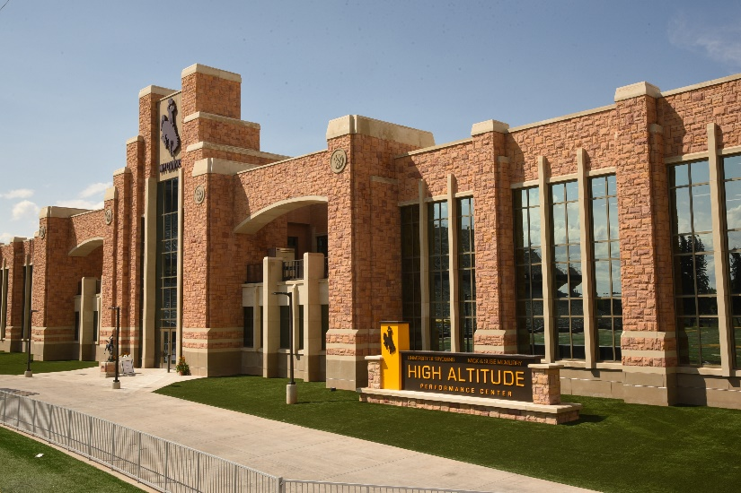
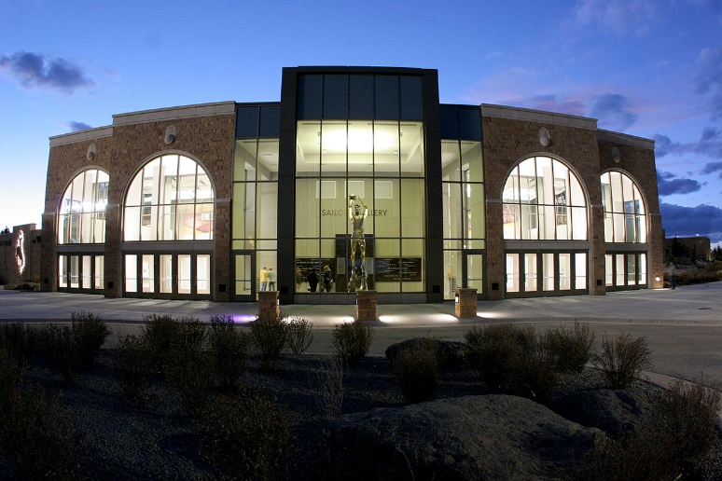
McMurry High Altitude Performance Center
Over $44M of private and state funds
12,000 Sq. Ft. Football Sports Performance Weight Training Area
8,000 Sq. Ft. Olympic Sports Performance Weight Training Area
Plyometric workout areas, including sand pit, stairs, and turf ramp
Kinesiology training/research area
New, modern football locker room
Nutrition focused training table and fueling station
Enhanced Sports Medicine area with recovery pools and altitude control chamber
Enhanced Academic Center with 70 computer stations and
multiple tutor/counseling/study rooms
Arena Auditorium Remodel
$30M of private and state funds
New entryway including Kenny Sailors statue
Upgraded retractable theatre seating
New basketball floor with additional practice courts
Upgraded LED lighting and sound system
High Definition video board system
Courtside LED boards/scoreboards
Upgraded men’s and women’s basketball locker rooms
Upgraded Sports Medicine area
New Sports Performance Weight Training Area
Enhanced concessions facilities including commissary
New theatre style film room

Slide 6
UW Intercollegiate Athletics Future Projects
Corbett Pool Renovation or New Stand-Alone Pool Facility
Estimated cost $25M-$35M depending on size, location, and exterior finishes
West Side Stadium Renovation
Lower west major maintenance
Restrooms (including ADA) , Seating (including ADA), Concessions, Lighting, Storage
Media/Press area upgrade to Division I standards
Adequate technology, restrooms, elevator, seating, heating, etc.
South Entrance Upgrade
Provide for quality entrances in the south and develop a pedestrian link to main campus, plus a positive game day experience on the south side
Estimated cost $50M-$60M
Soccer Facility Renovation
Current facility does not meet UW standards for playing surface, locker rooms, and restrooms
New facility needs to include a larger playing surface and sports specific lighting
Artificial surface with lighting is also a need of Intramural/Campus Rec sports as well as Athletics
Estimated cost $4M
Wresting Practice Facility Expansion
Need to provide a larger, safe space for training of wrestling student-athletes (nationally ranked wrestling program)
Current facility lacks sufficient space to safely train based on the number of student -athletes on roster
Expansion to the south is possible, but expensive, due to demolition/construction needed in the Fieldhouse
Estimated cost $1.5M

Slide 7
-
-
7.62%
$531,964
15.05%
$1,212,806
% annual growth
Annual $ change
7.29%
$547,654
13.21%
$1,224,838
Total Growth 50.38% $3,517,262

Slide 8
UW vs. San Diego State Comparison
FY11
FY17
Football Spending $5.95M
University of Wyoming
Football Spending $10.5M
$4.55M Increase
FY11 Record 3-9, Ranked 8th in MWC
FY17 Record 8-6, Ranked 2nd in MWC
San Diego State
Football Spending $12.1M
Football Spending $14.6M
$2.51M Increase
FY11 Record 9-2, Tied 3rd in MWC
FY17 Record 11-3, Ranked 1st in MWC
University of Wyoming
MBB Spending $2.74M
MBB Spending $3.13M
$39K Increase
Average MWC ranking 7th
Never finished above 4th
San Diego State
MBB Spending $3.64M
MBB Spending $5.92M
$2.28M Increase
Average MWC ranking 2nd
Three 1st place rankings
Two 2nd place rankings

Slide 9
University of Wyoming Intercollegiate Athletics does not
need the most resources in the Mountain West Conference
to be successful, but we cannot be successful if we are in the
bottom 1/3. It is clear that resources drive success.
FY17 Spending
San Diego State
Boise State
Wyoming
Utah State
San Jose State
$51.57M
$45.46M
$38.67M
$34.21M
$30.68M
The future is very bright, but we must continue to look for strategic ways
to invest in our programs.

