Slide 2
BREAKING THROUGH
The University of Wyoming Board of Trustees in July 2017 adopted “Breaking Through 2017-2022: A Strategic Plan for the University of Wyoming” following an extensive planning process that began in September 2016.
This is the first annual report on the university’s progress toward meeting the goals of the strategic plan, which revolves around a bold vision:
As the Equality State’s university, we strive to break through barriers and explore new frontiers of teaching and learning. Through the unfettered pursuit of knowledge, we aim to apply innovation, intelligence and tenacity to meet the economic, social and environmental challenges of today, and to create a sustainable, diverse and equitable world without borders for tomorrow.

Slide 3
GOAL 1 DRIVING EXCELLENCE
Join together as an intellectual community already renowned for its regional, national and global relevance and impact by fostering and rewarding excellence in teaching, scholarship, innovation and creative endeavor.

Slide 4
GOAL 1 | DRIVING EXCELLENCE Performance Indicators (metrics)
Key Performance Indicator | Baseline | Year 1 | 2022 Goal
Changes in external recognition of scholarly work | Invest in a database | Software not yet acquired | 1 decile improvement from baseline indicators
External research funding: awards and expenditures | $85.18 million in external awards/$108.13 million in expenditures | $80.67 million in external awards/$84.67 million in expenditures | $115 million in external funding
Income-bearing IP licenses | 2 to 3 per year | 0 | 5 or more per year
Degree programs created, substantially modified, or eliminated | 192 degree and certificate programs | 2 new programs; 4 programs modified; no eliminations | 8 new academic programs; 4 modified or eliminated
Number of international students | 791 | 785 | 1,050
Number of students and faculty participants in study abroad | 395 students; 30 faculty | 470 students; 38 faculty | 600 students; 50 faculty

Slide 5
GOAL 1 | DRIVING EXCELLENCE Other Initiatives Contributing to Goal Attainment
Developed new academic programs in Outdoor Recreation & Tourism Management and Cybersecurity, helping to address workforce needs in Wyoming
Signed new partnership agreements with Freie Universität Berlin and Université de Strasbourg
Advanced plans to enhance professional academic advising services for first-year, distance, and transfer students; career advising; internship coordination; tutoring; and supplemental education through program fees

Slide 6
GOAL 2
INSPIRING
STUDENTS
Inspire students to pursue a productive, engaged and fulfilling life and prepare them to succeed in a sustainable global economy.

Slide 7
GOAL 2 | INSPIRING STUDENTS Performance Indicators (metrics)
Key Performance Indicator | Baseline | Year 1 | 2022 Goal
Overall enrollment (Enrollment growth projected for both in-state and out-of-state students) | 12,366 | 12,397 | 13,500
Enrollment of transfer students | 967 | 1,086 | 1,200
Enrollment of underrepresented students | 13% | 13% | 17%
Retention rate for FTFT (First-time, full-time baccalaureate degree-seeking) | 76% | 78.1% | 80%
Construction of new residence halls | Create a 10-year Plan for Student Housing | 10-year housing plan developed; currently under review by legislature’s UW Housing Task Force | 10-year plan in implementation; 2-3 new residence halls in construction or completed

Slide 8
GOAL 2 | INSPIRING STUDENTS Performance Indicators (metrics)
Key Performance Indicator | Baseline | Year 1 | 2022 Goal
Student participation in support services | 24.7% | 31.5% | 40%
4- and 6-year graduation rates for undergraduates | 25.8%/54.4% | 26%/58.2% | 33%/60%
Percentage of students completing an experiential transcript | Institute a co-curricular transcript | UW Connect under development | 25% of seniors have a co-curricular transcript
Placement in jobs or advanced degree programs one year following graduation | 66%* | Follow-up survey in progress | 85%
Percentage of graduates with credential from the Honors College | 4% | 3.6% | 8%
*Baseline placement data are 6-month figures

Slide 9
GOAL 2 | INSPIRING STUDENTS Other Initiatives Contributing to Goal Attainment
Continued efforts to improve community college transfer: launched Transfer Center and increased the number of 2+2 programs to 182
Launched the Institute of Innovation and Entrepreneurship, which will help to develop a culture of innovation and entrepreneurship, enrich educational opportunities for students, and enhance tech transfer operations
Established the Honors College
Developed new diversity and inclusion programming and training opportunities through the new Office of Diversity, Equity, and Inclusion

Slide 10
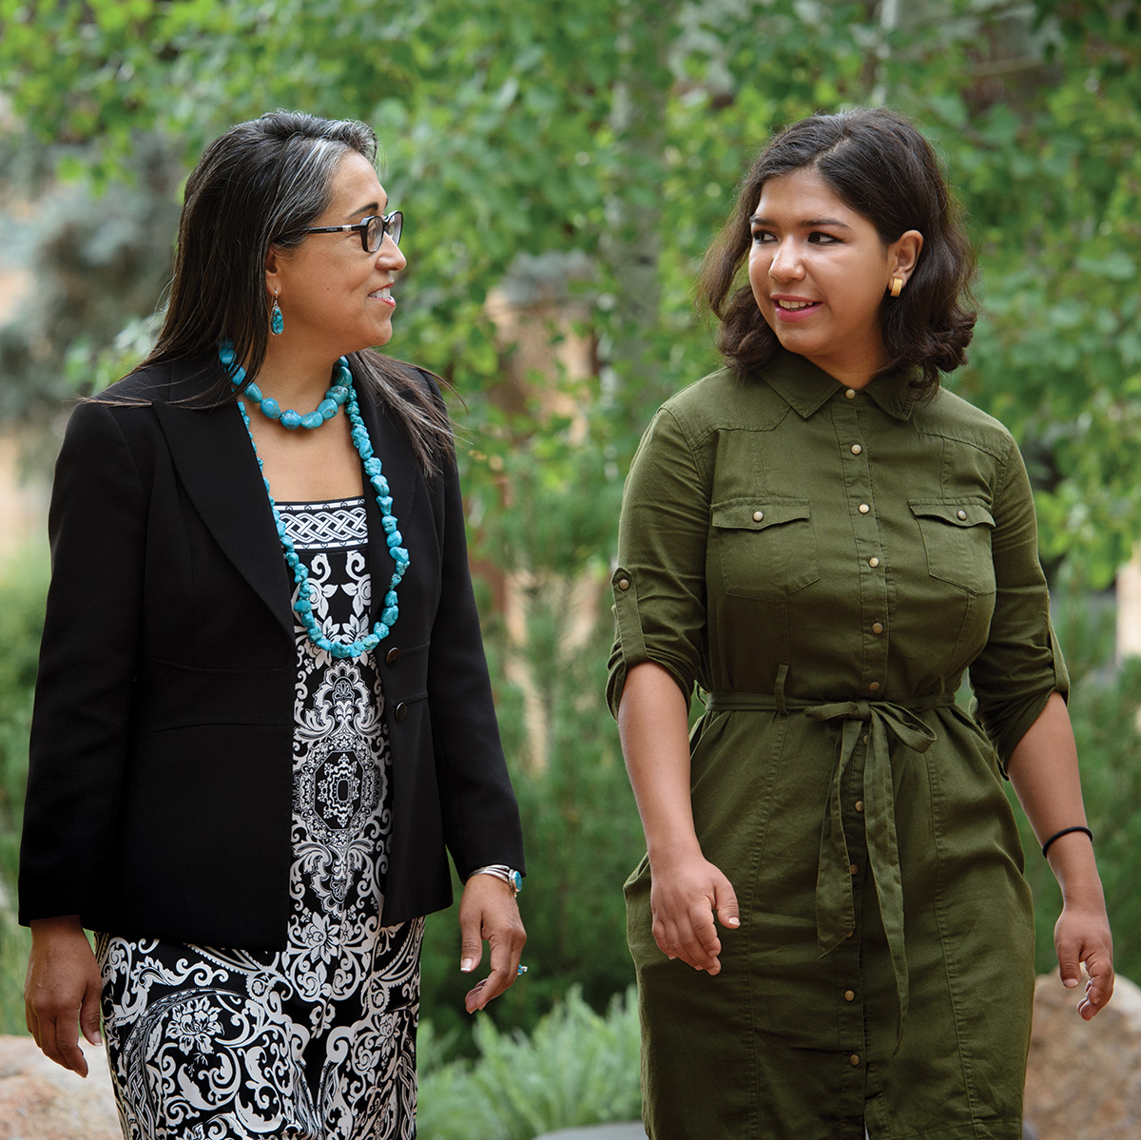
GOAL 3 IMPACTING COMMUNITIES
Improve and enhance the health and well-being of our communities and environments through outreach programs and in collaboration with our constituents and partners.

Slide 11
GOAL 3 | IMPACTING COMMUNITIES Performance Indicators (metrics)
Key Performance Indicator | Baseline | Year 1 | 2022 Goal
Carnegie Community Engagement Classification | Not designated | Conducted Engagement survey and held campus and community listening sessions, resulting in the publication of Envisioning Community Engagement and Outreach | Qualified to submit for 2024 deadline
Attendance at intercollegiate athletic events | 275,372 | 303,726 | 310,000

Slide 12
GOAL 3 | IMPACTING COMMUNITIES Other Initiatives Contributing to Goal Attainment
Direct engagement with Wyoming’s ENDOW initiative
New MOUs with the Eastern Shoshone and Northern Arapaho tribes
Opening of the Native American Educational, Research, and Cultural Center

Slide 13
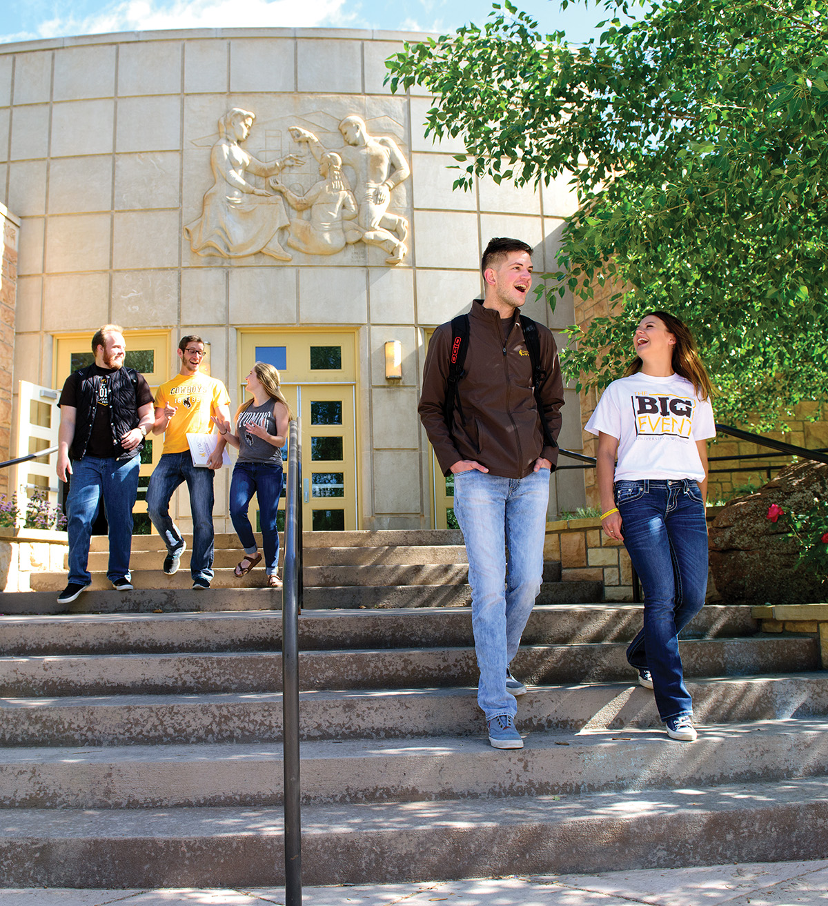
GOAL 4 A HIGH-PERFORMING UNIVERSITY
Assure the long-term strength and stability of the University by preserving, caring for and developing human, intellectual, financial, structural and marketing resources.

Slide 14
GOAL 4 | A HIGH-PERFORMING UNIVERSITY Performance Indicators (metrics)
Key Performance Indicator | Baseline | Year 1 | 2022 Goal
Campus climate and environment | Fall 2018 Campus Climate survey | Conduct focus groups Fall 2018; survey in Spring 2019 | TBD from survey data
Employee job satisfaction | Participate in Chronicle of Higher Education "Great Colleges" job satisfaction survey | Job satisfaction and support: 61%; Survey average across workplace categories: 46% | Job satisfaction and support: 71%; Survey average across workplace categories: 56%
Number of endowed faculty positions | 36 | 41 | 60
Total annual funding to the university | $505.6 million | $520.7 million | $555 million
Growth of university endowment | $450 million | $500.3 million | $650 million

Slide 15
GOAL 4 | A HIGH-PERFORMING UNIVERSITY Performance Indicators (metrics)
Key Performance Indicator | Baseline | Year 1 | 2022 Goal
Deployment and full utilization of Enterprise Management System | Initiated | Financial Management and Budgeting systems implemented | Completion
Implementation of an incentive-based, decentralized budgeting system | Initiated | All-funds budget implemented in FY18 | Completion
Review and update of all University regulations and policies | Initiated | 23 UW Regulations modified and 3 new regulations approved as part of the regulatory structure review. 23 UW Regulations modified and 3 new regulations approved per normal UW business. | Completion
Campus Sustainability Ranking (STARS) | Not designated | UW joining STARS program | Bronze

Slide 16
GOAL 4 | A HIGH-PERFORMING UNIVERSITY Other Initiatives Contributing to Goal Attainment
Study of university salary policy and development of recommendations and a plan for market- and merit-based salary increases, which is being implemented this month
Examination of UW’s enrollment capacity, tuition and fees
Development of divisional and college strategic plans aligned to the University plan
Construction of College of Engineering and Applied Science facility; High Altitude Performance Center
Architectural planning for the Science Initiative facility, including state-of-the-art, highly flexible, and competitively assigned interdisciplinary research labs

