Slide 1

Common College Transcript - HEA 47
September 13, 2018

Slide 2
Background on HEA 47
HB0175, Common Transcripts:
Develop and maintain common college transcript system between WCC’s and UW
Develop a plan to establish electronic transcript transfer and common course numbering
Plan shall be submitted to JEIC by Oct 31st

Slide 3
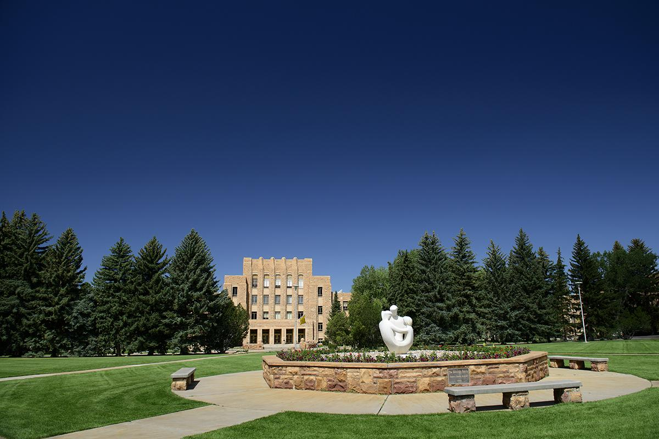
UW Response to HEA 47
Statewide HEA 47 Workgroup has been formed
Representation from:
  Wyoming Community College Commission
  All Seven Community College
  Wyoming Department of Education
  University of Wyoming
Support from this group extends HEA 47
  Statewide attainment initiatives
  (WHICHE grants)

Slide 4

Initial efforts in response to HEA 47
1. Statewide educational data sharing MOU
MOU - expanding data statewide involvement
  10 party MOU
  Course level data
  Financial aid
  Dual and Concurrent enrollment data

Slide 5
Initial efforts in response to HEA 47
2. Empowerment of WCCC Academic Affairs Council
Expand charge to include focused activity on identification of statewide course misalignment
UW to be incorporated into that portion of the ACC charge

Slide 6
Initial efforts in response to HEA 47
3. National Student Clearinghouse as transcript Vendor
Statewide participation and use of singular electronic transcript platform
If needed - bridge for data from non NSC schools

Slide 7
Initial efforts in response to HEA 47
4. Statewide catalog solution
Consistent student experience
Statewide course availability
Searchable educational opportunity

Slide 8
Initial efforts in response to HEA 47
5. Statewide Longitudinal Educational Database
Platform for statewide analytics
Alignment of catalogs and catalog conversions
Recruitment and enrollment functionality across WY

Slide 9
UW Response to HEA 47
Statewide HEA 47 Workgroup has been formed
Initial draft of legislative response is underway
Heightened involvement across higher educational partners
Carryover support of Statewide Attainment goal (ENDOW)

Slide 10
Common College Transcript – HEA 47
July 12, 2018

