Slide 1
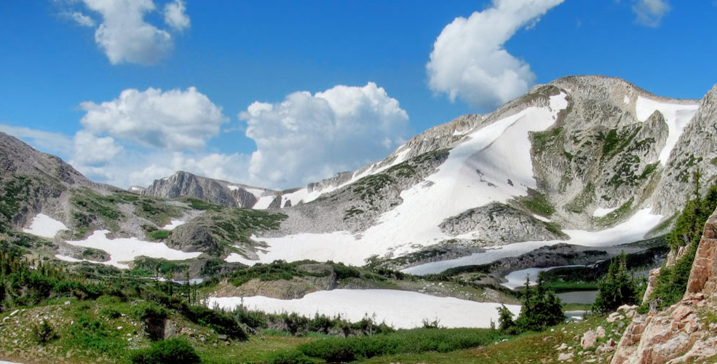
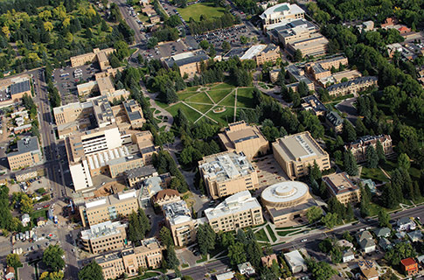
Grants, contracts, and supercomputing
Edmund J. Synakowski
Vice President for Research and Economic Development
January 24, 2019

Slide 2
UW is classified as a Tier 2 Research Institution, per Carnegie Classification of Institutions of Higher Ed
R1: Doctoral Universities – Highest Research Activity
130 universities nationally
This level includes U of NE, U of CO; CSU
R2: Doctoral Universities – Higher Research Activity
139 universities nationally
This level includes U of ID, ND, SD, and MT; also ID, ND, SD, MT State
R3: Doctoral Universities – Moderate Research Activity
163 universities nationally
UW

Slide 3
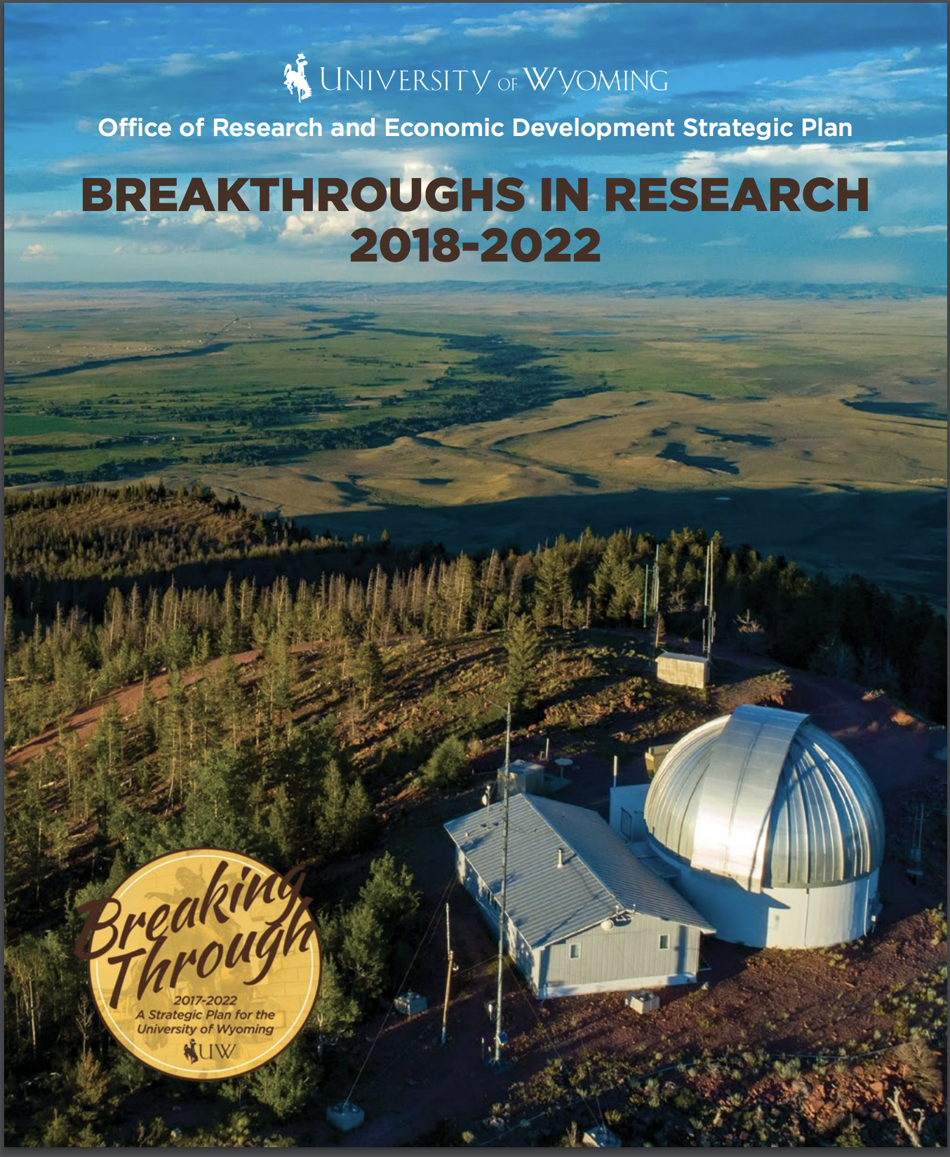
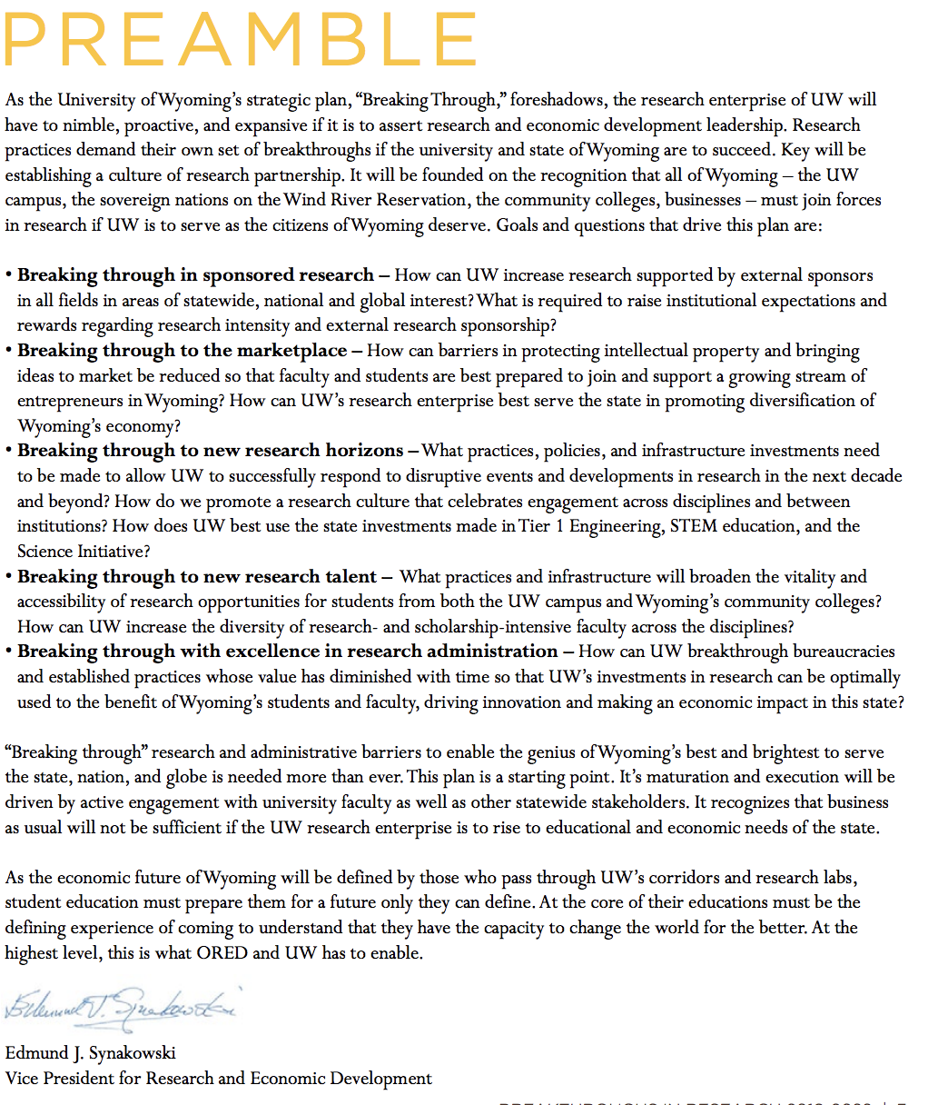
UW’s Office of Research and Economic Development has developed a strategic plan

Slide 4
Grants and Contracts thus far in FY 2019
Grant capture – through November 30
FY 2019: $53,277,412 grants awarded, financial aid subtracted (BoT report)
Funds via 263 grants
Compare to same time in FY 2018: $41,520,090; FY 2017: $39,550.339
Recent submissions
November 2018: ORED submitted 28 proposals for ~$11 M
December 2018: ORED submitted 19 proposals for ~$4.6M
29 proposals scheduled for submission in January, $ TBD
Government shutdown may reduce grant capture in near term, as some agencies are closed (NSF, NOAA, NEH, USDA, USFS, USGS, EPA, more…)

Slide 5
Indirect cost recovery: funds to the university to cover the indirect costs of doing research
Total IC recovery, FY 2018: $12,018,820
Normal distributions to Depts/Colleges/ORED: $2,023,123
Matching requirements: $947,514.73
Special distributions: $3,006,312
Remainder to central administration
Total IC recovery, FY 2017: $10,940.236.00
Total IC recovery, FY 2016: $11,884,712.07

Slide 6
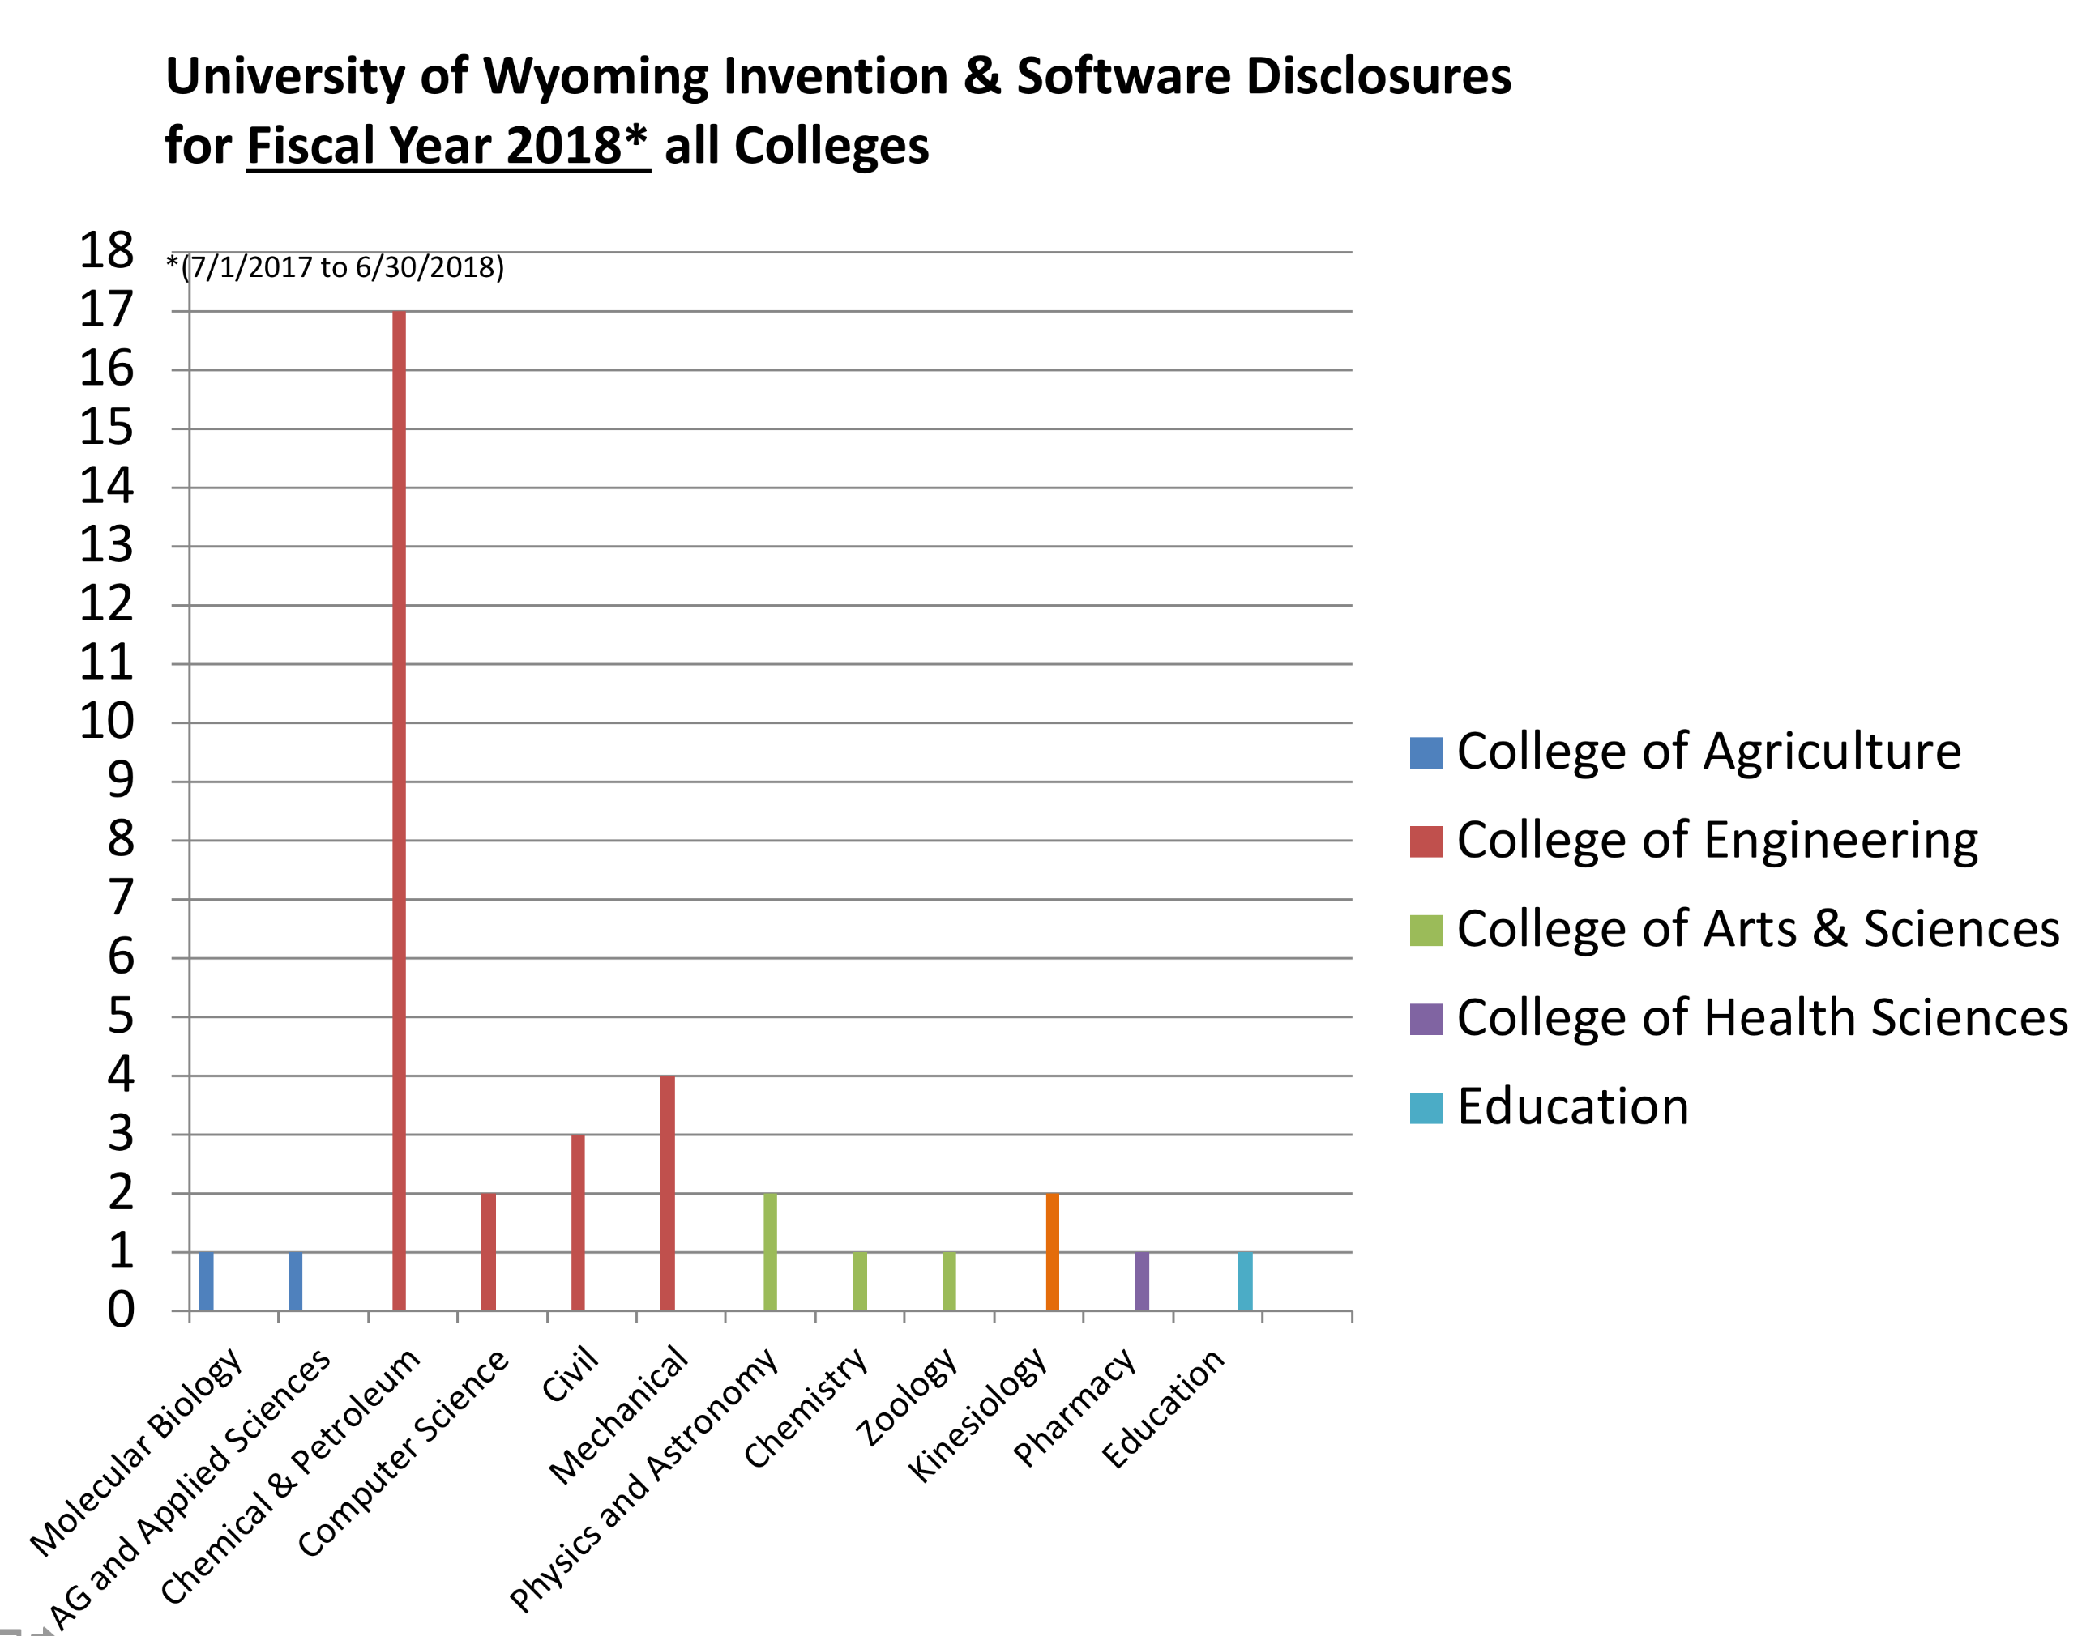
Research leading to IP, by department: Chemical and Petroleum Engineering has the most invention disclosures
For FY16/17/18:
Total UW patents filed
44/53/48
IP agreements
131/144/151
Invention disclosures
22/53/37
Number of option, license, assignment, or other agreements signed that convey rights to university-owned patents
1/3/3
UW Tech Transfer Office developing strategic plan to increase capacity, engage with Colleges to stimulate IP creation

Slide 7
Office of Research and Economic Development: services, recent actions, plans
State of play 1.5 years ago:
many departures from ORED, which was already lean
gaps in capacity in Research Services (proposal prep and submissions); other gaps include Tech Transfer, compliance, more…
aspiration demanded restructuring: informed by listening sessions, resources available, and looking at similar offices elsewhere,
we reorganized ORED, began hiring ➔ strengthening processes so they are scalable to a larger research effort such as pre-preposal support, compliance, centralized budgeting
Significant new hires have been made: examples
new Associate VP for Research (D. Hulme)
increased research service capacity (pre-proposal): ~2 FTE ➔ 4.5
proposal and budget preparation; award negotiation with sponsors
training in proposal writing (contracted seminars)
new Tech Transfer (Nowak) and Compliance (Broccardo) directors

Slide 8
To help optimize ORED and Sponsored Programs research services, Point Consulting is here to assess and advise
For ORED: research services (pre-proposal) have had capacity challenges, most recently in issuing sub-awards for grants, as FTE levels were low. As we staff up, we need to
better understand if we are at the right staffing level
Ensure that our practices in serving the colleges, and in how we work with the Office of Sponsored programs, are strong
Point Consulting Group arrived on January 14 and has begun interviewing our staff, as well as the staff in the Office of Sponsored Programs.
Deliverables will include a report, with observations and recommendations to ORED, Finance and Administration division, and the president

Slide 9
Wyoming N-CAR Alliance projects in FY18
N-CAR: National Center for Atmospheric Research
NWSC: N-CAR Wyoming Supercomputing Center
A partnership between the University Corporation for Atmospheric Research (UCAR – 117 members), the State of Wyoming, the University of Wyoming, Cheyenne LEADS, Wyoming Business Council, and Black Hills Energy.
Among universities in FY18, Wyoming ranked…
#1 in total allocations
#1 in total HPC charges
#2 in total users
#3 in active projects
This partnership can deliver even more that at present: Recent leadership discussions (UW and NCAR) revealed untapped possibilities for partnership

Slide 10
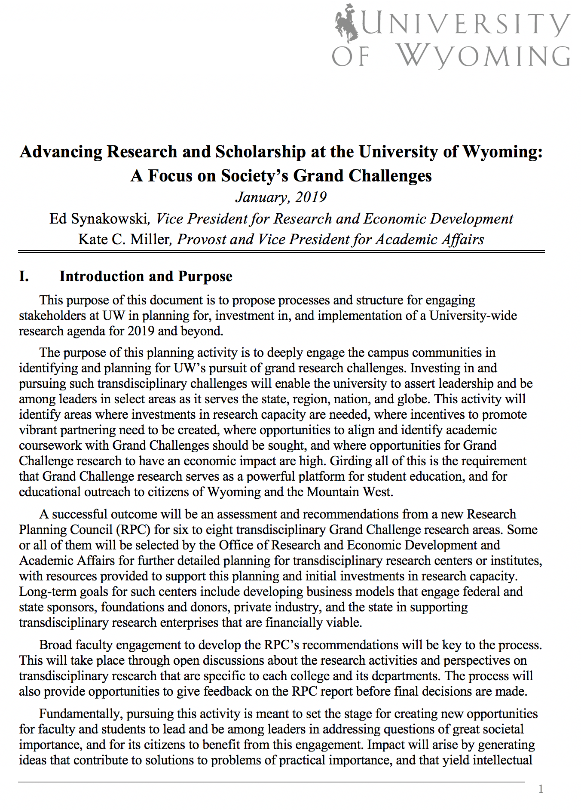
ORED and Academic Affairs are launching a new research strategic planning activity: transdisciplinary Grand Challenges
Sample Grand Challenges
Institutions that will matter most in coming decades: those who can respond to great transdisciplinary research challenges
Wyoming is a marvelous laboratory for many such challenges
Identifying the challenges: semester long process
Research Planning Committee being formed (associate deans, research intensive faculty, others)
Discussing with deans and directors on 2/5
Deliverable: a report with 6-8 challenges recommended for further planning and investment; preliminary gaps/strengths analysis; partnership possibilities
Report to BoT this summer
First page of draft document describing the research planning activity

