Slide 1
Undergraduate Student Financial Aid Plan for the 2020-21 Academic Year (Fiscal Year 2021)
July 18, 2019

Slide 2
Goals
Financial aid resources at the University of Wyoming (“UW”) should be developed, managed, and deployed in order to:
Enroll and deliver a quality education to as many Wyoming citizens as possible.
Maintain affordability of the cost of attending UW for students from lower-income Wyoming families
Limit student loan debt for Wyoming families
Retain students through graduation
Increase the share of financial aid paid by gifts provided to the UW Foundation

Slide 3
Financial Aid Recommendations for the 2020-21 Academic Year (Fiscal Year 2021)
The table below outlines eleven recommendations the Administration is proposing which together comprise the tuition and financial aid plan for the 2020-21 academic year (fiscal year 2021).
# | TOPIC/AREA | RECOMMENDATION | Current Financial Aid Model
1 | Academic Rating Index Matrix | Adopt New Academic Rating Index Matrix & Awarding Bands
2 | Non-Resident Rating 185 & Above (WUE & RMS150) | Eligibility Requirements: Raise to Equivalent of Trustees Scholars or Special Talent Cap Number of Available Awards at 50 | Academic Rating of 166.67 or above
3 | Non-Resident Rating 170-184.9 | $7,000 Award and Raise the Academic Rating Required to Receive the Award | $6,000 Award
4 | Non-Resident Rating 155-169.9 | $4,000 Award | $3,000 Award
5 | Non-Resident Rating 125-154.9 | $2,000 Award | $0 Award
6 | Resident Rating 185 & Above | Minimum of $6,500 (These Students Are Essentially Trustee Scholars) | Trustee Scholars
7 | Resident Rating 170-184.9 | $3,500 Award | $1,000
8 | Resident Rating 155-169.9 | 1,500 Award | $0
9 | Resident Rating 125-154.9 | $500 Award | $0
10 | Resident Need-Based Financial Aid | $1M of Need-Based Aid to Wyoming Undergraduates | $0
11 | Resident Transfer Student | $4,000 Award with Requirements of an Associate Degree, 75 or Less SCHs, and a 3.0 GPA or Higher Cap Number of Available Awards at 125 | $1,000

Slide 4
Recommendation #1: Proposed Merit-Based Financial Aid Matrix
The new Academic Rating Index (ARI) is based upon a 200-point scale which equally weights (50% each) a student’s standardized test score (ACT or SAT) and high school grade point average (HS GPA). A student’s ARI score is calculated by using the following formula:
ARI Score = (HS GPA x 25.00) + (ACT x 2.77778)
Example of ARI Score Calculation:
200 = (4.00 x 25.00) + (36 x 2.77778) = a perfect/highest possible ARI score

Slide 5
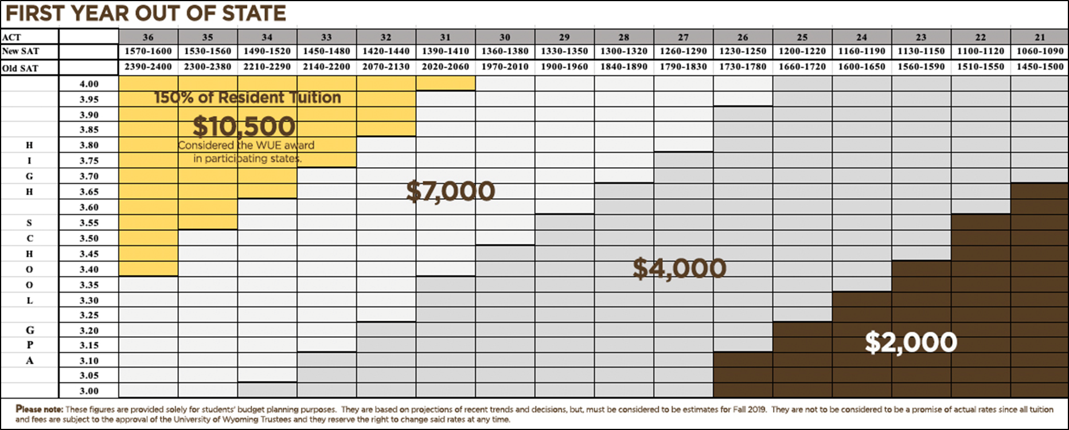
Recommendations #2, 3, 4 & 5: Non-Resident Financial Aid
$11,825

Slide 6
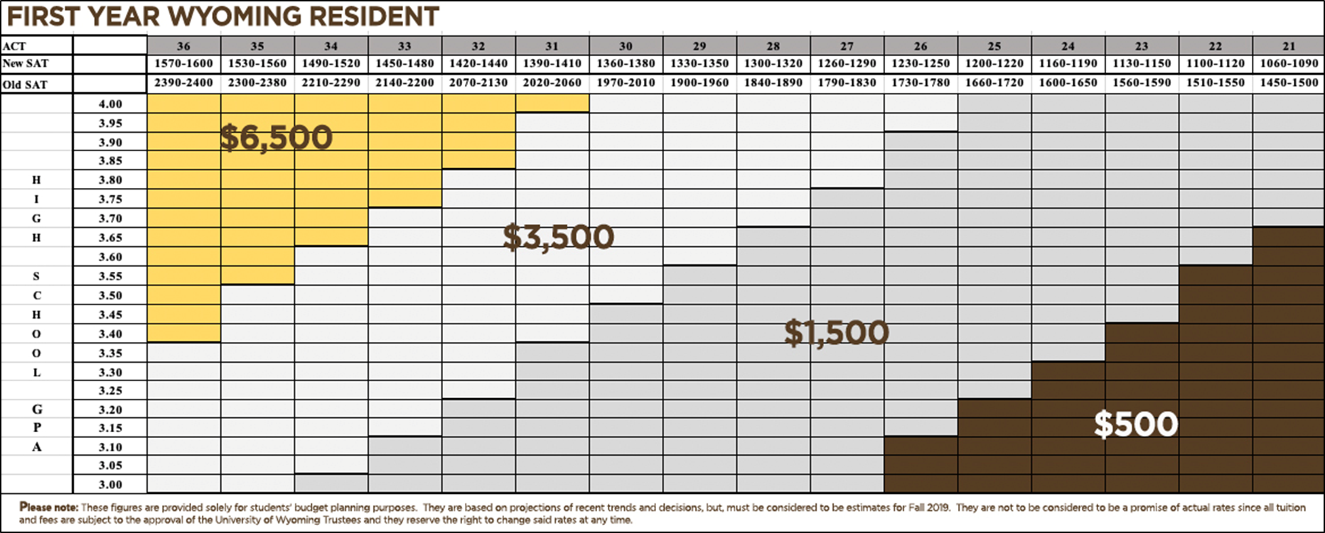
Recommendations # 6, 7, 8 & 9: Wyoming Resident Financial Aid

Slide 7
Recommendation # 10: Total Cost of Attendance for Undergraduate Resident
 | 2019-20 (FY20)
Category | Semester (15 credits) | Academic Year (30 credits)
Direct Costs:
Tuition¹ | $2,085 | $4,170
Mandatory Fees | $706 | $1,411
Advising Fees² | $90 | $180
Program Fees³ | $195 | $390
Room⁴ | $2,247 | $4,493
Board (Meal Plan)⁵ | $2,972 | $5,944
Sub-Total Estimated UW Direct Costs | $8,295 | $16,588
Indirect Costs:
Books/Supplies⁶ | $600 | $1,200
Travel | $420 | $840
Personal | $1,100 | $2,200
Estimated Total Cost of Attendance Budget | $10,415 | $20,828
RESIDENT (UNDERGRADUATE)
2019-20 Total Estimated Cost of Attendance | $20,828
2019-20 Total Estimated Direct Costs | $16,588
% of 2019-20 Total Estimated Cost of Attendance
95% | $19,787
90% | $18,745
85% | $17,704
80% | $16,662
75% | $15,621
70% | $14,580
65% | $13,538
60% | $12,497
55% | $11,455
¹ Tuition amount is based on $139 per credit hour (actual tuition will vary based on the actual credit hours enrolled).
² Advising Fees are $6 per credit hour (actual advising fees will vary based on the actual credit hours enrolled).
³ Program Fees vary from $3 and $25 per credit hour.
⁴ Room amount is based on a standard double occupancy room.
⁵ Board amount is based on an unlimited meals per week plan.
⁶ Actual cost of books and supplies will vary.

Slide 8
Recommendation #10: $1M of Resident Need-Based Aid
Estimated Family Contribution (EFC) | Rating: 185 & Above | Rating: 170-184.9 | Rating: 155-169.9 | Rating: 125-154.9 | Rating: 124.9 & Below
$0 | 81% | 81% | 81% | 81% | 54%
$1 - $5,576 | 66% | 66% | 66% | 66% | 54%
$5,577 - $9,999 | 62% | 62% | 62% | 62% | 54%
$10,000 - $17,999 | 58% | 58% | 58% | 58% | 54%
$18,000 - $24,999 | 56% | 56% | 56% | 56% | 54%
$25,000 & Above | 54% | 54% | 54% | 54% | 54%

Slide 9
Fall 2018 Enrollment Profile of First-Time, Full-Time Students
The table below contains the average GPA, ACT, SAT and class rank by Academic Rating Index score groupings for all 1,851 first-year students who enrolled in the University of Wyoming for the 2018 fall semester.
Excludes student athletes.
Excludes student athletes and out of state students receiving the alumni tuition rate of 150% of resident tuition.
Excludes student athletes.

Slide 10
Enrollment Goals By Population: 2020 Planning
 | Fall 2017 | Fall 2018 | Fall 2019 (Assumed) | Fall 2019 To Date | Fall 2020 Plan Assumptions | Fall 2020 Modeling Ranges
First Year In State | 871 | 853 | 853 | 817 | 930 | 880-890
First Year Out of State | 607 | 721 | 721 | 879 | 635 | 750-765
First Year Alumni | 81 | 107 | 107 | 96 | 115 | 100
First Year Athletes | 126 | 170 | 170 |  | 170 | N/A
TOTAL | 1,685 | 1,851 | 1,851 | 1,792 | 1,850
Transfer In State | 572 | 569 | 569 | 531 | 569
Transfer Out of State | 285 | 252 | 252 | 200 | 252
Transfer Athlete | 19 | 15 | 15 |  | 15
TOTAL | 876 | 836 | 836 | 731 | 836

Slide 11
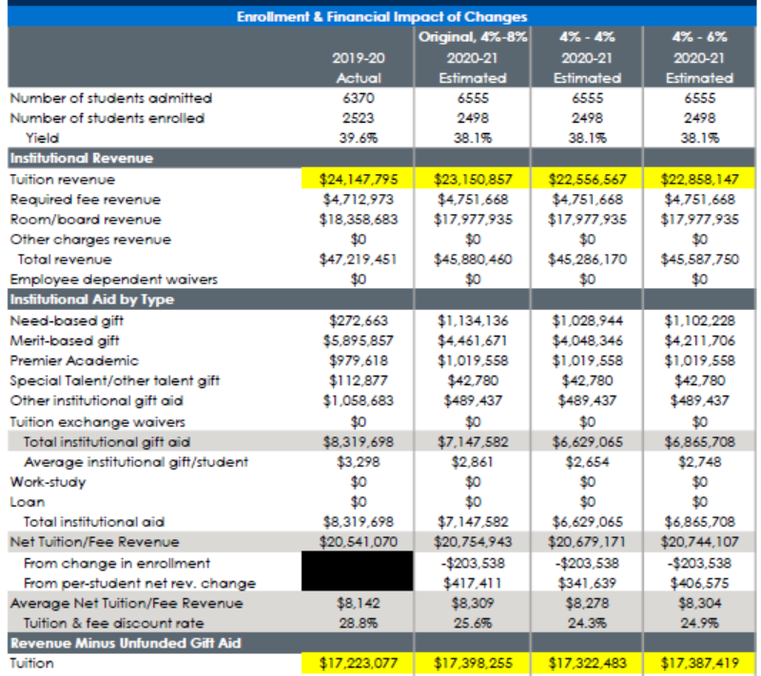
2020-21 Annual Plan Summary: All First-Year Students

