Slide 1

1.

Slide 2
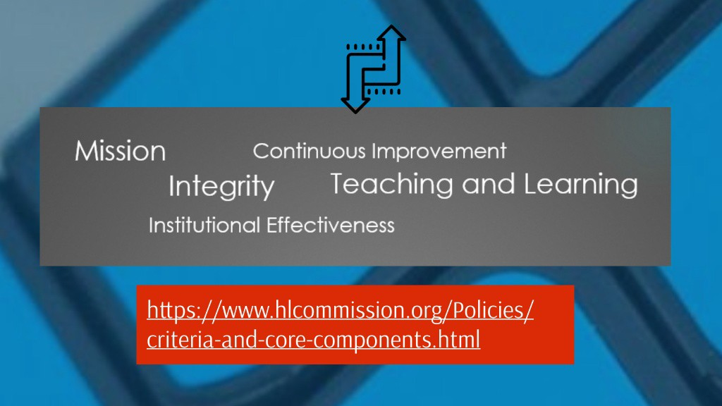

Slide 3
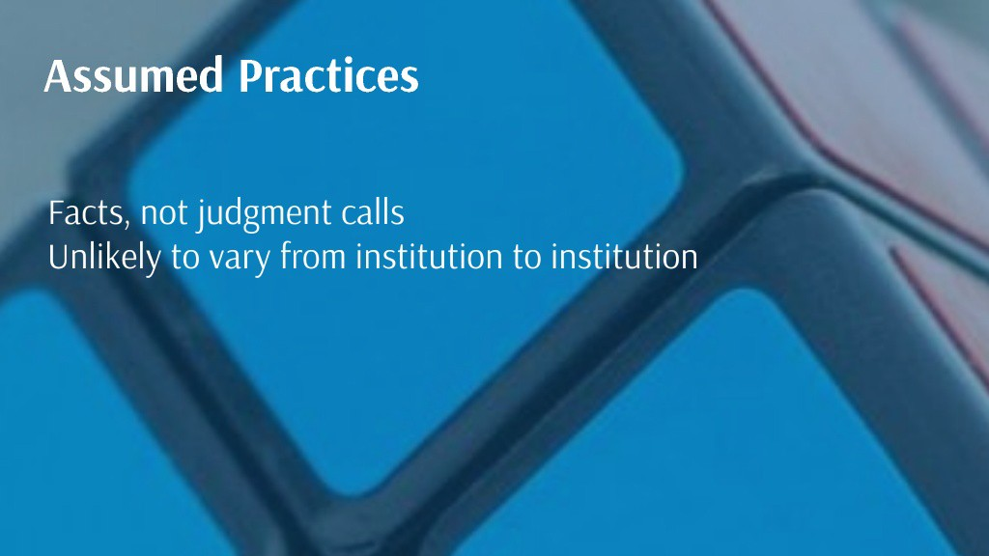

Slide 4
Criteria for which you are directly responsible
1A
2A
2C
5B

Slide 5
Role of the Board –HLC Criteria
1.A. The institution’s mission is broadly understood within the institution and guides its operations.
1.A.1. The mission statement is developed through a process suited to the nature and culture of the institution and is adopted by the governing board.
If someone asked you about this, what would you say?

Slide 6
Role of the Board - HLC Criteria
2.A The institution operates with integrity in its financial, academic, personnel, and auxiliary functions; it establishes and follows policies and processes for fair and ethical behavior on the part of its governing board, administration, faculty, and staff.
If someone asked you about this, what would you say?

Slide 7
Role of the Board - HLC Criteria
2.C. The governing board of the institution is sufficiently autonomous to make decisions in the best interest of the institution and to assure its integrity.
  The governing board’s deliberations reflect priorities to preserve and enhance the institution.
  The governing board reviews the reasonable and relevant interests of the institution’s internal and external constituencies during its decision-making deliberations.
  The governing board preserves its independence from undue influence on the part of donors, elected officials, ownership interests or other external parties.
  The governing board delegates day-to- day management of the institution to the institution’s administration and expects the institution’s faculty to oversee academic matters
If someone asked you about these, what would you say?

Slide 8
Role of the Board - HLC Criteria
5.B. The institution’s governance and administrative structures promote effective leadership and support collaborative processes that enable the institution to fulfill its mission.
The governing board is knowledgeable about the institution; it provides oversight of the institution’s financial and academic policies and practices and meets its legal and fiduciary responsibilities.
The institution has and employs policies and procedures to engage its internal constituencies—including its governing board, administration, faculty, staff, and students—in the institution’s governance.
Administration, faculty, staff, and students are involved in setting academic requirements, policy, and processes through effective structures for contribution and collaborative effort.

Slide 9
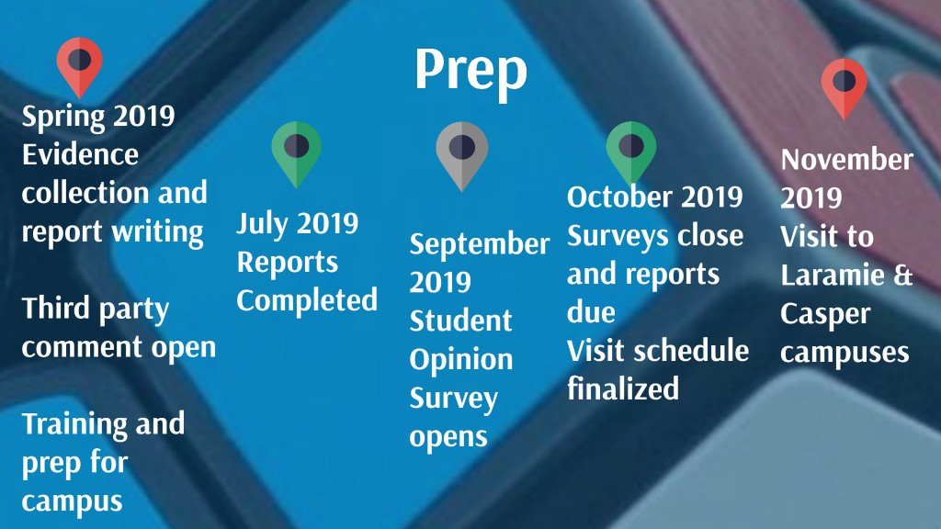

Slide 10
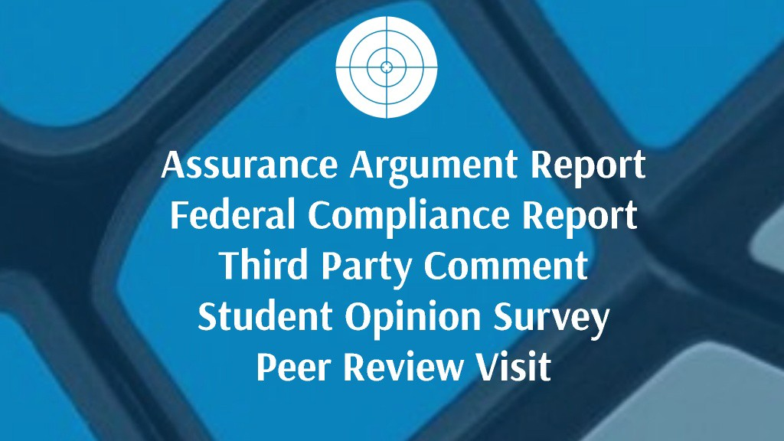

Slide 11


