Slide 1
Online Education
at the University
of Wyoming
Dr. Kate Miller
Provost and Vice President for Academic Affairs

Slide 2
UW Distance Education Mission
Offer Wyoming residents access to education at every stage of life, regardless of location, to increase educational attainment, advance career opportunities, and foster economic diversification in the state by providing affordable, high-quality, online education centered on access and student success.
Notes:
Overview; introduce present members of the distance team.

Slide 3
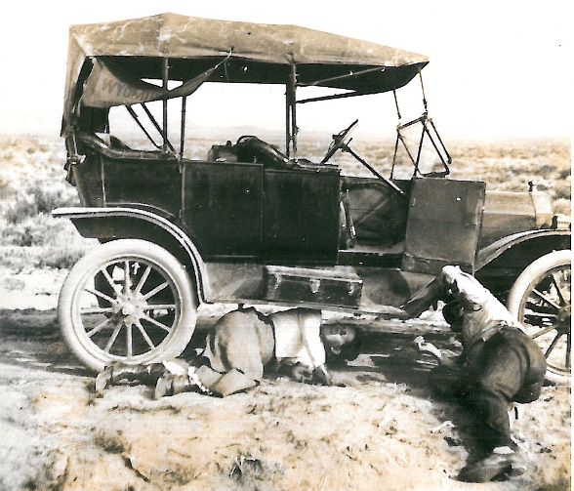
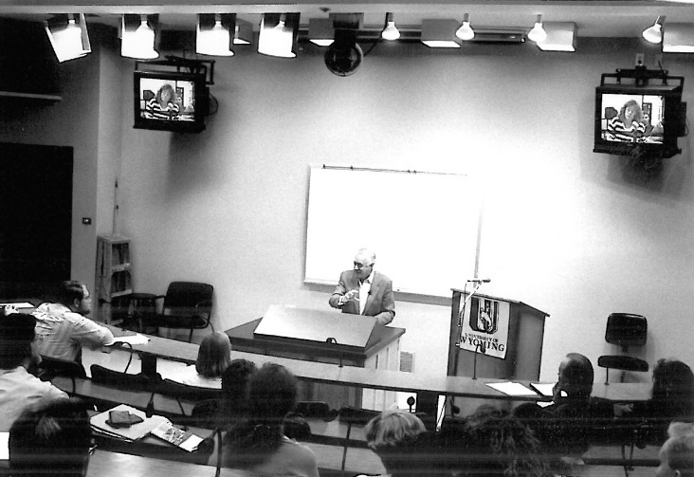
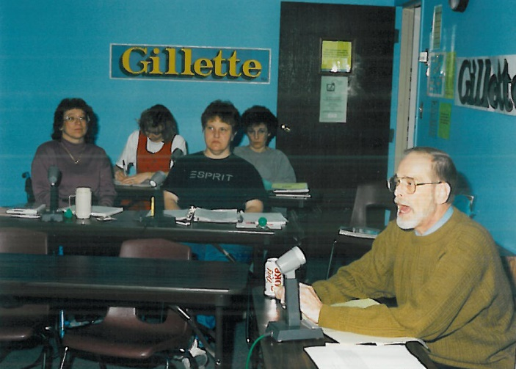
Education at a Distance: Then and Now
A long history…
Today…
Education at a distance is largely delivered online: UW offers 450-525 online courses each fall and spring semester; 200-300 each summer
More than 400 instructors taught online courses in Academic Year 18-19

Slide 4
Online Education Delivery Modes
Synchronous Online | Asynchronous Online | Blended/Hybrid
Courses resemble traditional on-campus college classes in that students must be (virtually) present at the same time—even though they are conducted over the Internet. Example: Courses delivered in real time by a professor in a fixed location with students joining from remote locations via Zoom. | Courses do not require students to log in at a specified time. Students can engage course material at any time of day, but generally are required to turn in assignments by set deadlines. This makes them more flexible for adult learners and other students with limited schedules. 75% of UW’s distance courses in 2017-18 year were offered in an asynchronous format; more courses and programs are being revised for asynchronous delivery. | Combines online educational materials and opportunities for interaction online with traditional place-based classroom methods or face-to-face activities. It involves some elements of flexibility for the student over time, place, path, or pace, but requires the physical presence of both teacher and student—at least occasionally.

Slide 5
Who are UW’s online students?
UW enrolled 1,661 fully online students in spring 2019; 1,614 in fall 2018
13.2% of total UW student population in AY 2018-19
Undergraduate*: 849 Wyoming residents (87%); 130 non-residents (13%)
Graduate*: 551 Wyoming residents (81%); 131 non-residents (19%)
28% of all UW graduate students are distance students
Mostly adult learners
Average undergraduate student age = 31 (21 for Main Campus)
Average graduate student age = 37 (28 for Main Campus)
67% Female, 33% Male
80% are enrolled as part-time students
* Spring 2019 figures

Slide 6
Online Enrollments at UW
AY13-14
AY14-15
AY15-16
AY16-17
AY17-18
AY18-19
Number of
Students
Enrolled
Completely
Online
1,614
1,661
Unduplicated
Headcounts
WY Resident
Non-resident
Online
Course
Enrollments
by Student
Credits
Hours
Fall
Spring
Summer

Slide 7
Current Online Programs at UW
Master’s (11)
Business Administration
Curriculum and Instruction
English
Health Services Administration
Higher Education Administration
Human Development & Family Sciences
K-12 Educational Leadership
Kinesiology and Health
Learning, Design, and Technology
Public Administration
Special Education
Certificates (12)
Cadastral/Land Surveying (UG)
Early Childhood Program Director (UG)
Educational Leadership K-12 Principalship (Grad)
Educational Leadership K-12 Superintendent (Grad)
English as a Second Language (Grad; UG Endorsement)
Learning, Design, and Technology-Online Instruction (Grad)
Literacy: a) K-6; b) 7-12; c) K-12 (Grad)
Play Therapy (Grad)
Special Education (Grad)
Teachers of American Indian Children (Grad)
Community College Leadership (Post-Masters)
School Social Work (Post-Masters)
Undergraduate (9)
Bachelor of Applied Science in Organizational Leadership
Business Administration
Criminal Justice
Family and Consumer Sciences
General Studies
Nursing (RENEW; RN-BSN)
Nursing (BRAND)
Psychology
Social Science*
Doctoral (8)
DNP Doctorate of Nursing Practice
EdD Curriculum & Instruction
EdD Higher Education Administration
EdD Higher Education Leadership
EdD Learning, Design, and Technology
PhD Curriculum & Instruction
PhD Higher Education Administration
PhD Learning, Design, and Technology
=Top 5 programs by enrollment; *No longer accepting applications

Slide 8
What is in the pipeline?
College of Business is developing an online BS in Accounting planned to begin spring 2020
11 programs received 2019 Innovation Funds
BS Psychology (Asynchronous)
BA Criminal Justice (Asynchronous)
BSN Nursing (Program expansion)
Master of Accounting (Asynchronous)
Master of Business Administration (Redesign)
Master of Finance (Asynchronous)
Funded and guided by TEI, the College of Education will develop undergraduate programs to be offered fully online starting with Elementary Education
Exploring expansion of online BGS tracks and BAS areas of emphasis
Master of Kinesiology and Health (Asynchronous)*
Master of Public Administration (Asynchronous)
Cybersecurity Certificate (Asynchronous)*
UG and Grad GIST Certificates (Asynchronous)*
Math HLC Certification (Asynchronous)*
BOLD=New program offering

Slide 9
Efforts to Build Online Delivery Capacity
In fall 2019, implementing new software, programs, and services to enhance capacity for delivery of online education
Honorlock: Proctoring program for online test-taking
NetTutor: 24/7 online tutoring service for all students supporting all subject areas
CourseTune: Curriculum mapping; assessment of student learning outcomes development
Quality Matters: Rubrics for assessing course quality; training and certification for online instruction
UW LinkedIn Learning (HR): Includes training modules designed specifically for online instructors
Elevate: Course and enrollment management system for non-credit course offerings
Ruffalo Noel Levitz: Investing in updating and revising online program websites
Examining options for expanding capacity to enroll and support online students; grow new programs
Marketing, lead generation, and recruitment
Student services, advising, and coaching
Instructional design

Slide 10
Goals for the Months Ahead
New program launches in Spring 2020
BS in Accounting completion degree
By mid-December 2019, schedule the launch of five additional programs within 18 months, with priority on undergraduate completion and 4+1 programs
Identify a new staffing and service model to build additional capacity for the delivery of online education for implementation in FY21
Redesign of UW’s online program websites and marketing materials in AY19-20
Graduate GIST certificate

Slide 11
Supplementary Slides

Slide 12
Online Enrollments: Close Peers + CSU
INSTITUTION (# PROGRAMS) | RESIDENT | NON-RESIDENT | TOTAL ONLINE
University of Wyoming (40) | 1,400 | 261 | 1,661
University of Idaho (25) | 714 | 290 | 1,004
University of Nevada-Reno (8) | 891 | 175 | 1,066
New Mexico State University (58)* | 1,164 | 438 | 1,602
University of Rhode Island (7) | 176 | 283 | 459
Utah State University (40) | 1,797 | 1,245 | 3,042
University of Maine (41) | Data Unavailable at Time of Report
Oklahoma State University | 1,340 | 278 | 1,618
Montana State University (13) | 244 | 286 | 530
South Dakota State University (29)* | Data Unavailable at Time of Report
University of Montana (21)* | Data Unavailable at Time of Report
North Dakota State University (--) | 502 | 432 | 934
Colorado State University (45) | 3,243 | 1,086 | 4,329
List excludes minors and licensure programs | *Includes Associates and/or Associates of Applied Science degrees

Slide 13
Competitors Enrolling Wyoming Students
More than 100 WY students
50-99 WY students
25-49 WY students
Western Governors University (746)
Grand Canyon University (195)
University of Phoenix (173)
Brigham Young University-Idaho (173)
Black Hills State University (171)
American Public University System (167)
Southern New Hampshire University (143)
Chadron State College (142)
Park University (124)
Liberty University (115)
Colorado State University (111)
Columbia Southern University (107)
Colorado Technical University (87)
Arizona State University (86)
Utah State University (86)
Penn Foster College (85)
Ashworth College (83)
Valley City State University (83)
Capella University (82)
Purdue University Global, Inc. (79)
Stevens-Henager College-Ogden (64)
University of North Dakota (47)
Excelsior College (36)
Colorado Christian University (34)
Regis University (28)
University of South Dakota (27)
Weber State University (27)
American College of Education (26)

Slide 14
2016 Reorg of Outreach School Functions
Enrollment Management
+2 FTE Outreach Registration & Summer School ; +1 Degree Analysist
Institutional Marketing
+ 2 FTE Student Resources & Digital Marketing; + 2 UW TV
Institute for Innovation in Instruction & Assessment
Establish institute to transform educational experiences for ALL students through faculty innovation centers
7 FTE from OCP + 1 FTE Assessment + ECTL
Outreach School
Information Technology
+ 5 FTE from Outreach Technology Services
Office of Global
Engagement
Establish autonomous unit to include functions of IPO, ISS, ELC, plus ….
+ 1FTE Ambassador & Events Coordination
Office of the Provost Business Office
+ 2 FTE for centralized accounting & budgets
+ 1 FTE for compliance & accreditation
UW-Casper &Regional Centers
Streamline & Restructure

