Slide 1
Office of Diversity, Equity, and Inclusion Annual Update
Board of Trustees Meeting
September 12, 2019

Slide 2
Response Rate and Demographics
2,976 Responses Collected
Selected Demographics of Respondents
Non-Benefitted Employees
380 completed out of 472 surveys started
80.5% completion rate, overall 9.5% completion rate
Benefitted Employees
968 completed out of 1,121 started
86.4 % completion rate, overall 34% completion rate
Students
1,032 completed out of 1,351 surveys started
76.4% completion rate, overall 8.8% completion rate
Veterans = 5% for employees and students
Student Athletes = 5%
International Students = 8%
Transfer Students = 27%
Students in Fraternities/Sororities = 9%
UW Laramie Campus = 94%
Distance Learning = 5%
UW Casper Campus = 1%
Native Wyomingites = 42% for students and employees
Hispanic/Latinx = 6.64% across all racial demographics for employees and students

Slide 4
Selected Highlights of the UW Diversity Campus Climate Survey
Sexual Orientation/Gender Identity:
Only half of straight respondents found UW accepting of all sexual orientations, and only one-third of those who are not straight find UW welcoming.
Over one-quarter of respondents indicated they were not comfortable with a ‘non-binary’ identified individual, meaning that a non binary student could be confronted with dozens of classmates and several faculty a year who are not comfortable in their presence.
The narrative responses to these questions indicate a high level of anger by some respondents.
Gender:
Only one-half of respondents find UW inclusive of individuals regardless of gender and fully one-third of respondents see gender discrimination at UW as a problem.
While 22% of men see gender based discrimination as a problem, 37% of women, and virtually all trans and genderqueer respondents indicated gender discrimination as an issue.
Safety:
Concerns were raised by women, transgender and genderqueer individuals especially at night on campus.

Slide 5
Selected Highlights of the UW Diversity Campus Climate Survey
Race:
While white respondents find that UW encourages inclusion of all races, non-white respondents feel and have different experiences at UW and in the community with less than half of virtually all non-white racial categories indicating that UW is welcoming to those who are not white.
Over one-quarter of respondents of all races have personally witnessed racial discrimination.
International Students:
One-third of international students feel discrimination.
Religion:
36% of respondents have some experience or jokes about religious beliefs.

Slide 6
Selected Highlights of the UW Diversity Campus Climate Survey
Disability:
For all respondents, 7% indicated they did not know how to register with Disability Services or notify Human Resources for a disability to receive accommodations with 25% unaware of how to find support for a disability
Of particular concern is the perceived lack of support and services for those with mental illness services, and for access to services for staff.
Food/Housing insecurity:
34% of respondents shared that they often or sometimes ran out of food and did not know where to obtain more.
7% of students indicated that they had a few times of not knowing where they would be spending the night.
Work/Classroom Environment:
One quarter of faculty and staff are not comfortable discussing issues of diversity, inclusion or equity in their department or office or classroom.
Notes:
DSS most recent data indicates they served 535 students during 2017-2018

Slide 7
Why it matters: Students
Race/Ethnicity | Fall 2018 Percentage Based on 12,450 Students
International | 5.7%
Hispanic of any race | 6.2%
Native American or Alaska Native | 0.5%
Asian | 1.2%
Black or African American | 0.9%
Native Hawaiian or Other Pacific Islander | 0.1%
White | 70.5%
Race and ethnicity unknown | 10.8%
Two or more races | 4.1%
Other UW Demographics | Fall 2018 Percentage Based on 12,450
Veterans | 7%
Female | 51.1%
Male | 48.9%
Graduate | 19.7%
Undergraduate | 80.3%
Wyoming Residents | 66.6%
Non-Residents | 33.4%
Graduated in 4 Years (2012 Cohort) | 52%
Graduated in 6 Years (2012 Cohort) | 60%

Slide 8
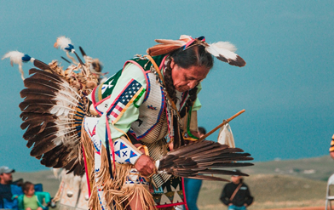
Why this Matters: Employees
Fall 2017: 2,625 employees, 13.75% identified as Minorities
Fall 2018: 2,787 employees, 14.82% identified as Minorities
Minorities increased 1.07% in 2017 to 2018
The goal for 2022 is a 5% increase overall for Minorities
Administrator: 2.75% in 2017 to 6.20% in 2018, a 3.45% increase
Availability = 21.25%
Professional Non-Faculty: 11.60% in 2017 to 12.01% in 2018 or an increase of 0.41%
Availability = 25.87%
Faculty/Academic Professional: 15.37% in 2017 to 16.34% in 2018 or an increase of 0.97%
Availability = 26.20%
Notes:
Fall 2017: 2,625 employees, 13.75% or 361 identified as Minorities
Fall 2018: 2,787 employees, 14.82% or 413 identified as Minorities

Slide 9
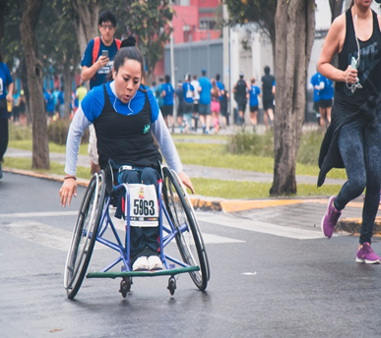
Why it Matters: Employees
Fall 2017: 2,625 employees, 1.87% of UW employees identified as Individuals With Disabilities
Fall 2018: 2,787 employees, 1.79% of UW employees identified as Individuals With Disabilities
Individuals With Disabilities decreased 0.08% from 2017 to 2018
The goal for 2022 is a 2% increase overall for Individuals With Disabilities
Availability = 6.4%
Fall 2017: 2,625 employees, 3.16% of UW employees identified as Veterans
Fall 2018: 2,787 employees, 2.98% of UW employees identified as Veterans
Veterans decreased 0.18 % from 2017 to 2018
The goal for 2022 is a 5% increase overall for Veterans
Availability = 20.6%
Fall 2017: 2,625 employees, 42.02% of UW employees identified as Women in the Faculty/Academic Professional Job Category
Fall 2018: 2,787 employees, 42.71% of UW employees identified as Women in the Faculty/Academic Professional Job Category
Women increased 0.69% from 2017 to 2018
The goal for 2022 is a 5% increase overall for Women in the Faculty/Academic Professional Job Category
Availability = 48.12%
Notes:
National availability according to Bureau of Labor Statistics 2017 for Veterans and IWDs

Slide 10
Strategies in Place and Future Plans
Recruitment pipeline development for diverse and underrepresented employees and students.
Retention initiatives for diverse and underrepresented employees and students.
Search committee support and role in the hiring process.
Diversity education initiatives.
Initiatives to address campus climate issues.
Diversity Campus Climate Survey Town Halls for campus community input and focus groups to dive deeper into issues of concern.
Regular attention to issues of diversity, equity, and inclusion with goals and metrics for the University because we cannot thrive when members of our community feel unwelcome.

