Slide 1
COVID Update Latest Progress on Preparations for Return to Campus
August 12, 2020

Slide 2
Return to Campus
Path to Opening
Board of Trustees Meeting (8/12)
PMO /
Working Groups
COVID
Policy
Class Modality
and Schedule
Facilities Preparations
Pre-Return
Testing
Status: Completed
Standup PMO Team
Define Governance Structure
Establish Working Groups (WG)
Agree on WG Charters
Status: On Track
Detailed policy based on Plan to Restart Campus & Restore Normal Campus Operations
New temporary policies as needed
Status: Completed
Class modality plans
Class schedule and room assignments
Status: At Risk
Enhanced Cleaning Schedule
Room Configuration
Classroom Technology
Hiring for Enhanced Cleaning
Campus Signage
Status: At Risk
Vault Testing Plan
Leadership Pilot
Testing Communications
Non-compliance Procedures
Early Wave Testing
All Employees / Students Testing
START
OPEN
Return to Campus and Work
Surveillance
Testing Program
Pre-Return
Training
COVID
HUB
Closing
Decision Matrix
Status: Closely Monitoring
Building Open: August 10th
Move-in Week: August 17th
Start of Classes: August 24th
Status: At Risk
Program Model
Staffing
Lab Equipment
Diagnostic Tests Supplies
Status: On Track
Training Communication
Non-compliance Procedures
Employee Training Launched
Student Training Launched
Training Completed
Status: At Risk
Support Model
Technical Infrastructure
Training and Support
Hiring for COVID Hotline
Hiring for Contact Tracing
Status: Closely Monitoring
Response Options
Triggers
BOT Approval
Scenario Planning
Monitoring & Tracking Triggers
2

Slide 3
Return to Campus
Considerations for Path Forward
Board of Trustees Meeting (8/12)
Status Quo On-campus instruction begins as scheduled on August 24th with mix of in-person, Hyflex and fully virtual courses.
Soft Return All classes begin on time, online on August 24th. Students, faculty and staff return to on-campus instruction on September 28th.
Phased Approach All classes begin on time, online on August 24th with a phased on-campus return for cohorts of students starting in early September.
Fully Virtual All classes begin virtually on August 24th and remain virtual for the fall semester.
Institutions With Similar Components
3

Slide 4
Return to Campus
Phased Approach
Board of Trustees Meeting (8/12)
Fully utilizes the generous state support through the CARES Act by decreasing risk and maximizing the opportunity for success of the fall restart plan
Provides an opportunity to extend the in-person experience for a cohort of students who are likely to benefit the most from that experience
Ensures additional time to operationalize and staff a surveillance testing program
Aids in decreasing campus density
Provides an opportunity to establish and reinforce a culture of personal and social responsibility
Provides an opportunity for experiential learning among early returning students
Provides additional time to ensure that learning spaces are fully equipped and ready for high quality teaching and learning
Provides faculty with additional time to fine-tune the face-to-face experience using hybrid / hyflex approaches
4
Notes:
Ensures additional time to operationalize and staff a surveillance testing program
this is needed in order to return all students to campus and remain as safe as possible
research supporting 2X/week testing;
delay impacted by supply chain issues, staffing needs;
reinforces our steadfast commitment to the health and safety of our students, employees and Laramie community.
Aids in decreasing campus density
While the testing program is being finalized
Decreasing density can contribute to lowering infection rates
Provides an opportunity to extend the in-person experience for a cohort of students who are likely to benefit the most from that experience
Possible cohorts include first year students, with priority on first gen students; classes than require in-person experiences, graduate teaching assistants, ROTC, athletes
Allows increased f2f support for these students (while other students are receiving this support remotely)
Provides an opportunity to establish and reinforce a culture of personal and social responsibility
Adoption of preventative measures is essential to the University fully opening and staying open
Phased approach allows for establishing and reinforcing a culture of compliance amongst a smaller cohort before the larger student body returns
The cohort can serve as ambassadors for promoting healthy behaviors upon full return
Provides an opportunity for experiential learning among early returning students
Engage students in active learning that fosters leadership, advocacy and commitment,
provide 1 tuition free credit for students who help to shape the university by engaging in a variety of return to campus efforts
Provides additional time to ensure that learning spaces are fully equipped and ready for high quality teaching and learning.
Technology in these classrooms is critical to the synchronous teaching and learning that occurs in an hybrid or hy-flex environment
Provides faculty with additional time to fine-tune the f2f experience using hybrid/hyflex approaches

Slide 5
Return to Campus
Phased Approach
Board of Trustees Meeting (8/12)
Phase 1: Aug 24 – Sept 4
All classes online
No additional students on campus
Remote work where possible
Testing for students and employees who must remain on campus
Phase 3: Sept 28 – Nov 20
All students return for 8 full weeks of face-to-face instruction
Increased campus employees, but continued work for home where possible
Surveillance testing program
Phase 4: Nov 23 – Dec 11
All classes and final exams switch to remote delivery
Employees continue working as per staffing plan
Testing based on disease prevalence
Phase 2: Sept 7 – Sept 25
Some students return, in-person classes begin
Face-to-face critical employees return to campus
Weekly random sampling testing program
# of Students: 1,500
# of Students: 3,500
All Students on Campus
All Students Online
5

Slide 6
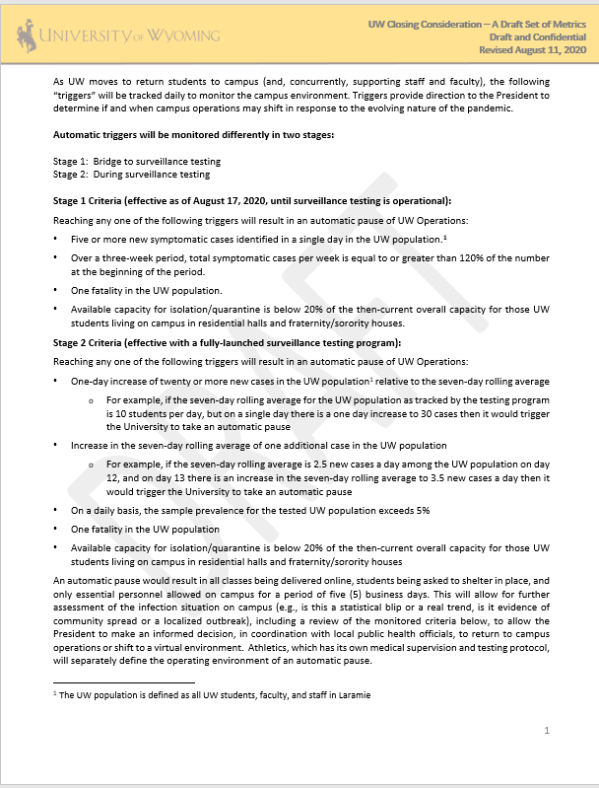
Return to Campus
Closing Considerations
Board of Trustees Meeting (8/12)
Automatic triggers will be monitored differently in two stages:
Stage 1: Bridge to surveillance testing
Effective as of August 17, 2020, until surveillance testing is operational
Stage 2: During surveillance testing
Effective with a fully-launched surveillance testing program
For Discussion
6

