Slide 1
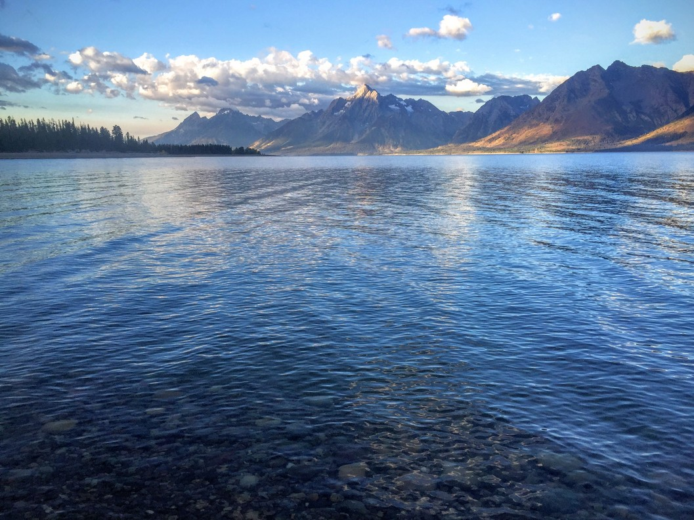
Re-envisioning UW’s Grand Teton Campus:
The UW-NPS Research Center at AMK Ranch
Photo: M. Dillon
Notes:
Thanks and mention research station and thursday talks … Saturday U all summer on Thursday evenings. If you'd like to get on that mailing list, send us an email at uwnps@uwyo.edu

Slide 2
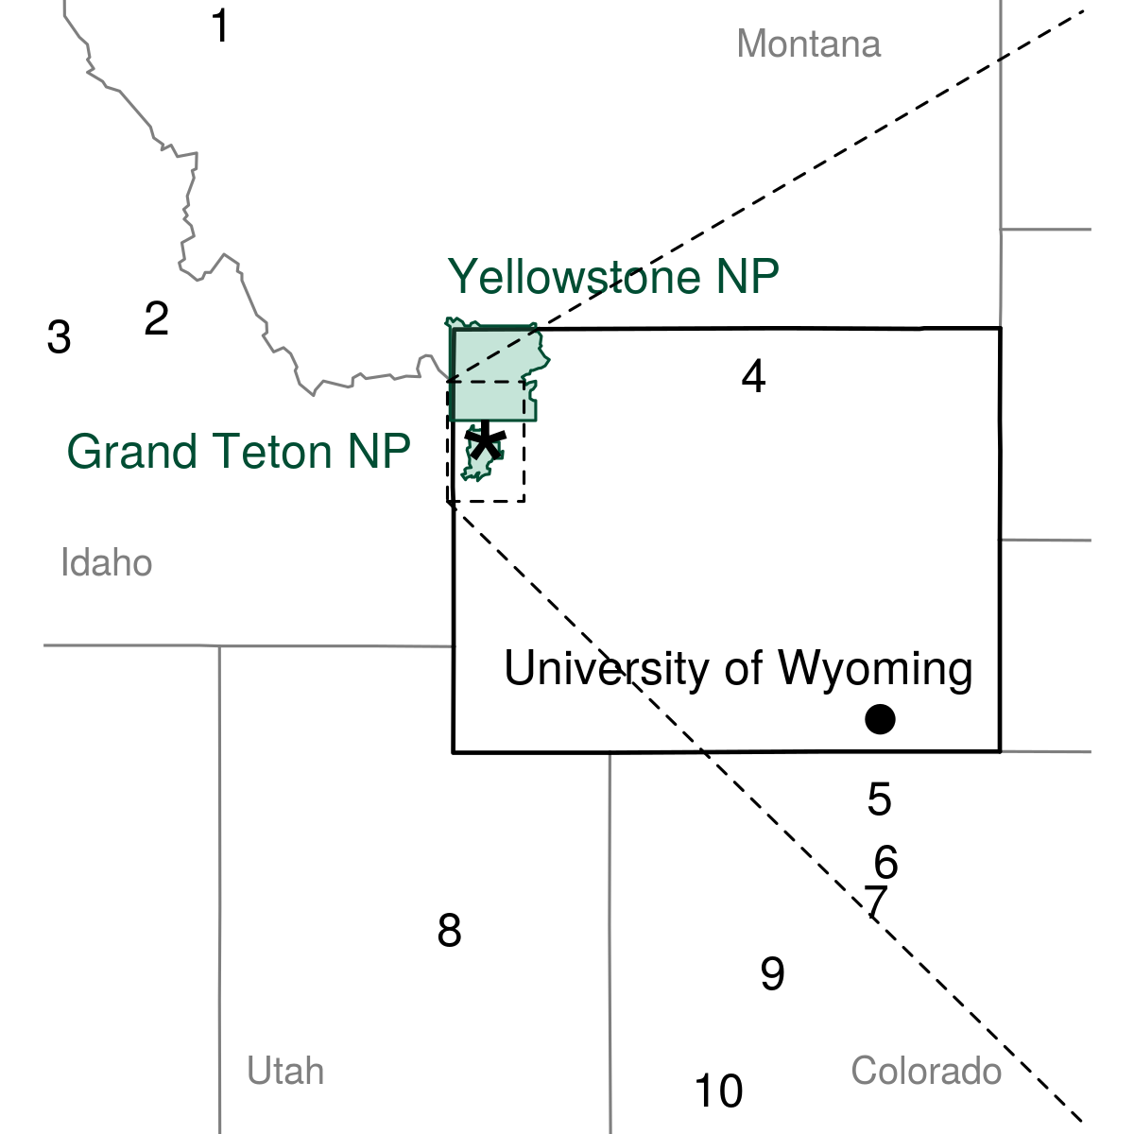
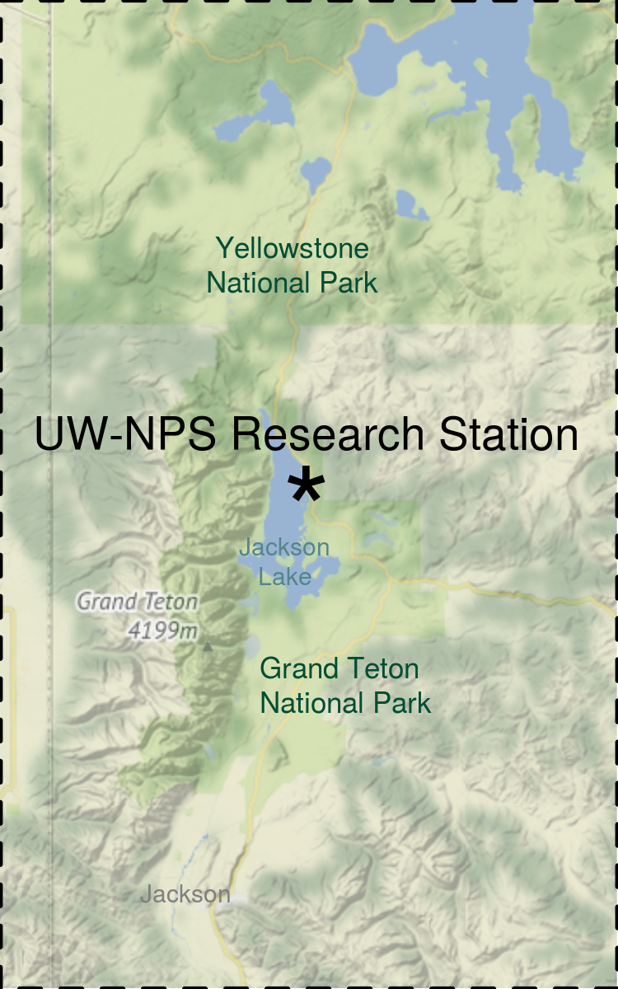
Only Field Station in GYE
Flathead Lake
Taylor Wilderness
McCall Field Campus
Spear-o-wigwam
CSU Mountain Campus
UC Mountain Research Station
DU Mount Evans
Capitol Reef
RMBL
Mountain Studies Institute

Slide 3
Current Mission
The UW-NPS Research Station promotes and provides opportunities for management-oriented and basic research in all fields of science in the Greater Yellowstone Ecosystem.

Slide 4
UW - NPS Partnership
20 year General Agreement signed October 2018
UW occupies and uses the space in return for maintenance and stewardship
UW and GTNP each contribute at least $25,000 annually to the small grants program
UW and GTNP each contribute at least $2,500 annually to support two park interns
UW and GTNP agree to work together on research station improvements

Slide 5
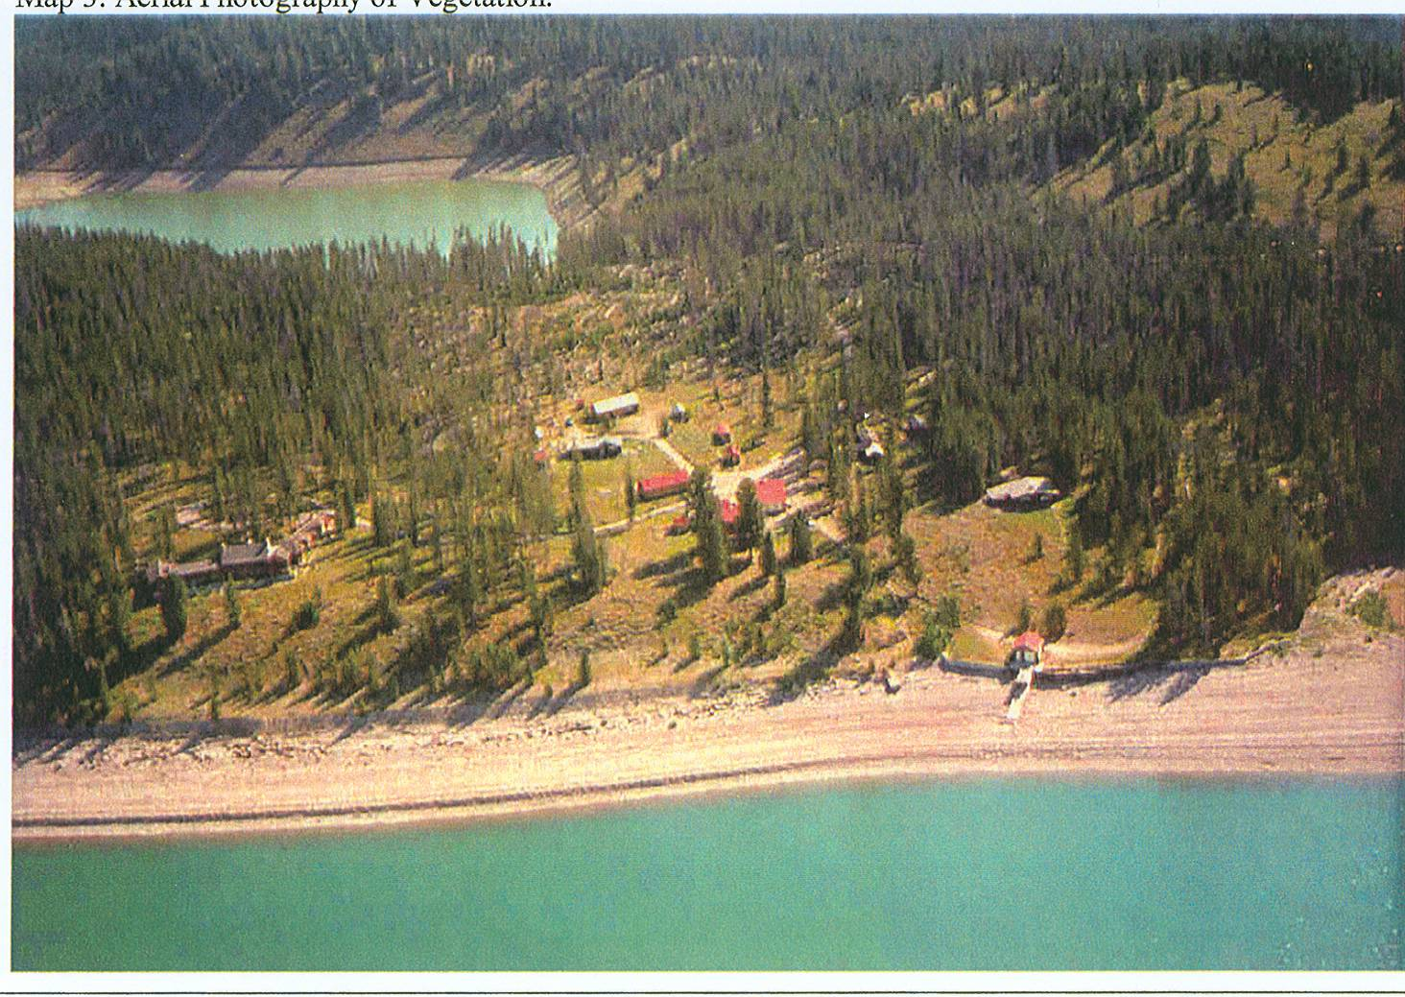
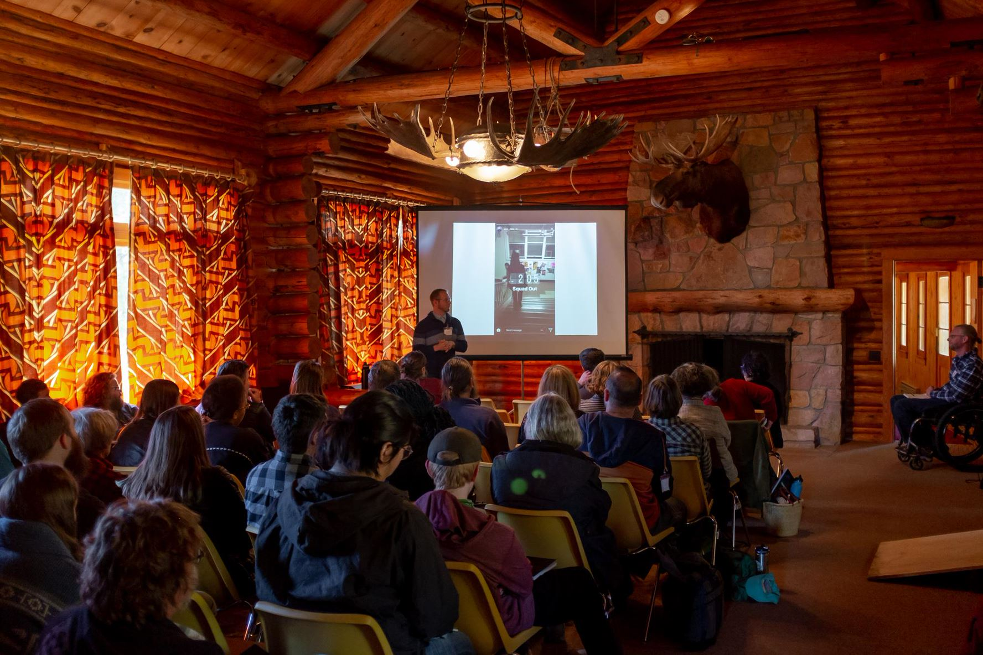
AMK Ranch Historic District
Sargent’s Bay
400 acre peninsula
17 buildings
Jackson Lake

Slide 6
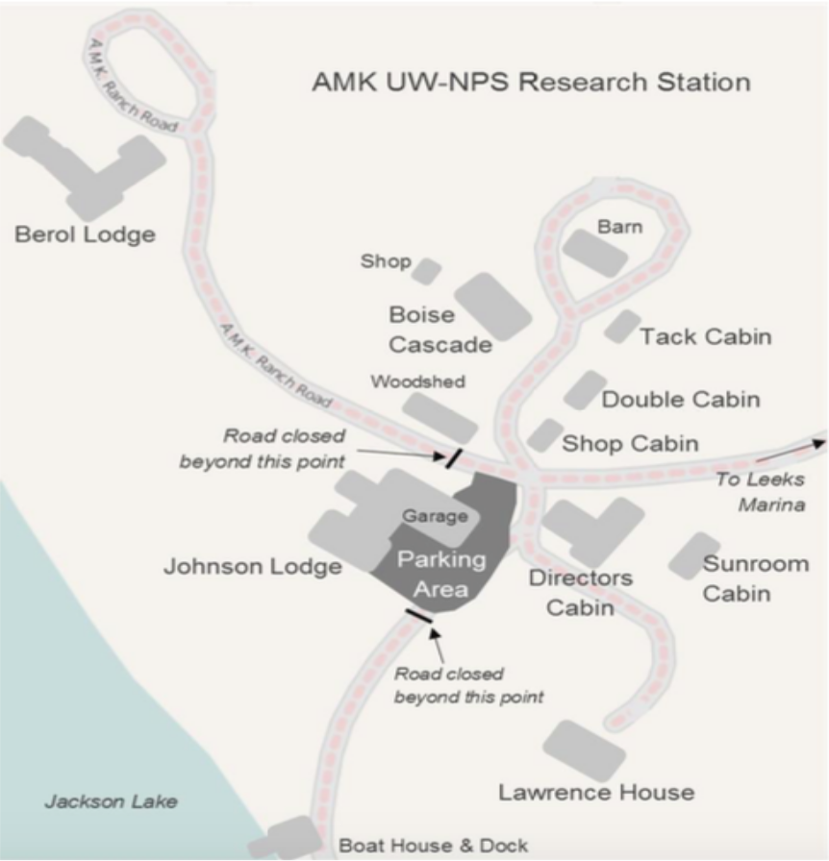
UW-NPS Research Station Campus
~ 50 acre campus
8 buildings housing up to ~60 people/night

Slide 7
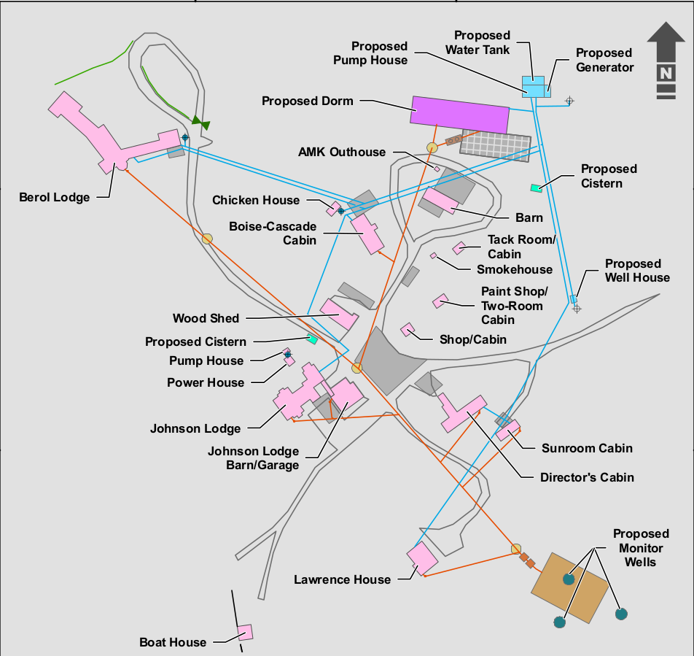
Campus Improvements
2015 FONSI
Replace water and wastewater systems (in progress)
Lakeshore erosion controls (slated for Spring 2020)
NPS Environmental Assessment:
New Dormitory and associated parking.
5800 ft², 1 story to house 25 people
Commercial kitchen, dining, and laundry facilities
Single ABA/ADA compliant room
New siding on Boise-Cascade Cabin

Slide 8
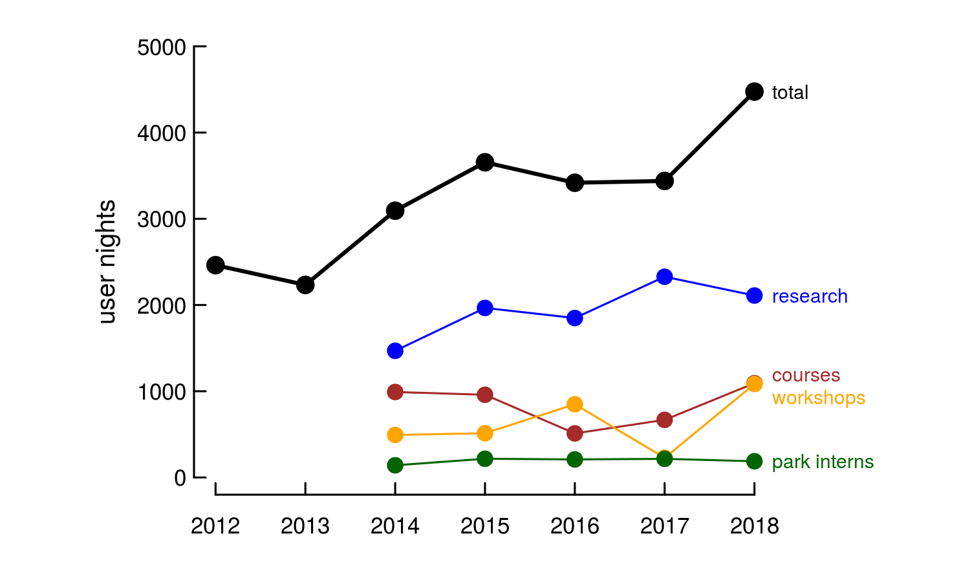
Opportunities for UW growth
Nearly doubling of station usage in last 5 years
UW usage for 2018:
9/46 research projects
5/18 courses
7/11 conferences

Slide 9
Task Force
Launched by the ORED in Fall 2019 in response to UW Board of Trustee interest and investment
~20 UW faculty, staff, and visitors have met on a near weekly basis to re-imagine UW’s role at the AMK.

Slide 10
2020 Vision
Over the next 5-10 years, make the UW Grand Teton Campus into a world-class home for world-class scholarship and experiences in Wyoming’s world-class setting.

Slide 11
2020 Vision
Inspiring discoveries: Advance the frontiers of knowledge by creating unique opportunities for students and scholars in Wyoming’s iconic landscapes;
Elevating experiences: Enhance and expand opportunities for place-based learning for UW students, community scholars, and the public;
Connecting communities: Share research and learning opportunities that cross boundaries and foster cooperation, understanding, and discourse.

Slide 12
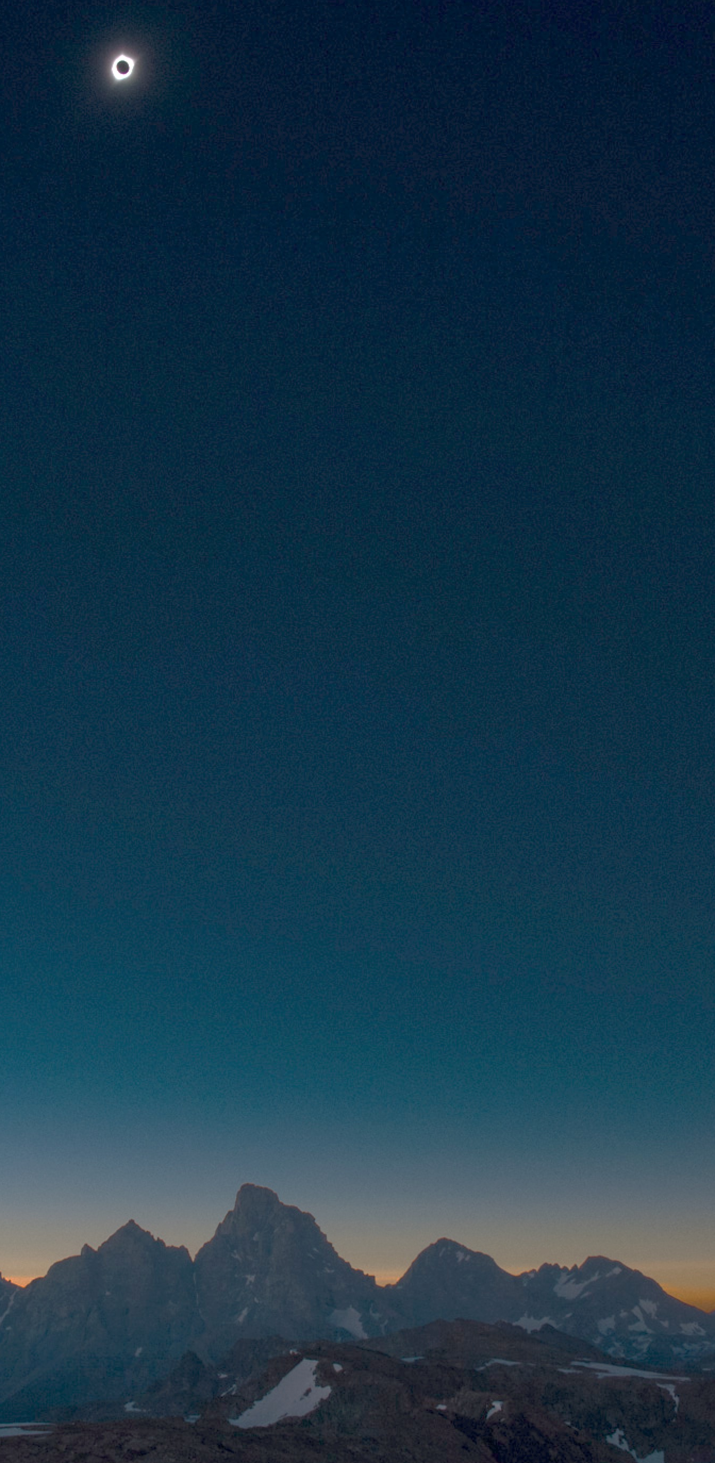
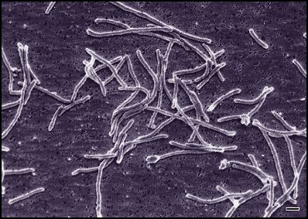
2020 Vision
Inspiring discoveries:
Advance the frontiers of knowledge
by creating unique opportunities for students and scholars in Wyoming’s iconic landscapes

Slide 13
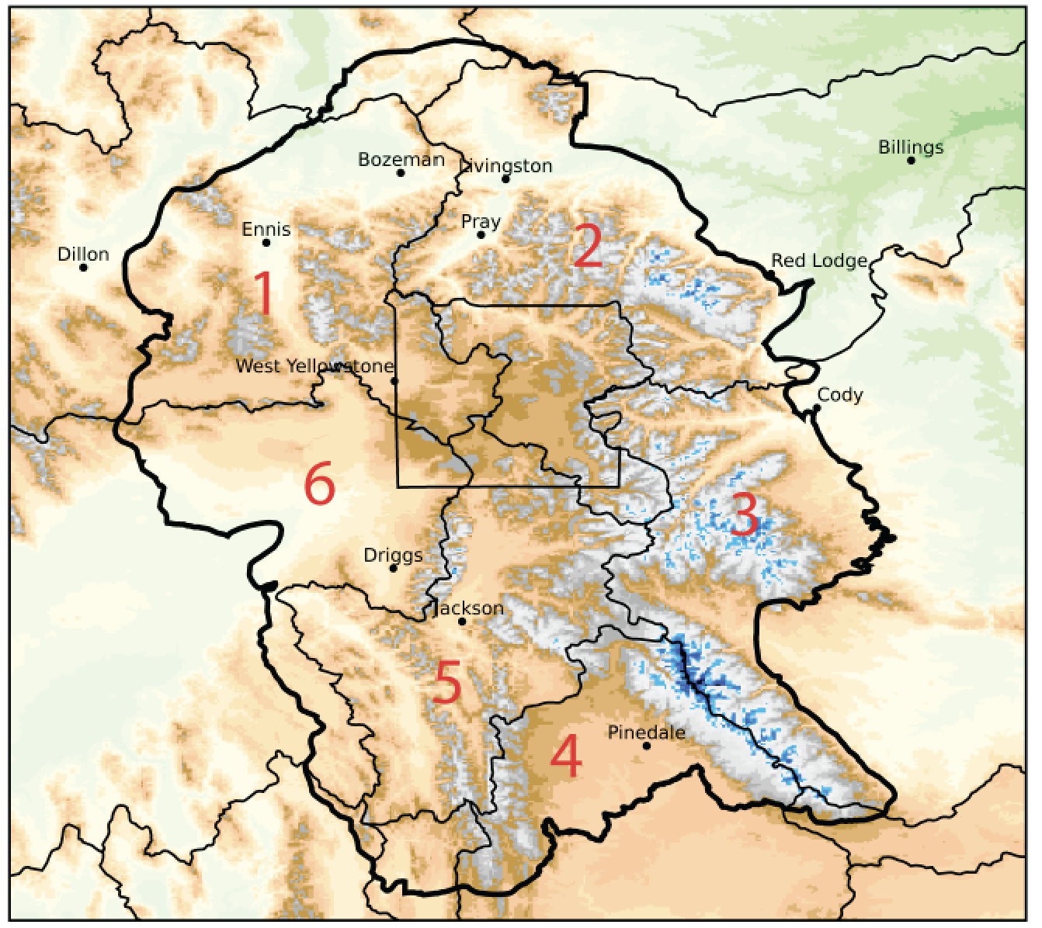
Iconic landscapes, unique opportunities
At the heart of the major western watersheds
Crossing
Boundaries
PHYSICAL
SCIENCE
AMK
At the center of the Greater Yellowstone Ecosystem:
Parks to Ranches

Slide 14
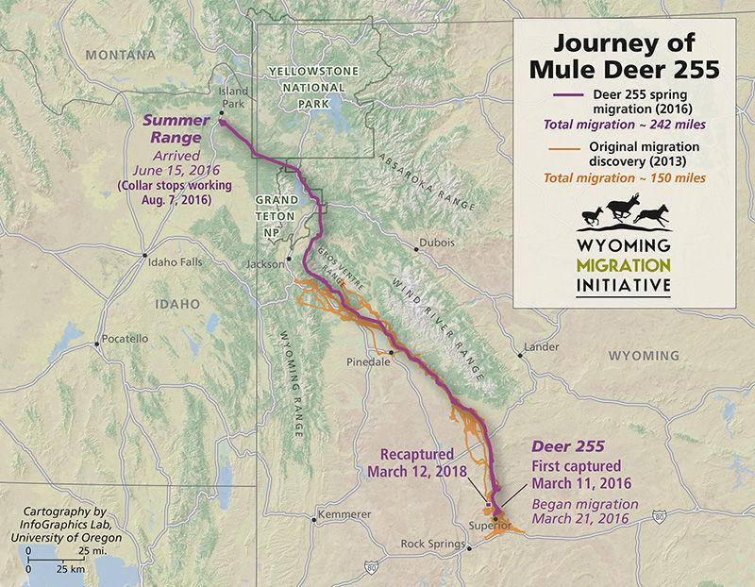
Iconic landscapes, unique opportunities
Crossing
Boundaries
BIOLOGICAL
SCIENCE
AMK
At the center of the Greater Yellowstone Ecosystem:
Parks to Ranches

Slide 15
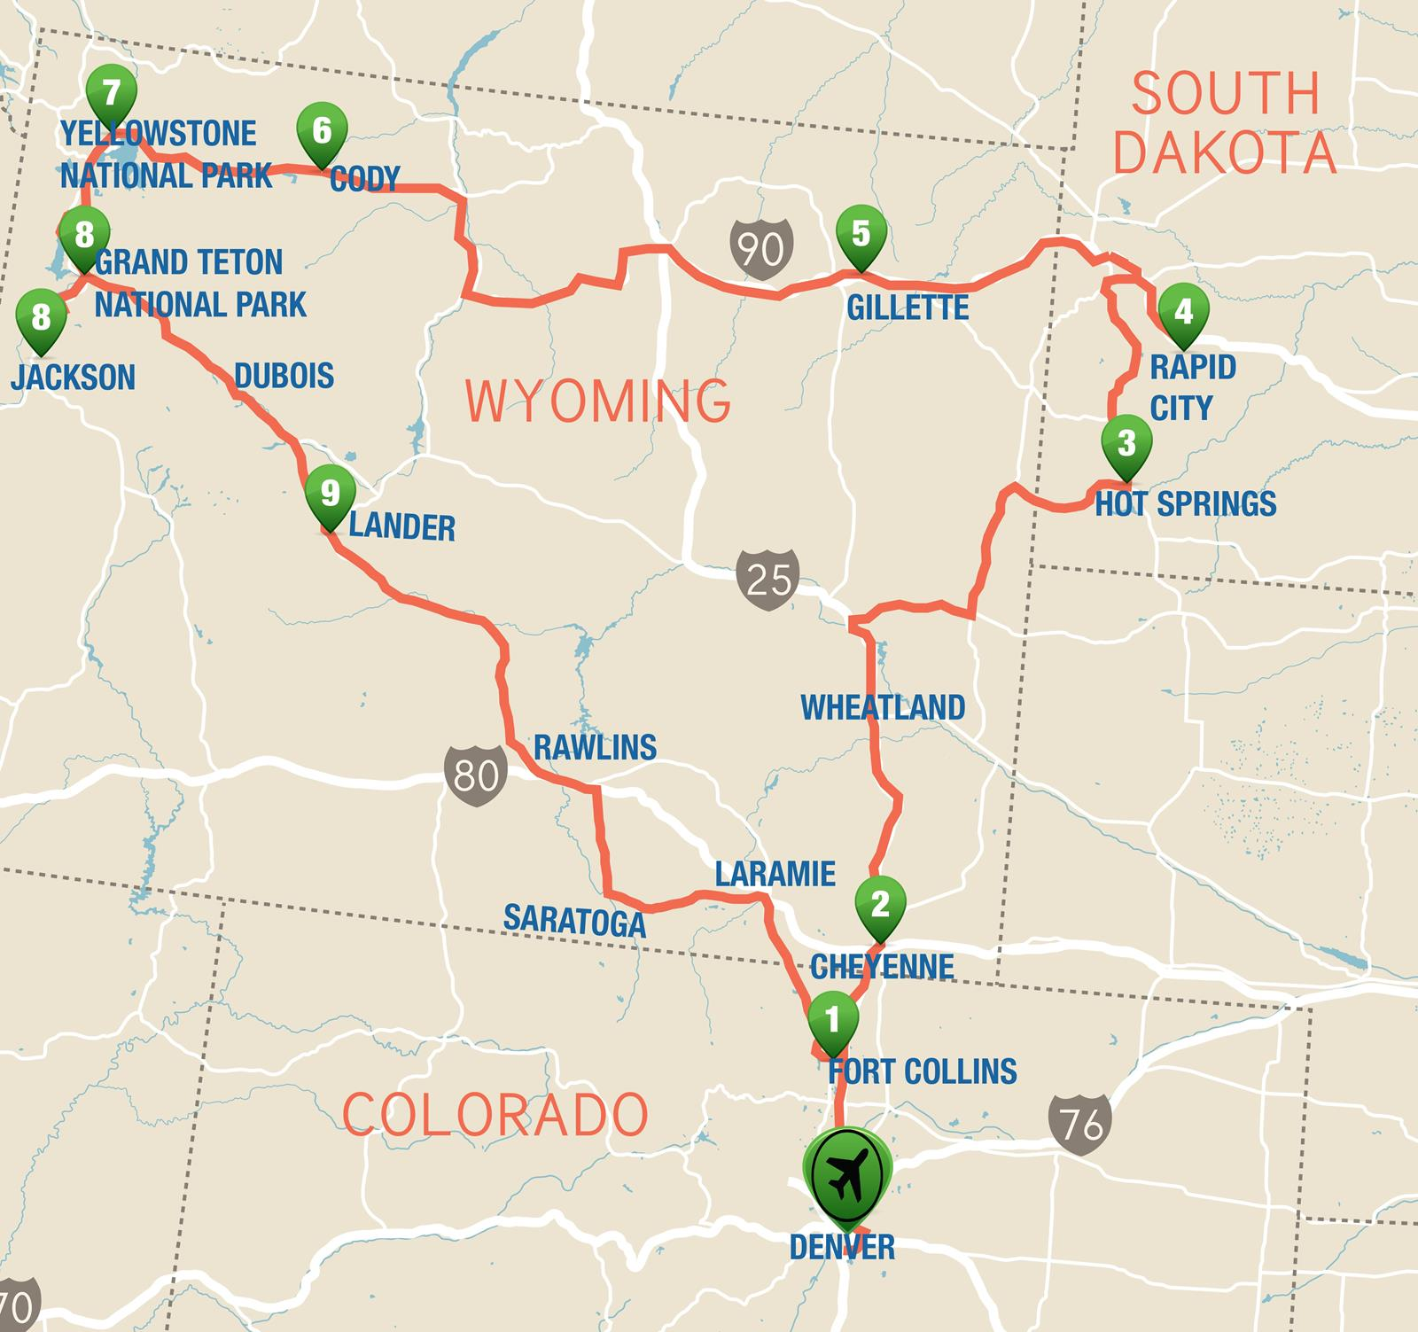
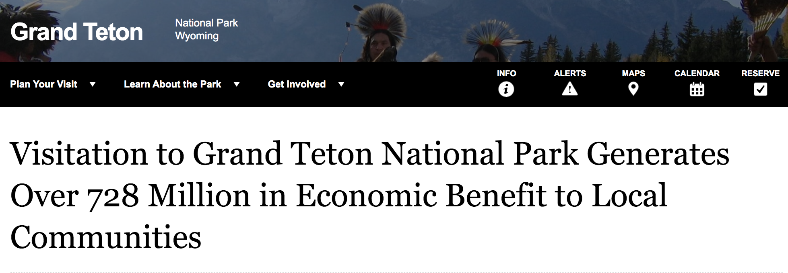
Iconic landscapes, unique opportunities
AMK
Crossing
Boundaries
SOCIAL
SCIENCE

Slide 16
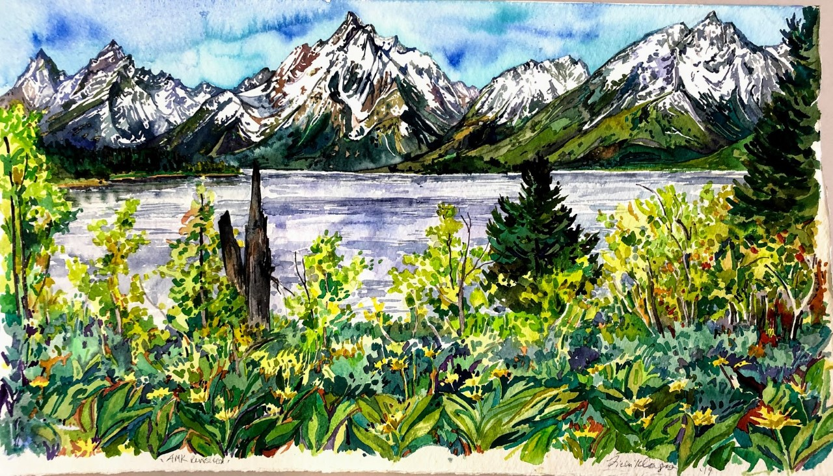
Iconic landscapes, unique opportunities
Crossing
Boundaries
HUMANITIES
Watercolor by Ricki Klages, UW Department of Visual and Literary Arts

Slide 17
Iconic landscapes, unique opportunities
Crossing
Boundaries
TRANSDISCIPLINARY

Slide 18
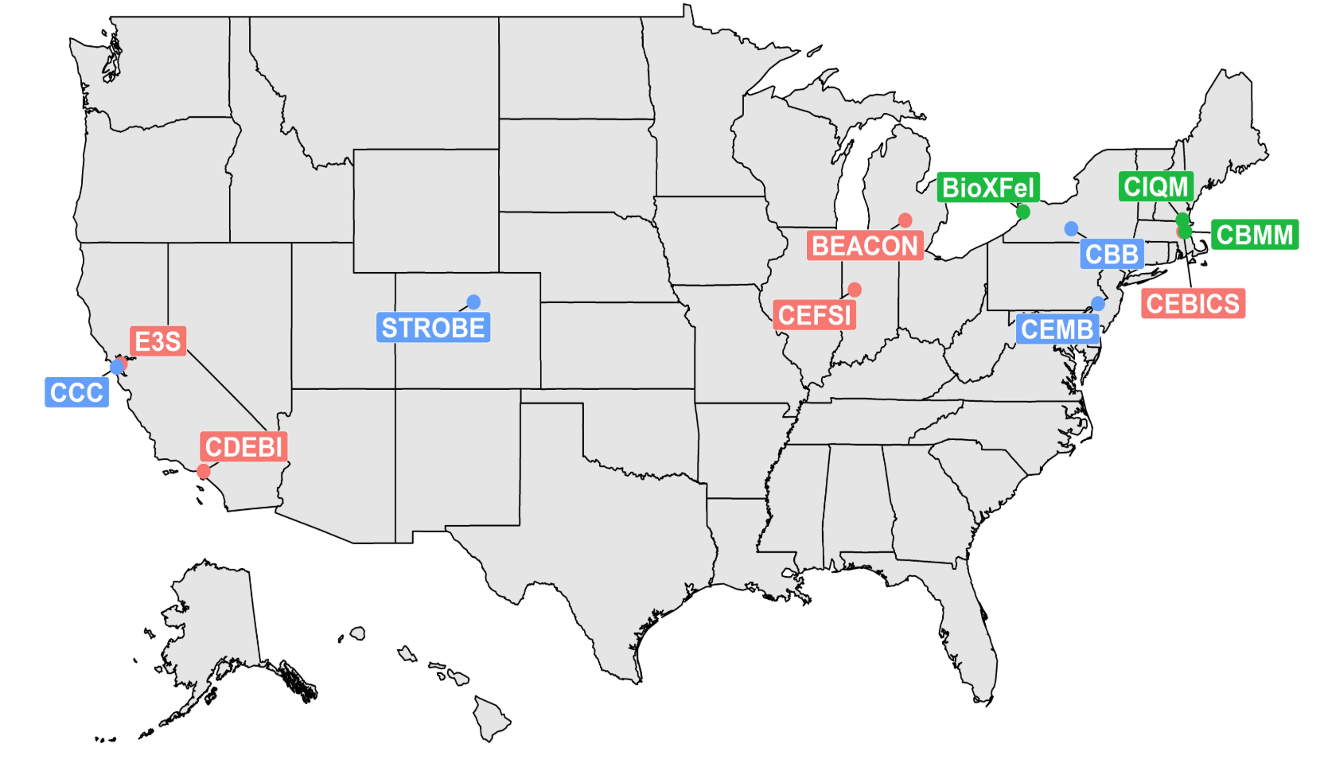
Iconic landscapes, unique opportunities
Funding Opportunities
AMK?

Slide 19
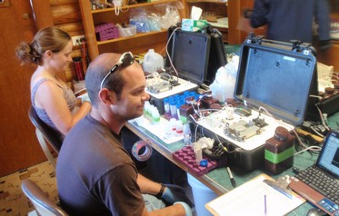
2020 Vision
Elevating experiences:
Enhance and expand opportunities
for place-based learning for UW students, community scholars, and the public

Slide 20
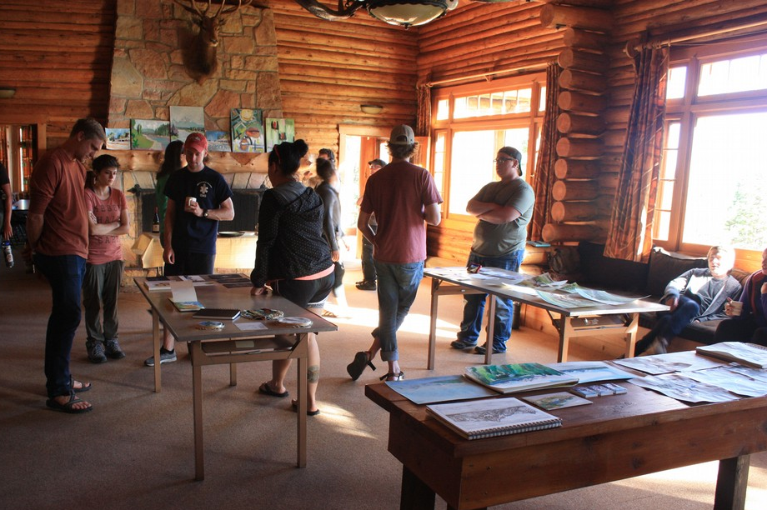
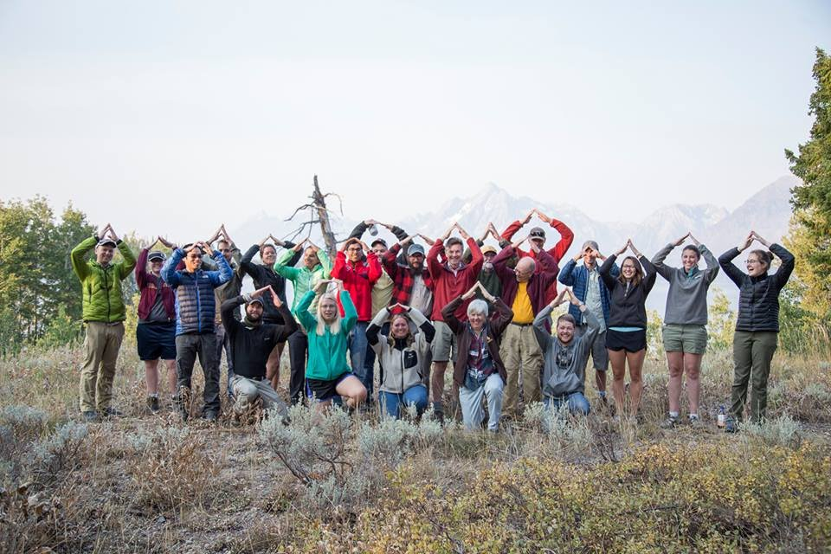
Courses
UW Art 4620: Outdoor Studio
Potential for expanded UW course use
Especially if open year-round
UW Geology Field Course, 2017
Potential for online and “life-long” learning
Tapping into the large numbers of GTNP visitors

Slide 21
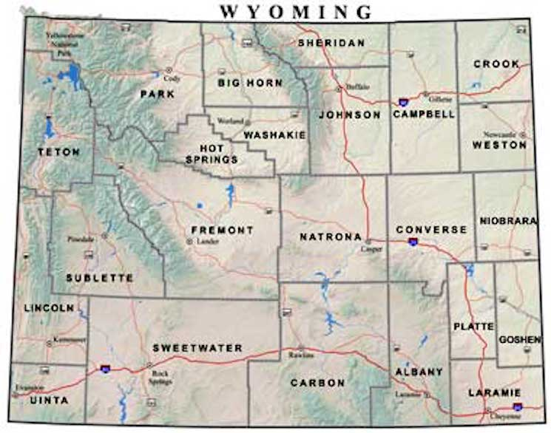
2020 Vision
Connecting communities:
Share research and learning opportunities that cross boundaries and foster cooperation, understanding, and discourse.

Slide 22
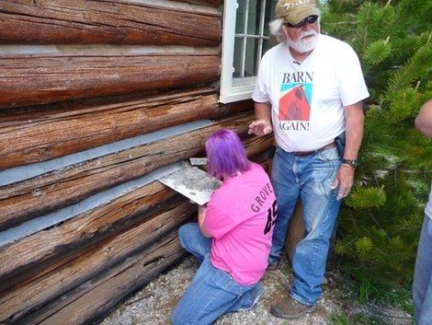
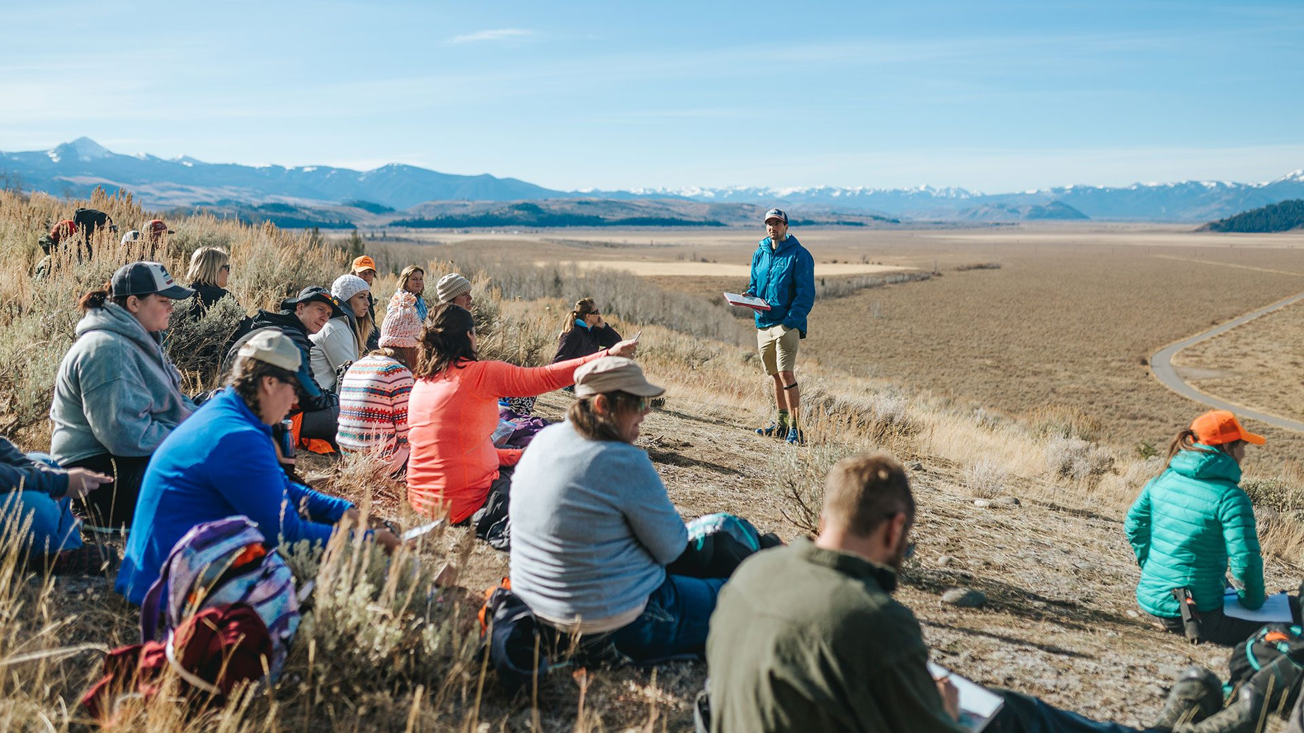
Toward an updated Campus Mission
World-class setting
World-class scholarship and experiences
World-class facility and programs
Teton Science School

Slide 23
Investing in New Programs

Slide 24
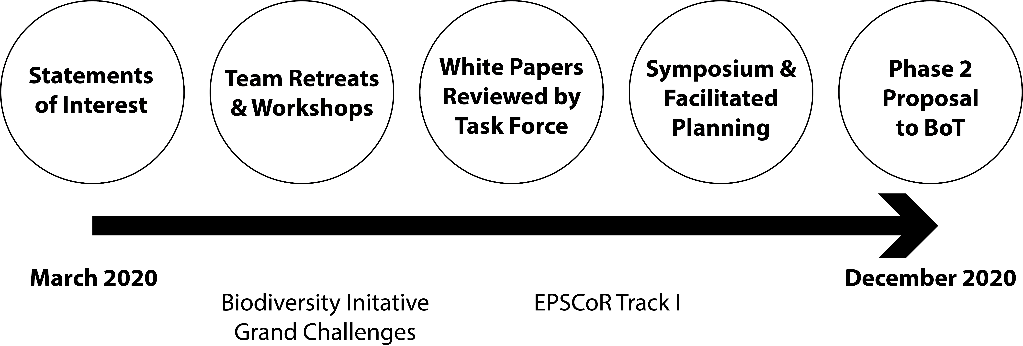
Investing in New Programs
Phase 1: A UW ORED-funded Call for Scholarly Visions

Slide 25
Investing in New Programs
Phase 2: UW-funded Grants to Launch New Programs
Proposal to UW Trustees in late 2020 based on the Scholarly Vision priorities
Launch a Teton Trans-boundary Incubator Program by providing funding for projects that launch long-term programs with the ability to attract new income streams (e.g., NSF grants; course fees; private fundraising)
Launch a Teton Scholars fellowship program for undergraduate and graduate students, post-doctoral scholars, and faculty.

Slide 26
Investing in New Programs
Phase 3: Facilitate and Sustain Excellent Programs through UW base support and the pursuit of new grants and donations based on the success of Phase 1 & 2.

Slide 27
Key Metrics
Increased UW use and scholarly impact:
10-15 new communities of UW faculty and students working at the Campus;
Regular development of new scholarly products worthy of national-level press coverage;
New large federally funded research programs.
Expanded place-based learning:
Doubling the number of courses offered through the Campus;
Development of new internship and research opportunities;
Long-term push to give every UW student an experience.
Increased range, volume, and mutual benefit of UW community partnerships

Slide 28
Investing in New Programs
Institutional Benefits:
Raise the profile of UW by communicating successes, discoveries, and connections
Improve UW student and faculty recruitment and retention by providing experiences and opportunities in the Tetons.

