Slide 1
Higher Learning Commission Accreditation Peer Team Visit Results
For the UW Board of Trustees, January 2020

Slide 2
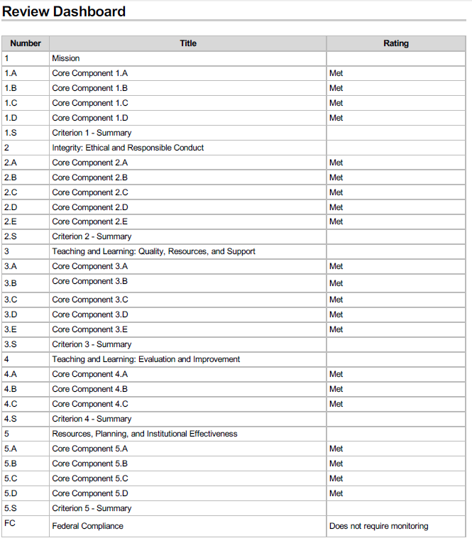
Summary of team findings

Slide 3
Narrative review summary
“The Peer Review Team commends UW on a well-written and well-documented Assurance Argument. Based on a review of this Assurance Argument, and interactions with various campus constituencies, the Team finds that UW remains in compliance with all criteria for accreditation, and that it meets HLC’s criteria for Federal Compliance. This visit included a multi-campus review of the University of Wyoming-Casper. The Team report indicates that the institution fulfills the expectations set forth by the HLC for additional campuses. The Team recommends that the University remains eligible to choose its Pathway for Accreditation.”

Slide 4
Narrative review summary
“It is clear that the University of Wyoming is a mission-driven institution with tremendous financial support from the State, allowing it to remain accessible and affordable. Its Board is a strong advocate for the institution; however, the Board and University Senior Leadership are encouraged to find ways to improve shared governance and strengthen the role of faculty in overseeing academic quality.”

Slide 5
Narrative review summary
“While the University has established an infrastructure for assessment of student learning, there continue to be areas for improvement. Finally, the University is commended for establishing and Office for Diversity, Equity, and Inclusion, and encouraged to make this a priority for the institution and provide adequate support for this Office.”

Slide 6
Thank you for visiting with the team!
Strengths | Strengths, con’t | Opportunities for improvement
Culture of assessment university-wide | Community college relations | Shared governance that depends currently on people rather than structures
Support from state, supportive governing board | Support for underrepresented student populations | More attention and intentional work with UW-Casper
Investment in diversity, equity, and inclusion | Outstanding facilities and technology | Catalogue system too reliant on manual intervention
Dedication to accessible & rigorous education | Use of data and surveys to continuously improve | Transparency in fee structure
Excellent faculty and staff, support for students inside and outside classroom | Budget planning supports strategic academic plans | Continued support and attention to learning outcomes and assessment
Revision and updating of regulations

Slide 7
Budget
Budgeted for Annual dues + visit prep + visit costs = $50,000 (Provost’s Division budget)
Actual spent = $36,710.54

Slide 8

Thank you!
HLC Reaccreditation Project 2020 Team
Anne Alexander, UW HLC Accreditation Liaison Officer

