Slide 1
COVID Update Latest Progress on UW’s Response to COVID-19
November 12, 2020

Slide 2
Return to Campus
Community Engagement
BOT Meeting: Thurs (11/12)
UW has partnered with the local community to help contain the spread of the virus and promote the community’s health and wellness:
Albany County Mask Mandate: Effective Friday, Nov. 6 through Nov. 30, persons within Albany County, Wyoming, including the City of Laramie, Wyoming, are required to wear face coverings in certain public settings.
UW Casper: Effective Monday, Nov. 2, In response to increasing COVID cases in the Casper community, including active cases at Casper College, UW Casper will establish a testing program in partnership with UW Laramie, leveraging the UW lab-developed testing capabilities and capacity to conduct targeted testing.
Cowboys Cash: Effective Friday, Oct. 30 through Dec. 31, the University of Wyoming has formed a partnership with Laramie Main Street Alliance to boost the Gem City’s small-business economy by providing $50 in gift certificates to each student who lives on UW’s campus and has purchased a university meal plan. “Cowboy Cash” can be used at Laramie’s small, locally owned businesses that are compliant with Albany County’s COVID-19 health and safety guidelines.
Off-campus Compliance: Effective Monday, Oct. 5, off-campus students who have been identified as non-compliant with UW’s testing programs may not enter campus for class or other activities for one week unless coming to take a COVID-19 test. If individuals take their test and it comes back with a negative result, they may resume on-campus activities the following week.
2

Slide 3
Return to Campus
Testing Program
BOT Meeting: Thurs (11/12)
White House coronavirus official commends Wyoming's testing, urges face mask use on visit
October 28 – The pandemic response coordinator for the White House Coronavirus Task Force on Wednesday visited the Wind River Hotel and Casino to meet with state, local and tribal officials regarding Wyoming’s COVID-19 response.
Dr. Deborah Birx commended Wyoming’s testing program and said the University of Wyoming’s testing protocols are on par with the best in the nation. But Birx also stressed the need for face masks and for residents to change their behavior in the short term.
(Source)
3

Slide 4
Return to Campus
Intervention
BOT Meeting: Thurs (11/12)
Given the increase in cases on campus and the approaching Thanksgiving holiday, the following intervention was announced yesterday:
Encourage and enable students to return home after testing negative during the week of November 9-13, and to self-isolate for 14 days once home to avoid spreading COVID to family members
This provides students with the opportunity to make their own decision on how best to navigate their return home
For consistency of the academic experience of all students, a shift to fully remote learning will begin the week of November 16-20.
Continue current operating environment for campus facilities, with these remaining open and available to students, faculty and staff to maintain resources for students to successfully complete the semester
Encourage employees to work remotely to the extent feasible
Continue to offer testing on campus, maintaining the current testing frequency
Continue Athletics under current protocols and supervision
4
4

Slide 5
Return to Campus
COVID Indicators
BOT Meeting: Thurs (11/12)
UW has continued to track the following indicators, including many that have been met given the recent surge:
Indicators | Threshold
Total # of symptomatic cases (on and off campus) per day: | 5 cases
Total # of on campus (Residence Halls, Fraternity and Sorority Life) student cases per day: | 5 cases
# of total cases per day over two consecutive days: | 15 cases
Seven-day rolling average of total cases: | Increasing over 20%
# of one-day increase of new cases in the UW population relative to the 7-day rolling average: | 20 cases
Sample disease prevalence: | Over 3%
# of UW fatalities: | Any (not met)
Capacity for isolation/quarantine: | Less than 20% (not met)
Hospitalizations (# of admitted COVID patients): | Track actuals (no thresholds)
Total # of active cases: | 150-200 active cases
Total # of new cases in a single day: | 40 new cases
5

Slide 6
Return to Campus
COVID Hub
BOT Meeting: Thurs (11/12)
There are three key areas that the COVID Hub oversee from general COVID-19
related inquiries to contact tracing and wellness support.
CONTACT TRACING
COVID HOTLINE
WELLNESS
In collaboration with the Wyoming Department of Health (WDOH), the COVID Hub helps control the spread of the virus on campus and within the local community by leveraging Contact Tracers to identify individuals who may have come in contact with a Positive Case.
The COVID Hotline provides email and phone support to UW constituents with general inquiries related to COVID-19, such as testing, positive cases, university COVID policies, housing, compliance, and more.
Working in tandem with the WDOH and Office of Residence Life, the COVID Hub informs UW positive cases of preliminary next steps, assists on-campus students with the transition to Quarantine and Isolation (Q/I) housing, and conducts patient outreach during their time in quarantine or isolation.
6
6

Slide 7
Return to Campus
Contact Tracing Process
BOT Meeting: Thurs (11/12)
RLDS views Google Doc to initiate isolation efforts for Positives Cases
Nycole works with RLDS to move on-campus Positive Cases into isolation housing
Q/I Support Coordinator checks in with isolated students
WDOH creates and assigns Positive Cases in Redcap software and works with UW to assign Contact Tracers
Positive Cases are issued official isolation orders in accordance with WDOH policy
Positive Case information and Close Contacts are input into Google Doc, TD, and RedCap
Positive Cases
Dashboard is updated, metrics are reported to leadership, and Positive Cases are created in Team Dynamix (TD)
Contact Tracers call Close Contacts and issue official quarantine orders in accordance with WDOH policy.
Contact Tracer views Google Doc to view assigned cases
Data reports are distributed to WDOH, EEPG, RLDS, and COVID Hub staff
Contact Tracer conducts outreach to Positive Case, identifies Close Contacts, and adds notes to Google Doc
Close Contact tickets are updated in Google Doc, TD, and RedCap
Danika receives, reconciles, and assimilates data on positive cases from multiple data sources
Close Contacts
RLDS views Google Doc to initiate quarantine efforts for Close Contacts
Nycole works with RLDS to move on-campus Close Contacts into quarantine housing
Q/I Support Coordinator checks in with quarantined students
DATA ANALYSIS
CONTACT TRACING
QUARANTINE & ISOLATION
FOLLOW UP
7
7

Slide 8
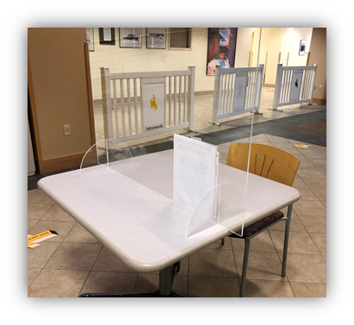
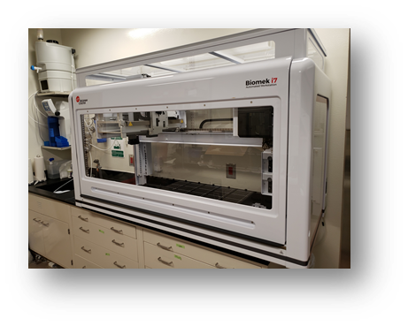
Return to Campus
Surveillance Testing Program
BOT Meeting: Thurs (11/12)
Union
Surveillance Testing Program
Who:
All students, faculty and staff who live on campus or are coming to campus in Phase 3 and Phase 4.
Crane-Hill Cafeteria
What:
The Surveillance Testing Program uses a Vault test or a UW lab test – both are saliva-based tests – to test for SARS-CoV-2, the virus that causes COVID-19. Each individual will complete the test 1 to 2 times every week.
When:
Launched on October 19, Surveillance Testing will be conducted throughout the duration of Phase 3 and 4.
Where:
Vault test is currently being administered in the Union Ballroom and the UW lab test is being administered in Crane-Hill Cafeteria.
Update on CLIA
UW contracted with an outside provider to facilitate the CLIA certification process and
anticipates being certified prior to the start of the Spring Semester.
8
Notes:
WILL- Brief review of testing and update on CLIA certification
~5 min.
WILL – can you share the picture of the robotics that we can insert since we have talked so much about it?
Who:
All students, faculty and staff on campus are required to participate. An exemption process is available for distance learners and remote employees, as well as those who can self-isolate when on campus.
What:
Individuals are tested using a Vault test or a UW lab test – both are saliva-based tests that test for SARS-CoV-2, the virus that causes COVID-19. The UW lab test is processed in a pool of four samples at the Wyoming State Veterinary Lab (WSVL), which allows for rapid results in a cost-effective manner. Until UW is CLIA certified, confirmatory Vault tests are required for positive pooled samples.
When:
Launched on October 19, Surveillance Testing will be conducted throughout the duration of Phase 3 and 4. In Phase 3, undergraduate students are required to test 2x per week, while graduate students and employees are required to test 1x per week. With a smaller testing population in Phase 4, this shifts to only 1x per week of all participants (currently estimated at approx. 4,200).
Where:
Vault test is currently being administered in the Union Ballroom and the UW lab test is being administered in Crane-Hill Cafeteria. In Phase 4 …

Slide 9
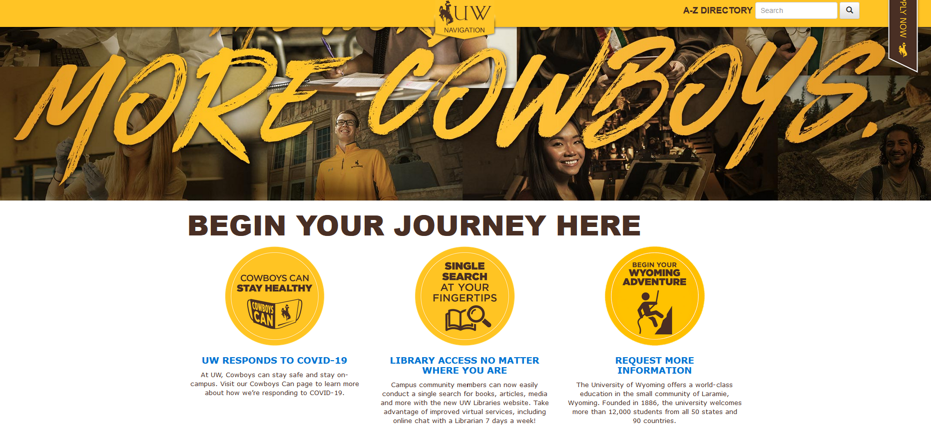
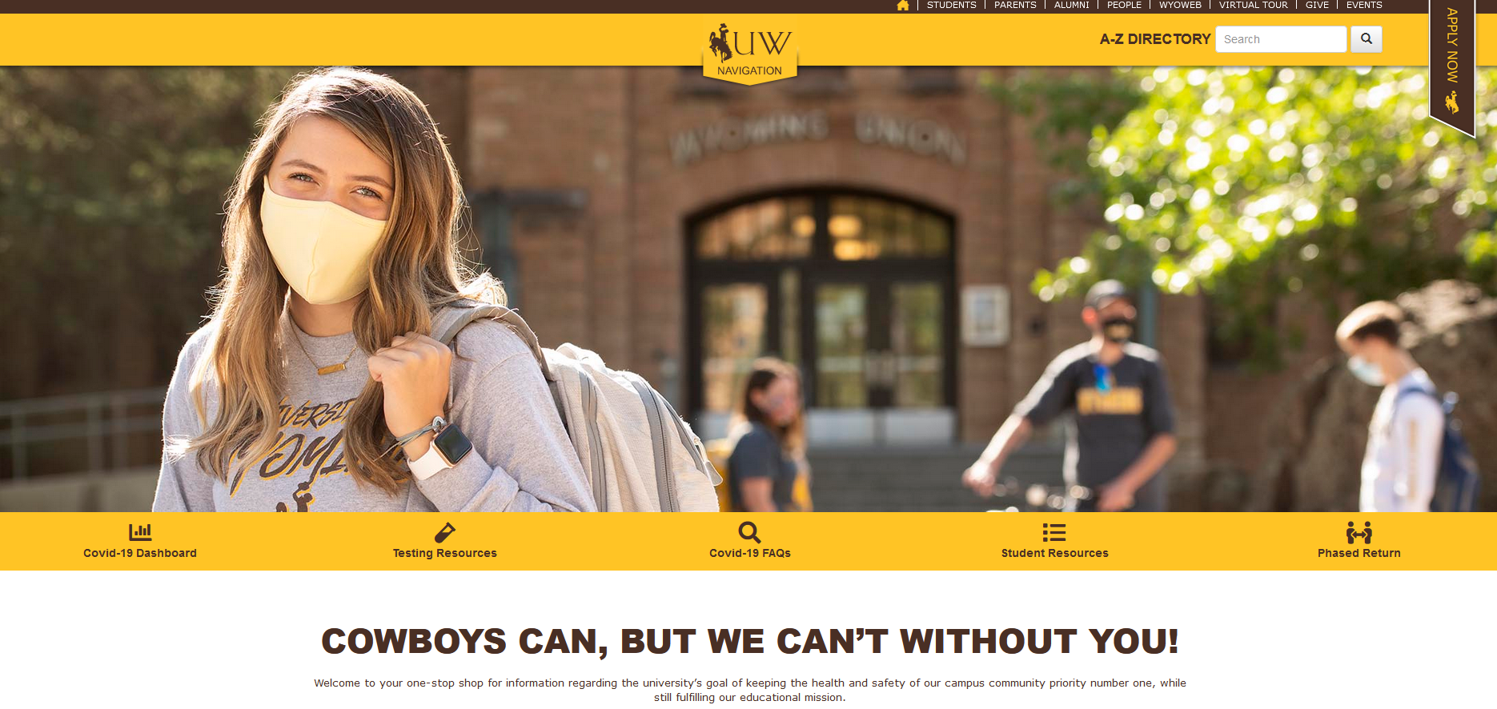
Return to Campus
COVID Communications
BOT Meeting: Thurs (11/12)
Revamped COVID-19 Webpage
Audience:
Targeted primarily at prospective students and parents but will also feature content for employees and current students.
Theme:
To create a cohesive experience across multiple channels, we created the site using the Cowboys Can theme. This will provide visitors with a similar experience as they move across the channels and provide them with a closer connection to the University.
Look and Feel:
We added clear imagery of students in masks and practicing social distancing. We also used colors to notate breaks within sections.
Sections:
To keep information clean and easy-to-navigate, we created clear sections of information.
9

Slide 10
Return to Campus
Spring Planning
BOT Meeting: Thurs (11/12)
Next Steps
Spring Academic Calendar has been posted.
Spring semester: January 25 – May 7
Final exams: May 10 -14
No classes on President’s Day (February 15)
The week of spring break has been converted to instructional days
2. Spring Semester Plan/Update
Update Governance Structure for Spring
Contingency Planning
3. Spring Plan to be presented to Board at December meeting.
10

