Slide 1
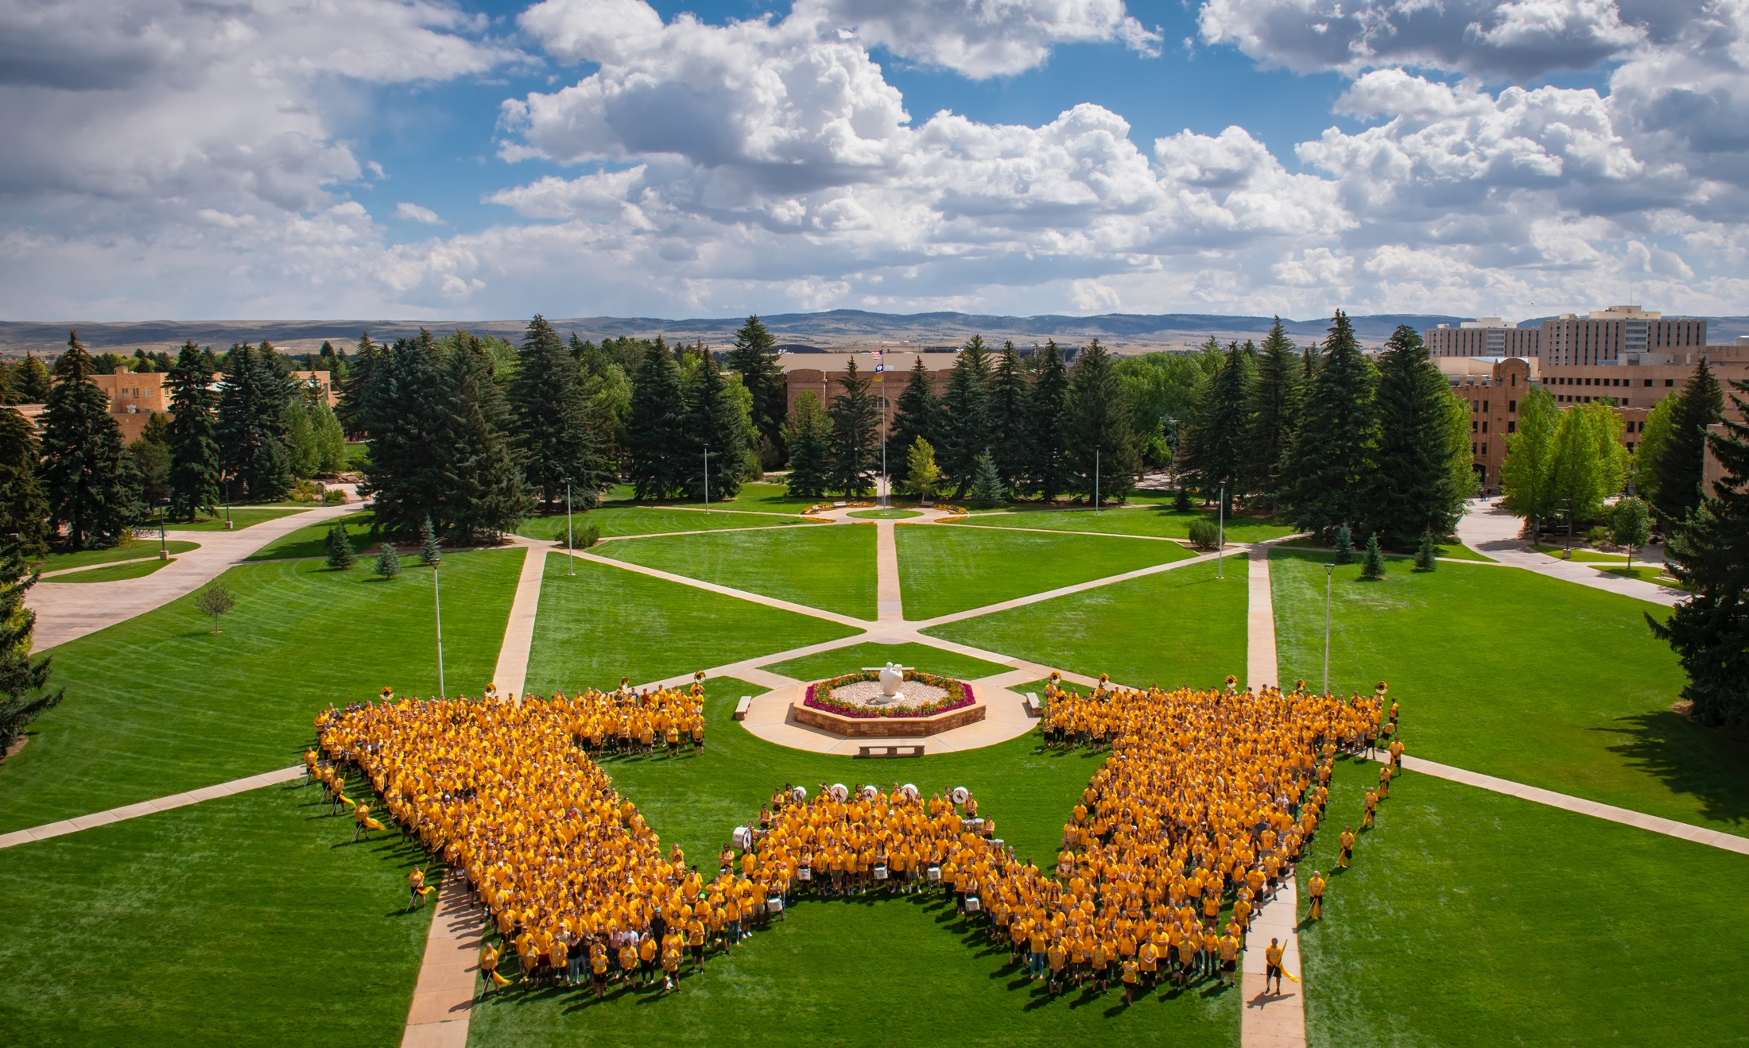

BUDGET PRESENTATION May 11, 2020

Slide 2
BUDGET SUPPORTS VISION
Aspire to National Preeminence
Serve Wyoming first
Educate the next generation of professionals and develop a workforce poised to lead a post-COVID-19 agricultural renaissance across the Mountain West
Leverage resources, capitalize on our strengths, build on our current outstanding research, education and outreach programs, and enhance our statewide collaboration
Exemplify leadership, collaboration, and innovation; foster a culture of achievement, engagement and pride within faculty and staff
Accomplishments in 2019
Restoring staffing (faculty, staff and administrative) to basic functional capacity
Integrated strategic planning with budget clarity and strategic resource allocation
Initiated a long-term planning process for meeting facilities and infrastructure needs

Slide 3
Capitalizing on the Unique Strengths of ANR
Relevant to Wyoming: ANR programs address contemporary challenges and opportunities for agricultural enterprises, natural resources, workforce development, education, and community vitality through education, research and outreach.
Committed to Wyoming: The college is comprised of faculty and staff with a resounding commitment to the betterment of Wyoming’s students, resources, and communities.
Exceptional Undergraduate and Graduate Programs: Students, alumni, parents, and employers all express a high satisfaction with program quality and graduate performance. This national reputation fosters excellent job placement for graduates and graduate students who are very competitive top-tier graduate and professional schools. Strong research productivity.
Stakeholder Engagement and Donor Support: The College is responsive to our stakeholders creating positive and productive relationships with alumni, agricultural producers, industry representatives, elected officials, and community leaders. ANR has privately funded initiatives in wildlife-livestock disease, range management, family and consumer sciences, plant science, and agribusiness.
Service to Wyoming: ANR provides critical services such as: the Wyoming State Veterinary Laboratory (WSVL), and the on-campus Early Childhood Education Center (ECEC).

Slide 4
Challenges – People and Infrastructure
Personnel Resources are lacking to reach critical functional level in teaching, research and extension
  Due to the inability to fully fund the recovery from former budget cuts and vacancy sweeps.
Major holes in administrative team – critical hires:
  Associate Dean & Director Agricultural Experiment Station
  Assistant Director UW Extension (Western region)
  Department Head in Animal Science
  Business Operations Director
9 Wyoming counties without a UW Extension Area Educator violates our contractual obligations
Facilities on campus need major maintenance and renovation.
  AgC is over 70 years old and has had few updates. AgC Addition is 50 years old.
  Heavily used AgC teaching labs critical for biological science courses need upgrades.
Off campus facilities are in desperate need of major maintenance and upgrades.
  R&E centers should be showcases for the community and hubs for community vitality and an agricultural renaissance.
  Let’s rebuild them with state-of-the-art technology to showcase how Ag is transforming, get on the front-end of the curve, and have facilities across the state that serve as living/real-life laboratories for students to excel over the next 30 years.

Slide 5
Opportunities for ANR
Agriculture is a cultural and economic imperative in Wyoming.
There is unprecedented support for agriculture in the Wyoming Legislature.
ANR programs have steady enrollment numbers and a realistic potential for expanding enrollment.
The College has faculty and facilities located in every Wyoming county and on the Wind River Indian Reservation.
Our newly re-structured budget provides the long-awaited clarity and accountability to engender enhanced support from stakeholders, elected officials, alumni, and other potential supporters.
Visibility and success of rodeo program brings attention to ANR and University.
Our College is uniquely positioned to contribute to COVID-19 recovery through our capacity in bio-medical research, food system innovations, agriculture, and community-based education.

Slide 6
BUDGET OVERVIEW/VARIANCE - Completely Reconstructed Budget: Emphasis on Accountability & Transparency
Increases in Salary due to:
  CPM Allocations
  Restoring administrative team (largely reflects supplemental pay for internal promotions)
  Addressing the deficit of Extension Educators expressed by Legislators and County Commissioners (3 Area Educator positions)
  Legislative actions (Vet Lab – Biocontainment Laboratory (BSL3))
  Moving full time salaries from Designated and Foundation to URO (and shifting part-time salaries to Designated and Foundation)
Increases in Service, Travel, and Supplies due to:
  Operating needs associated with more people
  Shifts from Designated to URO
  Rebuilding capacity at R&E Centers
 | FY20 |  | Dollar Variance Budget to Actual Unrestricted Operating | Percent Variance Budget to Actual Unrestricted Operating
 | Year Total | Q3 YTD
 | Unrestricted Operating Class
Summary Level Natural Accounts | Year Total Budget | Q3 YTD Actuals
Total Expenses After Transfers | $26,483,161 | $18,806,014 | ($7,677,150) | 71.0%
Statement of Activities Net Result | $22,893,861 | $16,836,678 | ($6,057,186) | 73.5%

Slide 7
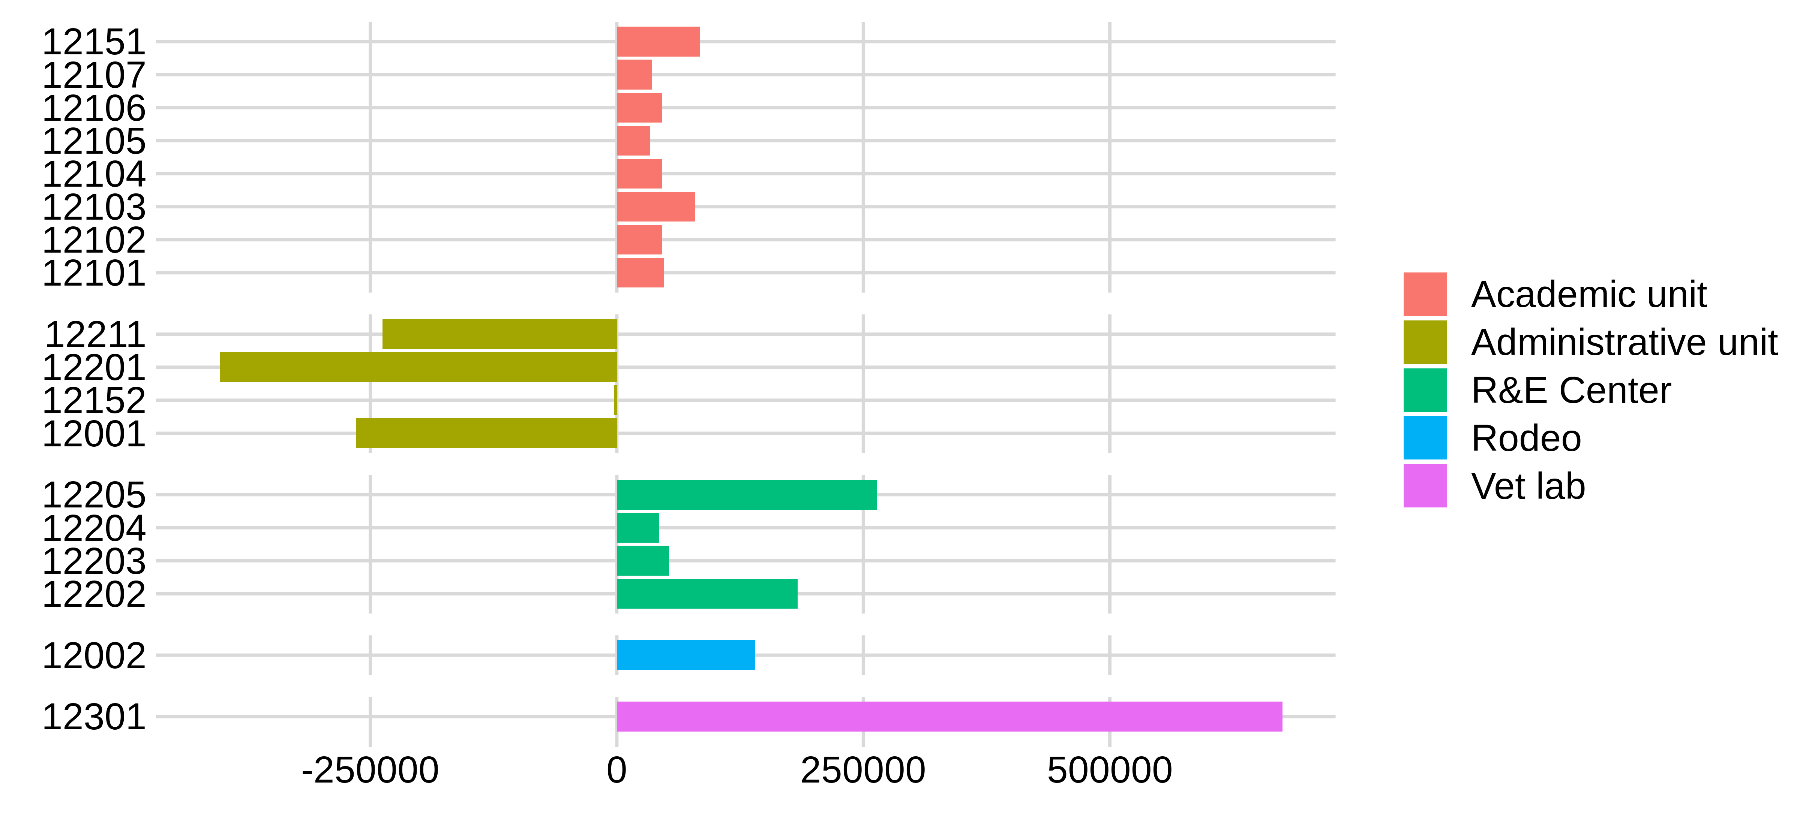
Unit Level Changes in Services, Travel and Supplies:
Provides mechanism for improved accountability
*Note, Vet Lab increase is due to shift from Designated Account to URO (Associated revenue was also shifted to URO

Slide 8
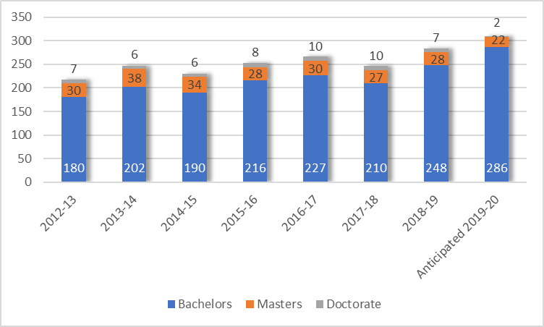

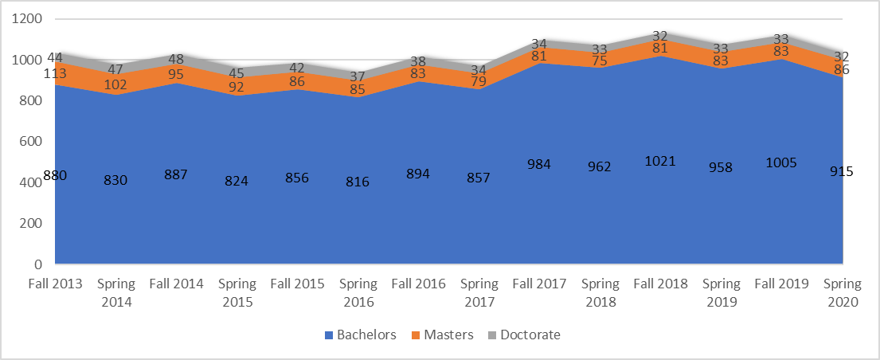
Total Primary Degrees Awarded
Student Headcount – Fall & Spring Semesters

Slide 9
Changes in College Staffing: 2015 to 2020
 | 2015 | 2019 | % Reduction | 2020
Faculty | 96 | 81 | 15.6% | 80
Academic Professionals (AP) | 130 | 111 | 14.6% | 105
Staff | 145 | 122 | 15.9% | 133
 | 371 | 314 | 15.4% | 318
Pooled Limited Temporary | 302 | 233 | 22.8% | 266
Work Study/Student | 34 | 22 | 35.3% | 26
Graduate Assistant | 137 | 132 | 3.6% | 122
Temporary Lecturer | 13 | 10 | 23.1% | 13
 | 486 | 397 | 18.3% | 427
TOTAL | 858 | 711 | 17.1% | 745

