Slide 1
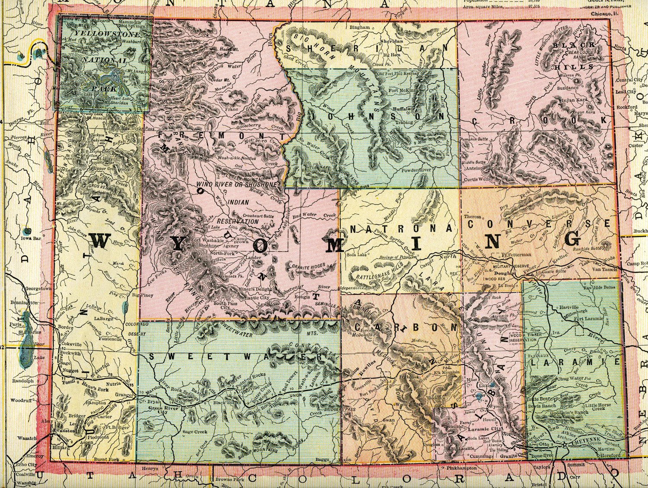
Budget Presentation
UW College of Business
May 12, 2020

Slide 2
Our Strategic Plan
We continue to invest in our strategic plan
Developed in 2018 with input from key stakeholders, launched in Jan 2019
The plan has been well received and reflects who we are
All key decisions must satisfy the strategic plan’s core objectives
Strategy has never
been more important!

Slide 3
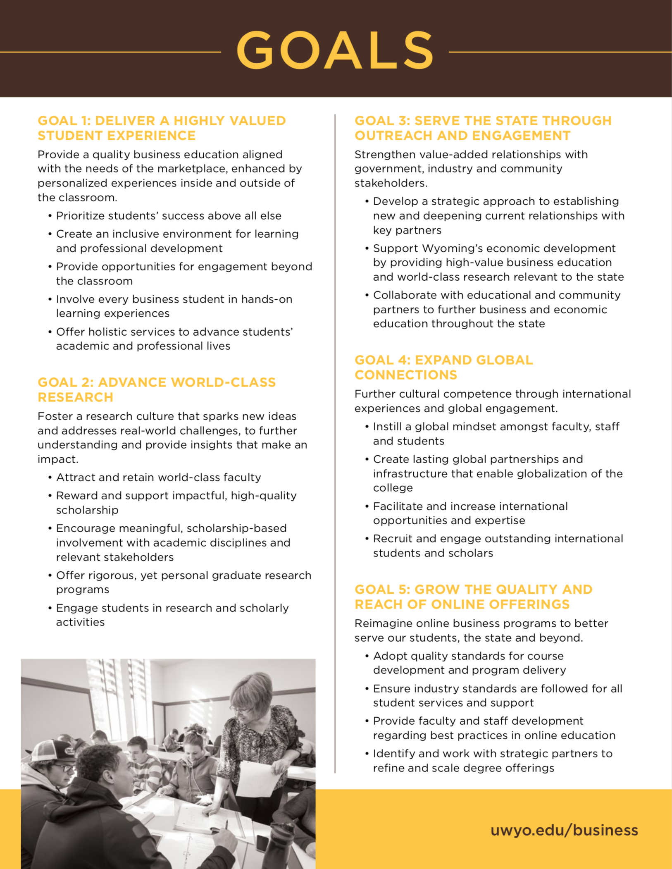
Our Goals & Priorities
GOAL 1 – The Student Experience
GOAL 2 – World-Class Research
GOAL 3 – State Engagement & Outreach
GOAL 4 – Expanding Global Connections
GOAL 5 – Growing Online Offerings

Slide 4
SWOT Analysis
Strengths
A great plan and solid leadership
Goal progress (e.g., GJSSC)
Influx of new talent
Strong external partnerships with
Weaknesses
Salaries and faculty resources
Heterogeneous research
Shallow leadership pool
Culture
Opportunities
Wyoming economic diversification
Need for quality business programs
Stakeholders motivated to partner
New revenue sources
Threats
The Wyoming and US economies
Lack of vision & strategic planning
Slow speed to market
Insufficient central support
INTERNAL
EXTERNAL

Slide 5
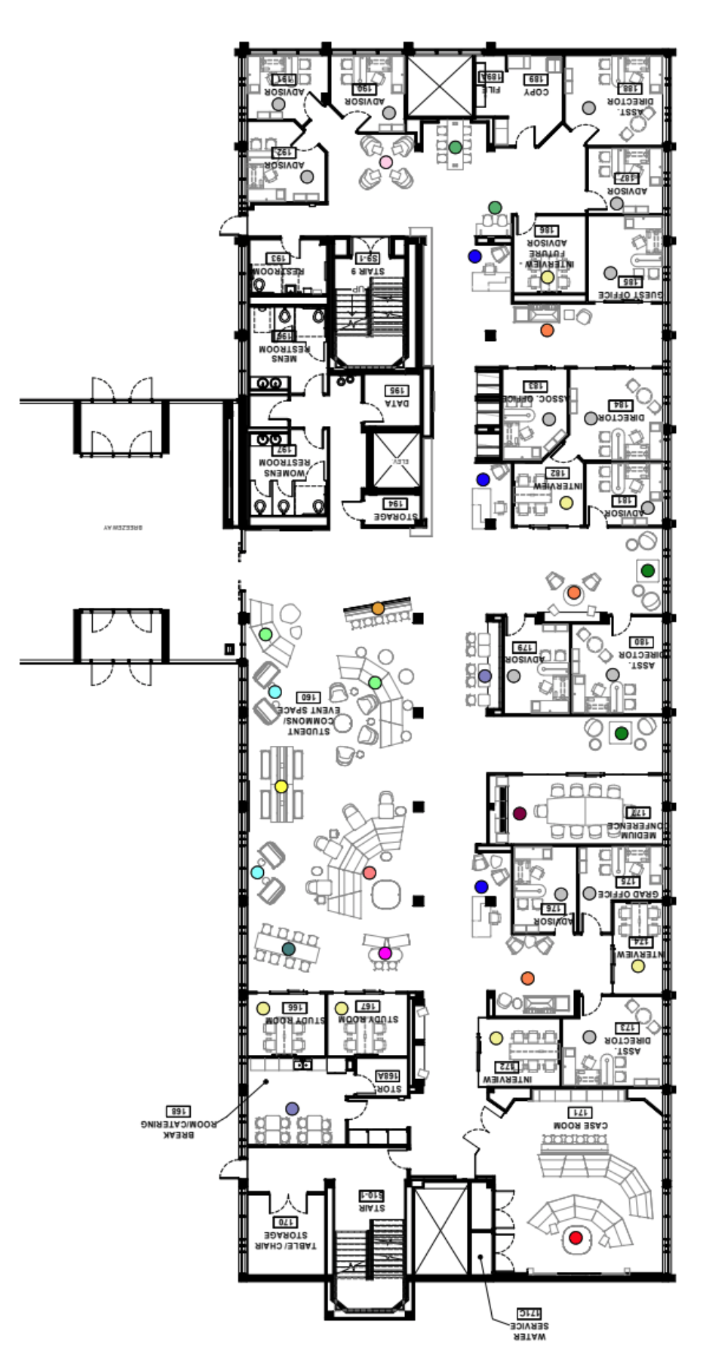
Goal 1: The Student Experience
Curriculum updates improve efficiency and provide flexibility
Majors 5+2 and Minor 3+2 model
MBA curriculum working group
Online course design and delivery
Building expertise to serve UW students and state’s needs
Entrepreneurship (post IIE and next steps)
Hospitality and leadership (new UG minors)
Center for Professional Selling and Sales Minor
Blockchain (initiative moving forward)
Center for Business and Economic Analysis (CBEA)
Green Johnson Student Success Center ($3M donor project)
Enrollment, Advising, Internships, and Career Readiness
Next step – Board approval for contract advertisement

Slide 6
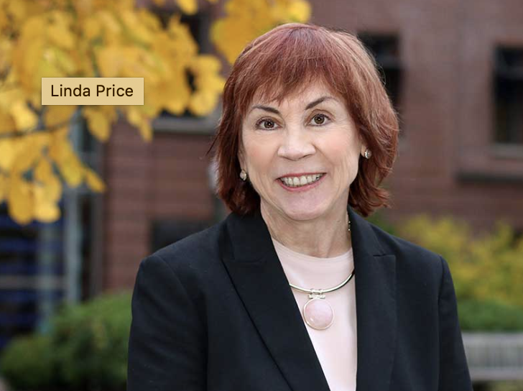
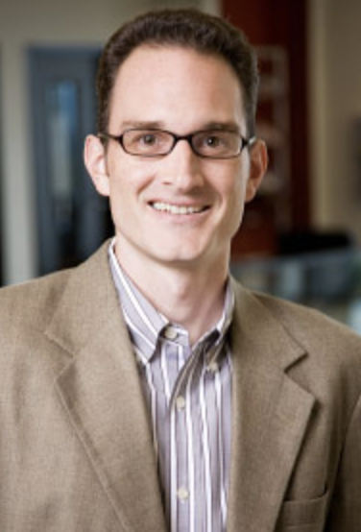
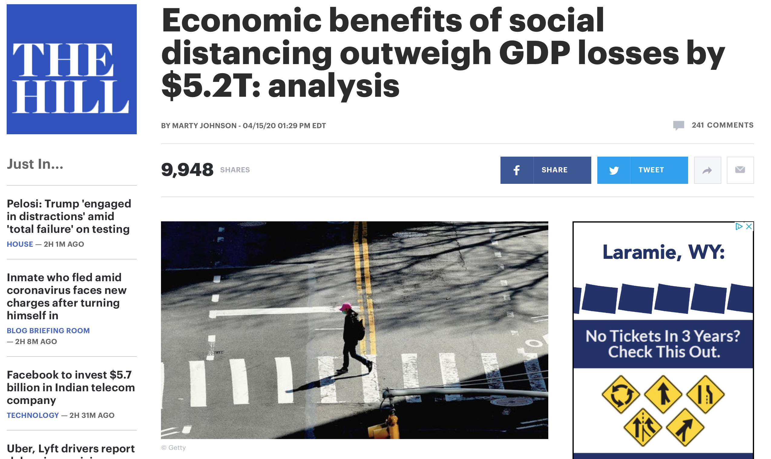
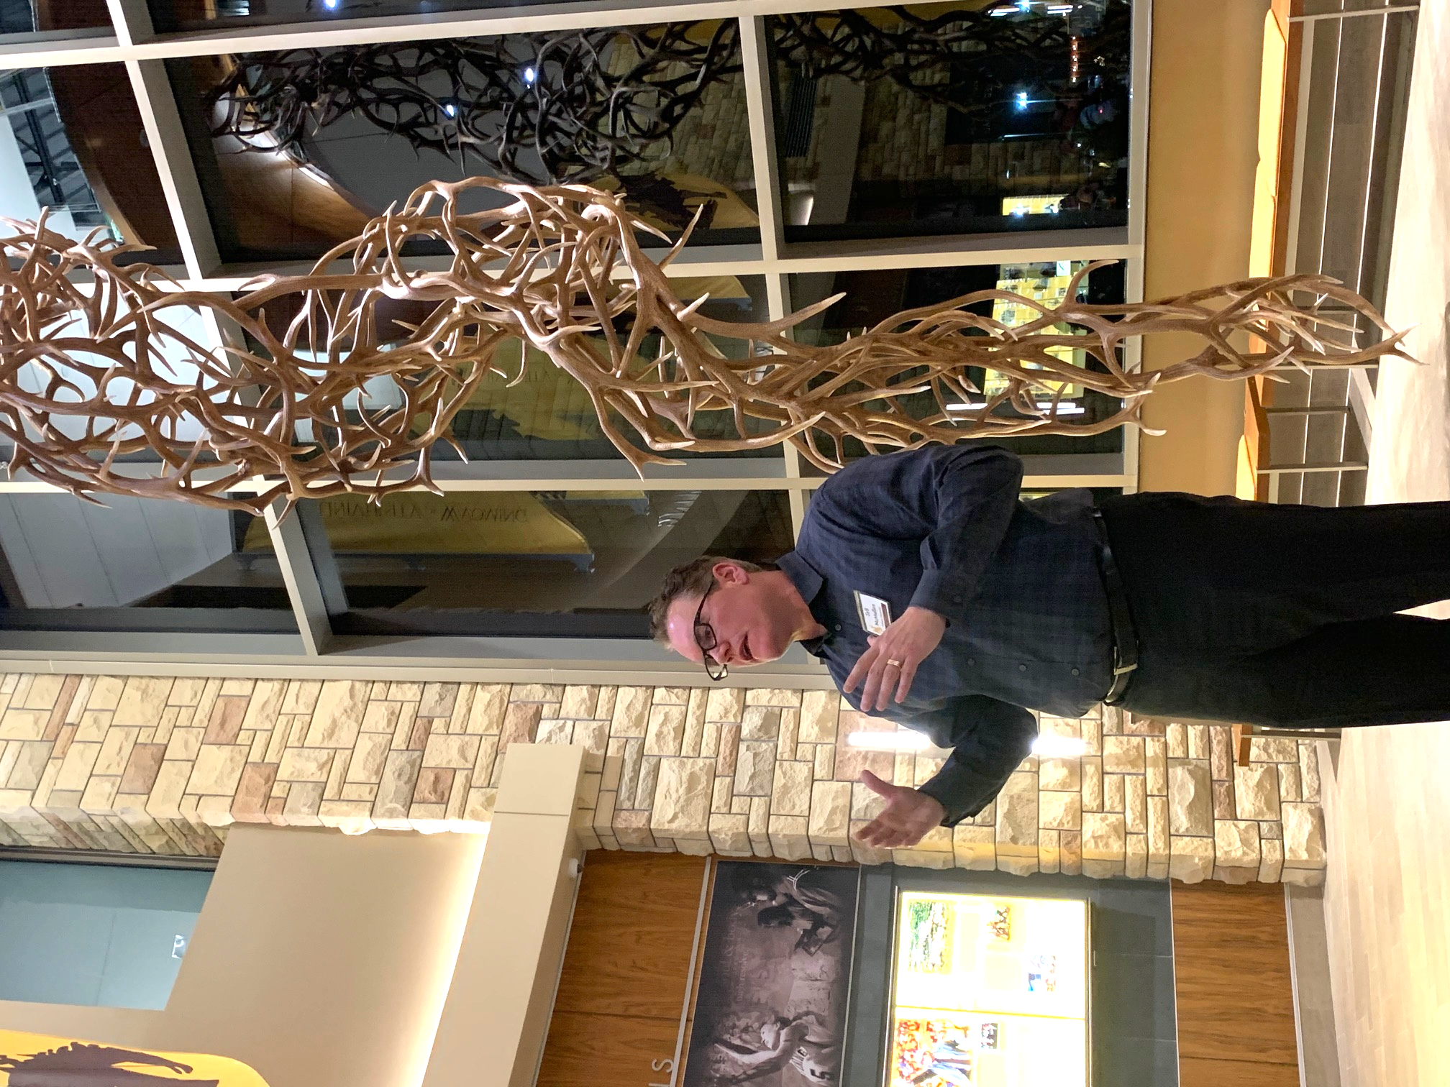
Goal 2: Research
Linda Price
University of Oregon
We are rebuilding faculty post 2016
Including senior faculty, 2 chairs
Our existing faculty are receiving (inter)national attention
Entrepreneurship conference
Economics has had a strong year
Top 5 UW department
Team of faculty working on the economic impacts of COVID-19 – getting national attention
Todd Cherry
Appalachian State
Ronn Smith
University of Arkansas
Plus assistant professors from: Georgia State, Cornell, Texas A&M, University of Kentucky

Slide 7
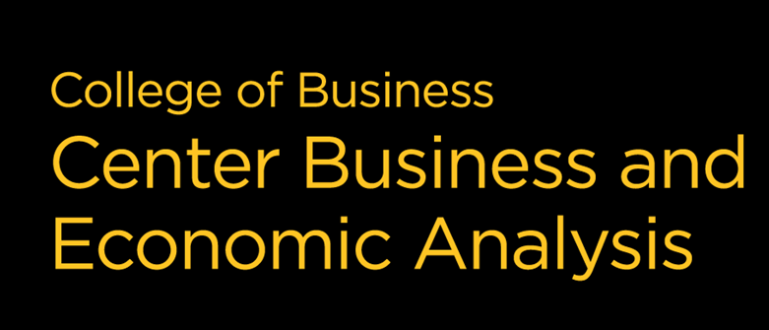
Goal 3: State Engagement
State & Local Government
Governor’s “Power Wyoming” and Revenue Diversification Task Force
Wyoming Business Council - consulting, metric development
Wyoming Workforce Services – workforce development, internships, placements
Energy Sector Economic Modeling/Forecasting – fossil and renewable sources
Wyoming Association of Municipalities – economic development resources for community leaders
Wyoming’s Business Community
State-wide economic development agency engagement – board leadership, special projects, strategic planning
Virtual small business information sessions with local business leaders
New summer (1) credit online course offerings
Classroom and field student experiential learning projects supporting state businesses
Access to faculty with entrepreneurial, start-up, and business sustainability expertise
Community Colleges and High Schools
Online UG degree completion (Acct)
HBM curriculum collaboration
Wyoming Association for Career & Technical Education – business education integration
Community College Summit – increasing access to curriculum and articulation/transfer efficiencies
Events
Jackson Hole Leadership Conference
Global Tech Summit
Wyoming Hackathon
Cheyenne Frontier Days

Slide 8
Goal 4: International
Relationships:
Building relationships in China, Norway, France, UK / Scotland
New program in Argentina Jan 2020
Spring 2021 business semester in England
Existing MBA and UG double degree programs with Pforzheim, Germany
Work in an interdisciplinary fashion with partners across the university (e.g., IAC, Cheney Center, SER, English)…COVID-19 gave a blow
Next steps:
Planning for 20/21 study abroad
Excited to explore opportunities with President Seidel

Slide 9
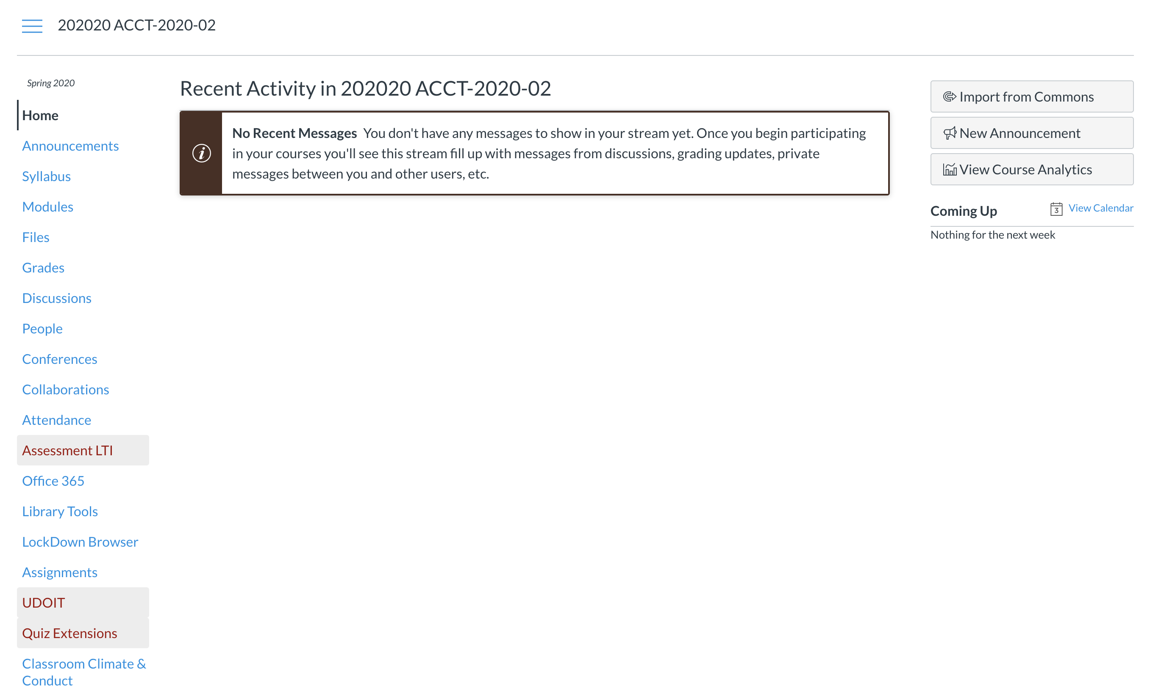
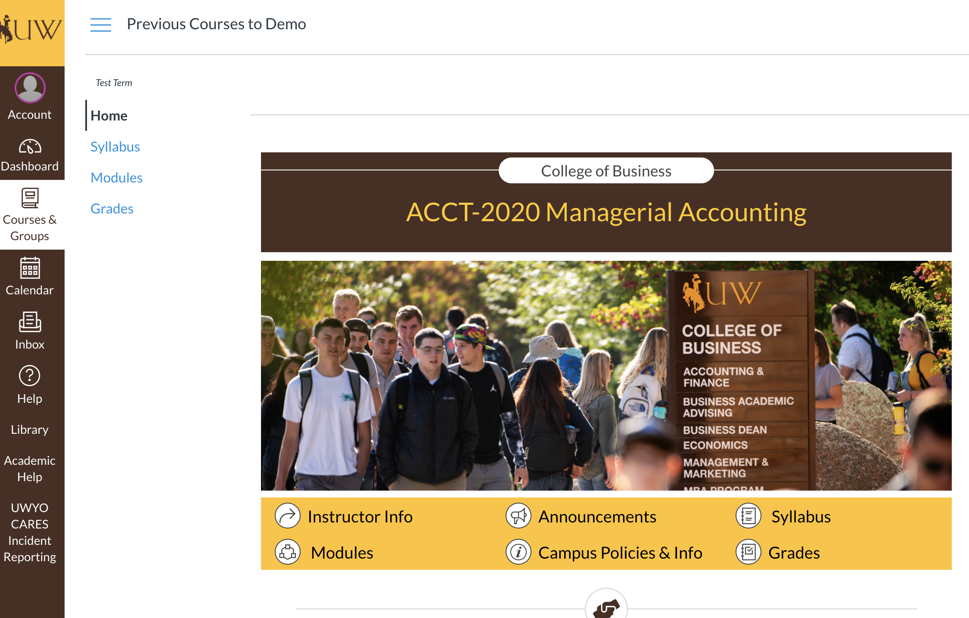
Goal 5: Online Offerings
Benefits of better design
Better recruitment, learning outcomes, and retention
Reduced confusion
Easier access to course content state-wide and globally
Similar experiences over time (simpler)
Branding consistency and appeal

Slide 10
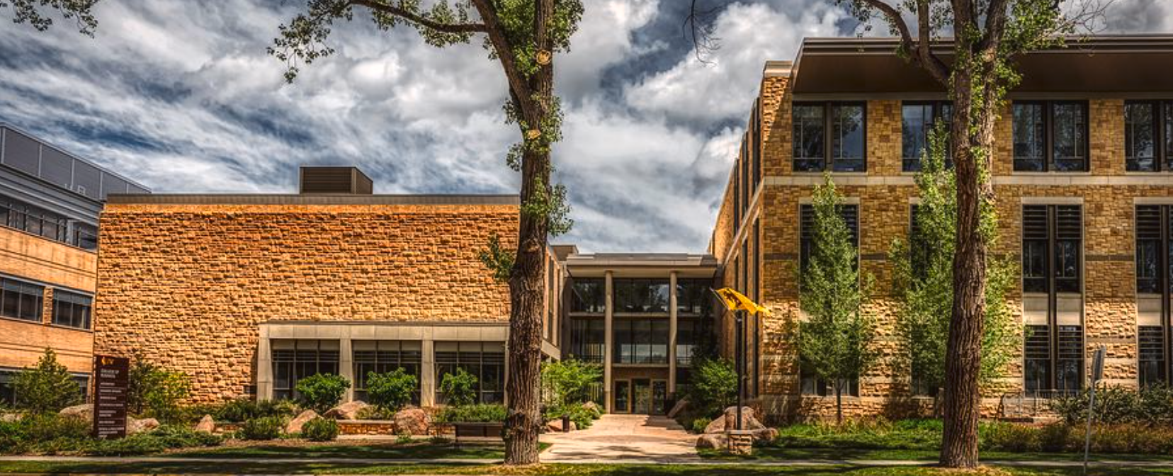
FY2021 Budget and Facilities
$18.3M operating budget and $77M endowment
Greater central support of operating budget allows endowments to be used for excellence (e.g., McMurry Summer Fellows) – Thank you!!
28,868 credit hours for Fall 19 & Sp 20 (21.4% are online – up next year)
Revenue increasing for CBEA and online distance learning - revenue generation is a priority
C&I received a major, state-supported, renovation plus a new addition in 2010
Facilities are doing great
Clarity needed on upkeep of facility used by many on campus (#2 busiest)

Slide 11
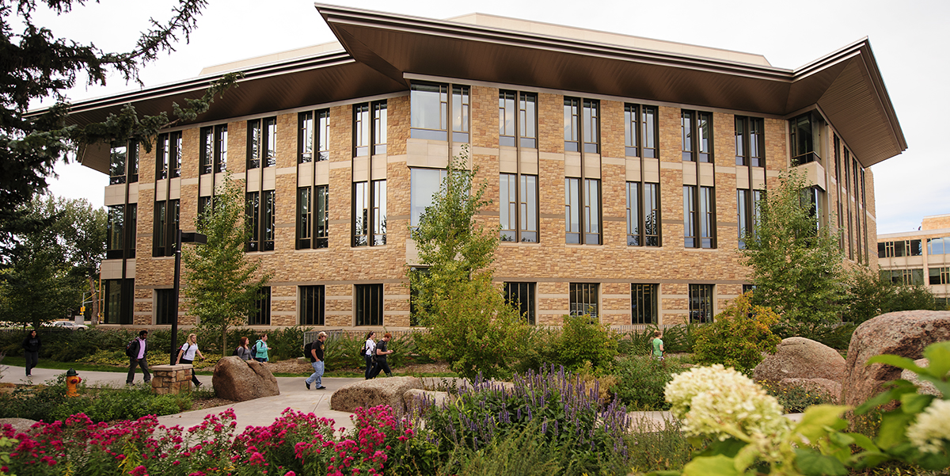
Thank you!
Questions & Answers

