Slide 1
Institutional Marketing
FY20 Highlights

Slide 2
Ad Strategies
Traditional, digital, public relations and experiential marketing
Ads were focused on funnel stage
Influencer marketing – Brand Ambassadors and Content Interns
Direct Mail
Public Relations Events
Digital Ads delivered via Google Search, Facebook, Instagram, Snapchat, YouTube, Display Ads: over 5 million statewide ad impressions
Social:
In January 2020, a new Assoc. Director of Digital and Content Strategy was hired
Role serves to create and direct strategy for social media and digital marketing
Social is our largest communications medium

Slide 3
Target Markets
Primary Market
Wyoming
Secondary Markets
CA, CO, IL, MN, NE, TX, Rapid City
Market Three
ID, KS, MD, MO, OH, OR, PA, VA, WA, WI
Market Four
AZ, FL, GA, IN, MI, MT, NC, NV, NY, OK, TN, UT

Slide 4
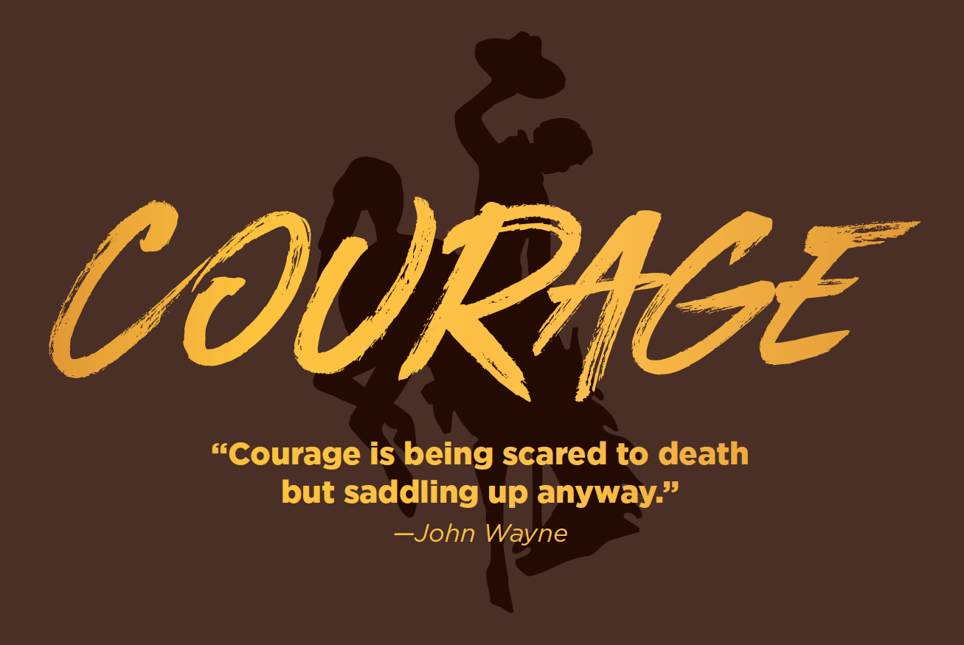
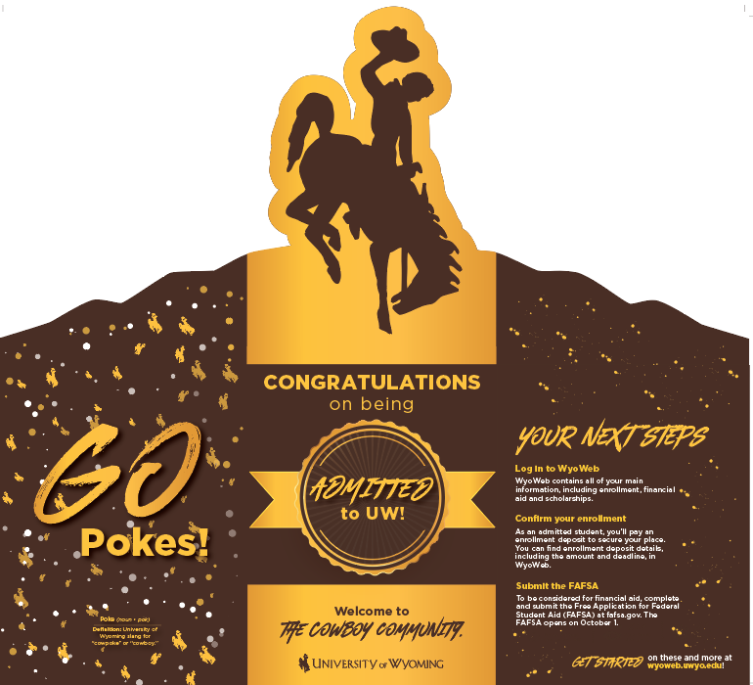
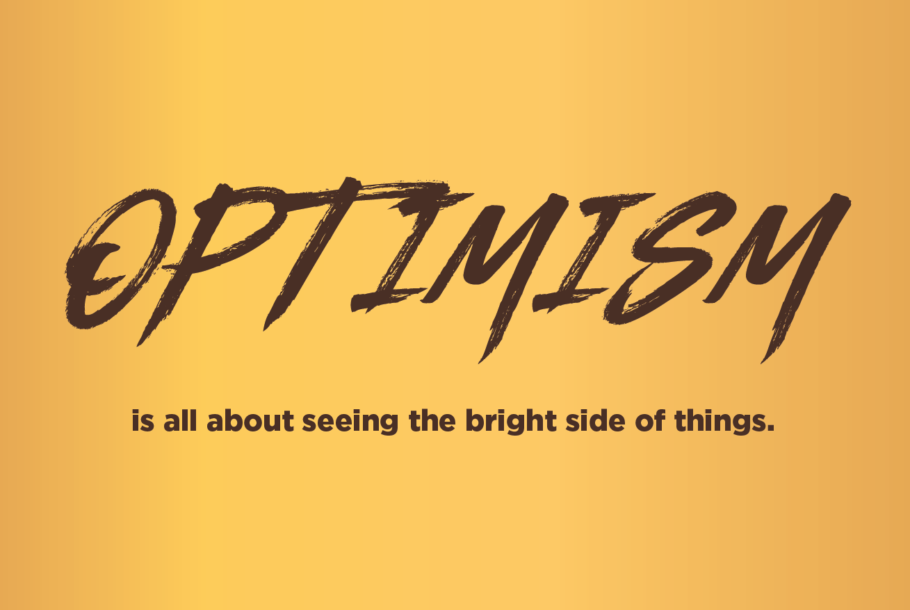
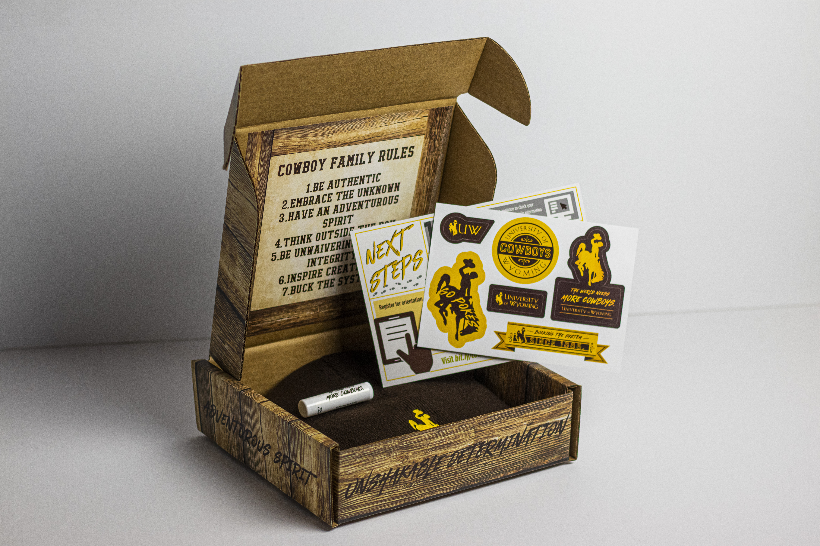
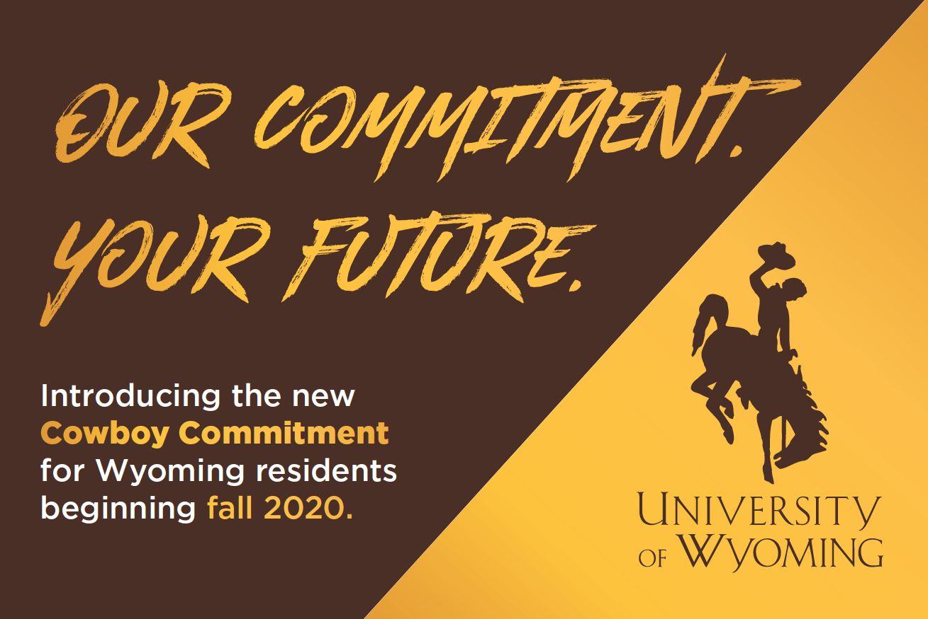
Addy Awards
Best in Show 2019
Multiple Gold and Silver awards in 2019 and 2020
Educational Advertising Awards:
Multiple Gold, Silver and Merit awards in 2019 and 2020

Slide 5
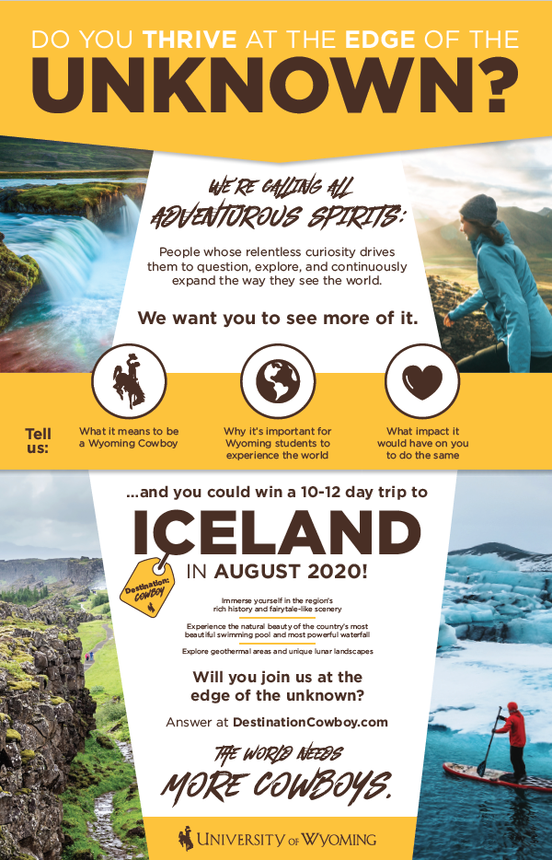
Destination Cowboy
34 entries from 18 states
First-ever Partnership with Education Abroad & FYS
In-State campaign to drive excitement about the University of Wyoming with high school underclassmen & increase awareness of power of studying abroad
17,000 visitors to Destination Cowboy site
Prize package awarded to one team of 2 students + one high school administrator

Slide 6
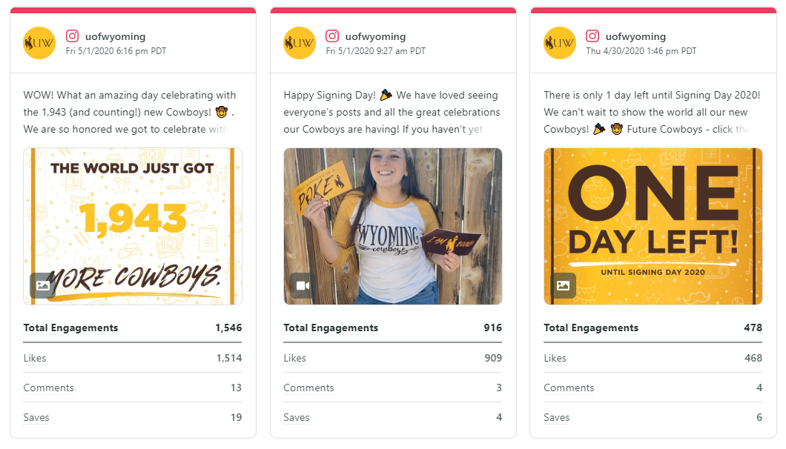
Virtual Signing Days
Social Media Total Engagement
Instagram: 25,000
Facebook: 14,000
SnapChat: 26,000
Giphy: 66,000
Website Engagement – www.uwyo.edu/signingday
Page views: 2,009
115 exited on “Confirm Enrollment” button
Time on Page: 4:09 (this is remarkably long compared to other pages)
1,840 map points plotted for enrolled students

Slide 7
Creative Services Workload
70 videos shot and produced
Magazines: UWYO, Foresight (CEAS), FOCUS (COB) and College of Education
Marketing/Communication Specialists from five colleges coordinate with us to create 100s of pieces: Flyers, event materials, brochures, booklet, ads, displays, Strategic Plans, Dean’s Report, recruitment pieces, newsletters, rack cards, logos, swag
Design for other campus units: President’s Office; Global Engagement; Outreach and Engagement; Diversity, Equity, and Inclusion; Research & Economic Development; UW Libraries; American Heritage Center; Haub School; Institutional Analysis; Admissions; UW-Casper; Alumni; Advising; Transfer; IT; Dean of Students
100s of images taken for headshots or placed on UW Photo Database; 50 Athletic events photographed
PRINT • PHOTO • VIDEO • WEB • SOCIAL MEDIA

Slide 8
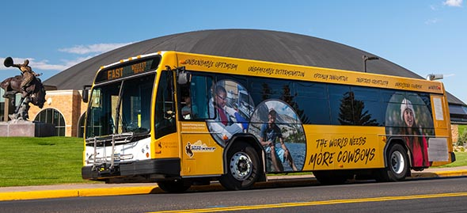
Additional Marketing for…
Light Pole Banners: 39 on UW campus; 30 on Snowy Range Bridge
The World Needs More Cowboys – And So Does Wyoming
Digital Billboards: Rock Springs, Cheyenne, Casper and Gillette
Wrap design on second UW Transit bus
State rodeo event sponsorships

Slide 9
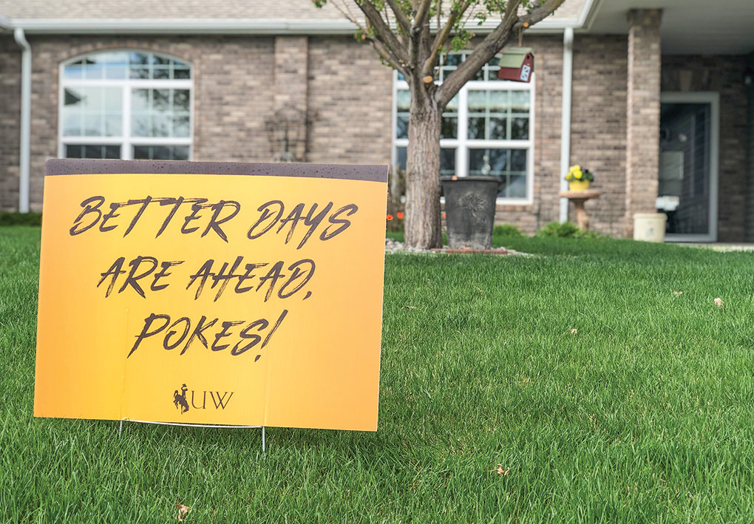
COVID-19 Response
Yard Signs conveyed an encouraging message; 6,000 distributed around Wyoming
Dozens of press releases highlighted UW faculty, staff and student contributions to the health crisis
Cowboy Coffee social media series
Regular posts starting early April gave students a sense of normalcy, rituals and resources
This was NOT used to communicate COVID-19 news. We intentionally separated this content so students could consume information that didn’t propagate fear or uncertainty. Each video is 1-5 minutes long
Better Day video series offering inspiring message; 67,000 views in first month
Chancey Williams virtual concert
Photo from Powell Tribune

