Slide 1
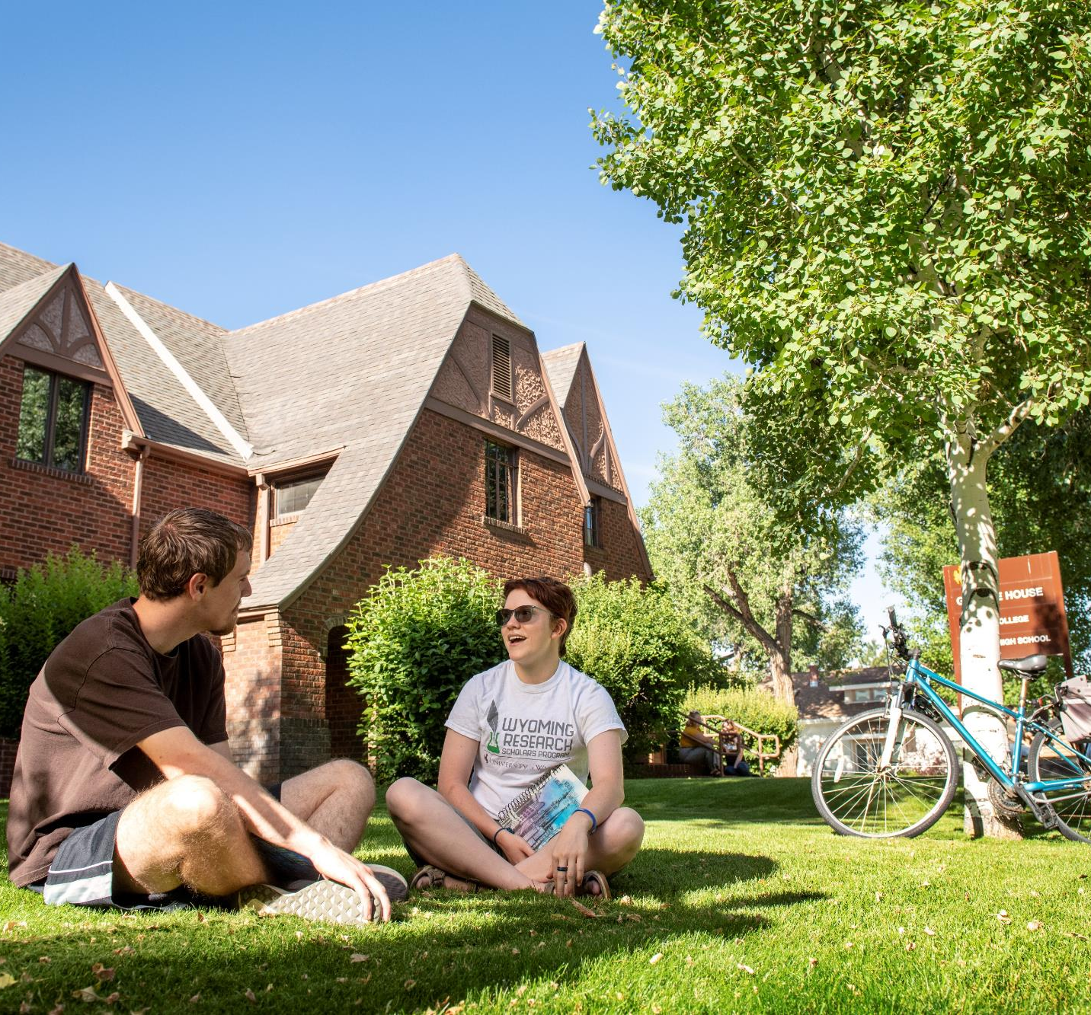
SLIDE 1
HONORS COLLEGE
Budget Presentation to Trustees
May 11, 2020

Slide 2
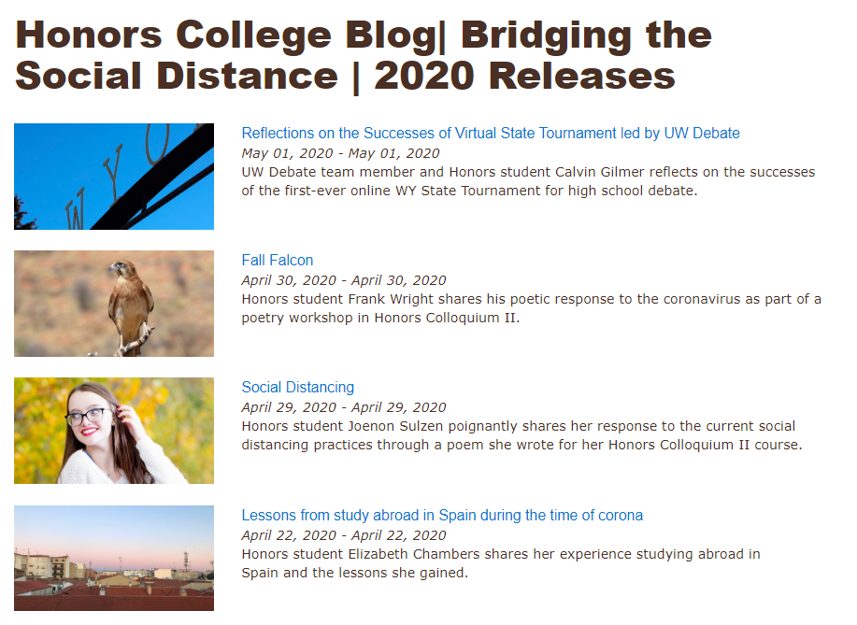
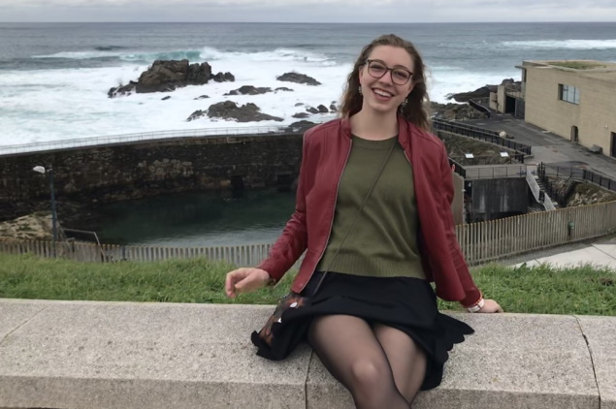
SLIDE 2
COMMUNITY
Kailee Behunin enjoying her study abroad experience in Spain just before being sent home due to COVID-19. Kailee shared her story on our Honors College blog Bridging the Social Distance.

Slide 3
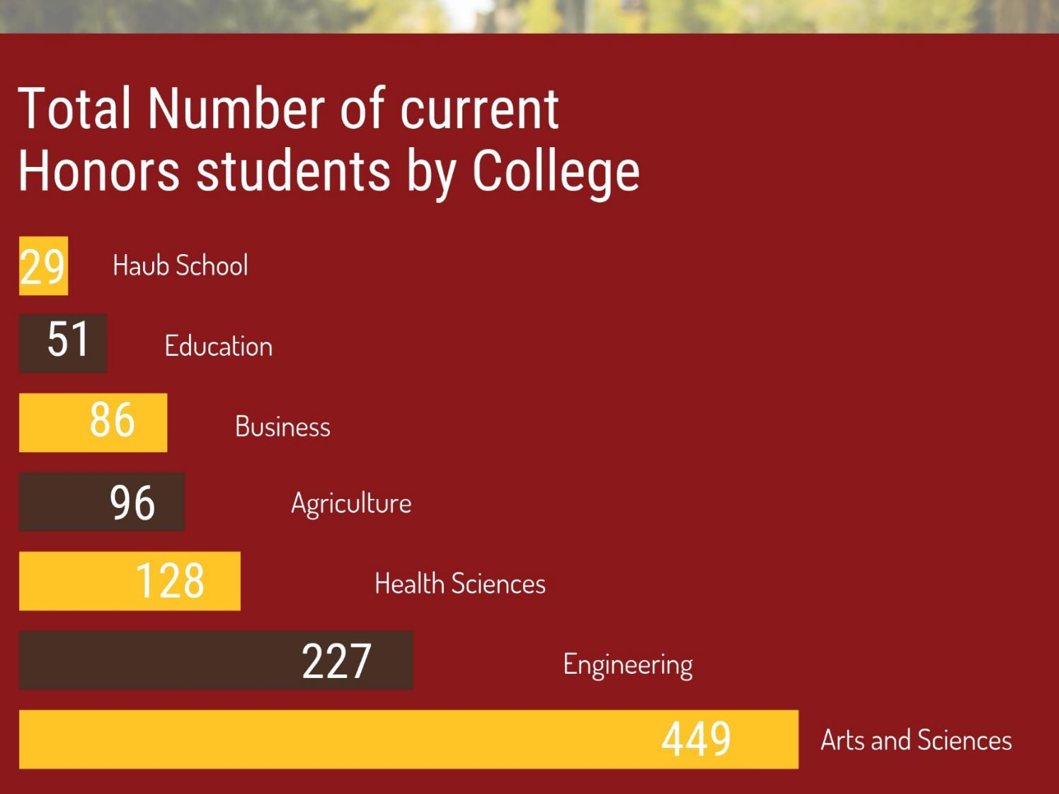
SLIDE 3 INTERDISCIPLINARY

Slide 4
Students in the HP 3152: Wyoming Walkabout course taught by Paul Taylor participated in a Sacred Site Field Trip to Tipi Rings with Lakota custodian TJ Murffit.
SLIDE 4 INNOVATIVE CLASSES
SELECT EXAMPLES OF COURSE OFFERINGS: HP 3151: Chinese Medicine and Models of Healthcare
HP 3152: History of U.S. Military Theory and Operations HP 4152: Business Application of Blockchain and Fintech HP 4152: Ideation, Innovation, and Invention

Slide 5
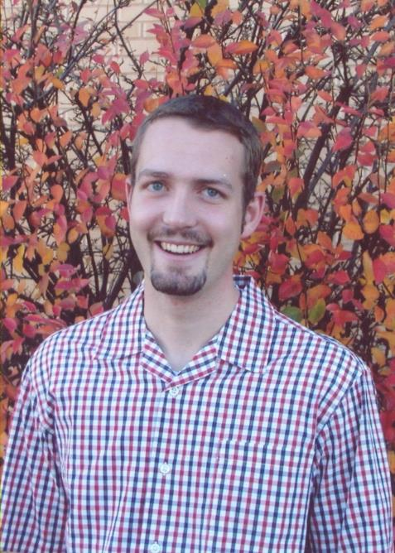
SLIDE 5 STUDENT RESEARCH
Asher Albertson (BS 2007) MD/PhD
Neurologist Washington University School of Medicine, St Louis
“I remember my first day as an undergraduate researcher like it was yesterday. Before that day, I vaguely knew that scientific advancement took place somewhere, but suddenly here it was, happening in real time, right in front of me. Unlike the classroom where I learned the principles of science - here were people just like me using those principles to discover new things about ourselves and the world around us. It struck me that they were trying to answer questions that weren’t yet written in textbooks. In the following weeks, I learned I could not only help answer those questions, but also ask and work to answer my own questions. That realization was one of the most profoundly meaningful experiences of my life.”

Slide 6
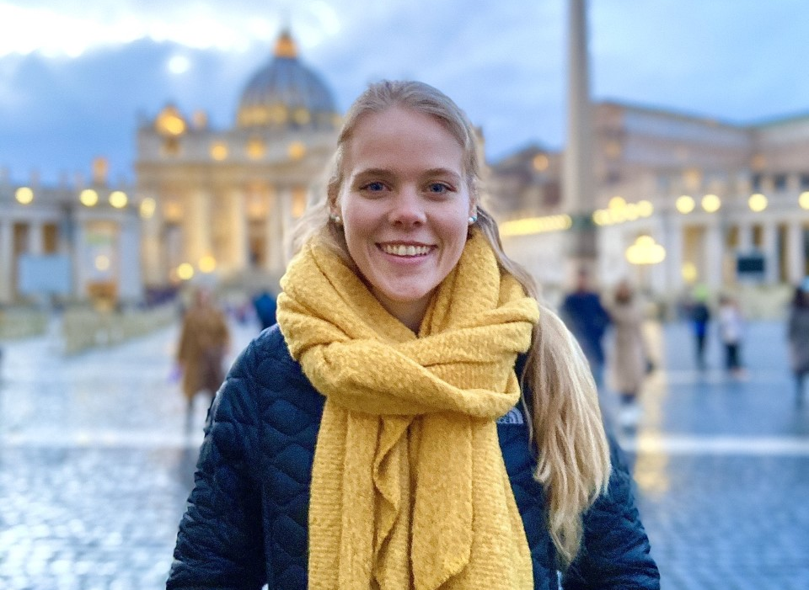
SLIDE 6 EDUCATION ABROAD
Explorations in Medicine, Science, and Art in Florence, Italy
Emily Schaneman, Visual Arts
“The most rewarding part of my study abroad in Italy was the inspiration I gained from both the wonderful art and amazing people I was with. Every part about my trip helped me grow in so many different ways. I was able to learn and discuss with people of different majors, be completely immersed in a new culture, have a thousand adventures, and so much more.”
Zoe Hendricks, Physiology
“Between discovering the best gelato in Italy to attempting to speak Italian with my host mom, my adventurous experience with Medicine, Science, and Art in Florence, Italy opened my eyes to the intriguing history of medicine and art depicting health during the Renaissance period.”

Slide 7
SLIDE 7 RECRUITMENT
OCTOBER IMPACT DAY | Fall 2018 | In-state Students (WY)
88 students attended Impacts Day with 80 of those attendees joining UW in Fall 2019
FEBRUARY IMPACT DAY | Spring 2019 | Out of State Students
68 students attended Impact Day with 64 of those attendees joining UW in Fall 2019
IMPACT DAYS TOTAL | 2018-2019 | 92% Recruitment
156 students attended and 144 of those attendees came to UW in Fall 2019

Slide 8
SLIDE 8 PRIORITIES AND INITIATIVES
Build concurrent Honors majors
Increase Honors College diversity
Scale up Honors online delivery
Stabilize the Budget

Slide 9
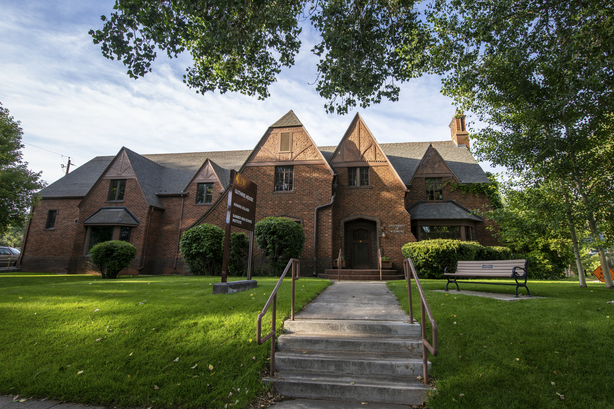
SLIDE 9

