Slide 1
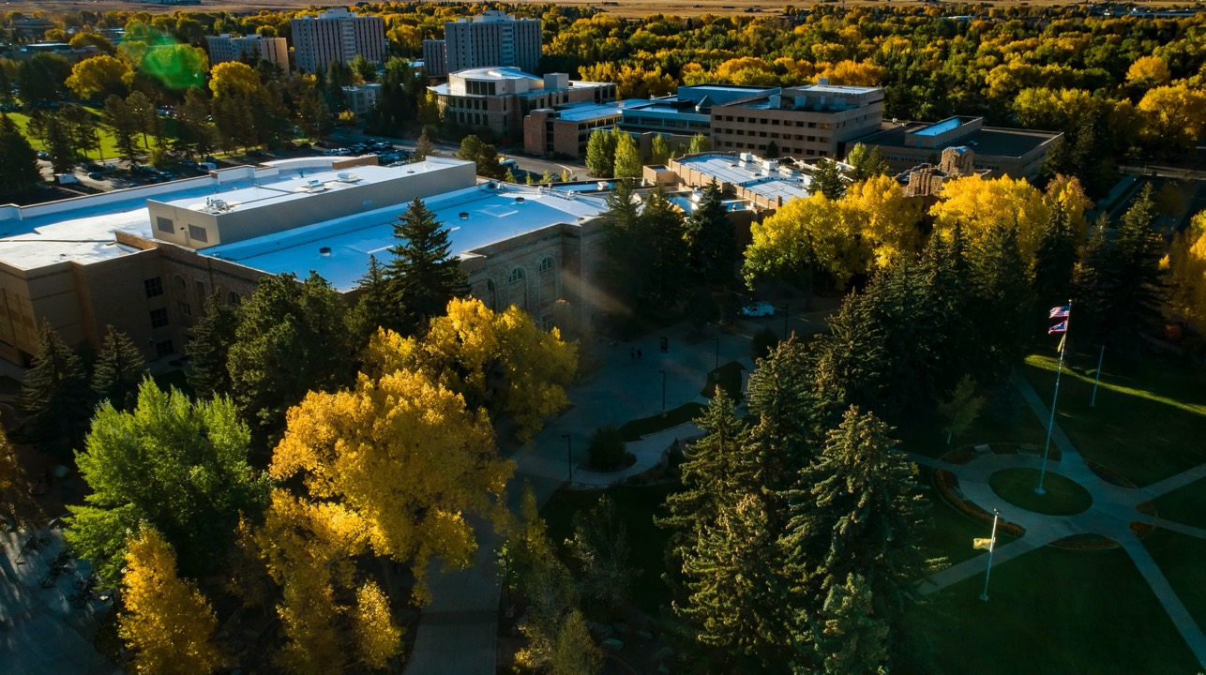
University of Wyoming
College of Education and Trustees Education Initiative® (TEI)
Annual Report to the Budget Subcommittee of the UW Board of Trustees
May 11, 2020

Slide 2
College Vision
We will make a positive and lasting educational impact on families, schools, and communities… locally, regionally, nationally and internationally
College Mission
This vision informs our teaching, research, and service as a research-based College. As part of a land-grant institution, the College of Education recognizes its responsibility to offer:
Preeminent programs that prepare exceptionally effective educational practitioners for roles in educational settings
and
Preeminent programs that prepare educational scholars to further educational theory, policy, practice and research

Slide 3
Strengths
Continuous National Accreditation and SPA National Recognition of College programs for over 65 years.
Campus leader in offering graduate and undergraduate programs in distance and online accessible formats.
30 year partnership with K-12 Education and Wyoming Department of Education through Wyoming School University Partnership (WSUP).
Expanded access to student teacher placement statewide (Was 9 districts now over 30).
Elevated importance of early childhood education.
Challenges
Two-year extension of Counseling Education Program Accreditation – CACREP.
UW Lab School nested within College of Education building.
Loss of faculty positions in high enrollment graduate programs.
Lack of uniformity in student teaching observation instrumentation. Continuing funding to support the Trustees Education Initiative.
Expanding student teaching placements statewide and future school-based work force design.
Support for distance education at UW – especially review of courses for ADA compliance issues.

Slide 4
Opportunities
Continuation of funding to support the Trustees Education Initiative.
Focus programs on distance delivered, “home-grown”, location-bound teacher education programming statewide.
Consider interdisciplinary graduate degree programs in mental health counseling services.
Strengthen focus on scientific literacy instruction and research in LRCC.
Threats
Economic conditions nationally and in Wyoming.
Hiring too many adjuncts to teach due to loss of faculty lines in highly enrolled programs.
The economic necessity of supporting local community schools
Low interest in teaching as a profession.

Slide 5
College of Education
Enrollment Trends in Teacher Education
Year over Year 2018-2019
Enrolled Changed Major Graduated Total % Change
2108 210 43 241
2019 186 57 211 ↓12%
Bachelors Education Year Over Year (2018-2019)
Elementary Education ↓ 9% (N = 355)
Secondary Education ↓ 4% (N = 197)
Agricultural Education ↑ 20% (N = 37)
Technical Education ↓ 67% (N = 1)
Special Education w. El Ed* (N = 7)
Total Undergraduate Education Students Enrolled = 597

Slide 6
Enrollment Trends, Cont.
Masters Education Year Over Year (2018-2019)
Higher Education Administration ↑ 36% (N = 32)
Counselor Education ↑ 16% (N = 59)
Curriculum and Instruction ↓ 17% (N = 36)
ED ADM/ ED LDRS - ↓ 20% (N = 40)
ITECH - ↓ 50% (N = 4)
Special Education - ↓10% (N = 44)
Natural Science - ↑ 16% (N = 11)
Total Masters Student Enrollment = 226
Doctoral Education Year Over Year (2018-2019)
Higher Education Administration ↑ 36% (N = 23)
Counselor Education ↓ 25% (N = 15)
Curriculum and Instruction ↓ 25% (N= 13)
Literacy Education – Flat (N = 15)
Mathematics Education - ↑ 30% (N = 13)
ED ADM/ ED LDRS - ↓ 13% (N = 40)
ITECH - ↓ 20% (N = 8)
Total Doctoral Student Enrollment = 127

Slide 7
College of Education Faculty
Number of FTE Faculty = 54 FTE
Number of FTE Staff = 21
Number of TEI Staff = 2
Number of TEI PT Staff = 1
COLLEGE OF EDUCATION

Slide 8
College of Education Space
% Education Annex classroom usage by Education & UW Courses
63%*
% Education Building classrooms usage by Education and UW Courses
38%
Education and McWhinnie Hall Office Space Utilization
Total Office Spaces = 103
Total Office Spaces Occupied Fall 2020 = 101
Total Office Spaces Unoccupied = 2
(To be assigned to adjuncts)
* Highest average usage of any UW classroom facility – Sasaki Master Planning Group

Slide 9
PARTNERSHIP
The Trustees Education Initiative ® (TEI) engages in a partnership with the UW College of Education to create and sustain preeminent educator preparation programs. All TEI innovations and the UW-E4® Educator Preparation Model must:
Integrate seamlessly into the College’s programs
Scale to the size and scope of the College’s programs
Be Sustainable in terms of resource demands for supporting the College’s programs
IMPACT
Fundamentally changing educator preparation in Wyoming
Built on evidence and guided by results
Designed to positively affect PK-12 student achievement
Addresses educator shortages
Enriches UW student clinical experiences

Slide 10
Reduce and Integrate the Trustees Education Initiative (TEI) Budget
Challenge: Integrate TEI Budgets and Operations into the College of Education
1. Reduce TEI Budget to Achieve Deliverables in Efficient and Effective Manner
TEI Budget was 1.1M annually
TEI Budget after review is 680K annually
2. Integrate scaled down TEI costs into College of Education Budget
See handout for TEI Funding Plan

Slide 11
THANK YOU
COLLEGE OF EDUCATION
www.uwyo.edu/tei
www.uwyo.edu/education/

