Slide 1
Impact of COVID-19 on the Research Enterprise

Slide 2
Overview – Types of Research Impacts
Impact of lost productivity
Student impacts – progress towards degree
Lost opportunities
Added costs

Slide 3
Types of Research Impacts – Lost Productivity
Individuals still on payroll but not able to fully perform duties
Shift of faculty duties
Effort of individuals on state funding shifted from research to teaching
Lack of access to labs or research sites
Cancelled experiments - lab, clinical trials
Research conducted “in shifts” for social distancing
Travel restrictions
Inability to attract researchers, other workers, research subjects for projects
Inability to have collaborators on-site
Less effective collaborative activities
Conference attendance, planning workshops, working group meetings
Burnout

Slide 4
Types of Research Impacts – Added Costs
Added travel expense required because of social distancing
Expendables - lab supplies
Leases, non-refundable travel and registration expenses
Maintenance of animal care facilities, research plots, cultures
Loss of (or loss of use of) experimental animals, plants, microbes
Licenses, rental fees
Inability to operate key research instrumentation
Rental, software license, maintenance fees, expendables
Human subject compensation
Supply chain issues

Slide 5
Types of Research Impacts – Added Costs
Cancelled, non-renewals
Funds returned to agencies (NIH), DOE funds at risk
Missed project deadlines
Postponed contracts and grants
US Department of Agriculture (relocation of offices during COVID)
Ineffective cost extensions
Grants/contracts extended but without any follow-on funding to allow for completion of contracted work
Lost ticket revenue
Lost opportunity costs

Slide 6
Types of Research Impacts - Students
Burnout
Delays in graduation
Average loss of 1 semester for MS and longer for doctoral students
Lost opportunities
Student research
Grants and contracts - availability of funds (salary or operating)

Slide 7
Major concern across colleges
Sufficient funds to cover salary and costs of graduate or undergraduate students, post-doctoral associates and others who will need to have additional funding to complete their programs

Slide 8
Summary of College Costs
College | Non-Personnel Losses | Unrecoverable Graduate Student Costs
Agriculture and Natural Resources | $550,000 | $928K-1.8M
Arts and Sciences | $162,000 | $2.1-2.3M
Business | $109,886 | None reported
Engineering and Applied Science | $375,892 | $604,146
Haub School | $127,125 | None reported
Health Science | $119,000 | $57,000 – 500,000+
TOTAL | $1,324,993 | $3,689,146-4,761,146

Slide 9
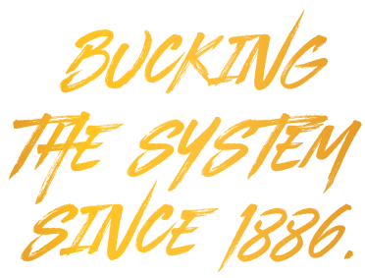
Questions?

