Slide 1
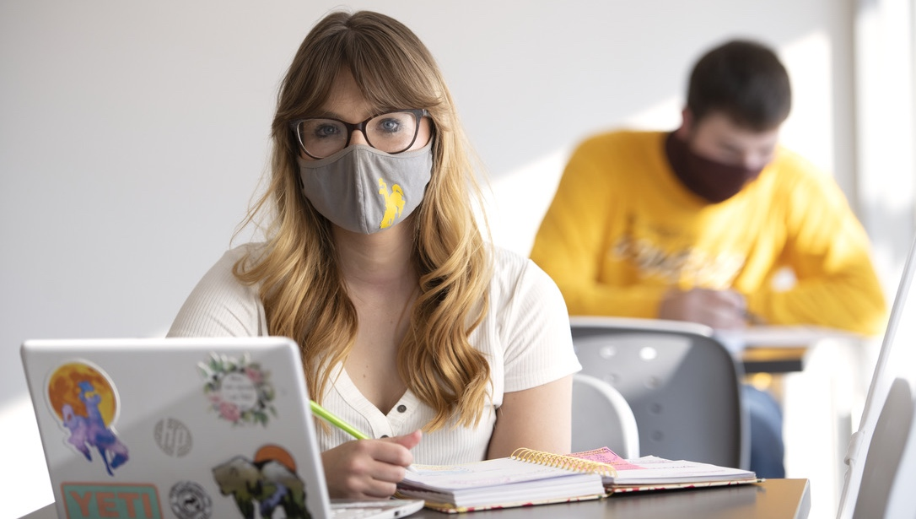
COVID-19 UPDATE
CAMPUS HEALTH & WELLNESS

Slide 2
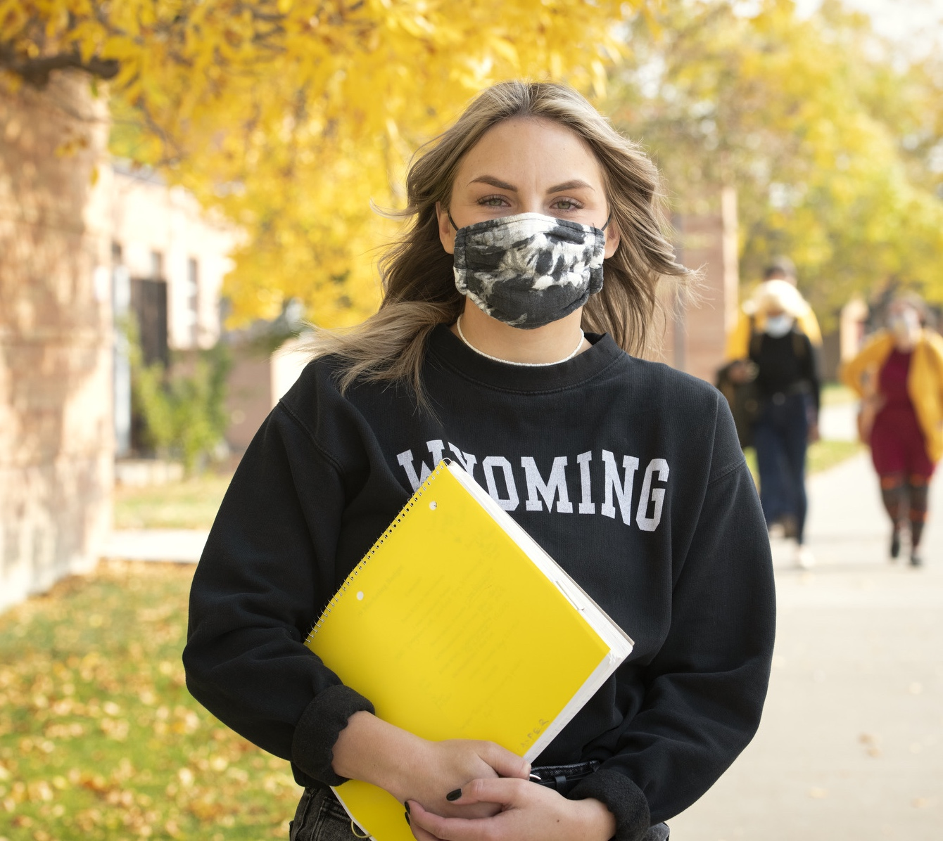
COVID-19 UPDATE
Counseling Support
UNIVERSITY COUNSELING CENTER
Evolutions to session support model
Availability of Drop-In sessions and Crisis appointments
Problem-solving sessions in the residence halls twice a week
Support of student support circles
Enhanced social media
Development of group session for students in quarantine or isolation
Increased outreach programming
Additional mental health support options available with our partners in
Psychology Center, WellSpring Clinic and Wellness Center.

Slide 3
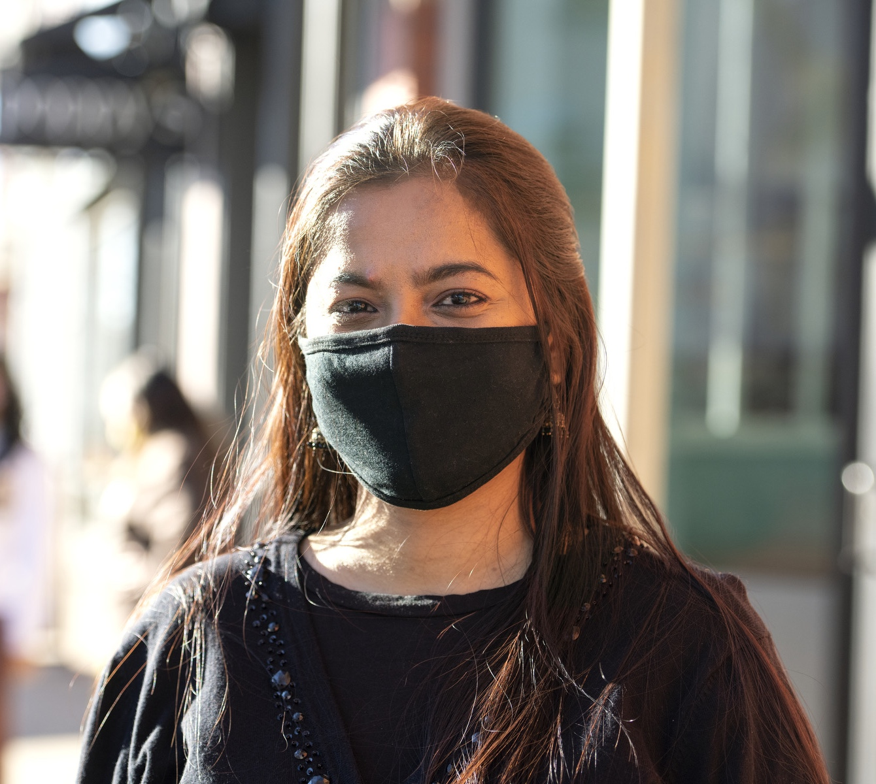
COVID-19 UPDATE
Other Wellness Support Resources
DEAN OF STUDENT OFFICE
Campus wide use of the UWYO Cares reporting form
Outreach and appointments with Student Welfare Coordinator to support
Collaboration with our campus partners to coordinate outreach to students
UW Food Share Pantry
WELLNESS CENTER
Enhanced programming efforts and robust social media campaign focused on wellness
MULTICULTURAL AFFAIRS & VETERAN SERVICES
Resource centers and support circles

Slide 4
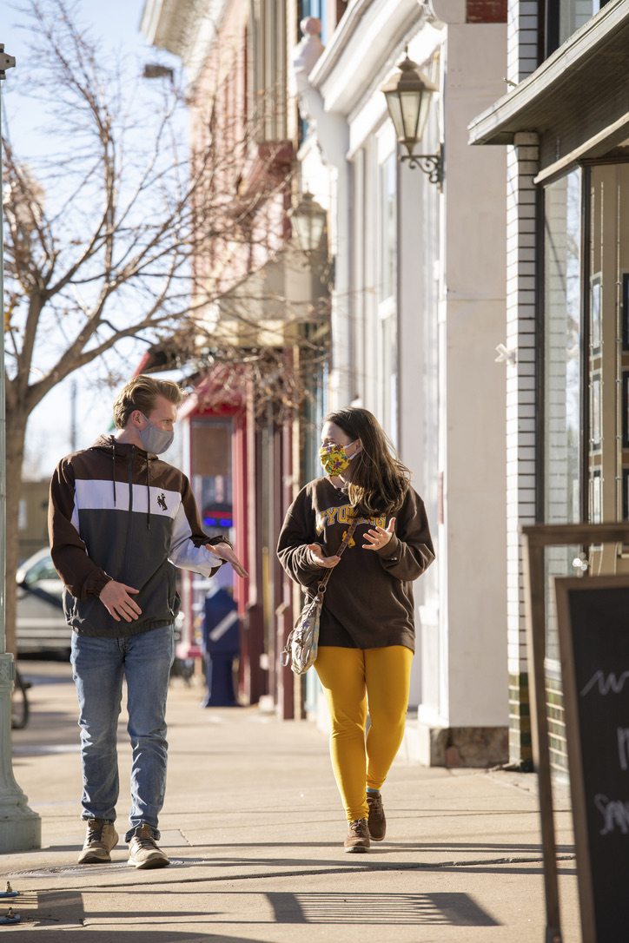
COVID-19 UPDATE
Fostering Engagement
Increase program opportunities
Service, Leadership and Community Engagement (SLCE)
Examples: Service & Senior Saturdays, The People’s Supper, Book Club, “SLCECast” Podcast and Spring Volunteer Challenge
Fraternity & Sorority Life
Examples: New Member Education Programs, Greek Week and FSL Awards
7220 Entertainment
Examples: Spring Involvement Fest, Grab & Go Events, Movie Nights, Ballroom Laser Tag and Comedians in Your Kitchen
Half Acre & Wellness Center
Examples: Outdoor Program Trips, Wilderness Medicine Clinic, Club Sports Clinics & Competitions and in-person wellness sessions and fitness classes
Enhanced communication to highlight programs
Creation of “The Lodge” – Our campus pop-up space on Fraternity Mall

Slide 6
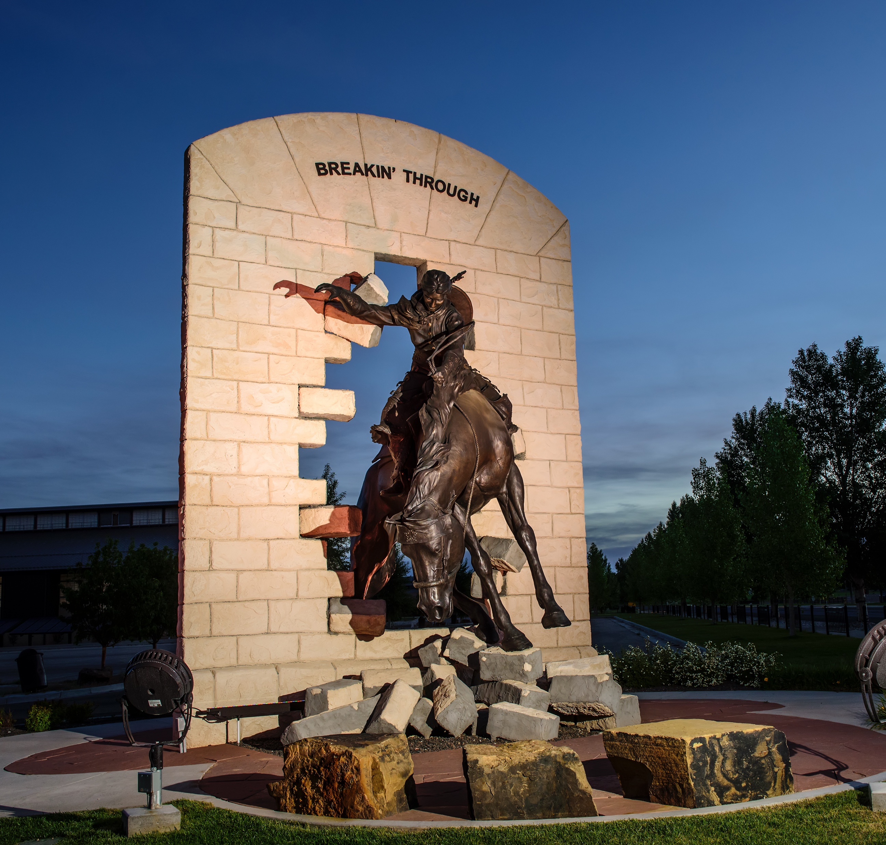
COVID-19 UPDATE
Parent Outreach &
Mental Health Resource Campaign
MONTHLY NEWSLETTERS FROM OFFICE OF STUDENT SUCCESS & GRADUATION
Focused on a theme to encourage dialogue between students and parents
Highlights campus resources and strategies for success
Opens the channel of communication from parents
PARTNERSHIP WITH INSTITUTIONAL MARKETING
Social media to highlight existing resources
Video development to introduce staff and promote resources

Slide 7
COVID-19 UPDATE
Cowboy Coaching
The “Cowboy Coaching” program pairs upperclassmen with freshman to provide mentorship, friendship and a peer-to-peer resource of which students can feel comfortable taking advantage.
RECENT EFFORTS INCLUDE:
Social media takeovers with Cowboy Coaches
Weekly meet-ups with Cowboy Coaches on Washakie Green
1x1 meeting each week to support academic challenges
Podcast and robot engagement

Slide 8
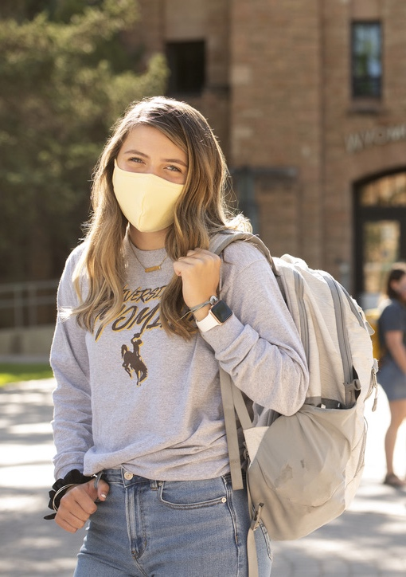
COVID-19 UPDATE
Courses & Faulty Connections
Significant attention to developing engagement and belonging in courses
Breakouts, video off days
Engagement opportunities with academic resources – makerspaces, archives, museum spaces
Days built with opportunities to laugh together and connect informally

Slide 9
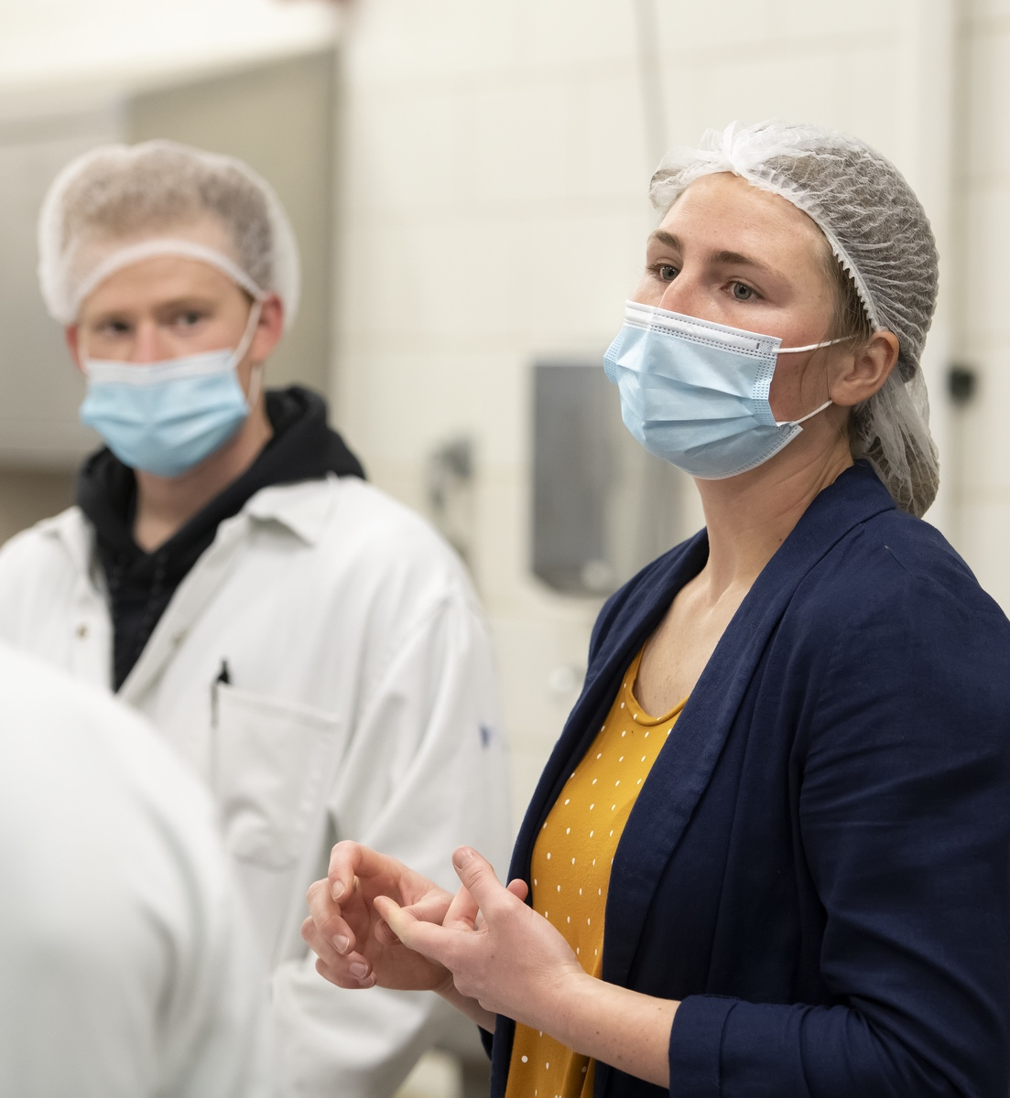
COVID-19 UPDATE
Faculty Wellbeing
Anxiety for exponentially increased workload and research productivity losses; juggling parental duties with work; loss of connection to colleagues – campus, nationally, internationally.
1:1’s and drop-in office hours with department heads, deans, and others to enhance and build community
Faculty get togethers with DoorDash
Flexibility – radio silence on weekends, or embracing the fact that some must do most work on weekends due to childcare and virtual school for children
Tips of the Hat and celebrating wins – small and large

Slide 10
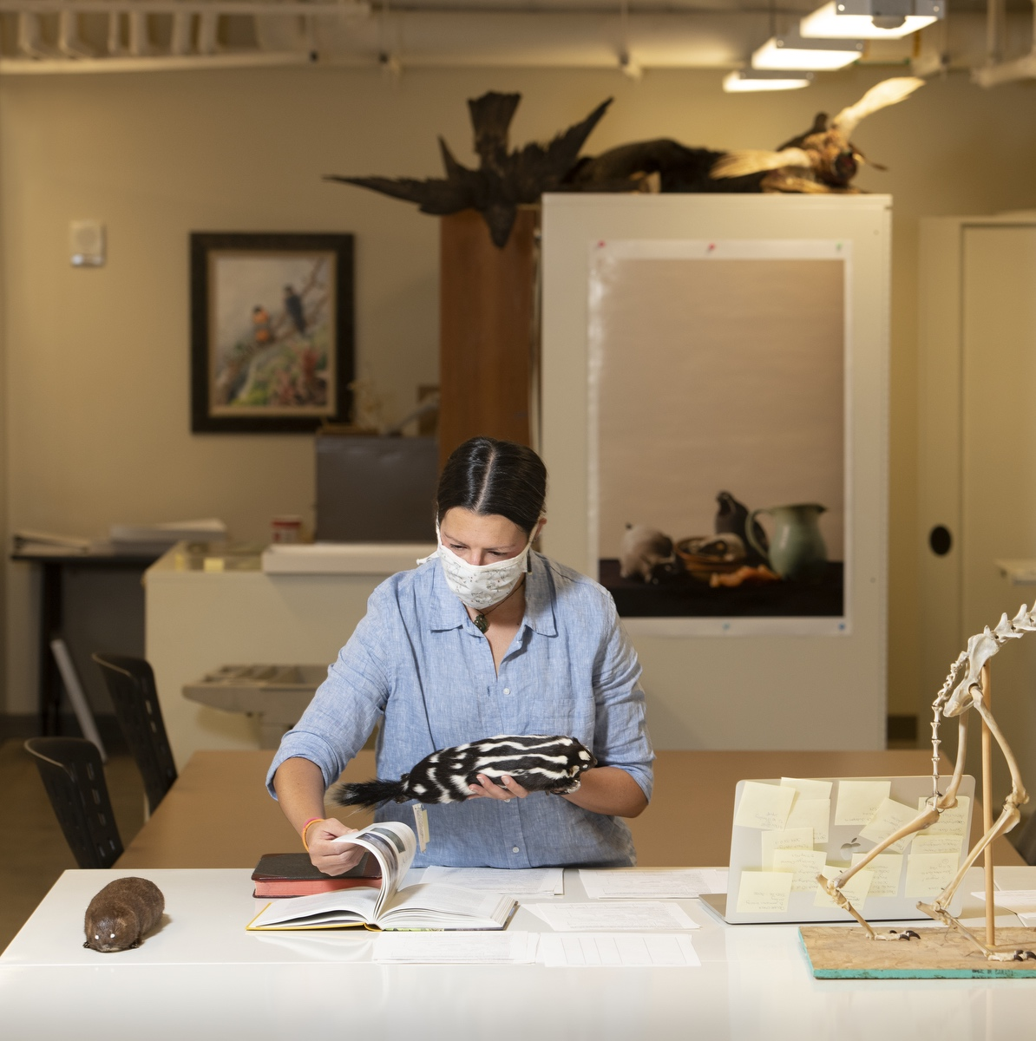
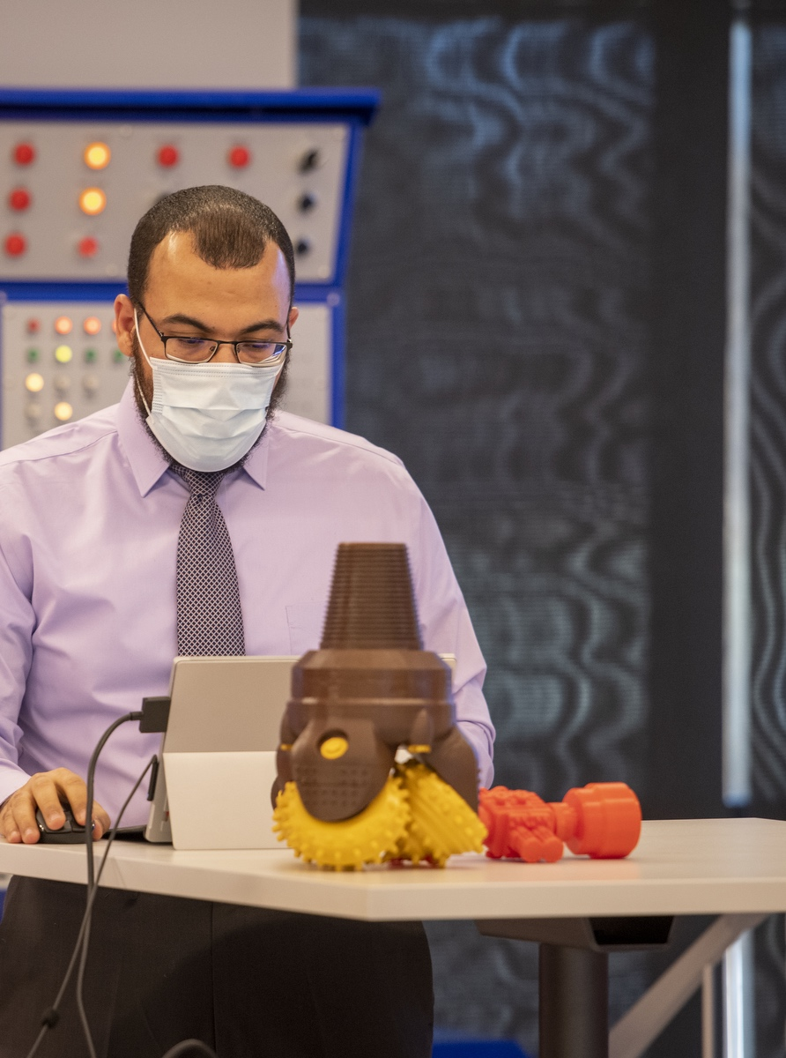
COVID-19 UPDATE
Staff Wellbeing
Anxiety for exponentially increased workload; juggling parental duties with work; loss of connection to colleagues
Supervisors and staff connection time
Remote work schedules, where possible
Flexibility, where possible
HR recently established Staff Wellbeing Committee
HR launched new Campus Wellness Resources webpage
Tips of the Hat and celebrating wins – small and large

Slide 11
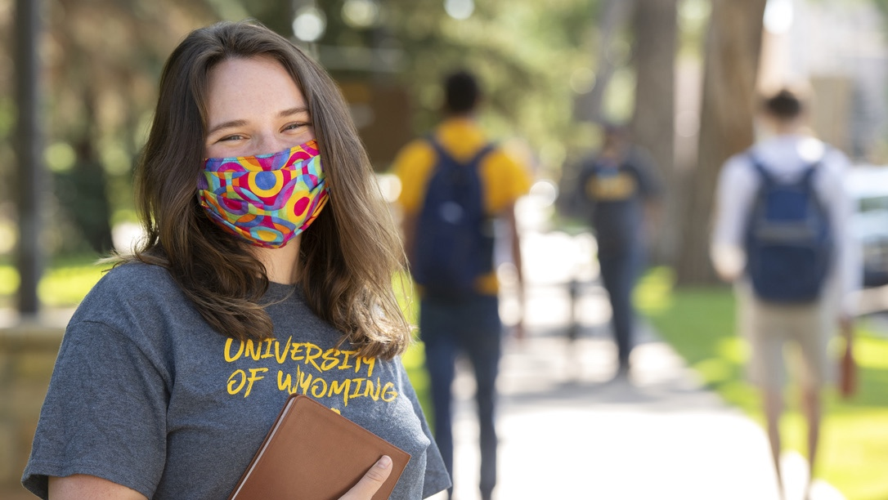
THANK YOU

