Slide 1


Office of Research and Economic Development
Fiscal Year 2021 Annual Report
January 13, 2022
Diana Hulme
Interim VP for Research
and
Economic Development

Slide 2

FY21 Annual Report Agenda
Agenda
ORED Staffing
eRA System
Regulations and Policies
SI Building Update

Slide 3
ORED
STAFFING

Slide 4


“ORED needs more staff!!”
How many people do we need?
Where are they needed?
What will they do for UW?
*Also need systems, policies, procedures

Slide 5
UW Reg 9-2 Working Group
Indirect Cost Policy Working Group, April 2021
Additional Key Positions Identified
Economic Development – 4
Pre-award – 14
Research Integrity & Compliance – 2
Tech Transfer - 4
Science Initiative - 3
ARCC - 7
Core Facilities – 4
What positions are really needed for Research at UW?
Compliance with federal, state, local regulations/policies
Sustainability of services
Contractual or legislative obligation
Positions prioritized by need
Highest priority positions hired first

Slide 6
ORED Staffing Increases
5/1/2018 – 12/31/2021
ORED Unit | 5/1/2018 | Net Increase | Current Total | Current Vacancies | New Positions Needed | Totals
Econ Development | 0 | 0 | 0 | 0 | 4 | 4
Pre-award | 2 | 5 | 7 | 1 | 7 | 15
Compliance | 4 | 1 | 5 | 0 | 2 | 7
TTO | 1 | 2 | 3 | 0 | 3 | 6
SI Building | 0 | 0 | 0 | 0 | 3 | 3
ARCC | 4 | 3 | 7 | 0 | 4 | 11
Core Facilities | 0 | 0 | 0 | 0 | 4 | 4
Finance | 1 | 2 | 3 | 1 | 0 | 4
Admin (VP, AVPs, Assts) | 3 | 1 | 4 | 1 | 1 | 6
Total Staff | 15 | 14 | 29 | 3 | 28 | 60
Salary Cost | $1.4 M | $0.9 M | $2.3 M | $.4 M | ~$1.7 M | $4.4 M

Slide 7
ORED Staffing

Slide 8
Electronic Research
Administration System

Slide 9

2021
eRA System Implementation Timeline

Slide 10
Regulations
and
Policies

Slide 11
2021
Policy and Procedures Update
UW Regulation 9-1: University Intellectual Property
Effective: October 13, 2021
Impact:
Provide ownership of academic course materials to creators
UW reserves perpetual license to use materials for teaching, education and accreditation.
Tiered distribution of income from patents; 60% to the inventor/author, 40% to UW to start. 50%/50% over $5M
UW Regulation 9-2: Indirect Cost Rates and Distribution
Effective: July 1, 2021
Impact:
Increased indirect cost (IC) to ORED
Q1 FY2022 = $2.4 M, Q4 FY2021 = $0.9 M
ORED salaries
Faculty startups
Research equipment
Strategic Initiatives
Service Center Policy
Issued May 17, 2021
Impact:
Guide management of service center financial operations in accordance with federal regulations

Slide 12

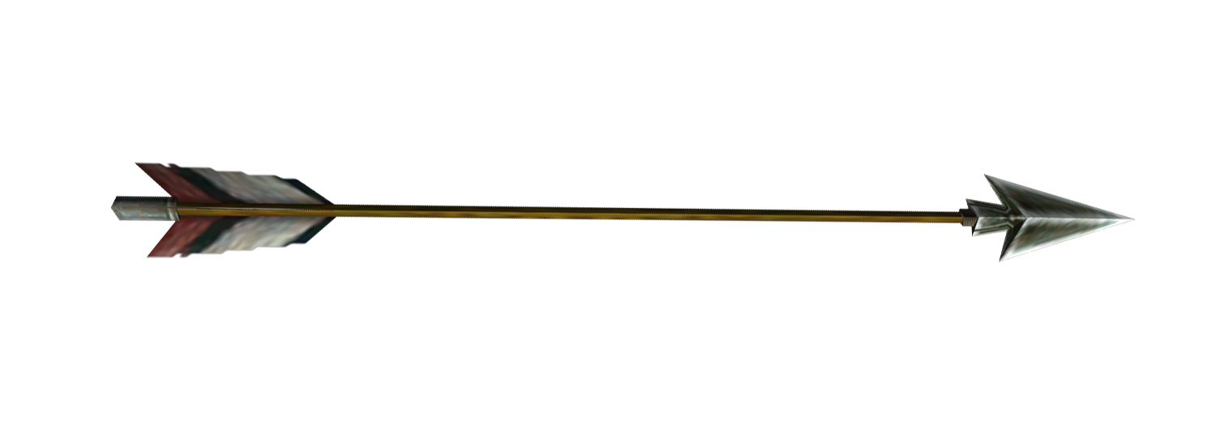
What will all of this do for UW?
Faculty/Student Success
R1 Status
IDC Return
Compliance

Slide 13
Economic
Development

Slide 14
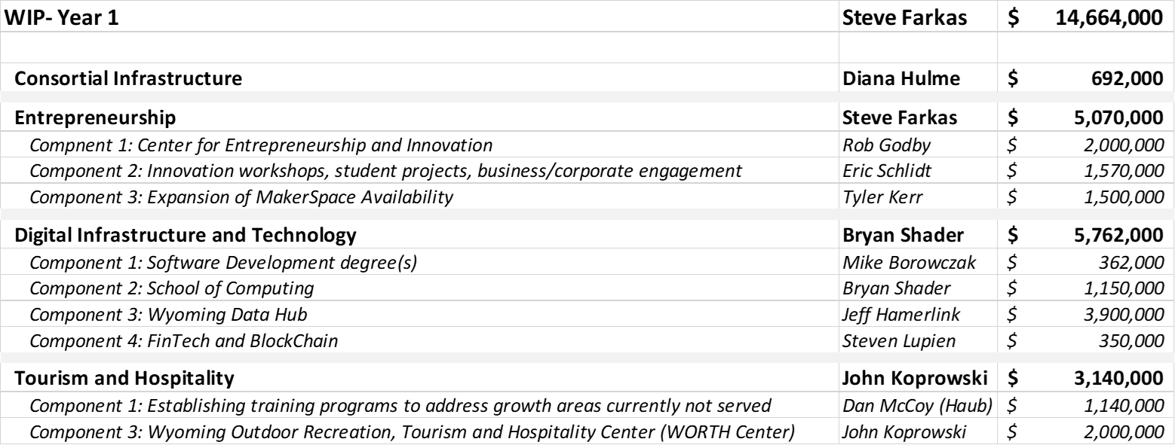
Economic Development (ED)
Pres Seidel has ambitious plans for ED Charging a group to develop a 5-year ED plan
Hired Assoc VP for Economic Development – Steve Farkas
WBC funding for IMPACT307, SBDC, MW - $2.0 M
Year 1 WIP Funding, $14.6 M

Slide 15
Science Initiative

Slide 16
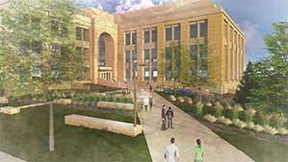
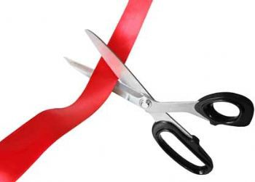

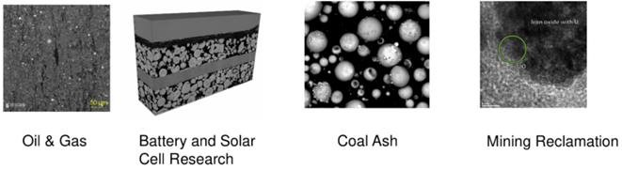
Science Initiative
Building ready for occupancy: by February 28, 2022
Ribbon Cutting Ceremony: March 2022
Move in dates: March 1 – June 30, 2022
Equipment Purchased for CASI:
FIB-SEM $1.5 M (WIP funds)
Hi Thruput Plant Phenotyper - $548 (WIP funds)
Micro CT Scanner - $1.2 M (WIP funds)
Confocal Microscope – $650k (INBRE funds)
Revisit SI phase 2:
Review during strategic planning
College reorg and School of Computing

Slide 17


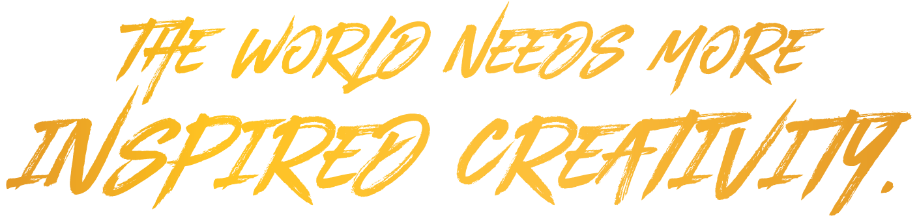
QUESTIONS?

Slide 19




Economic Development
Manufacturing Works (MW)
  Developed business Covid survival webinars for Wyoming Manufacturers
    Virtual work
    How and where to apply for Covid impact funds
  NIST MEP 5-year review – approved next 5-year cooperative agreement renewal
IMPACT 307
  Departure of Dave Bohling, Laramie Director
  20 companies launched in 2020
  26 in 2021 as of 9/1/21
  Standing up new incubator with LCCC in Cheyenne
  EDA grant (3 yr, $2.4 M)
    Expansion into underserved areas of the state
    Commitment to double the startup challenges in Wy from 5 to 10
Notes:
National Institute for Standards and Testing, Manufacturing Extension Partnership

Slide 20


Economic Development
Small Business Development Center (SBDC)
  40 Business Startups
  104 Jobs Created
  119 training events with 2,509 attendees - build business skills, improve operations
Technology Transfer Office
  New office location in Laramie IMPACT 307 Building
  Hired Licensing Manager
  20 patents filed in FY21
  14 Patents Issued in FY2021
  2 License agreements/options for FY21
This Photo by Unknown Author is licensed under CC BY-SA-NC
Notes:
SBDC – various business sector startups
TTO – 20 new patents filed in FY 21. 14 were issued that had previously been filed. In various fields but primarily petroleum and chemical engineering and biotech.
2 license agreements – Literacy Teachers and Cell Drop

Slide 21
FY21
Research Expenditures
Summary

Slide 22
Research Expenditures
Fiscal Year | Sponsored Project Expenditures
2019 (HERD Survey) | $87,490,609
2020 (HERD Survey) | $93,061,000
2021 (All sponsored activities) | *$100,702,792
Notes:
HERD survey
Collects data on research and development (R&D) expenditures at higher education institutions in the U.S. by field of research and source of funds
• completed annually for Fiscal year, due by the end of January of the following year. UW’s for FY21 has not yet been completed.
• results of the survey are primarily used to:
– assess trends in R&D expenditures across the fields of science and engineering (S&E)
– rank institutions by R&D expenditures
– maintain data from previous fiscal years for historical trend analysis purposes
Include expenditures that support: basic research, applied research, experimental development, research training.
Do not include: Other Sponsored Activity [OSA] - Programs and projects financed by Federal and non-Federal agencies and organizations that involve the performance of work other than instruction and organized research.
– Examples are: health service projects, public service projects, and education and community service programs.
So FY21 is the all in number from OSP that does include other sponsored activity. This number is therefore inflated but from the magnitude of this number, it is likely safe to say the HERD survey number for FY21 will be in line with FY20, or higher.

