Slide 1
Professional Development Leave – Report to the UW Board of Trustees Timeframe: September 8, 2020 – March 8, 2021 -Revisiting work at Greybull site 48BH92 for context -Published interpretation and methodologies employed at site -Published 3D digitization and photogrammetry workflows with DLF Teach 2.0 -Published various other 3D oriented conference proceedings -Application of 3D models in AR/VR using a variety of software
Chad Hutchens​ Chair, Digital Collections Office​ UW Libraries

Slide 2
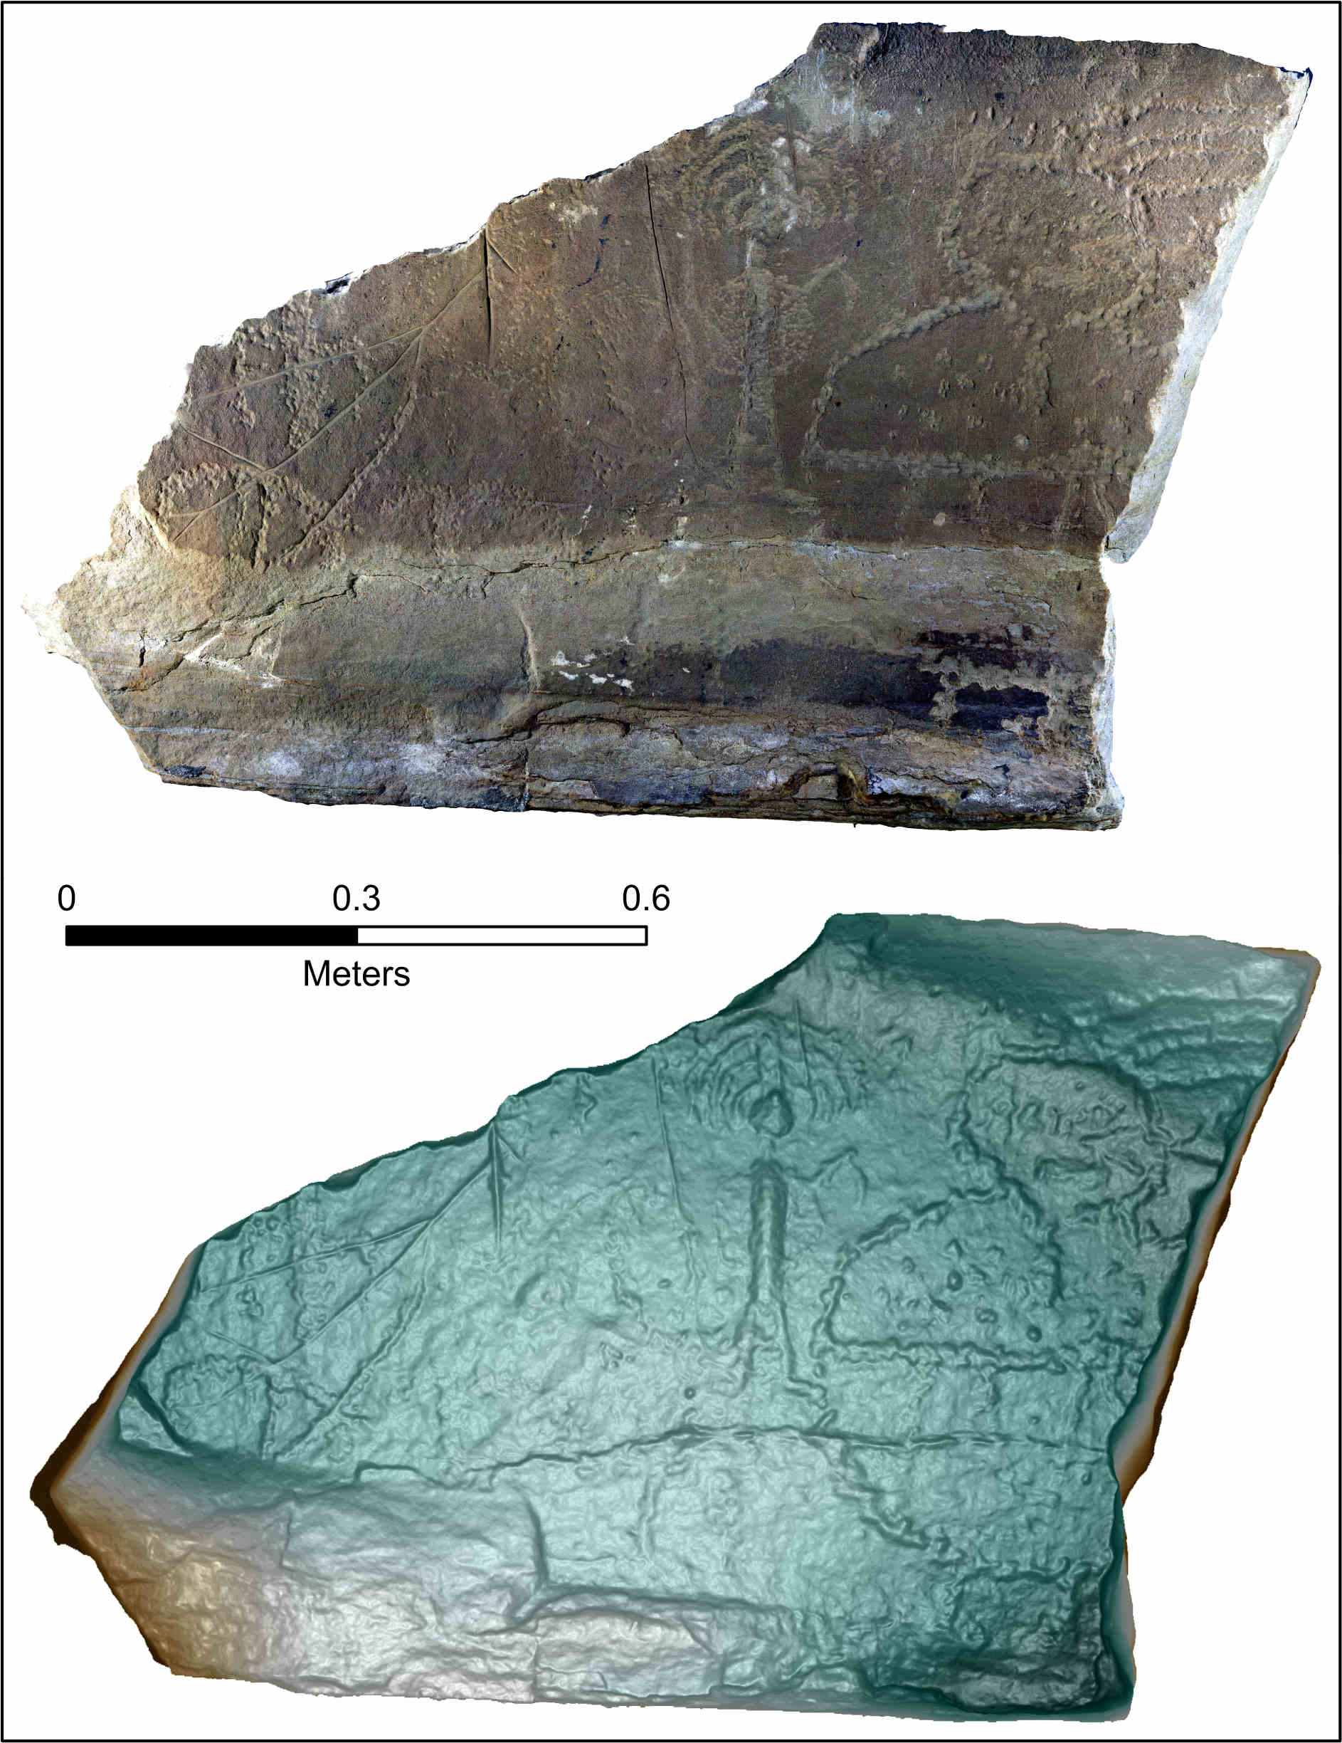
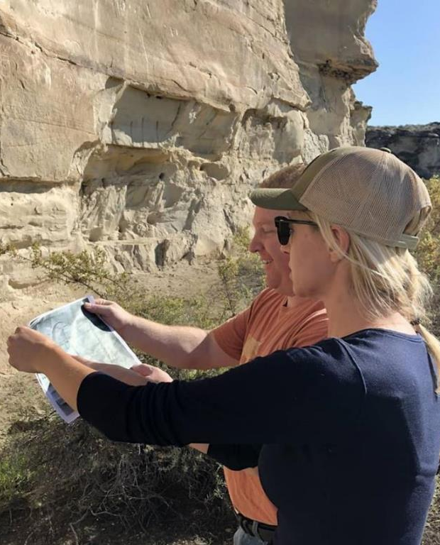
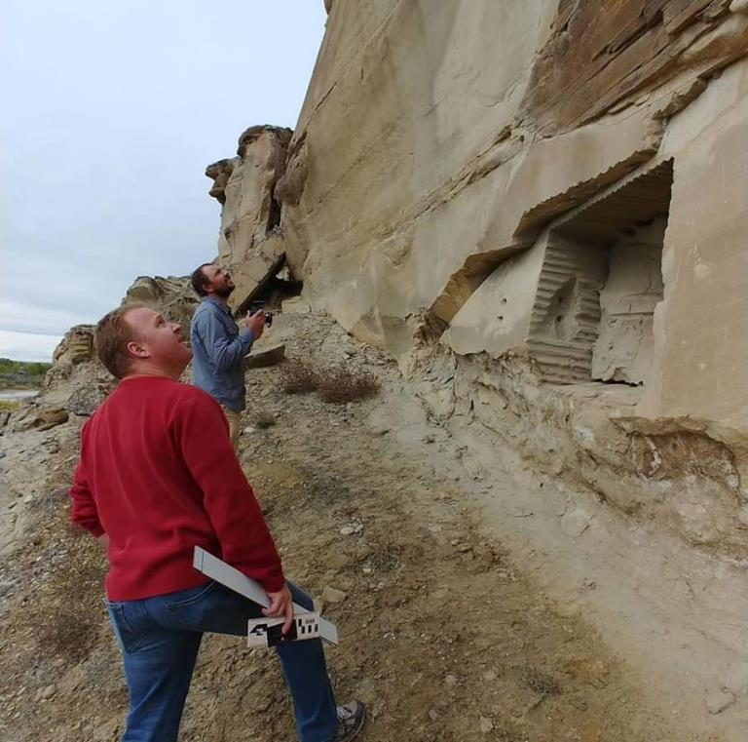
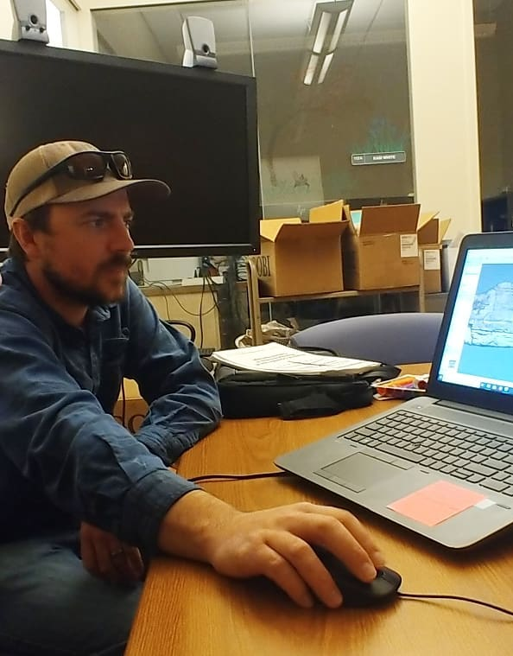
Ackowledgements: University of Wyoming Charles Koenig, PhD candidate in Anthropology
Marieka Arksey, former UW Archaeological Repository Curator Wyoming Institute for Humanities Research Wyoming Tribal Heritage Preservation Office Buffalo Bill Center of the West, Plains Indian Museum Bureau of Land Management
Chad Hutchens | chutchen@uwyo.edu

Slide 3
Greybull Site 48BH92: Research Question Image credit: Koenig et al, 2021. Description: Greybull site 48BH92 cliff face panorama. Can we use photogrammetry to reconstruct a partially destroyed Native American rock art site that is in numerous pieces and places?

Slide 4
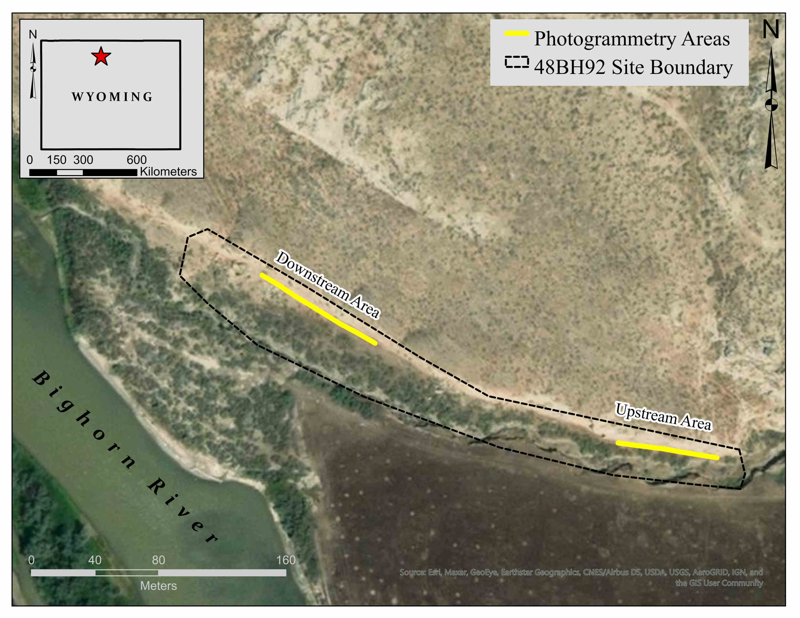
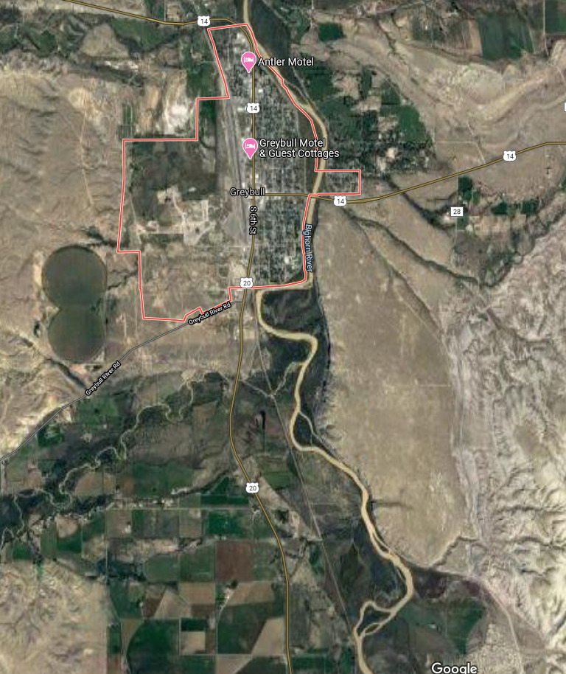
Where is Site 48BH92?
Greybull, Wyoming
Image credit: Koenig et al, 2021. Description: Greybull site 48BH92site boundary and photogrammetry areas. ​
Site 48BH92

Slide 5
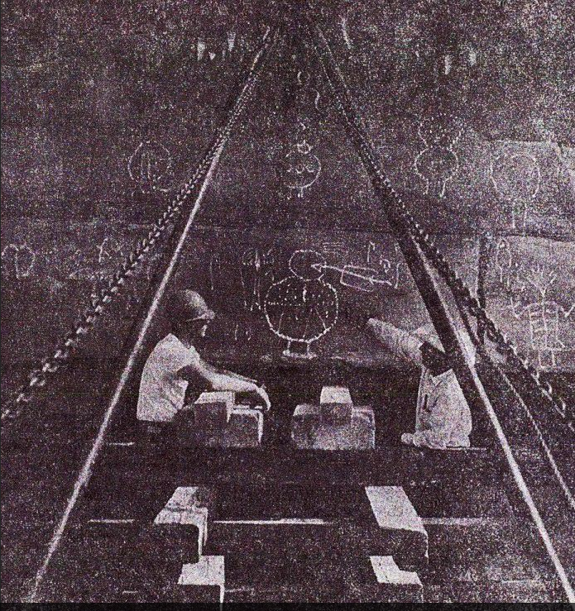
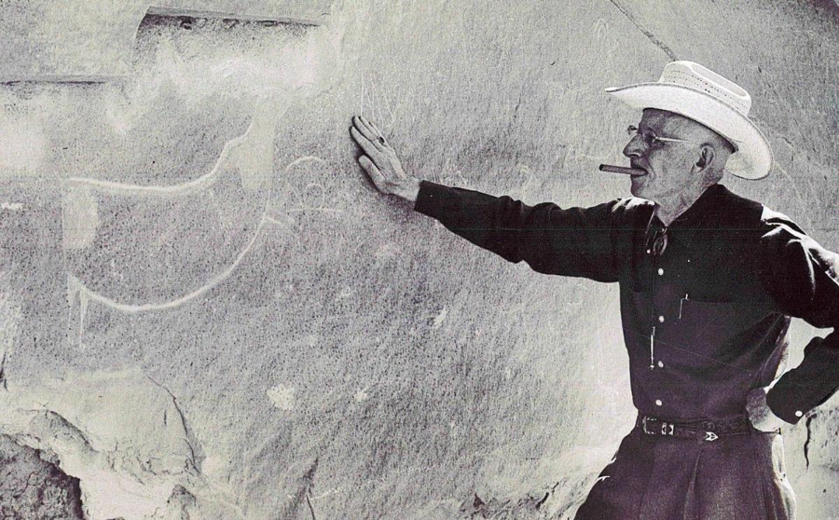
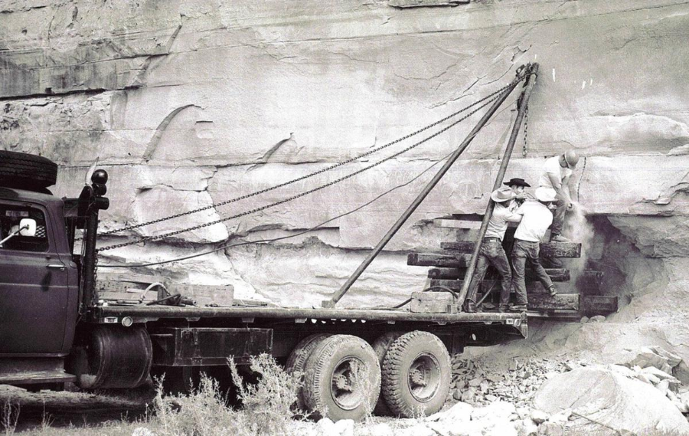
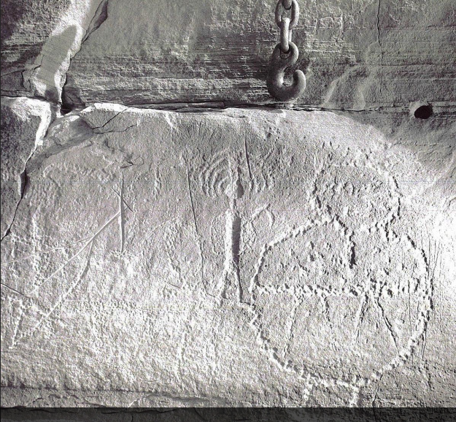
Petroglyph removal in 1962

Slide 6
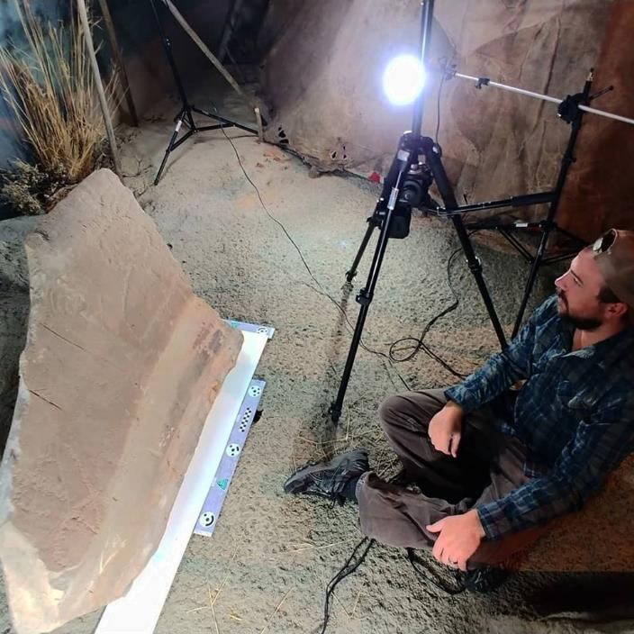
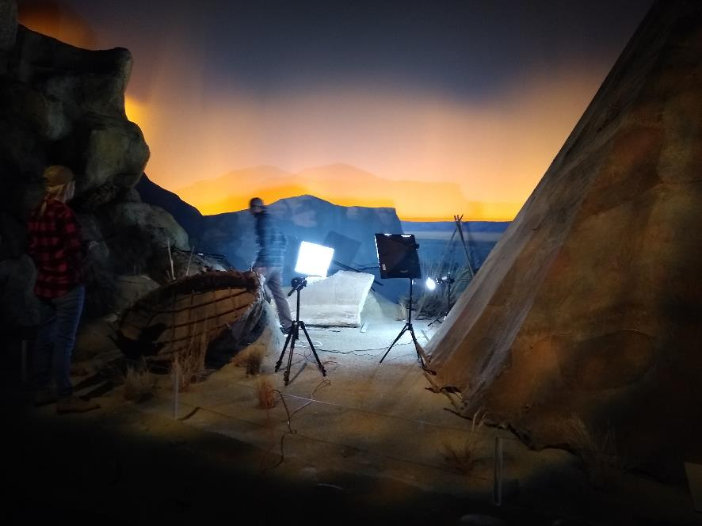
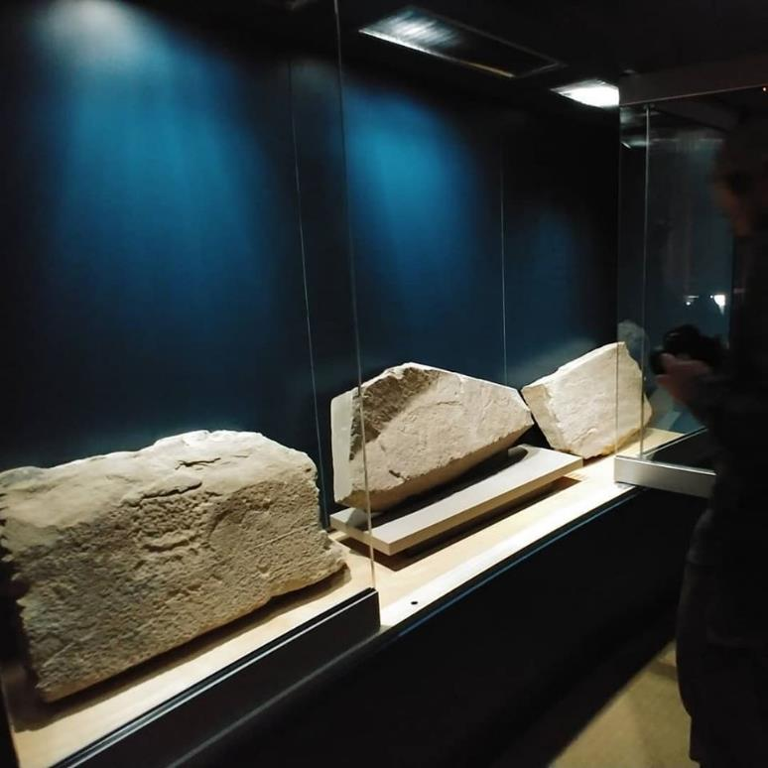
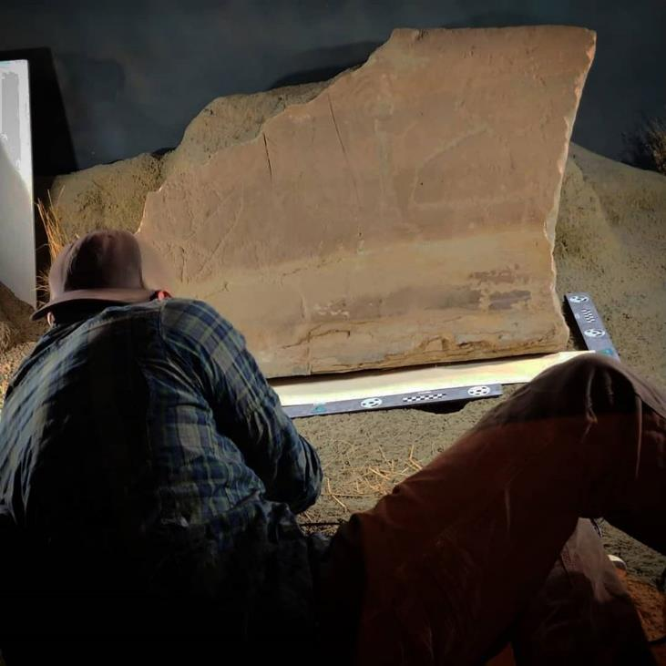
Fragments in the BBHC in Cody
Three fragments discovered while at the BBHC in Cody that may be from site 48BH92

Slide 7
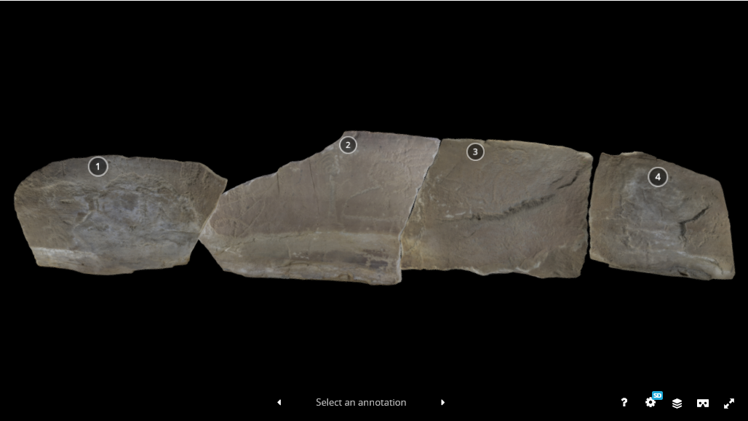
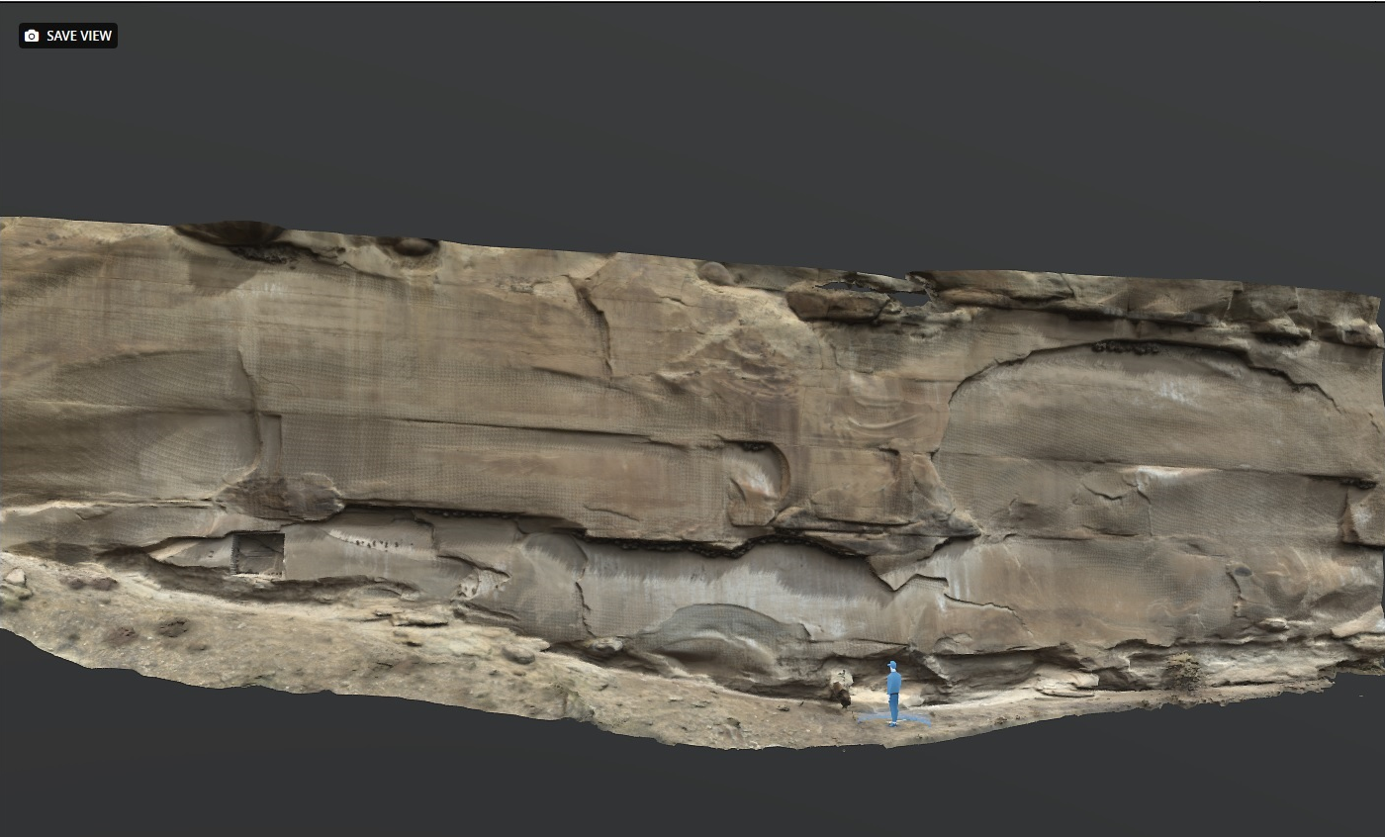
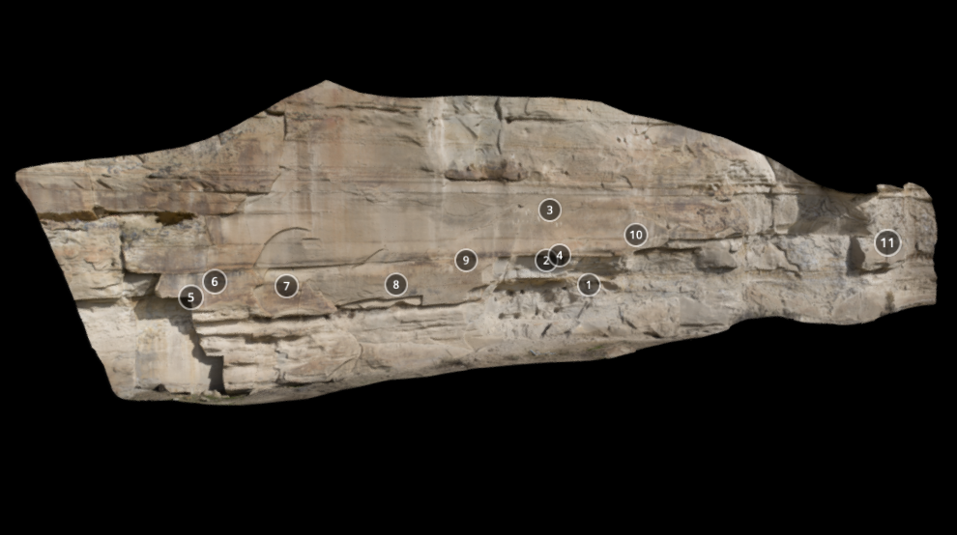
3D models online
https://sketchfab.com/uwlibraries/collections/site-48bh92

Slide 8
Publications from Sabbatical
Koenig, C. W., Castañeda, A. M., Arksey, M., & Hutchens, C. E. (2021). Digital Reconstruction and Preliminary Rock Art Inventory of the Greybull South Site, Wyoming. In American Indian Rock Art Volume 47 (No. 47). Sunbelt Publications. https://doi.org/10.15786/17954873 *Peer-reviewed*
Hutchens, C. E., & Koenig, C. (2021). Getting Started with 3D Digitization. In DLF Teach Toolkit 2.0: Immersive Technologies. Digital Library Federation. Available at: https://dlfteach.pubpub.org/pub/vol2-hutchens-koenig-getting-started-with-3d-digitization/release/1 *Peer-reviewed *

