Slide 1
Carnegie R1 Classification
Kevin Carman
January, 2022

Slide 2
Why does a “R1” designation matter?
Recruitment of outstanding graduate and undergraduate students
Recruitment and retention of outstanding faculty
Reputation among peer universities
Credibility with funding agencies
Enhanced opportunities to contribute to state economic development
Prestige with employers and alumni

Slide 3
Who determines Carnegie research classification?
Research
20 doctorates awarded in 2016-17
$5M research expenditures
Carnegie Foundation for the Advancement of Teaching
Indiana University
Last reclassification in 2018
130 R1
131 R2
Next assessment in December of 2021

Slide 4
Carnegie Metrics
Doctoral degrees
Humanities
Social Sciences
STEM
Other Professional
Non-Faculty PhD Research Staff (e.g., postdocs)
Research Expenditures
Science & Engineering (S&E)
Non-S&E
Each metric ranked (261-1)

Slide 5
Aggregate vs. Per Capita Indexes
Aggregate Research | Weight | Per Capita Research | Weight
STEM Doctorates | .909 | STEM Expenditures | .935
STEM Expenditures | .899 | Research Staff | .930
Research Staff | .894 | Non-STEM Expenditures | .619
Doctorates: Social Sciences | .864
Doctorates Humanities | .839
Non-STEM Expenditures | .817
Doctorates: Other Fields | .621

Slide 6
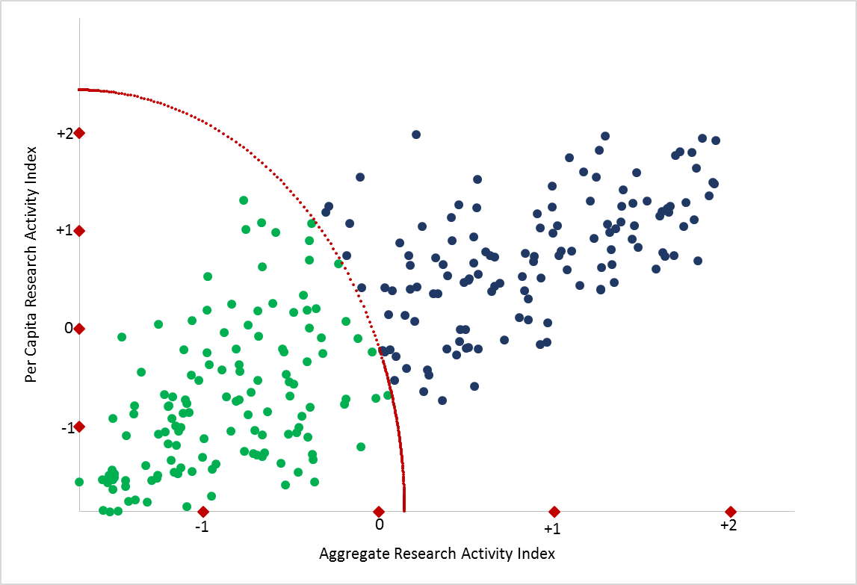
Combined weighted ranks are converted to standardized scores
149

Slide 8
How do we compare to R1 and R2 universities?
 | STEM Expenditures (1000s) | Non-STEM Expenditures (1000s) | S&E Research Staff | Doctorates: Humanities | Doctorates: Social Sciences | Doctorates: STEM | Doctorates: Other Fields
R1 Median | 295,776 | 18,986 | 346 | 36 | 37 | 160 | 65
R2 Median | 25,644 | 2,191 | 23 | 0 | 4 | 23 | 24
UW | 121,927 | 3,105 | 83 | 0 | 7 | 70 | 29

Slide 9
How do we compare to R1 and R2 universities?
 | Per-capita STEM Expenditures (1000s) | Per-capita Non-STEM Expenditures (1000s) | Per-capita S&E Research Staff | Number of Faculty
R1 Median | 232 | 15.0 | 0.27 | 1263
R2 Median | 63 | 4.7 | 0.05 | 469
UW | 229 | 5.8 | 0.16 | 530

Slide 10
The Need for Faculty in PhD programs
 | Utah | New Mexico | UW
Total faculty | 992 | 894 | 530
Faculty in PhD Programs | 853 | 737 | 347
% in PhD Programs | 86% | 82% | 65%

Slide 11
Doctoral Graduates
113

Slide 12
Doctorate Enrollment

Slide 13
Research Personnel

Slide 14
$57.4M
Total
$49.7M
STEM
Non-STEM
$7.7M

Slide 15
Year | Rank | R&D |  | Personnel |  | Doctoral Degrees Granted
 |  | S&E | NONS&E | Postdoc /Staff | Faculty | Humanities | Soc Sci | STEM | Other
2018 | 149 | $121,927 | $3,105 | 83 | 532 | 0 | 7 | 70 | 29
2021 | 180 | $91,738 | $1,323 | 44 | 531 | 0 | 9 | 65 | 21

Slide 16
Strategic next steps
Assure we are getting full credit
Postdocs and research faculty
Faculty salaries/HERD reporting
Reexamine appointments
Strategic investments/policies
Teaching loads
ORED/OSP
Faculty in doctoral programs
Doctoral programs in humanities/social sciences
Graduate assistantships
Graduate stipends
Office of postdoctoral studies

