Slide 1
Trustees Education Initiative Update 3-34-22
A New Model for Education in Wyoming

Slide 2
Trustees Education Initiative Update
A new framework to improve education across Wyoming

Slide 3
TEI Background
Education and the economy are inextricably linked.
Quality teachers differentiate educational experiences to affect state productivity and economic well-being.
The Trustees Education Initiative (TEI) was established by the UW Board of Trustees through a 2014 resolution, to ensure “vibrant, innovative teachers” across all Wyoming K-12 schools.

Slide 5
TEI Phase I Product in FY22
More than two-dozen pilot projects advancing educator preparation in Wyoming
Wyoming Early Childhood Outreach Network
WYTeach
Literacy Leadership PD Modules
Ethics embedded within elementary curriculum
Digital teaching and learning courses for K-12 and higher ed.

Slide 6
Forecast WY Labor Market Needs
The overall size of the teacher labor market in Wyoming is expected to remain stable at roughly 7,400 over the next decade (48 districts, 364 schools and 93,832 students).
As of March 10, there are 278 vacancies across the state.
Attrition, not expansion is the primary driver of demand.

Slide 7
Renewed Focus on Retention
There are currently 735 students in UW undergraduate programs leading to initial teacher licensure in WY.
CoE UG 3-year rolling average enrollment declined 5.5%.
Enrollment in the C&I Masters program has declined monotonically from 74 in 2017 to 36 in 2020.
While there are many UW initiated professional development opportunities, few of these are connected with credit toward advanced degree programs.

Slide 8
Teacher-Mentor Corps
Arc of the Master Teacher Career
1
2
3

Slide 9
Growing and Supporting Teachers
Enhancing the pre-service apprenticeship experience.
Support across the in-service induction period.
Providing systematic competency-based professional development that can stack toward an advanced, competency-based masters degree.
Unbundling in-service professional development for badging of competencies at the undergraduate level.

Slide 10
CoE / TEI Phase II Initiatives
Broadening placements and enriching the apprenticeship experience.
Wyoming Teacher-Mentor Corps.
Master Educator Competency Program

Slide 11
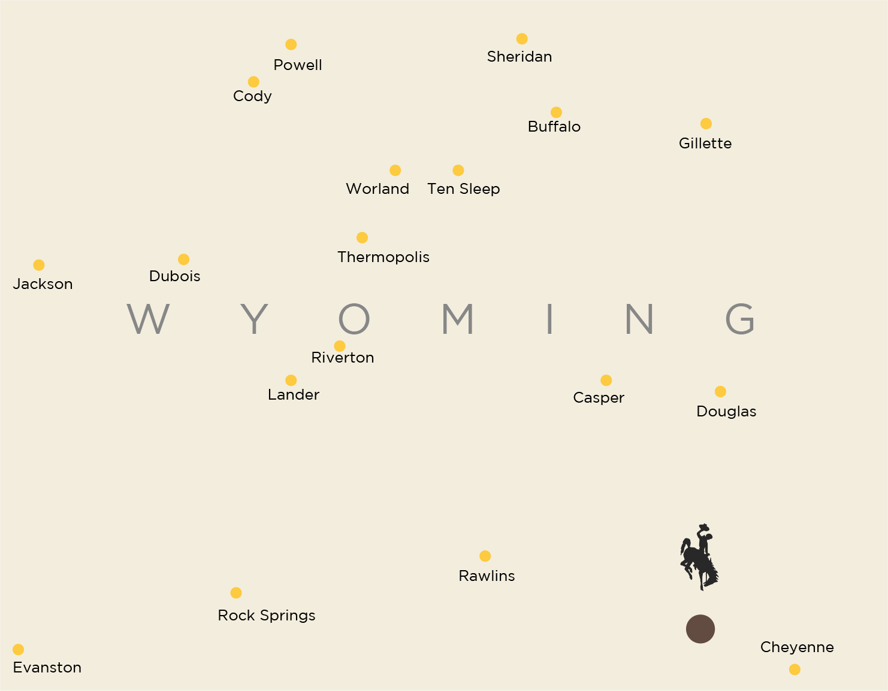
Broadening Student Teaching Placements --- Wyoming School University Partnership

Slide 12
Wyoming Teacher-Mentor Corps Supporting Teaching Excellence across Wyoming

Slide 13
A New Approach to Professional Development … Competency
The University of Wyoming Master Educator Competency Program will use both statewide and local definitions of educator success to help fundamentally improve learning experiences and educator outcomes in the College of Education.

Slide 14
Collaboratively developed competencies --- Statewide Primary Competencies Regional Secondary Competencies

Slide 15
A Stackable Framework

Slide 18
Market
$1.2 Billion Annual Marketplace for Education MAs
110,000 awarded annually @ > 10K each.
34% online
Compliance requirements, salary steps, and attrition are all drivers to this market.
Price sensitivity and demand for flexibility create heightened demand in the online market.
$400M online market growing 5% annually
$770M annually still offline
Many adjacent markets in education and other fields.

