Slide 1
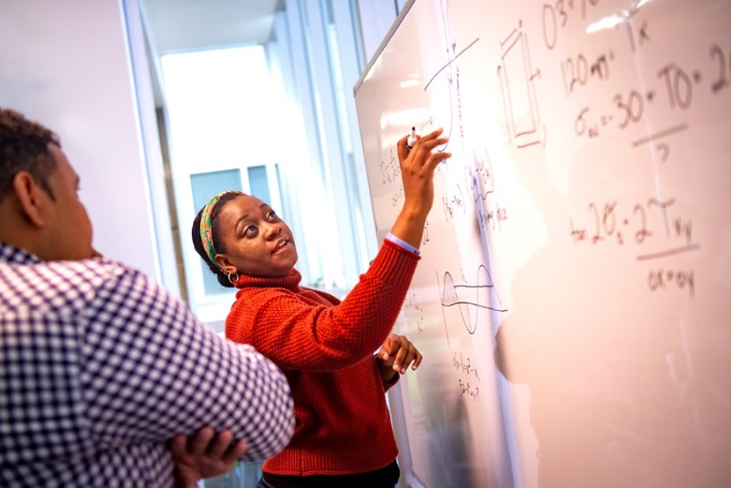
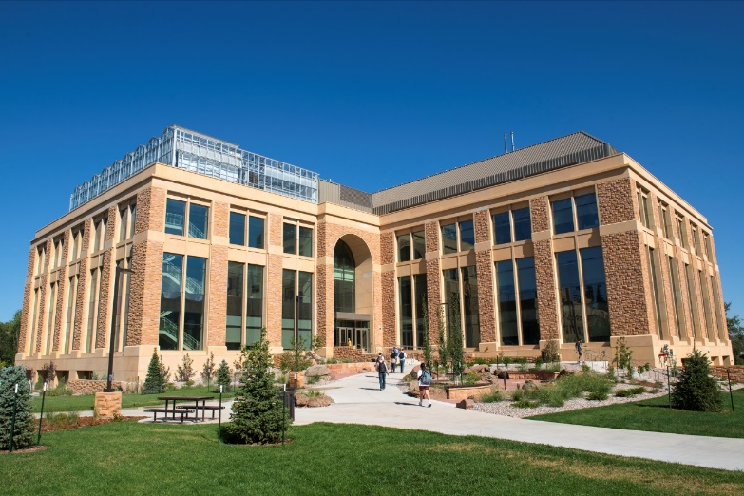
UW Top-Tier Science Initiative: Board of Trustees Annual Update
Mark Lyford & Greg Brown
Nov. 17, 2022

Slide 2
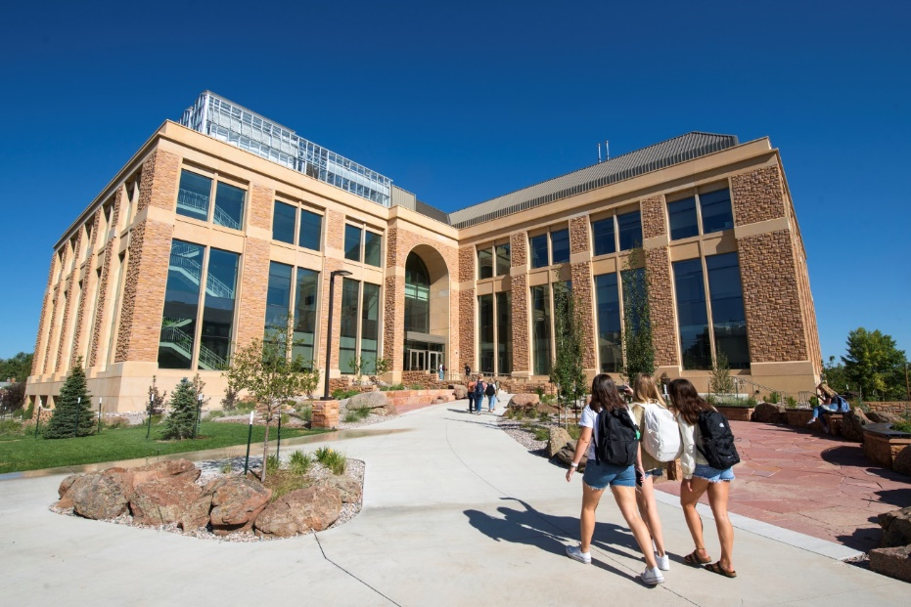
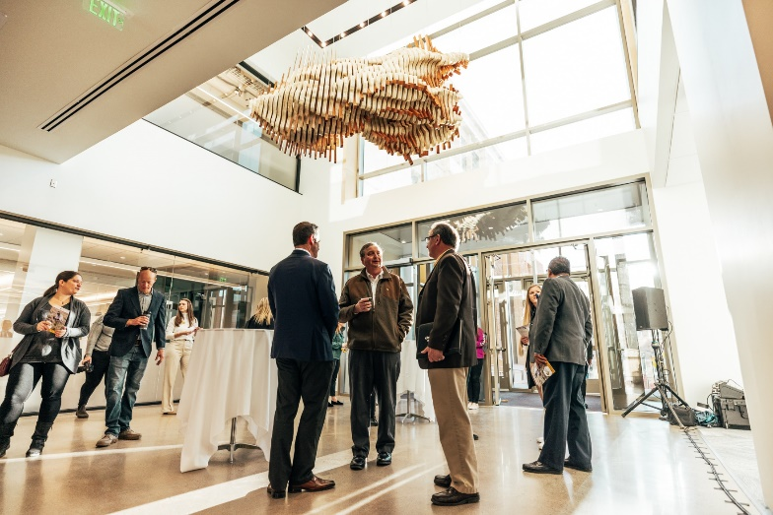
SI Point in History: Building Completion
SI Building Ribbon Cutting & Grand Opening Spring 2022
Not just another new building: Spaces designed to support innovation & collaboration in research, teaching & service
While an important center point, SI Building does not represent entire SI: SI extends across campus
Site of 1st Annual UW STEM Carnival to showcase STEM excellence at UW

Slide 3
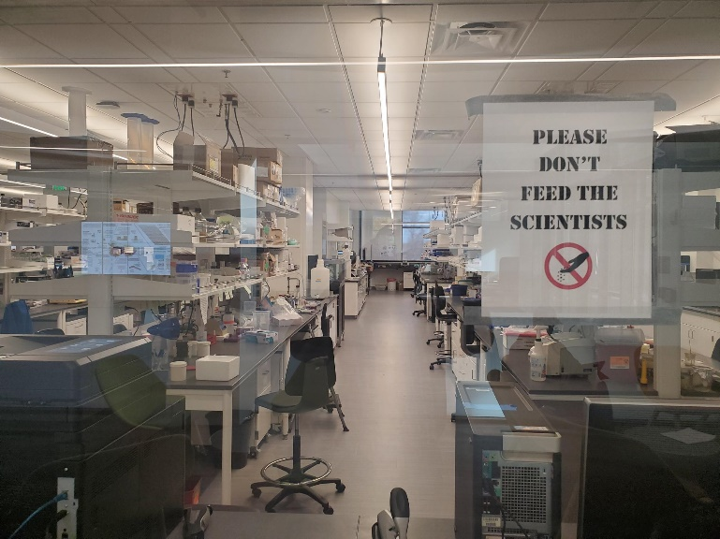
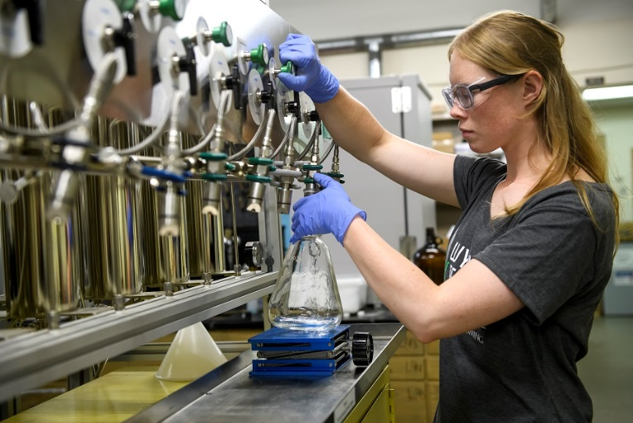
SI Building Highlights: Research
Open, shared wet-laboratory spaces to promote collaboration across 3 floors on the research wing
Move in began summer 2022
Current Research occupants: 22 faculty, 93 research scientists, postdocs, & grad students and many undergrads
Faculty from 6 departments & 2 colleges
Additional faculty to move in upon building completion

Slide 4
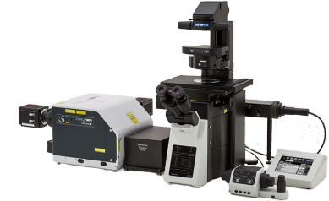
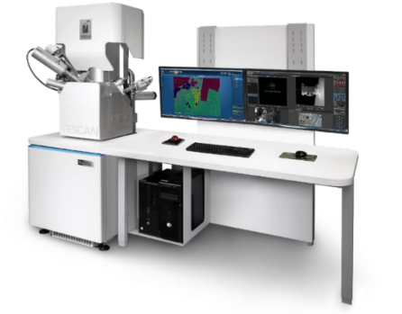
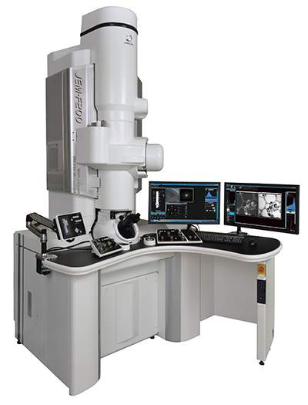
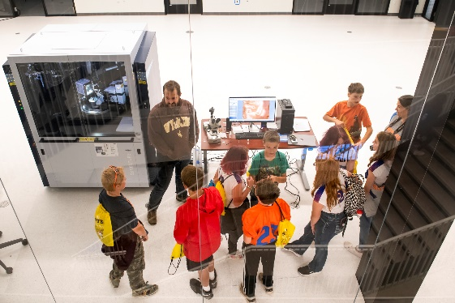
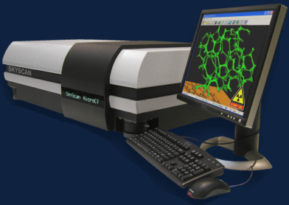
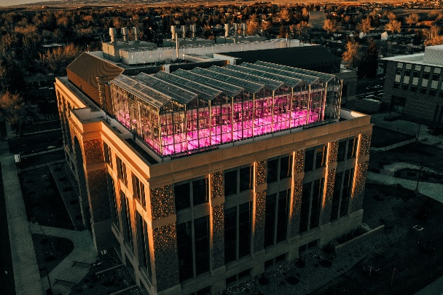
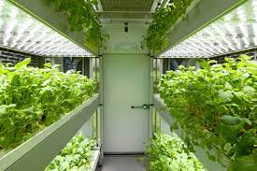
SI Building Highlights: Research Support
Center for Advanced Scientific Instrumentation (CASI) – core facility that provides cutting-edge instruments accessible to all faculty on campus (instrument purchase supported by WIP)
Greenhouses & Walk-in Growth Chambers – modern growth facilities to expand research opportunities and potentially collaborate with Plenty
Establishing connections across state and with business & industry

Slide 5
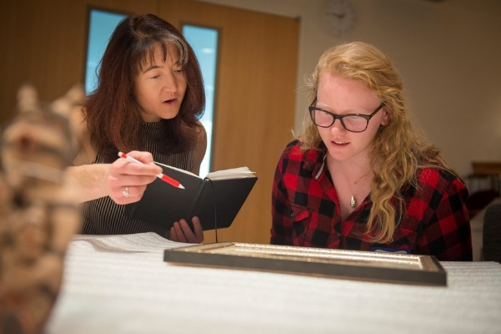
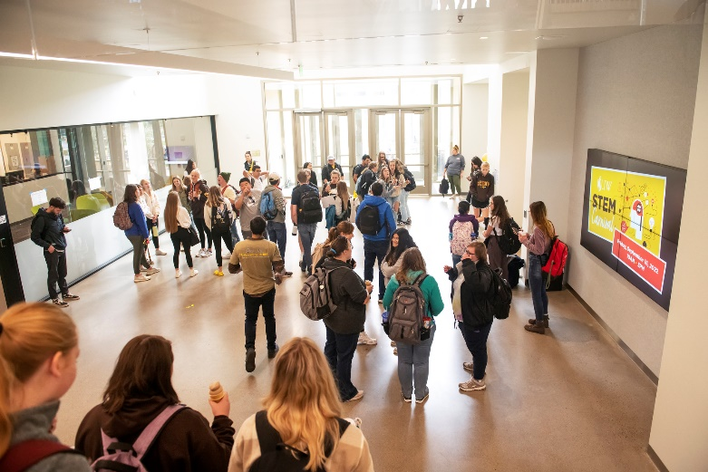
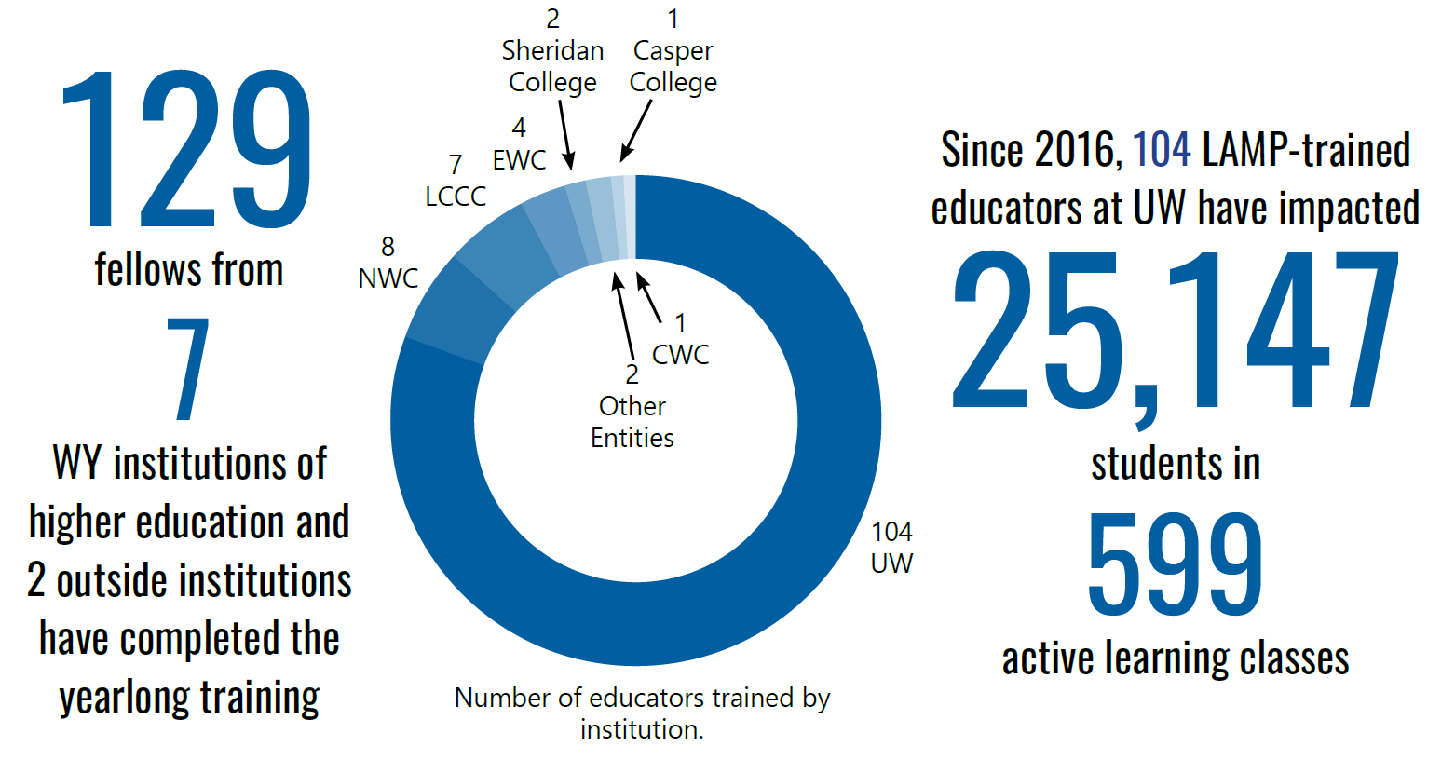
SI Program Highlights: LAMP
The full impact of the Learning Actively Mentoring Program (LAMP) now being realized in the new 204-seat Active Learning Classroom
Courses include Intro Biology, Intro Chemistry, General Microbiology, Ecology, Genetics, Integrative Physiology, Organic Chemistry
LAMP Director Rachel Watson continues to train faculty & students and is helping lead a national HHMI grant on inclusion in STEM

Slide 6
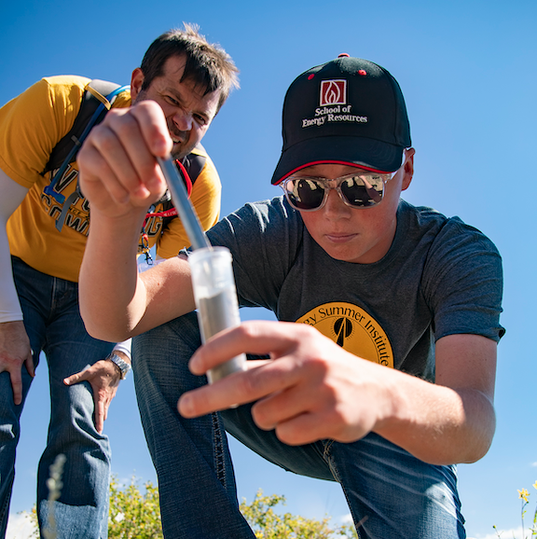
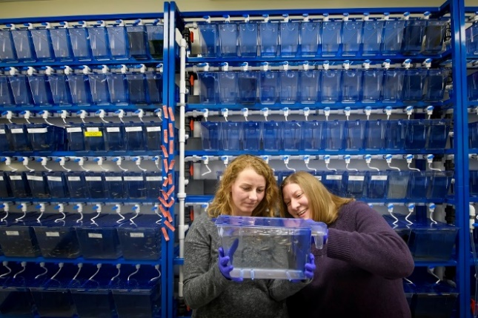
SI Program Highlights: WRSP
Wyoming Research Scholars Program continues to provide transformation experiences for our undergrads
53 current students representing 24 majors & 6 Colleges; 36 faculty mentors from 17 departments and 4 colleges
Director Jamie Crait is working to expand the research opportunities through Course-based Undergraduate Research Experiences
Weaving-in Entrepreneurship, Innovation & Business Development

Slide 7
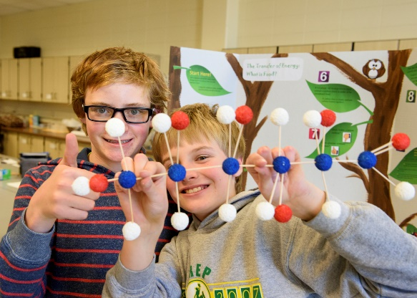
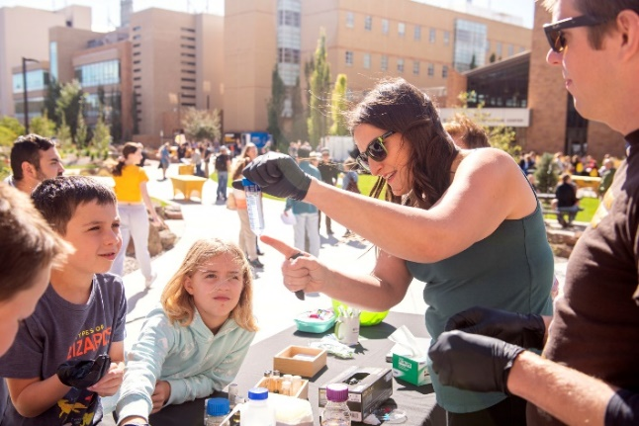
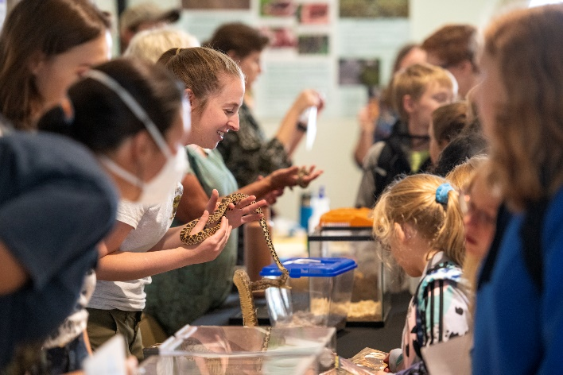
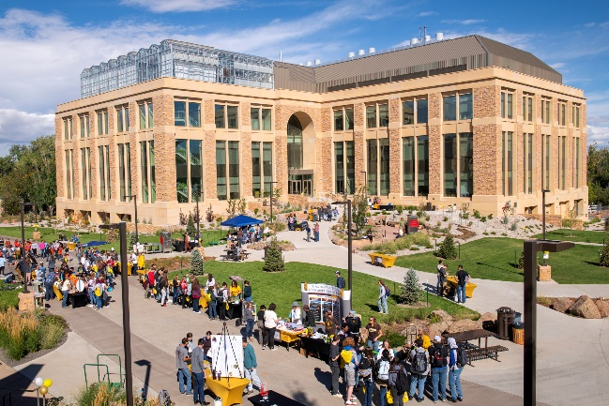
SI Program Highlights: SI Roadshow
SI Roadshow is expanding outreach and in-reach opportunities for Wyoming students, teachers and communities
Under Director Karagh Brummond, the SI Roadshow hosted the 1st Annual UW STEM Carnival in collaboration with the President’s Office: 600-700 people attended, 36 departments and programs participated

Slide 8
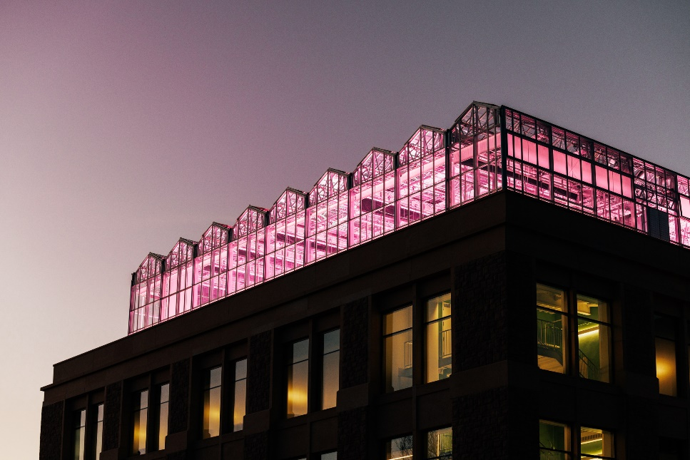
Looking to the Future: SI 2025 Charge from President Seidel
Anticipate a nationally renowned interdisciplinary science institute
Establishment of SI Executive Committee to oversee all top-level decisions for direction of SI
Establishment of SI Faculty Leadership Committee to provide recommendations on SI 2025 Vision
Creating a Science Institute
Hiring Institute Director
Forming UW and national advisory groups
Developing competitive model for interdisciplinary research
External funding, science outputs reviewed, new groups incentivized to compete for project space
Considering renovation of vacated research spaces
Collaborations with other Initiatives
Entrepreneurship and Corporate partners

Slide 9
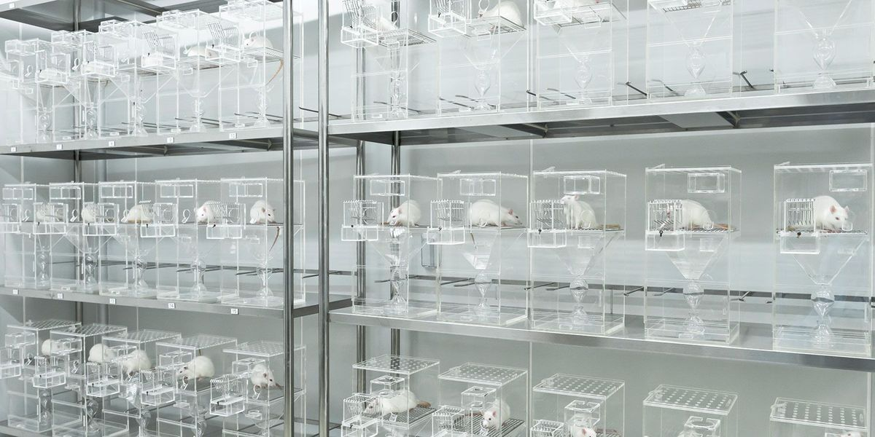
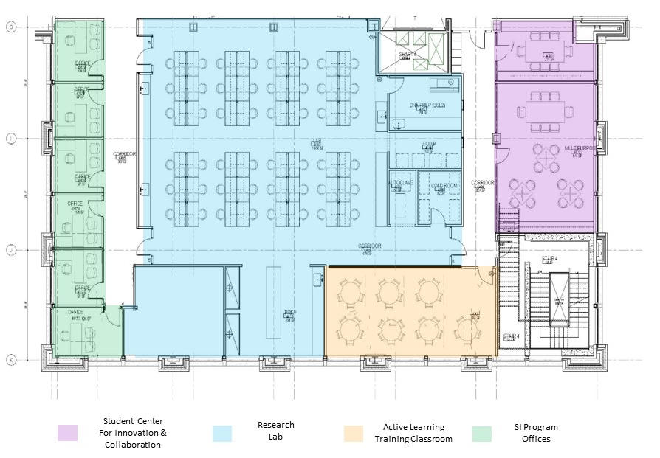
Looking to the Future: Budget Request
Current UW budget request
$12.5M in one-time to complete shelled spaces in SI Building – Vivarium, Level 1 research space, SCROLL (Student Collaborative Research Outreach & Learning Laboratory)
$3.6M annually to fully support SI programs – finalize current programs (LAMP, WRSP, Roadshow) and implement PhD Scholars Program & Competitive Research Innovation Programs

